Slide 1
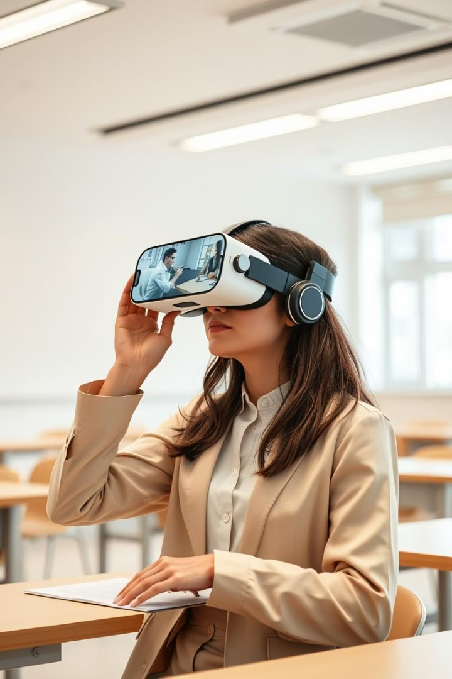
AUGMENTED REALITY AND VIRTUAL REALITY
Presented by:
NAME: R.NADHIN
ROLL : 24CDR065

Slide 2
KONGU ENGINEERING COLLEGE
CAR
NAME: R.Nadhin
Roll NO: 254378

Slide 3
Car logo

Slide 4


Slide 5
CAR ABOUT
CAR DREAM OF MANY PEOPLE

Slide 6


Slide 7
CAR
CAR MORE OF HUMER USED
THING DAY LIFE USED CAR

Slide 8


Slide 9

COME SOON PART 2
THANK YOU

Slide 12

Methodology
Our approach involved:
Researching existing AR/VR solutions and their impact.
Selecting suitable development platforms (Unity, ARCore, Oculus SDK).
Creating sample AR and VR environments.
Conducting usability tests with a selected group of users.
- Analyzing feedback based on ease of use, learning curve, and user satisfaction.

Slide 13
Discussion: AR vs. VR & Use Cases
AR integrates digital elements into the real world, enhancing real-time interaction, while VR creates a completely immersive experience.
Their use cases span:
Education: Virtual labs and interactive learning
Healthcare: Surgery simulation and patient care
Industry: Virtual training and product demos
The major barriers include hardware costs, content availability, and user adaptability.
.

Slide 14
Conclusion
AR and VR hold immense potential to revolutionize how we learn, train, and interact.
Even though there are some problems with using these technologies, ongoing research and new ideas are likely to solve them. Using these technologies can make experiences better, faster, and more interesting.

Slide 15
Future Scope of AR and VR
Opportunities for future development include:
Enhancing tactile feedback with advanced haptics
Expanding use in remote education and diagnostics
Leveraging AI for adaptive learning environments
Creating cost-effective, cross-platform compatible tools
The future of AR and VR is deeply intertwined with the evolution of human-computer interaction.

Slide 16
References
Science Direct -https://www.sciencedirect.com/science/article
GeeksforGeeks -https://www.geeksforgeeks.org/virtual-reality-vs-augmented-reality-whats-the-difference/
ARM-https://www.arm.com/markets/consumer-technologies/ar-vr

Slide 17
Thank You

