Slide 1



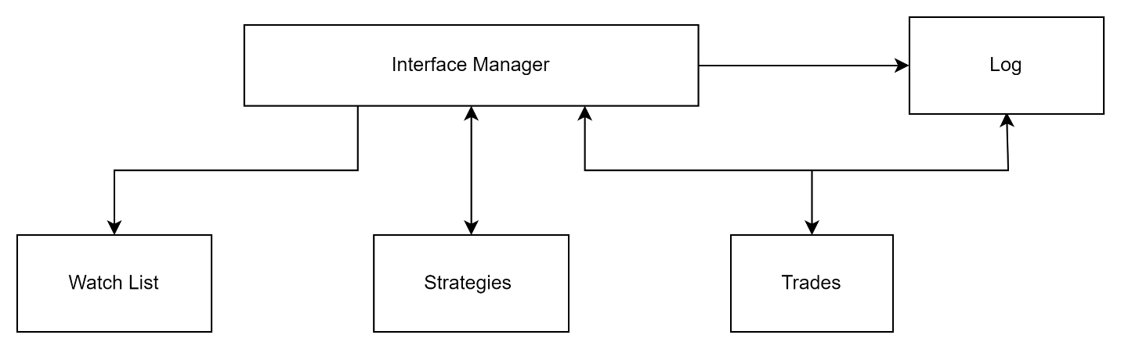
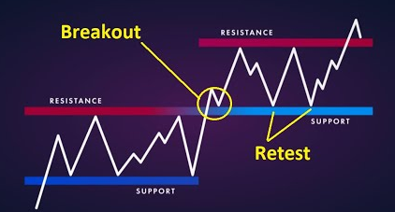
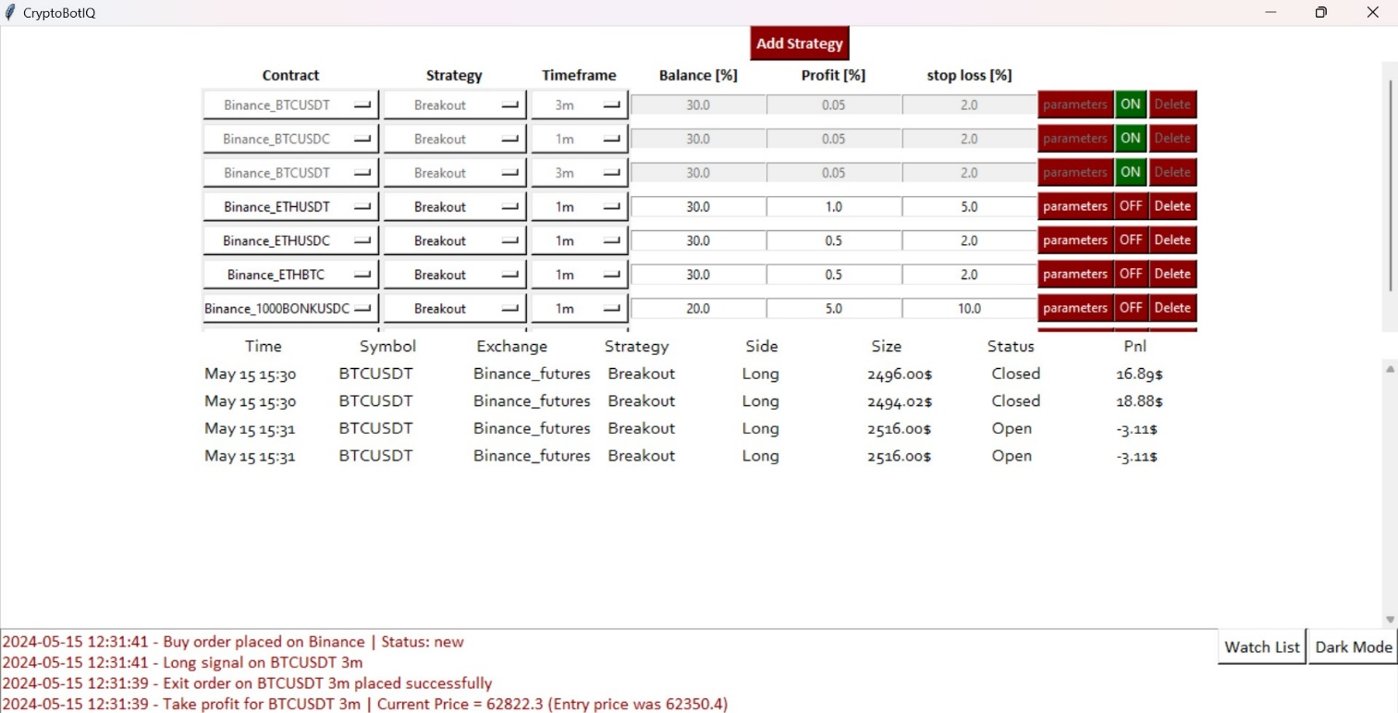
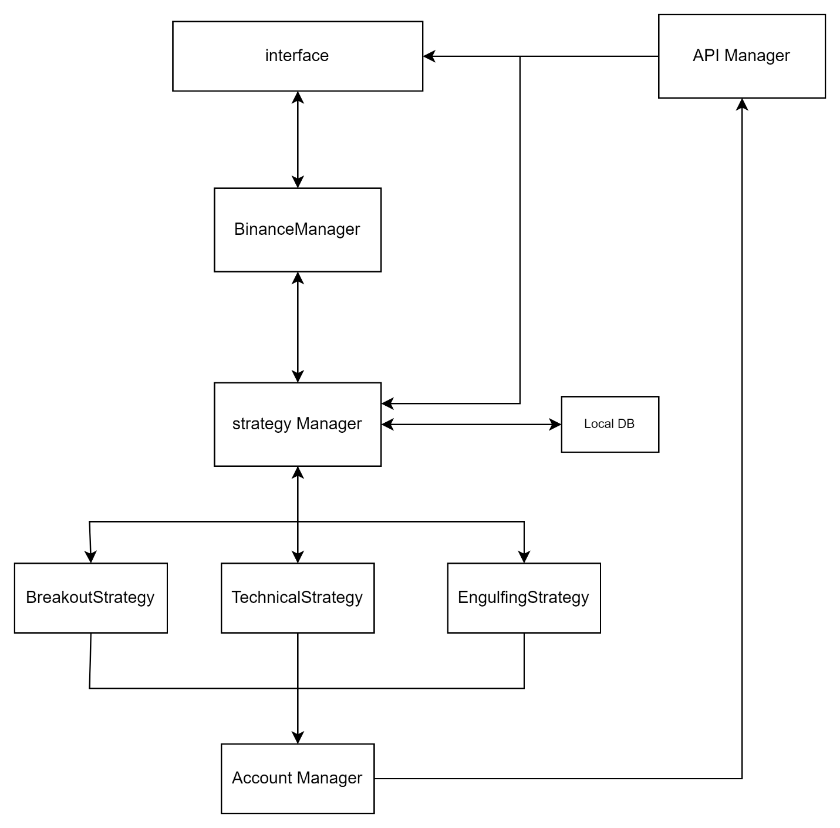
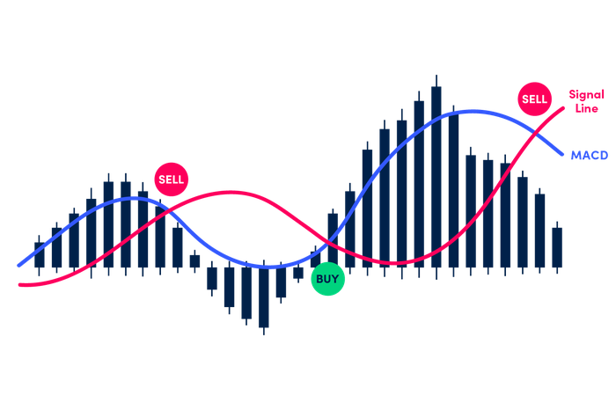
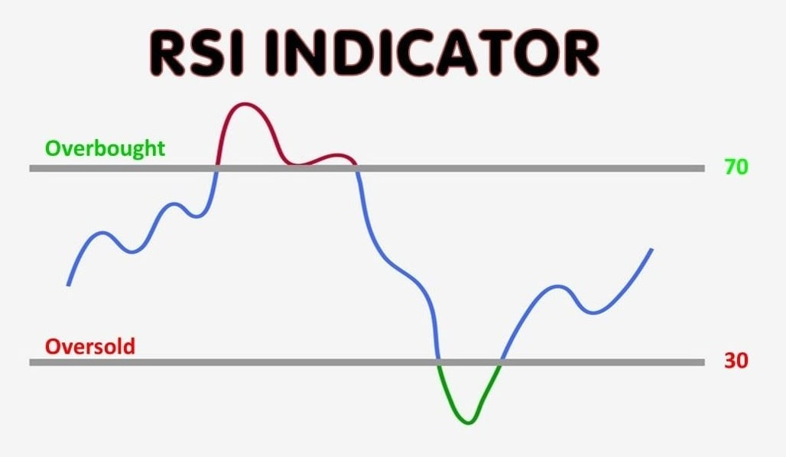
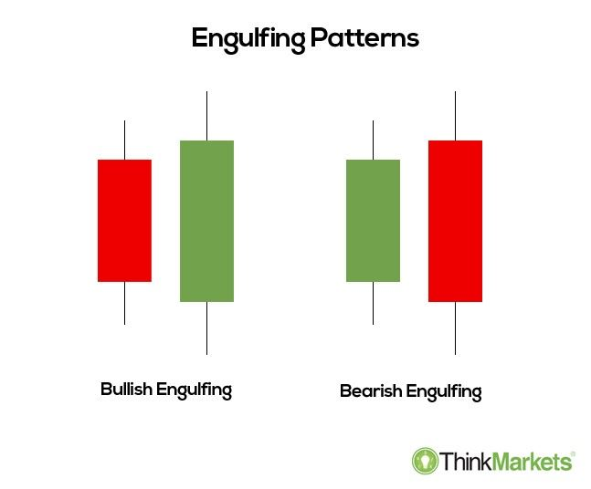
CryptoBotIQ
Nadi Najjar and Maria Simaan, Supervised by koby kohai
Introduction
User Interface
Breakout strategy
Horizon Detection
Trading industry is growing rapidly, especially crypto trading. And Everyone wants to get into crypto trading and start earning profits
But the problem is that they don’t know anything about trading, and this results to money loss, time loss and stressful days.
The brute force solution was to learn how to trade, and set daily 3-4 hours only for trading.
But here comes cryptoBotIQ to improve the process.
Entering a trade when the price breaks through a key support or resistance This breakout is expected to lead to significant price movements.
A breakout above the resistance level may indicate the beginning of an upward trend, and therefore, in this situation, the bot will enter a long position.
Conversely, a breakout below the support level indicates the beginning of a downward trend, and therefore, in this situation, the bot will enter a short .
Goals
block diagram of the interface
Our interface consists of several components:
Log - This is where we print messages and information for the user.
Strategies Selection - here, the user chooses which strategy to start and what parameters to use.
Trades- This section includes information about the open trades.
Watch List- This is where you can monitor the price of the coin.
Uses different algorithms to decide the trend of the crypto currency in the near and distant future.
It will manage all transactions in parallel without the trader's intervention and wasting time.
convenient UI for anyone starting in this field.
Block diagram
Technical strategy
In this strategy we use a combination btween two things:
RSI (Relative Strength Index) which measures the speed and change of price movements to identify overbought or oversold conditions in a market.
MACD (The Moving Average Convergence Divergence) – which is a trend-following momentum indicator that shows the relationship between two moving averages of a security’s price.
Engulfing strategy
In this strategy we have two patterns:
Bulish Engulfing - Indicates a potential upward reversal, with a larger bullish candle engulfing the prior smaller bearish candle
Bearish Engulfing- Indicates a potential downward reversal, with a larger bearish candle engulfing the prior smaller bullish candle.
Conclusions
Challenges
Using Technical strategy we got the best PNL in comparison of Breakout and Engulfing strategies.
Fewer configuration parameters results for better experience for the user and less confusion.
Using Machine Learning for price prediction won’t fit in our case, because currency price moves very randomly, and until now there is no Machine learning model that can predict processes with this level of randomness.
To prevent WebSocket timeout at the application's start when no currency is selected for automatic trading, we now register to receive information for the default currency (BTCUSDT), ensuring the connection remains intact.
We added a database to save information every 10 seconds during the bot's operation, preventing loss of data if the application crashes due to bugs, common during development.
2024

