Slide 1
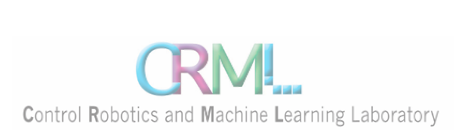

CryptoBotIQ
Students: Nadi Najjar & Maria Simaan
Supervisor: Koby kohai
Date : 19/05/2024

Slide 2

Motivation
Trading industry is growing rapidly, especially crypto trading.
Everyone wants to get into crypto trading and start earning profits.
What’s the problem?
They don’t know anything about trading, it will result to money loss, time loss and stressful days.
The brute force solution was to learn how to trade, and set daily 3-4 hours only for trading.

Slide 3


Solution
cryptoBotIQ
Uses different algorithms to decide the trend of the currency in the near and distant future.
the bot will manage all transactions in parallel without the trader's intervention and wasting time.
convenient UI for anyone starting in this fie
Notes:
So we decided to develop a bot for trading in the crypto market, which uses algorithms to decide the trend of the currency in the near and distant future, and accordingly start a new profitable transaction.
Another thing we provide to the user is a simple and convenient UI for anyone starting in this field. All the user will need to fill in are a few parameters that will serve the bot in its operations. And the bot will manage all transactions in parallel without the trader's intervention and wasting time

Slide 4
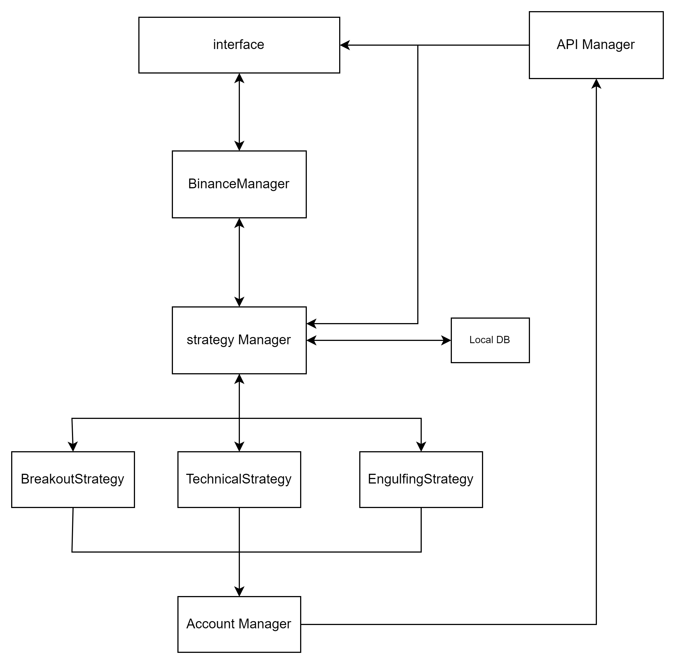

Slide 5

Strategies
Breakout
Technical strategy
Engulfing strategy

Slide 6
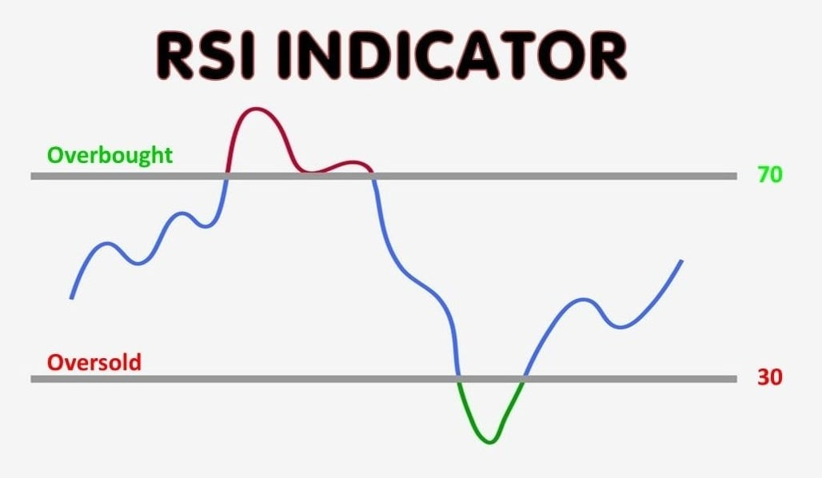
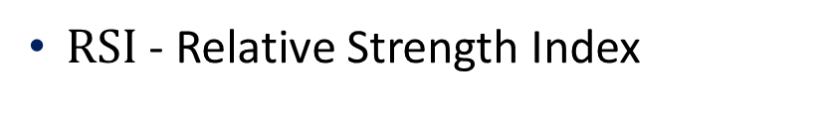
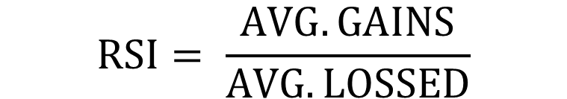
Technical strategy
$RSI$ - Relative Strength Index
$$RSI= \frac{AVG. GAINS}{AVG. LOSSED}$$
Notes:
It is widely used to identify overbought or oversold conditions in a stock or asset. The idea behind the RSI is to compare the size of recent gains and losses over a specified time period and represent this on a graph as an index ranging from 0 to 100. Generally, RSI values above 70 indicate that a stock may be overbought, while values below 30 indicate it may be oversold.
overbought refers to a stack that has increased rapidly in a short period of time and may reverse lower.
oversold refers to a stack that has decreased sharply in a short period of time and may reverse higher.

Slide 7
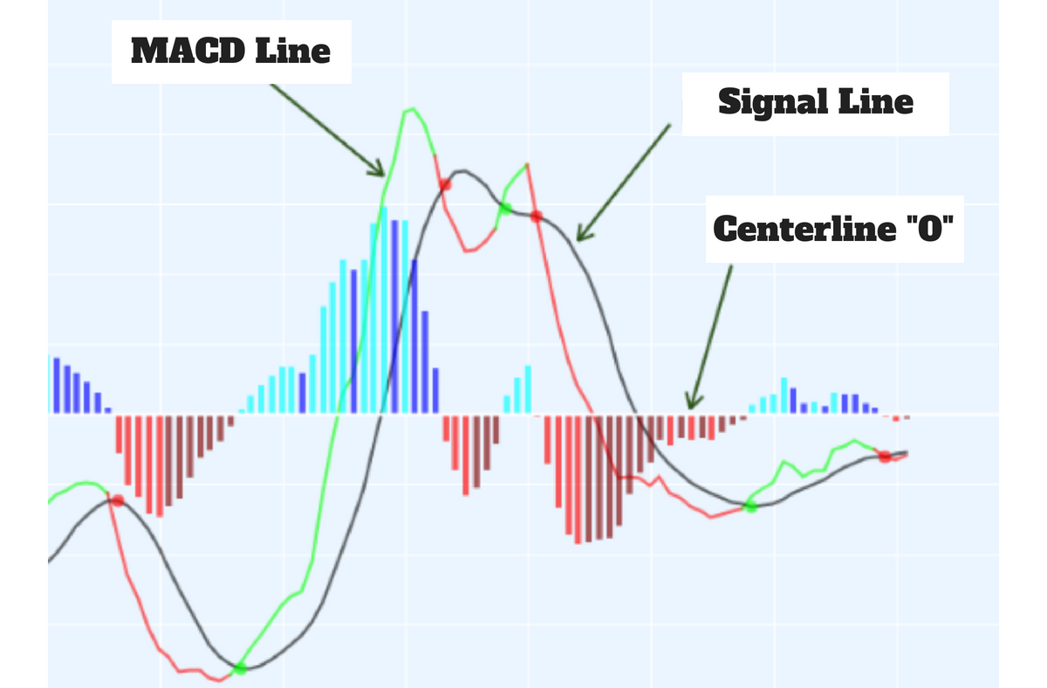
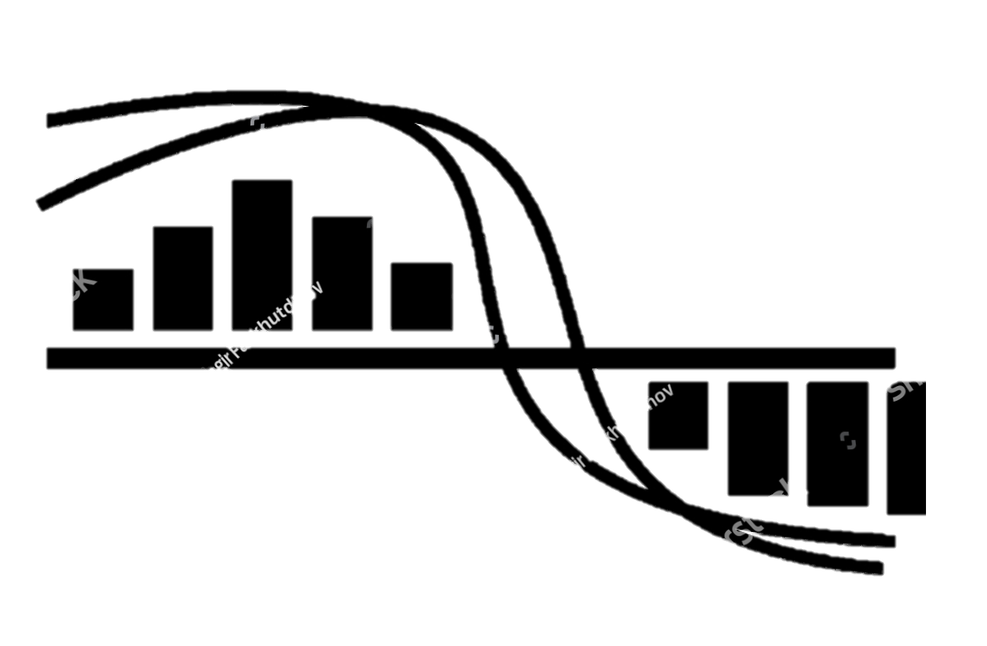

$MACD$- Moving Average Convergence Divergence
Notes:
$EMA −$Exponential Moving Averages
We used ema_fast and ema_slow, which are calculated from the closing prices of candles. With ema_fast typically representing a shorter time period and ema_slow representing a longer time period.
We calculate the MACD Line by subtracting the long-term EMA from the short-term EMA to get the MACD Line.
we did also use ema_signal, to calculate signal line.
By comparing the MACD line with its signal line, traders can generate buy or sell signals.

Slide 8
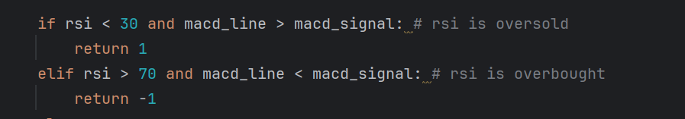
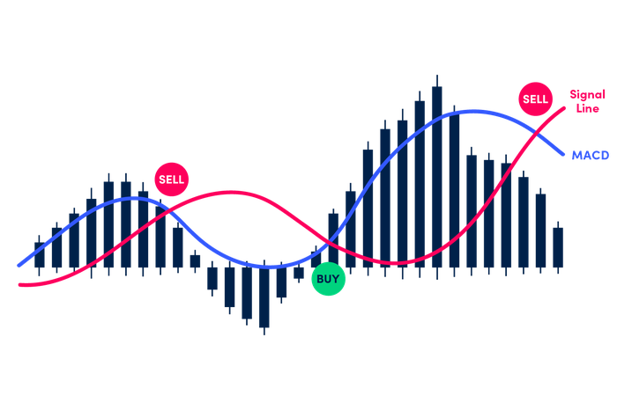

Slide 9
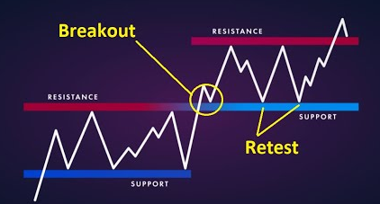
Breakout
Breakout is basically when a price breaks through a key support or a resistance level. Which usually leads to a huge price movements.
Notes:
Breakout is basically when a price breaks through a key support or a resistance level.
Which usually leads to a huge price movements.
Volume - refers to the number of shares or contracts traded in a security or market during a given period of time. It is a measure of how much trading activity is taking place

Slide 10
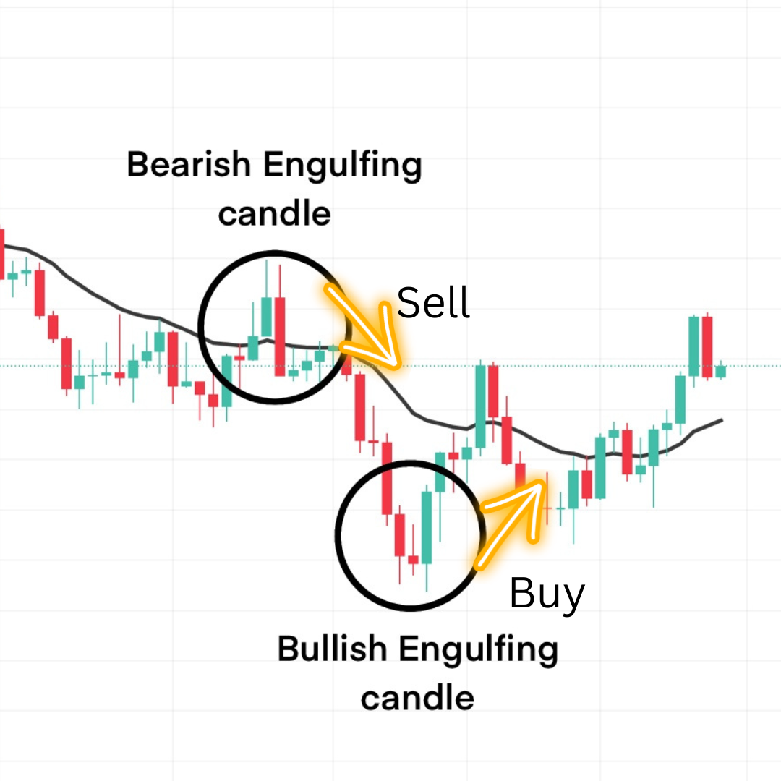
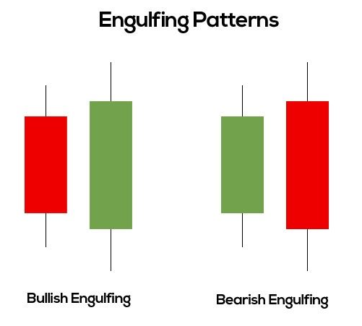
Engulfing strategy
Notes:
An engulfing pattern typically consists of two candlesticks and can signal a potential reversal in the trend. There are two types: bullish engulfing pattern and bearish engulfing pattern.
Traders often use engulfing patterns as signals to potentially enter or exit trades, depending on the direction of the pattern and the overall market context.
Bullish Engulfing Pattern: This pattern occurs during
a downtrend when a small bearish candle is followed
by a larger bullish candle that completely engulfs the
previous candle's range. It suggests a possible shift from
bearish to bullish momentum.
Bearish Engulfing Pattern: Conversely, the bearish engulfing pattern happens in an uptrend when a small bullish candle is followed by a larger bearish candle that engulfs the previous candle's range. This signals a potential reversal from bullish to bearish sentiment.

Slide 11
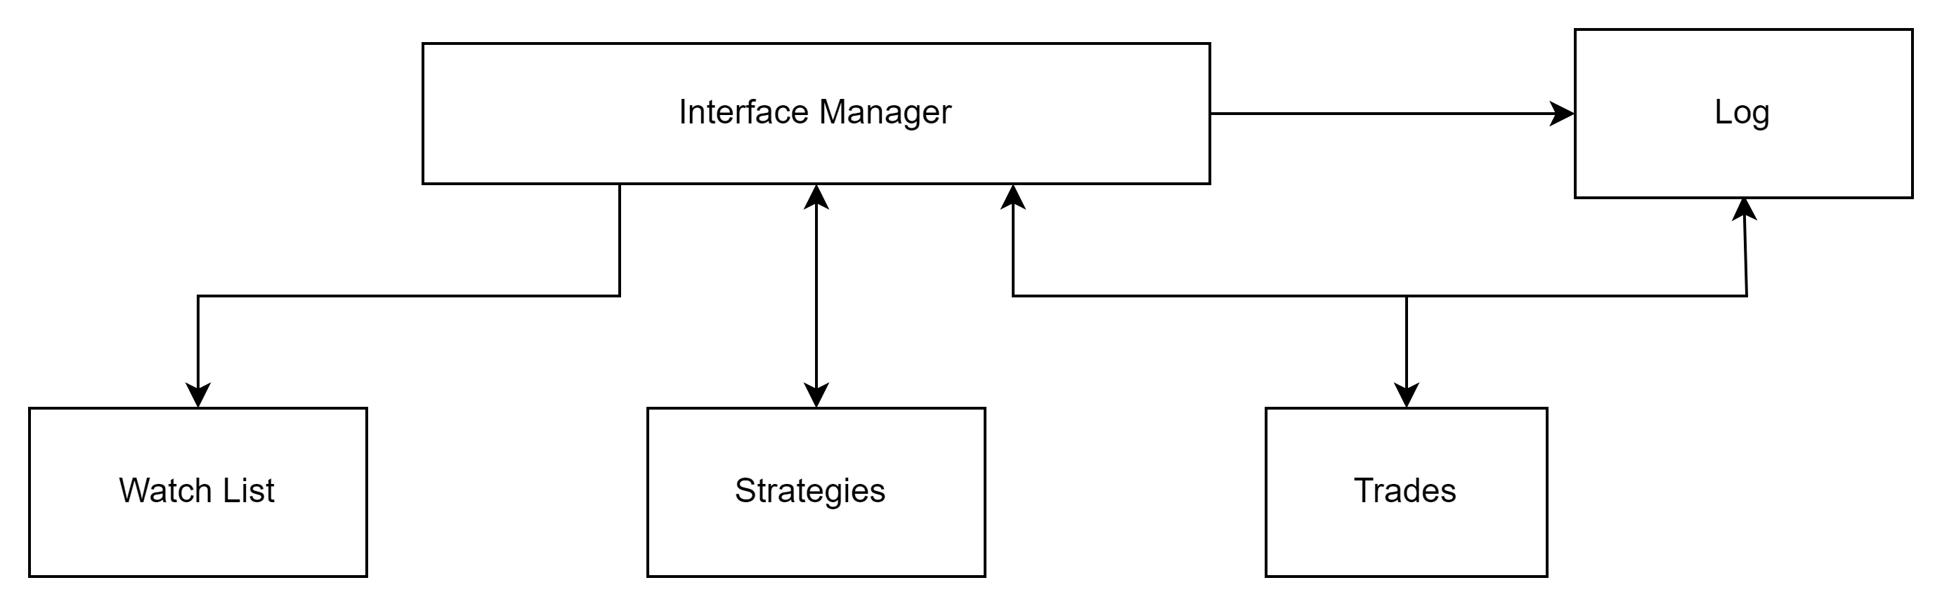

UI – User Interface

Slide 12

Challenges
WebSocket connection would consistently timeout after 10 minutes.
When closing the application/losing connection we would lose all the data.
When trading bot in loss, there was no automatic stop loss, and the bot could reach high losses in one position.
Notes:
At the start of our application's development, we encountered an issue where the websocket connection would consistently timeout after 10 minutes.
Upon investigation, we discovered that this occurred because the client had not yet selected a currency for automated trading and bot initialization.
To resolve this, we implemented a solution that registers to receive information for the default currency (BTCUSDT) preemptively, ensuring a stable and uninterrupted websocket connection even before the client selects a currency for automatic trading.
In every application, bugs exist, and sometimes these bugs can cause the application to crash. As a result, we would lose all the data and all the current currencies the bot was trading automatically. We solved this problem by adding a database to the application so that during the bot's operation, we save the data every 10 seconds to the database. This way, if the application crashes, we are able to load all the important data without any loss.
We sometimes would lose all the data and all the current currencies the bot was trading automatically.
We solved this problem by adding a database to the application so that during the bot's operation, we save the data every 10 seconds to the database. This way, if the application crashes, we are able to load all the important data without any loss.

Slide 13

Things to add
New strategies
Improvements and additions to the user interface .
Notes:
Today, there are so many different strategies being used in the trading market. We have implemented only a small number of them in our project. A great addition to our project would be to add some new strategies such as:
There are always improvements that can be added
to the user interface to make it easier and more
friendly for the user.

Slide 14


THANKS!

