Slide 1
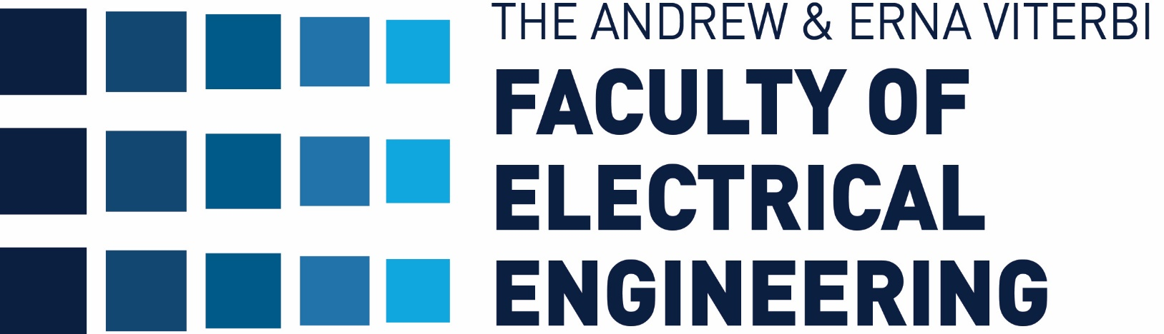
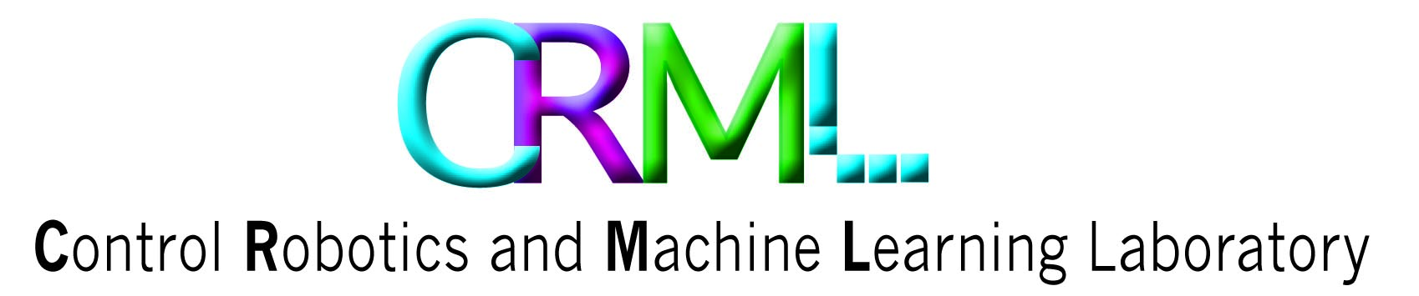

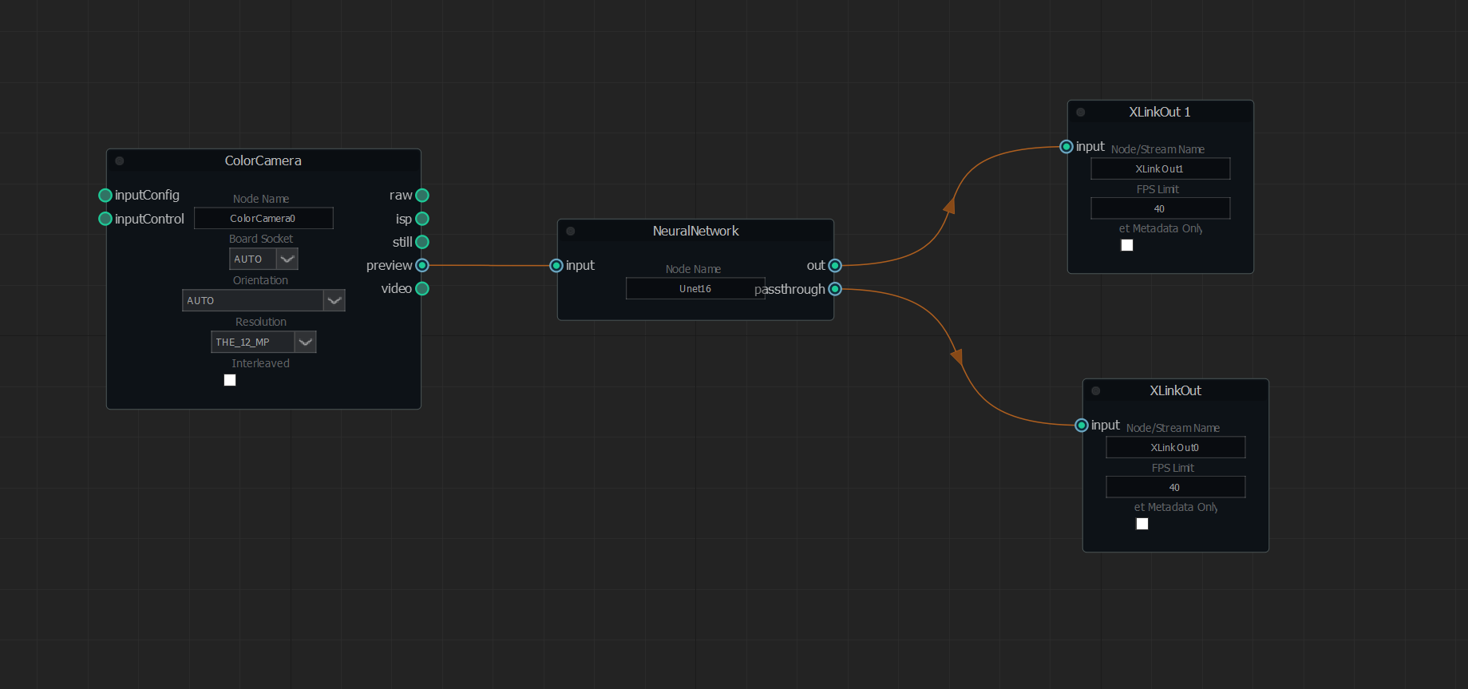
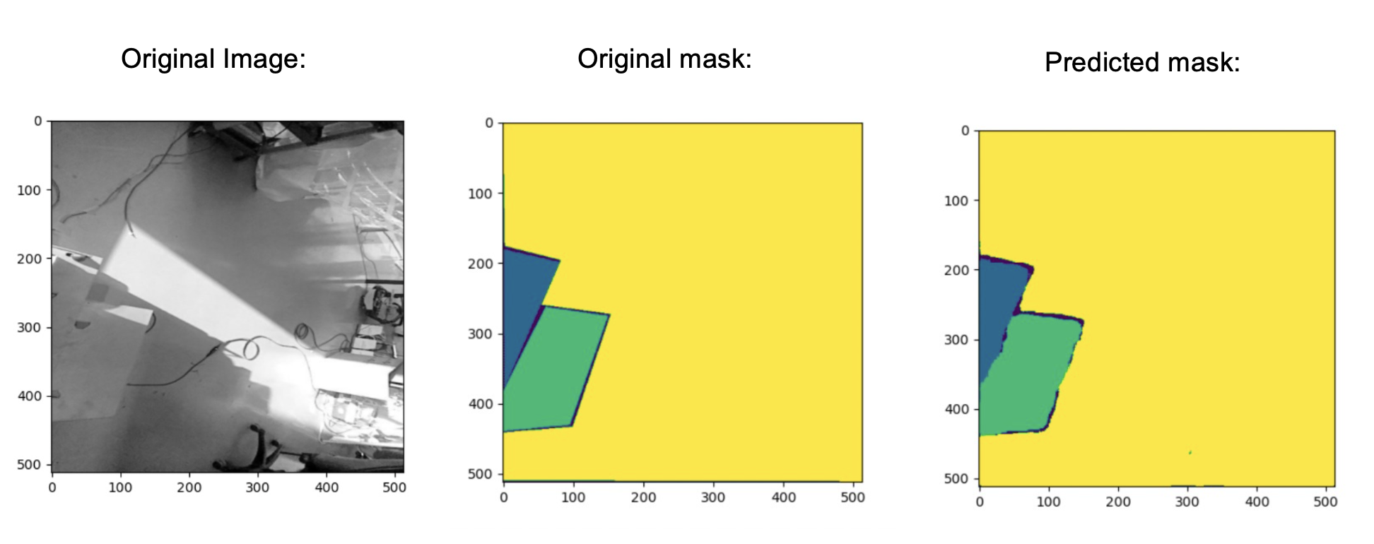
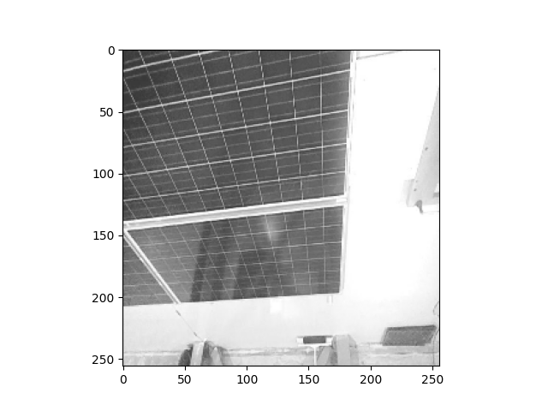
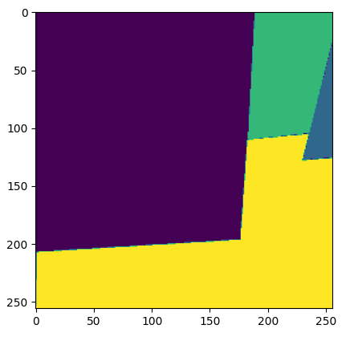
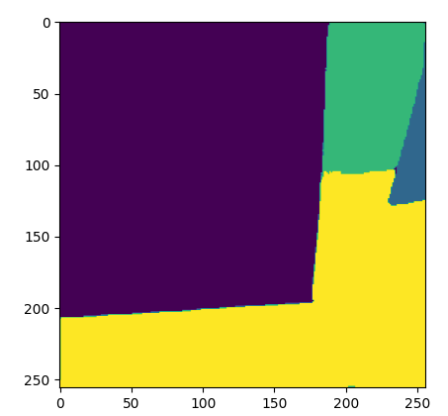
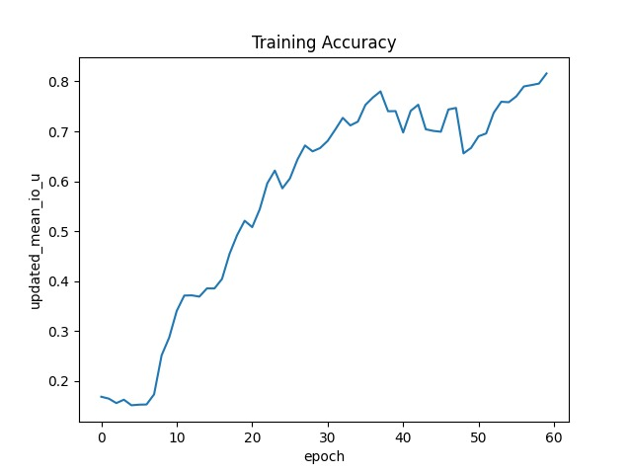
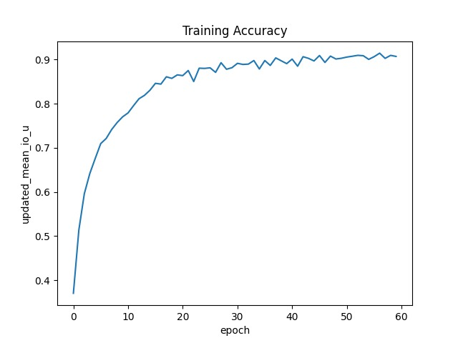
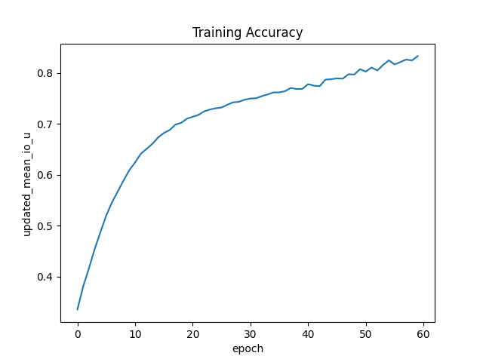
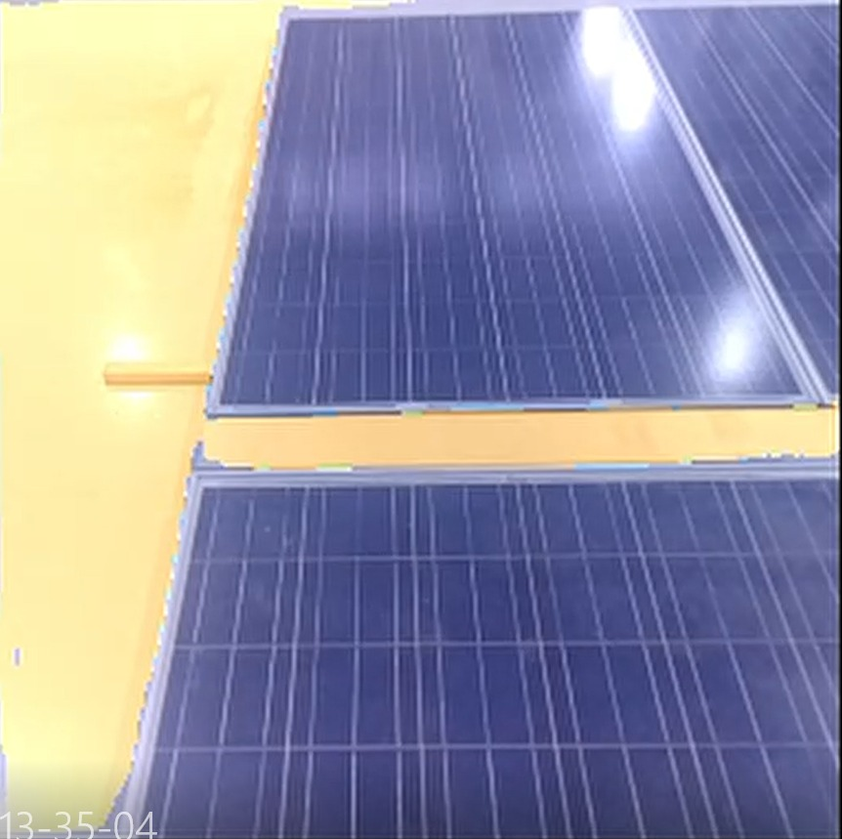
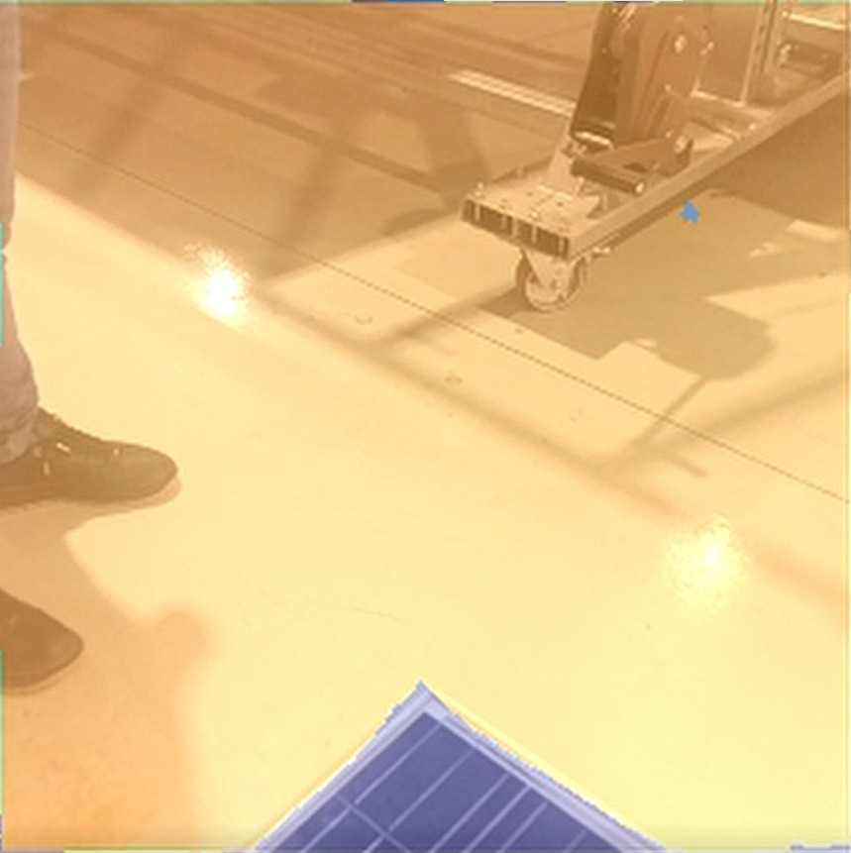
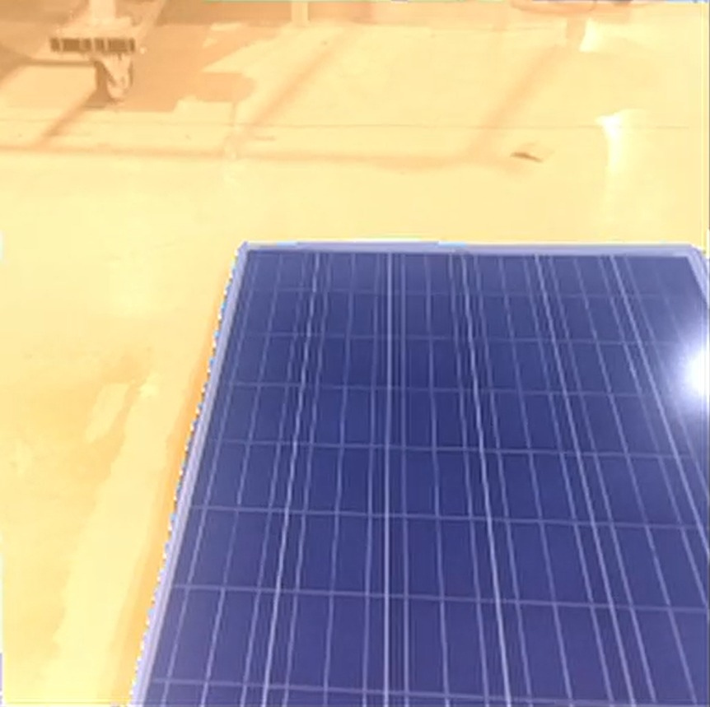
Semantic Segmentation For Solar Panel Arrays
Nadi Najjar and Luna Khoury, Supervised by Koby Kohai
Introduction
GPU level object detection
Inference Architecture
Solar cleaning Robots are equipped with sensors like IMU that is used to help the robot drive on the surface of the solar panel during the cleaning process.
After Certain distance, the IMU reading starts to drift and as a result of that the robot can’t clean in a straight path.
The solution was to clean in sequences that increases battery consumption and wastes more time in cleaning so the effiency decreases.
Our solution uses semantic segmentation to help the Robot localize and map the solar array in Real Time
Accurate and consistent mask prediction
Adaptive thresholds help in handling varying environmental conditions, such as sun glare
Preview Node – Frame (512,512)
Input Node – Input of the Neural Network
Out Node – Semantic Segmentation of the frame
Passthrough Node – Original Frame
Simulation Results
Goals
Create 2D Mapping of the solar array in real time for future localization.
Real Time decision making of robot moving on the solar panels to help IMU.
Camera level object detection
Challenges
Results
In the first 2 Plots, we can see how the accuracy of the model improved per epoch pass, the left plot describes the DeepLabV3+ Architecture with (256,256) frame as an input and the right plot describes Unet16 Architecture with (256,256) frame as an input
The second line plot describes the Unet16 Architecture with (1024,1024) input frame.
Dataset - Custom Dataset creation, from image acquisition to ready to use ”COCO” Dataset.
Training - Use of pre-trained Model gave us bad accuracy, so we fully trained the model, and that takes time and power.
Deploy –
Deploying the trained model to oak-d camera requires a few compilations to get the proper format.
Getting good enough fps (30+) required model size modifications.
Real Time semantic segmentation of the solar arrays, we can see that our model easily detected the solar panel surfaces and the background, thanks to the trained Unet16 Network Architecture .
The model run on board in 40 fps speed with 2.5 TOPS power on intel VPU that oak-d camera uses.
Conclusions
Using Unet16 Architecture we got the best performance, both in accuracy and fps metrics.
We chose to work with (512,512) input frame, because it gave as the best acc-fps division.
Prepare and plan the dataset well before the start of the implementation.
March 2023

