Slide 1
WALKING LIGHT

Slide 2
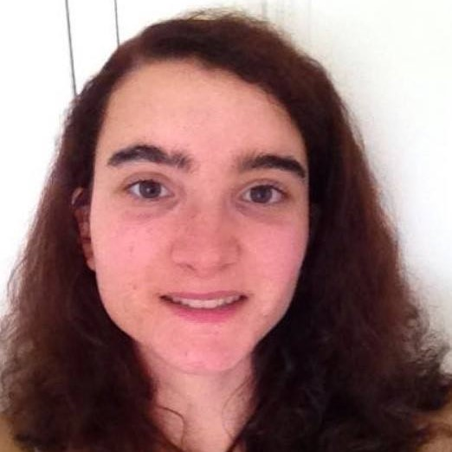
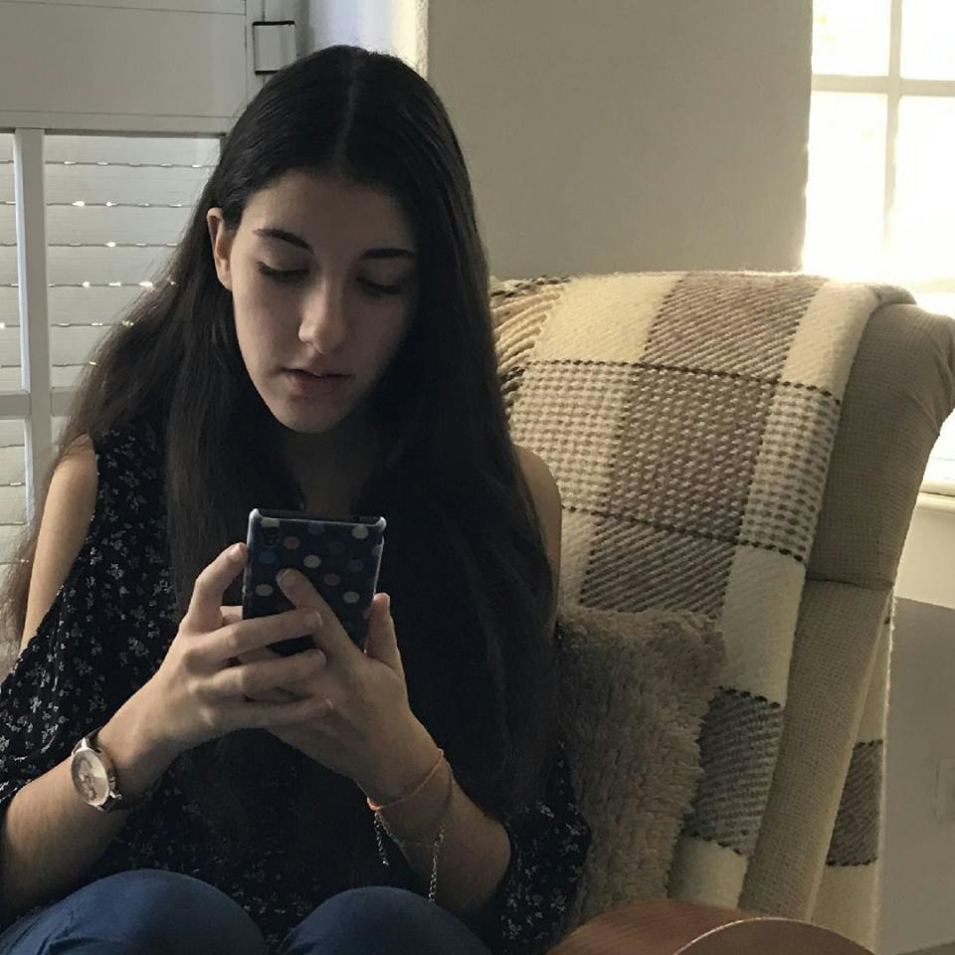
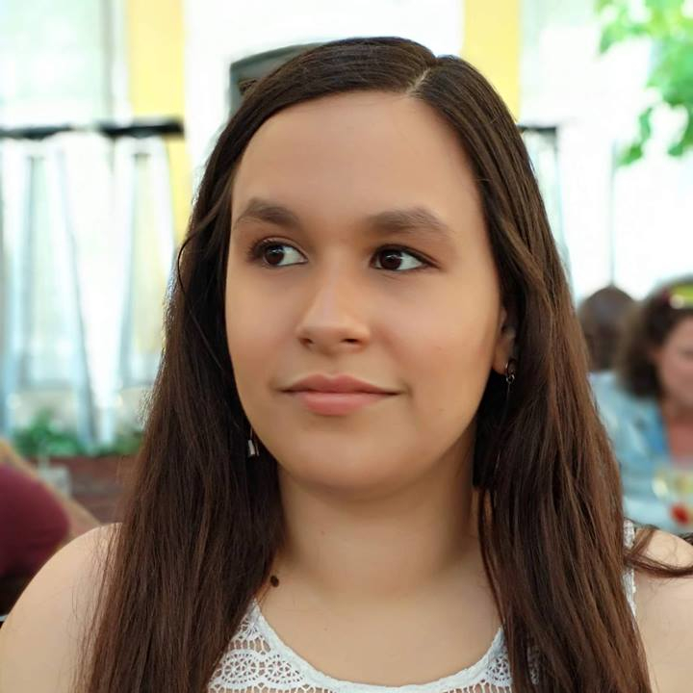
Bárbara Ramalho
GROUP MANAGER
Mafalda Morgado
RESEARCHER
Nádia Mourão
DESIGNER

Slide 3
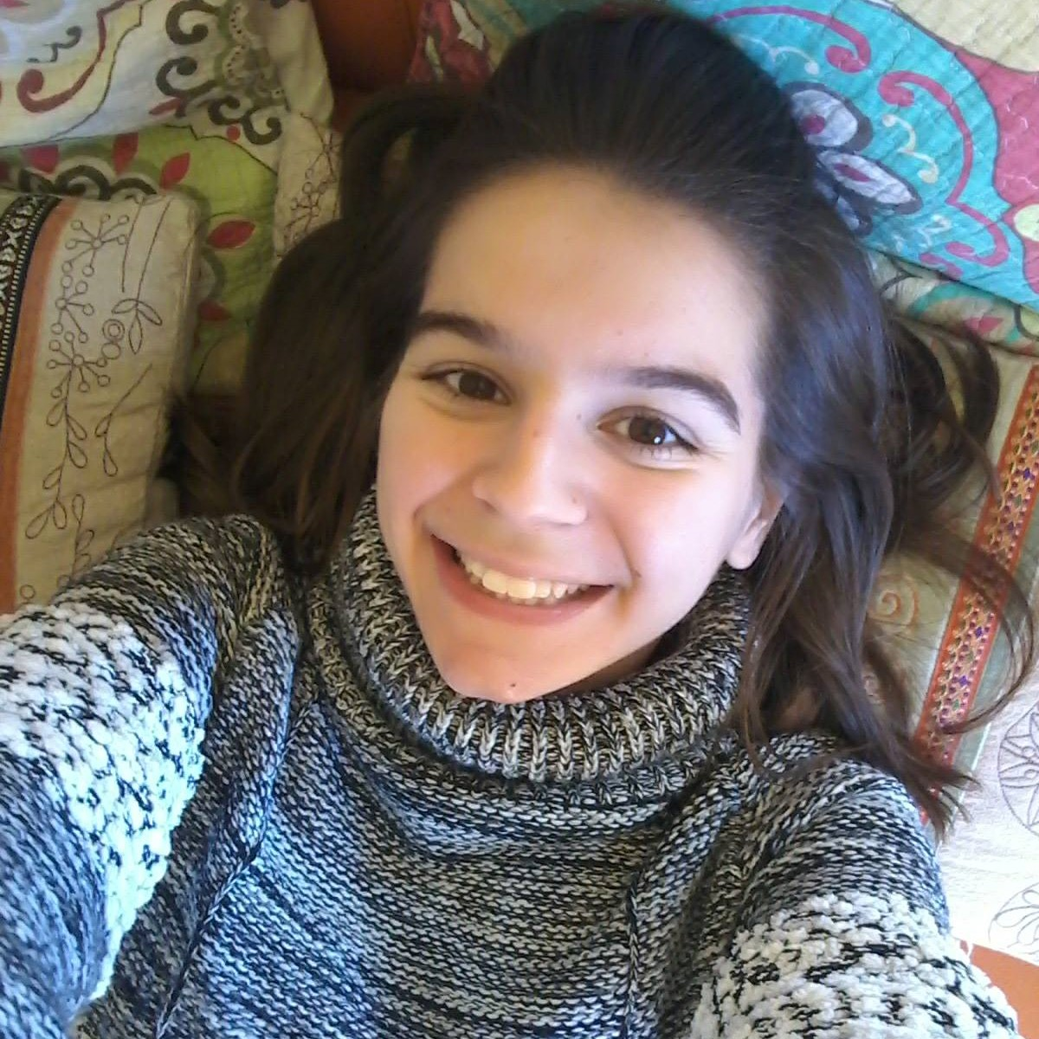
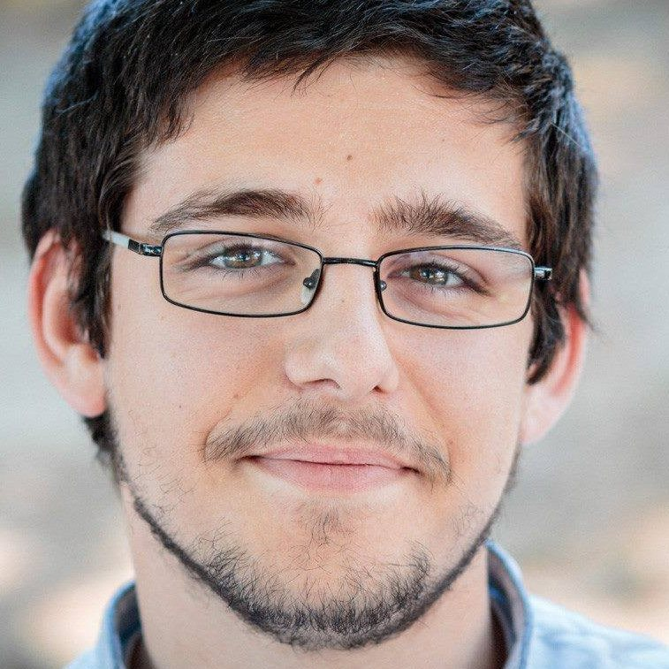
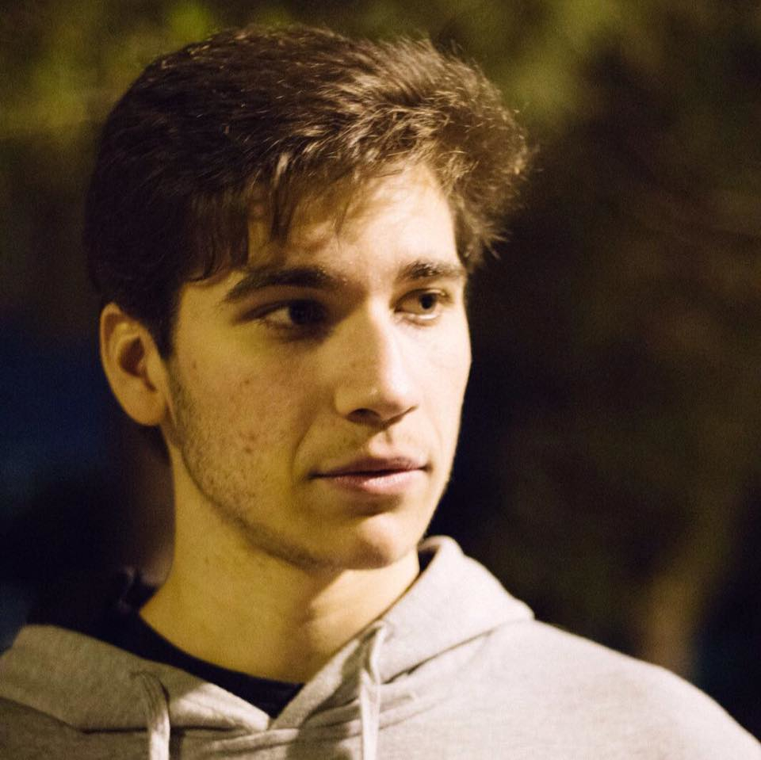
Carolina Veloso
FRONT-END DEVELOPER
Hugo Lencastre
BACK-END DEVELOPER
André Vieira
BACK-END DEVELOPER

Slide 4
SOLUTION CONCEPT

Slide 5
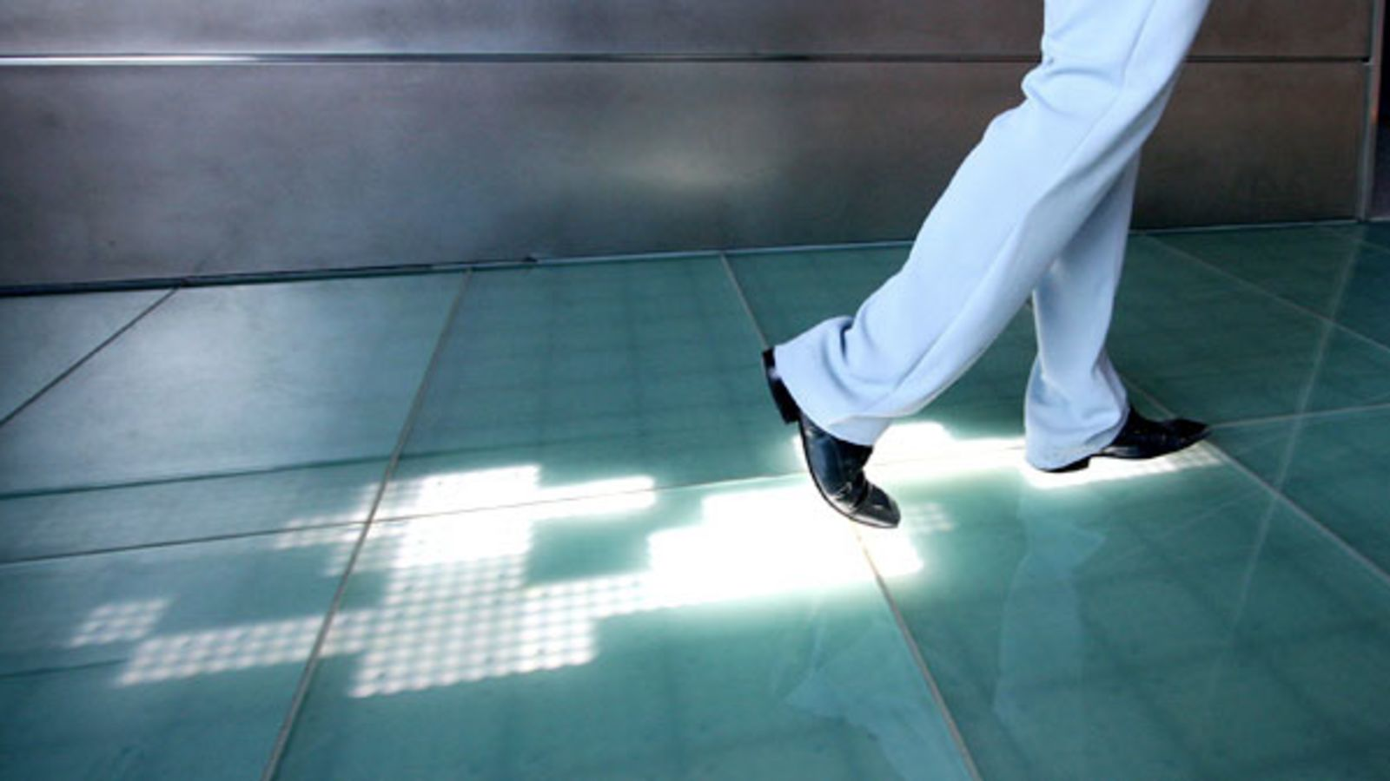
INTERACTIVE PLATFORM

Slide 6

Colour Code
Green
Valid Ticket
Orange
Invalid Ticket
Red

Slide 7
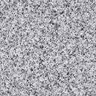
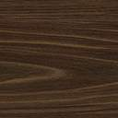
PLATFORM – ARRAIVEL

Slide 8
PLATFORM – GOING TO VALIDATE

Slide 9
PLATFORM - VALIDATING

Slide 10
PLATFORM - VALID

Slide 11
PLATFORM – WALK FREELY

Slide 12
INVALID TICKET

Slide 13
PLATFORM – TRY TO VALIDE AND FAIL

Slide 14
PLATFORM - VALIDE

Slide 15
Time Out

Slide 16
PLATFORM – IN THE BEGINNING

Slide 17
PLATFORM – AFTER 1 MIN

Slide 18
USER STEPS OUTSIDE THE PLATFORM

Slide 19
PLATFORM - VALIDE

Slide 20
PLATFORM - VALIDE

Slide 21
PLATFORM - VALIDE

Slide 22
LEAVING THE TRAIN

Slide 23
PLATFORM

Slide 24
PLATFORM - LEAVING THE TRAIN

Slide 25

REVISORS

Slide 26
PLATFORM

Slide 27

IMPROVEMENT

Slide 28
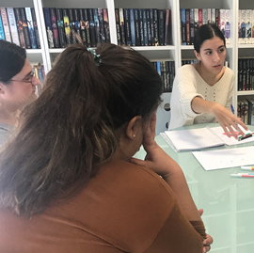
IMPROVEMENT
This system was validated by our user research, and improved in design iterations, where we organized interviews, focus groups, formative user studies and usability testing to make sure that user’s felt comfortable and found our solution intuitive and effective.

Slide 29
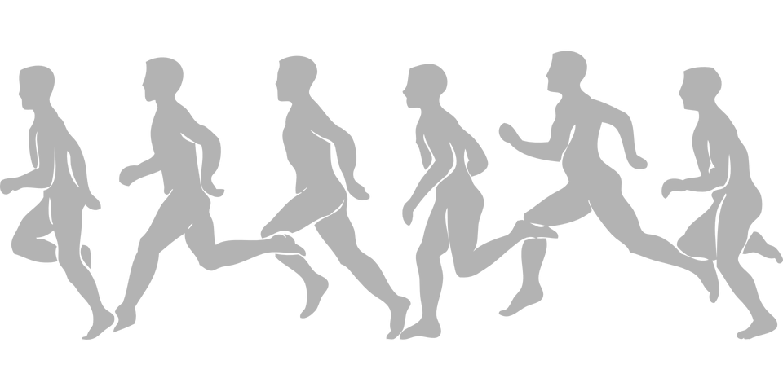
FEEDBACK
Reason that people don’t validate
Because they forgot or were in a hurry to catch the subway

Slide 30
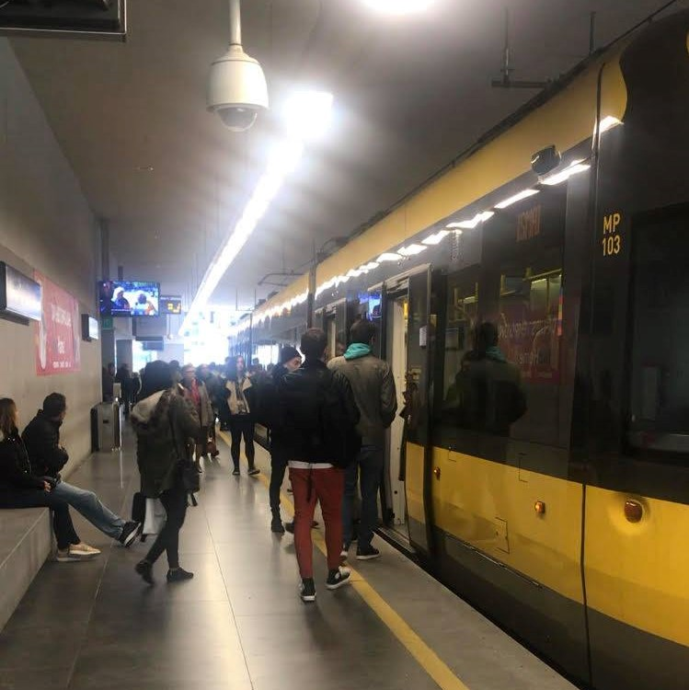
REASEARCH
This was actually validated when two members of our team went on the trip to Porto to study the infrastructures and understand the system, and caught the subway, forgetting to validate their tickets.

Slide 31
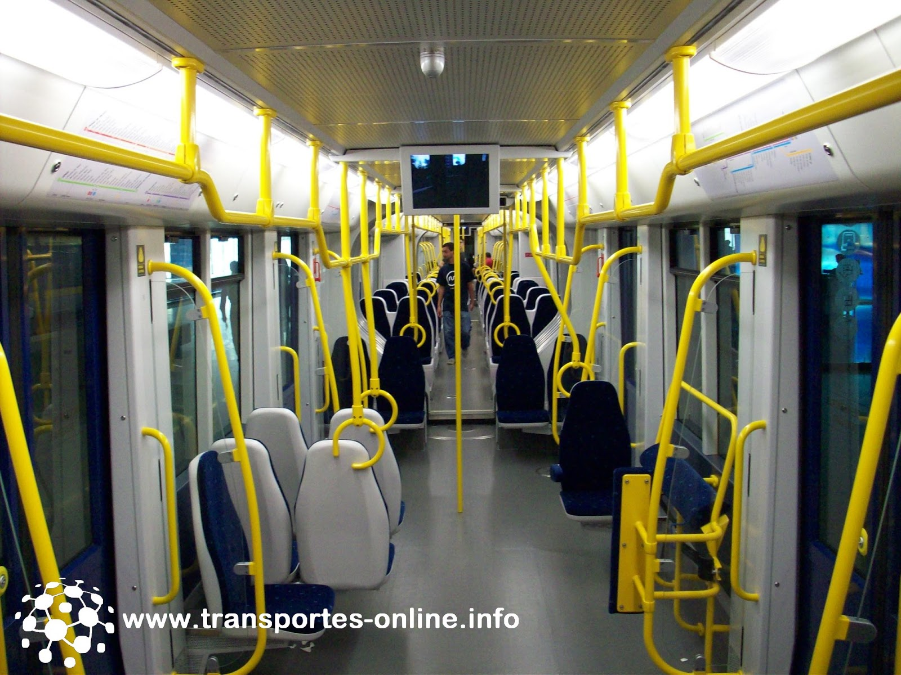
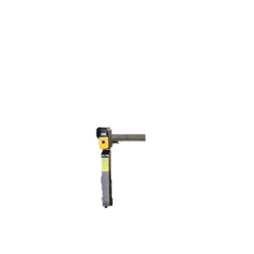
ADDITIONAL VALIDATORS

Slide 32
We understand that this would encourage people to always use the subway without validating their tickets, and only validate inside the carriage when a revisor approaches.

Slide 33
LOG IN
AS DUAS HIPOTESES

Slide 34
ESCOLHA DA ESTACAO
LISTAS DE COMBOIOS

Slide 35
IMAGEM DA ESTACAO
BLOQUIAR

Slide 36
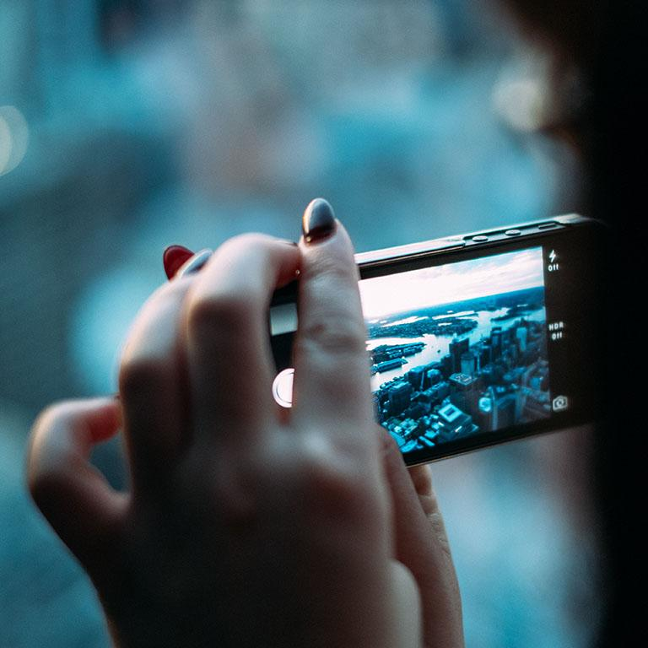
WANT BIG IMPACT?
Use big image.

Slide 37
SOLUTION CONCEPT

Slide 38
TRANSITION HEADLINE
1
Let’s start with the first set of slides

Slide 39
Quotations are commonly printed as a means of inspiration and to invoke philosophical thoughts from the reader.

Slide 40
THIS IS A SLIDE TITLE
Here you have:
A list of items
And some text
But remember not to overload your slides with content
Your audience will listen to you or read the content, but won’t do both.

Slide 41
YOU CAN ALSO SPLIT YOUR CONTENT
White
Is the color of milk and fresh snow, the color produced by the combination of all the colors of the visible spectrum.
Black
Is the color of coal, ebony, and of outer space. It is the darkest color, the result of the absence of or complete absorption of light.

Slide 42
IN TWO OR THREE COLUMNS
Yellow
Is the color of gold, butter and ripe lemons. In the spectrum of visible light, yellow is found between green and orange.
Blue
Is the colour of the clear sky and the deep sea. It is located between violet and green on the optical spectrum.
Red
Is the color of blood, and because of this it has historically been associated with sacrifice, danger and courage.

Slide 43
A PICTURE IS WORTH A THOUSAND WORDS
A complex idea can be conveyed with just a single still image, namely making it possible to absorb large amounts of data quickly.

Slide 44
WANT BIG IMPACT?
Use big image.

Slide 45
USE CHARTS TO EXPLAIN YOUR IDEAS
White
Gray
Black

Slide 46
AND TABLES TO COMPARE DATA
 | A | B | C
Yellow | 10 | 20 | 7
Blue | 30 | 15 | 10
Orange | 5 | 24 | 16

Slide 47

MAPS
our office

Slide 48
89,526,124
Whoa! That’s a big number, aren’t you proud?

Slide 49
89,526,124$
185,244 users
100%
That’s a lot of money
And a lot of users
Total success!

Slide 50
OUR PROCESS IS EASY
First
Second
Last

Slide 51
LET’S REVIEW SOME CONCEPTS
Yellow
Is the color of gold, butter and ripe lemons. In the spectrum of visible light, yellow is found between green and orange.
Blue
Is the colour of the clear sky and the deep sea. It is located between violet and green on the optical spectrum.
Red
Is the color of blood, and because of this it has historically been associated with sacrifice, danger and courage.
Yellow
Is the color of gold, butter and ripe lemons. In the spectrum of visible light, yellow is found between green and orange.
Blue
Is the colour of the clear sky and the deep sea. It is located between violet and green on the optical spectrum.
Red
Is the color of blood, and because of this it has historically been associated with sacrifice, danger and courage.

Slide 52
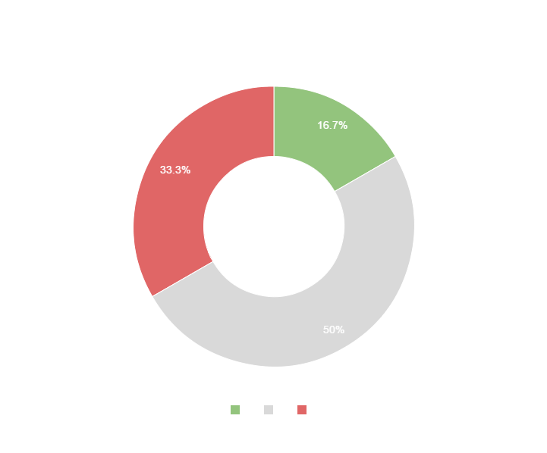
You can copy&paste graphs from Google Sheets

Slide 53
Place your screenshot here
ANDROID PROJECT
Show and explain your web, app or software projects using these gadget templates.

Slide 54
Place your screenshot here
iPHONE PROJECT
Show and explain your web, app or software projects using these gadget templates.

Slide 55
Place your screenshot here
TABLET PROJECT
Show and explain your web, app or software projects using these gadget templates.

Slide 56
Place your screenshot here
DESKTOP PROJECT
Show and explain your web, app or software projects using these gadget templates.

Slide 57
Thanks!
ANY QUESTIONS?
You can find me at
@username
user@mail.me

Slide 58
CREDITS
Special thanks to all the people who made and released these awesome resources for free:
Presentation template by SlidesCarnival
Photographs by Unsplash

Slide 59
PRESENTATION DESIGN
This presentations uses the following typographies and colors:
Titles & body copy: Quicksand
You can download the fonts on this page:
https://www.fontsquirrel.com/fonts/quicksand
Dark gray #2e3037
Aqua #39c0ba
Salmon #f35b69
Blue #6d9eeb
You don’t need to keep this slide in your presentation. It’s only here to serve you as a design guide if you need to create new slides or download the fonts to edit the presentation in PowerPoint®

Slide 60
SlidesCarnival icons are editable shapes.
This means that you can:
Resize them without losing quality.
Change line color, width and style.
Isn’t that nice? :)
Examples:

Slide 61
😉
Now you can use any emoji as an icon!
And of course it resizes without losing quality and you can change the color.
How? Follow Google instructions https://twitter.com/googledocs/status/730087240156643328
✋👆👉👍👤👦👧👨👩👪💃🏃💑❤😂😉😋😒😭👶😸🐟🍒🍔💣📌📖🔨🎃🎈🎨🏈🏰🌏🔌🔑 and many more...

