Slide 1
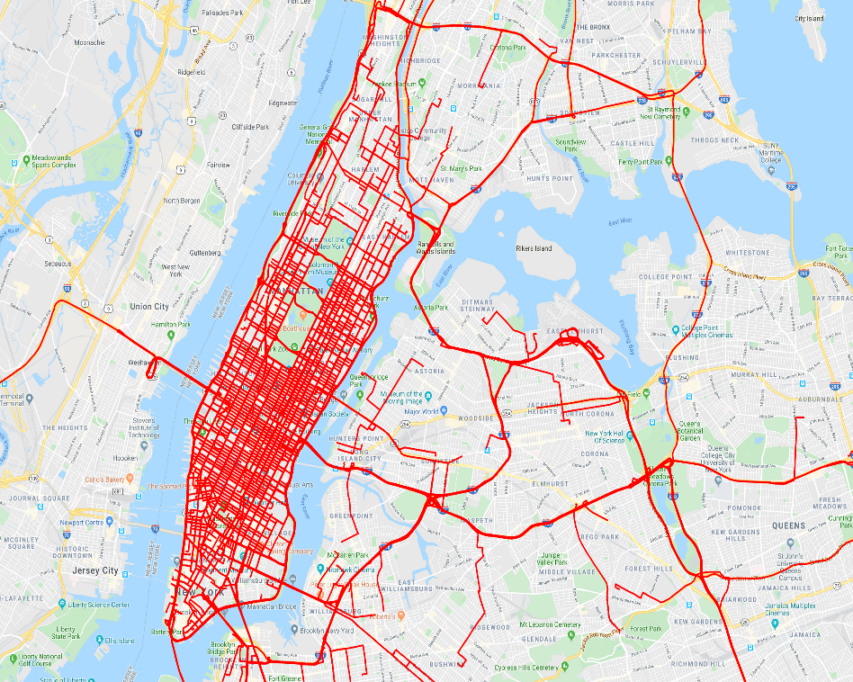
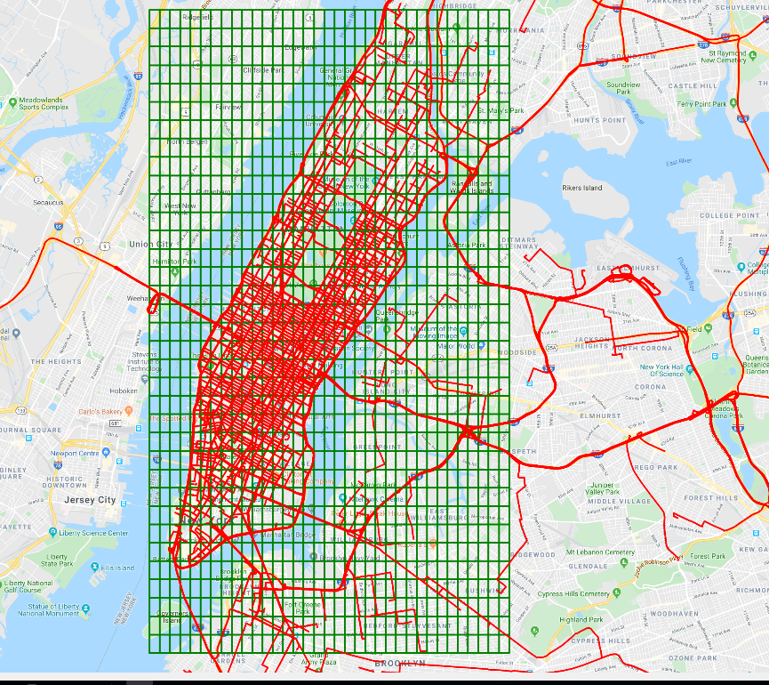
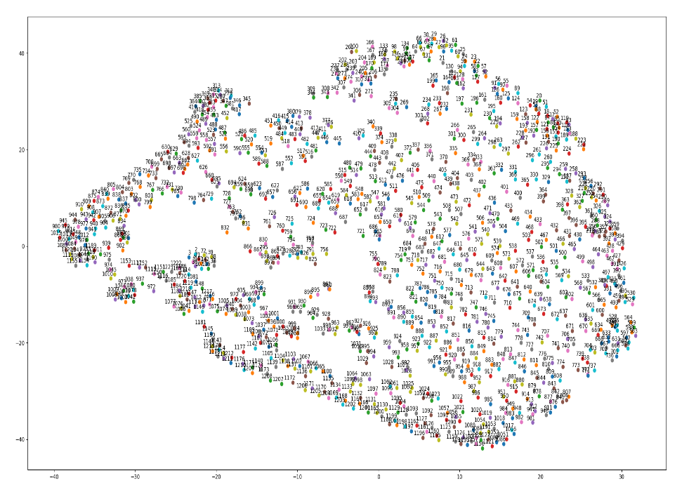
Trajectory data
Trajectory data with Grids
Converting walks into vector embedding
Converting trajectories into grid cell walks
Model Comparative Analysis to learn semantic relations between geographical areas
Embedding visualization using t-SNE

