Slide 1
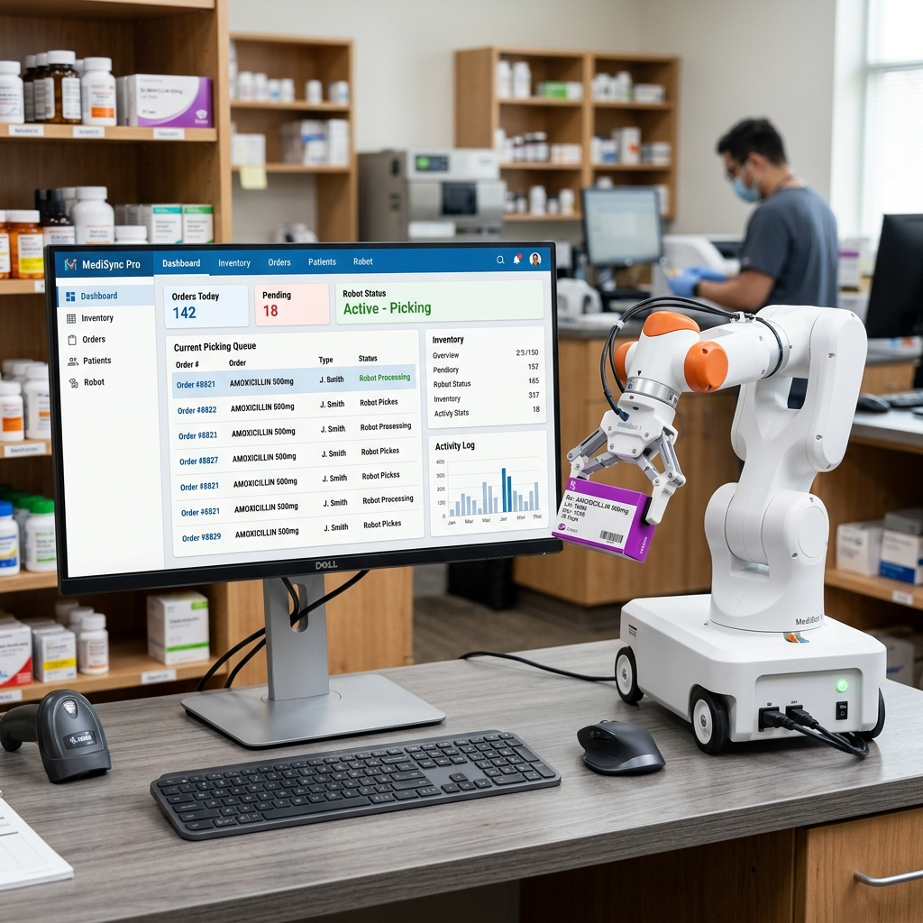
01 Introduction & Motivation
Project: APMS & Roshetety
Goal: Replace manual paper work with a smart pharmacy system
Why?: Pharmacies lose money on expired drugs and patients wait too long
Vision: Connect patients at home to a robotic dispenser in the pharmacy

Slide 2
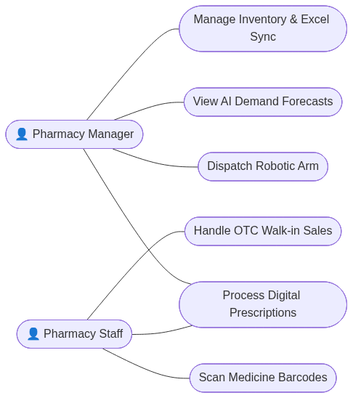
02 Background
Pharmacies still use old ledgers and paper prescriptions
Reading handwritten prescriptions causes dangerous medical errors
Robots exist but lack software that connects them to the patient
We used modern technologies (Flutter, AI, OCR) to solve this

Slide 3
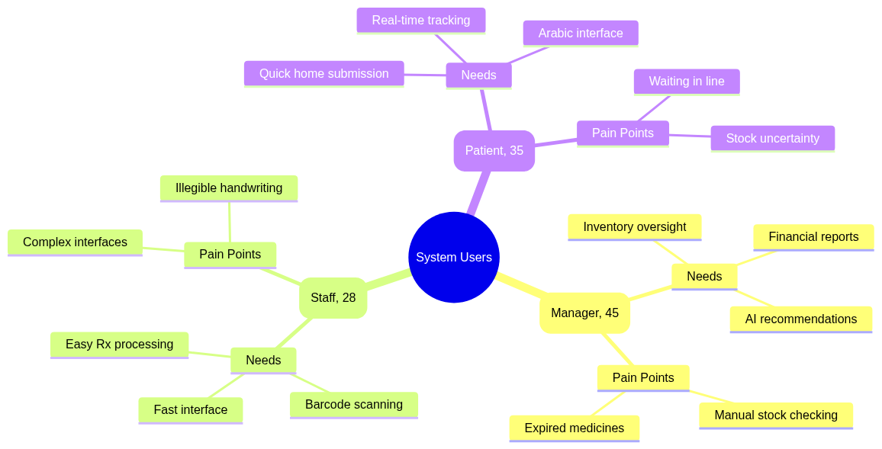
03 Problem
1. Pharmacists cannot read bad handwriting
2. Medicine expires on shelves without warning
3. Patients waste time going to pharmacies just to check if medicine exists
4. Missing data to forecast future sales

Slide 4
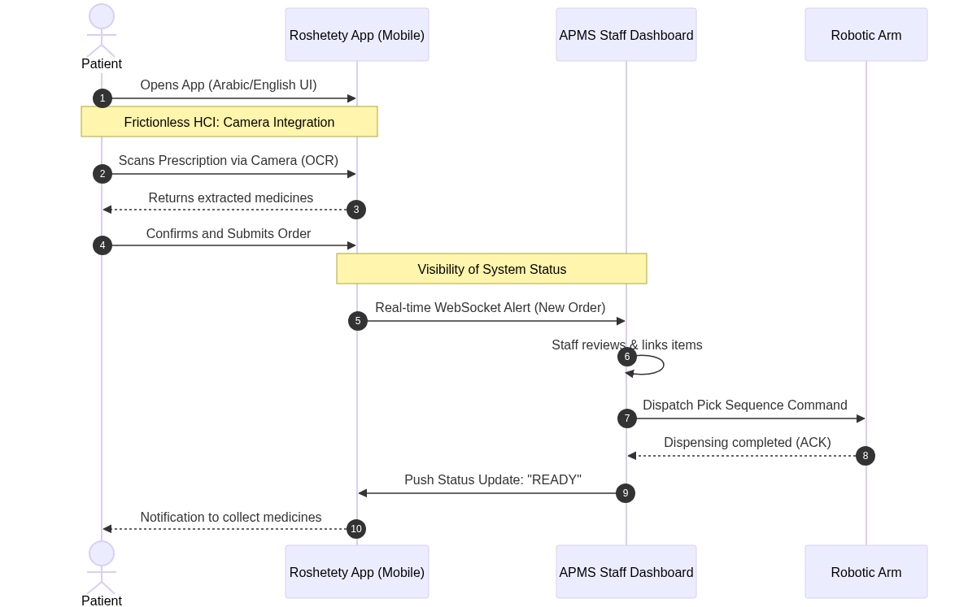
04 Available Solutions & Proposed Solution
Current systems are too complex and don't include AI or Robots
Our Solution: 'Roshetety' app for patients to scan prescriptions
Our Solution: 'APMS' dashboard for staff to manage stock
We connected them automatically to a physical robotic arm!

Slide 5
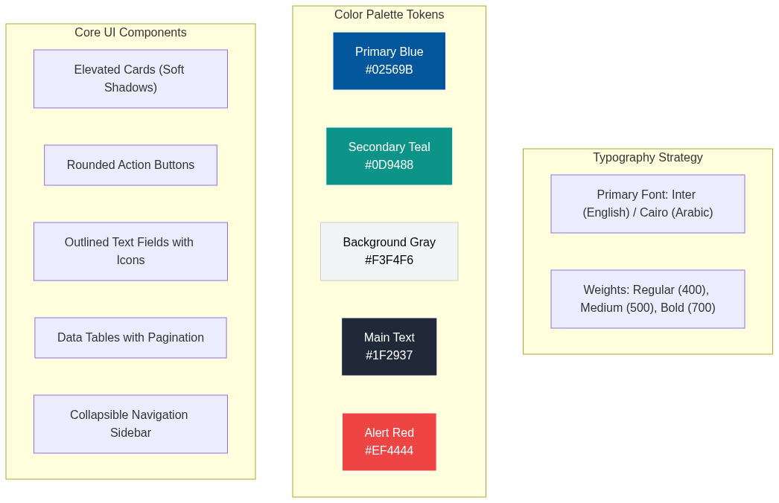
05 User Analysis and Design Requirements
Designed for three main users: Manager, Staff, Patient
Used simple, clear buttons and big text for busy staff
Colors tell a story: Green (In Stock), Red (Expired), Yellow (Low)
Arabic language support for all patients in Egypt

Slide 6
06 Literature Review
Reviewed standard Pharmacy Management Systems
Researched Optical Character Recognition (OCR) for reading medical text
Studied AI models for predicting medicine demand
Selected the best open-source AI tools suitable for local networks

Slide 7
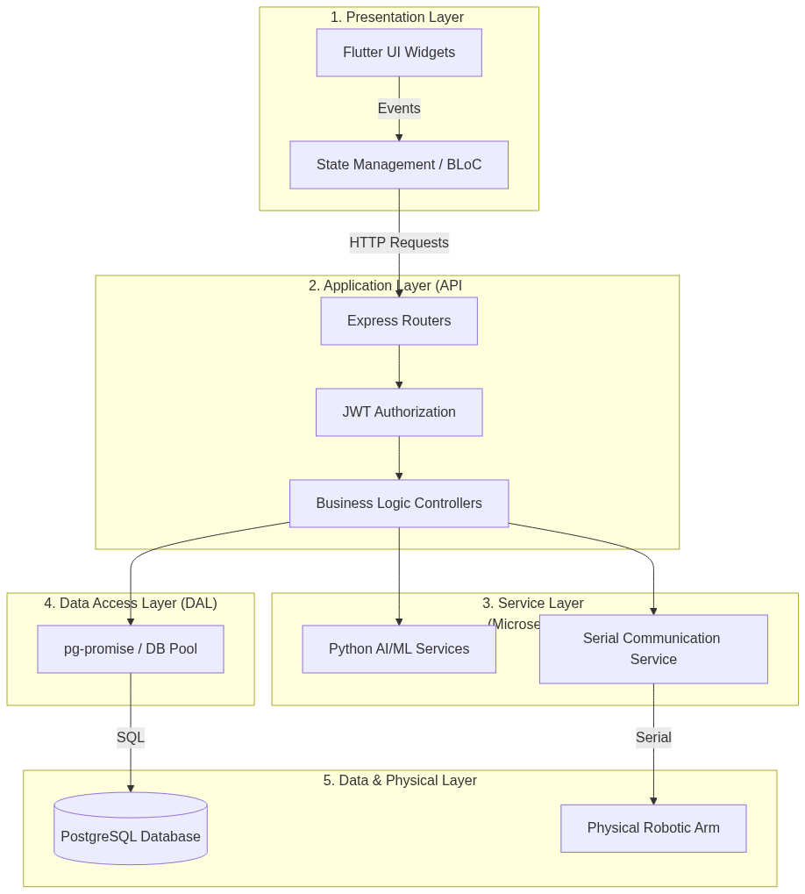
07 Methodology and Design
Built a central brain (API Gateway) that handles all requests
Created a secure Database to store all invoices and stock
Added an AI command center that runs locally without internet
Ensured system works fully offline to protect patient data

Slide 8
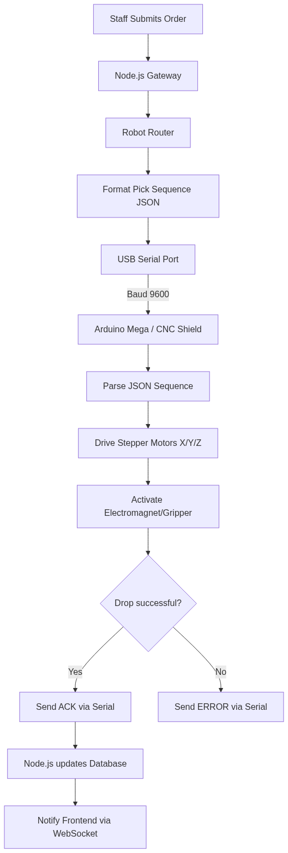
08 Implementation
Developed the Patient App and Staff Dashboard using Flutter
Built smart AI that fixes spelling mistakes in OCR reading
Created a Chatbot where managers can ask 'What is expiring?'
Successfully connected software to the hardware Robot Arm

Slide 9
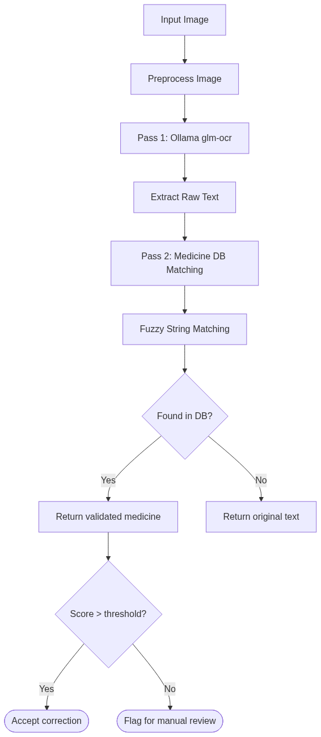
09 Evaluation and Results
The OCR system successfully reads difficult prescriptions
The AI accurately predicts which medicines will be needed next month
The system is extremely fast (under 1 second response)
The Robot successfully dispenses the correct medicine automatically

Slide 10
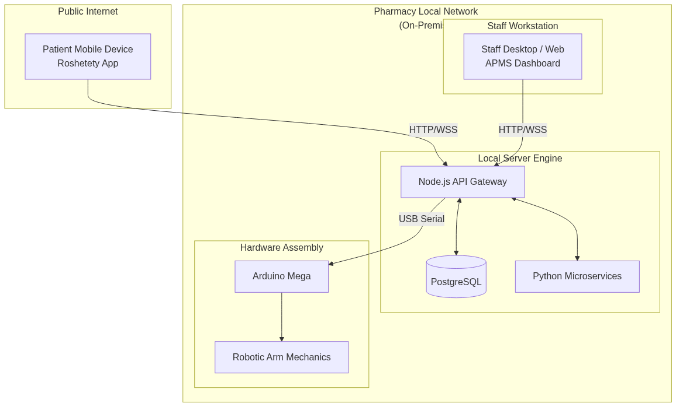
10 Future Work
Connecting multiple pharmacies in a large chain
Adding online payment directly in the patient app
Using cameras to double-check the robot picked the right box
Expanding the AI to provide medical advice to pharmacists

