Slide 1
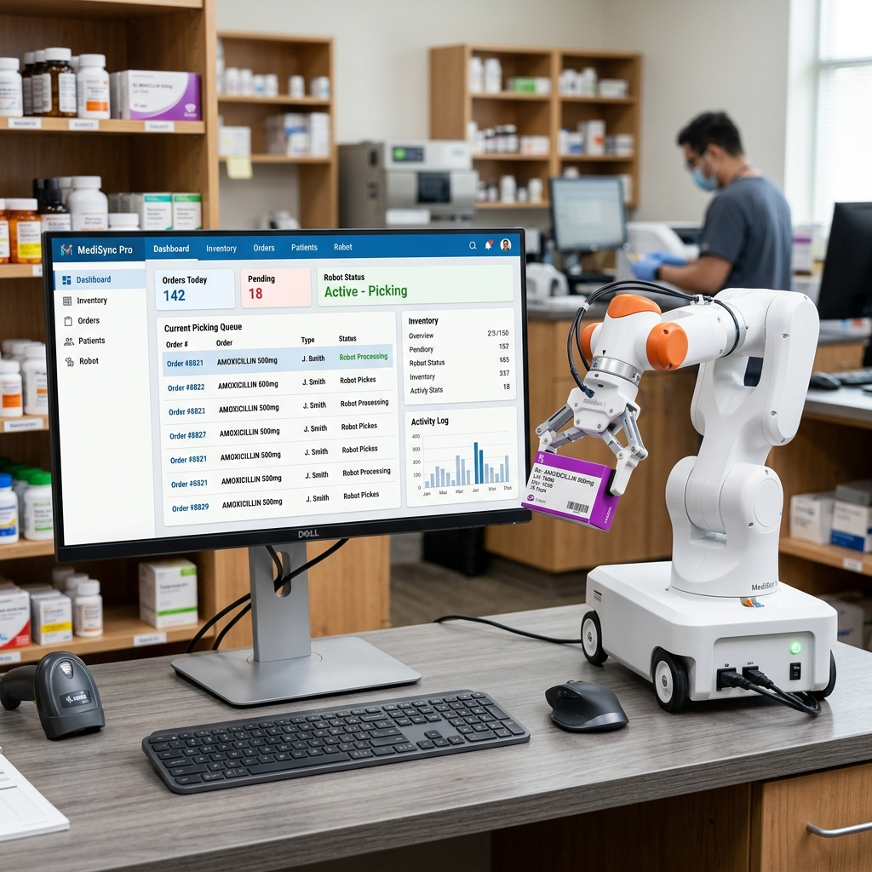
01 Introduction: Project Vision
Project: APMS & Roshetety
Goal: Replace manual paper work with a smart pharmacy ecosystem
Bridging the gap between the patient at home and the pharmacy
Integrating software with physical robotic dispensing

Slide 2
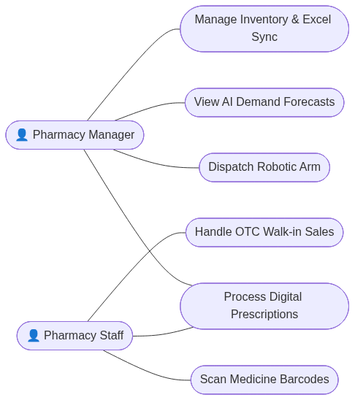
01 Motivation: Why We Built This
Pharmacies suffer from massive losses due to expired drugs
Patients wait too long and face errors due to bad handwriting
The need for an automated, smart, and safe dispensing method
A push for full digital transformation in Egyptian pharmacies

Slide 3
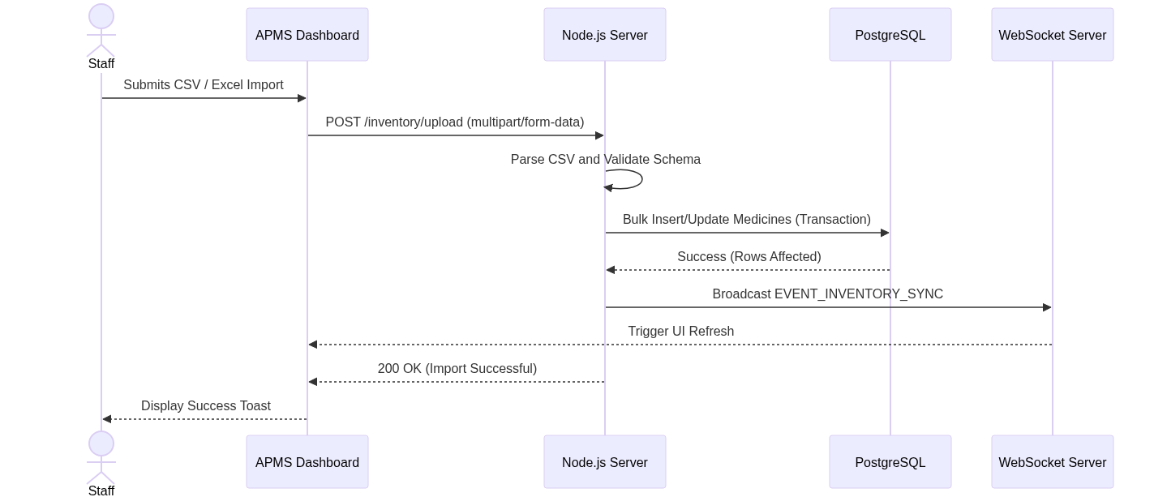
02 Background: Current Pharmacy State
Most pharmacies still rely on old physical ledgers
Paper prescriptions are easily lost or misread
Lack of real-time inventory tracking leads to unexpected stockouts
Manual auditing takes hours of pharmacist time daily

Slide 4
02 Background: The Rise of AI in Healthcare
AI is now used to predict what medicines will be needed
Optical Character Recognition (OCR) can now read medical texts
Modern software can automate re-ordering of low stock
Hardware robots are becoming affordable for local pharmacies

Slide 5
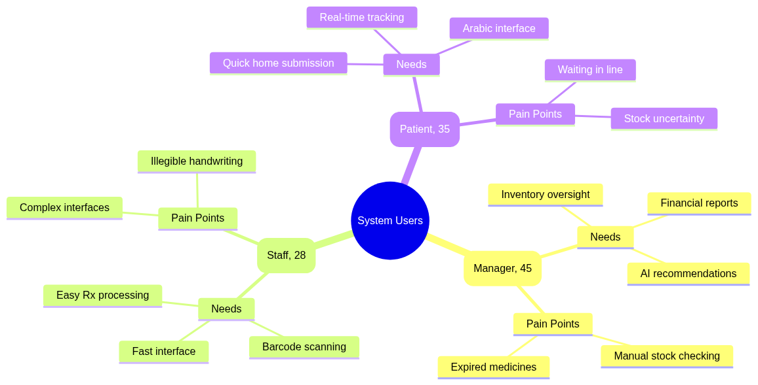
03 Problem: The Danger of Bad Handwriting
Pharmacists struggle daily to decode doctors' handwriting
Misread prescriptions lead to dangerous medical mistakes
Time is wasted verifying the prescription with the doctor
Patients get frustrated by long waiting times

Slide 6
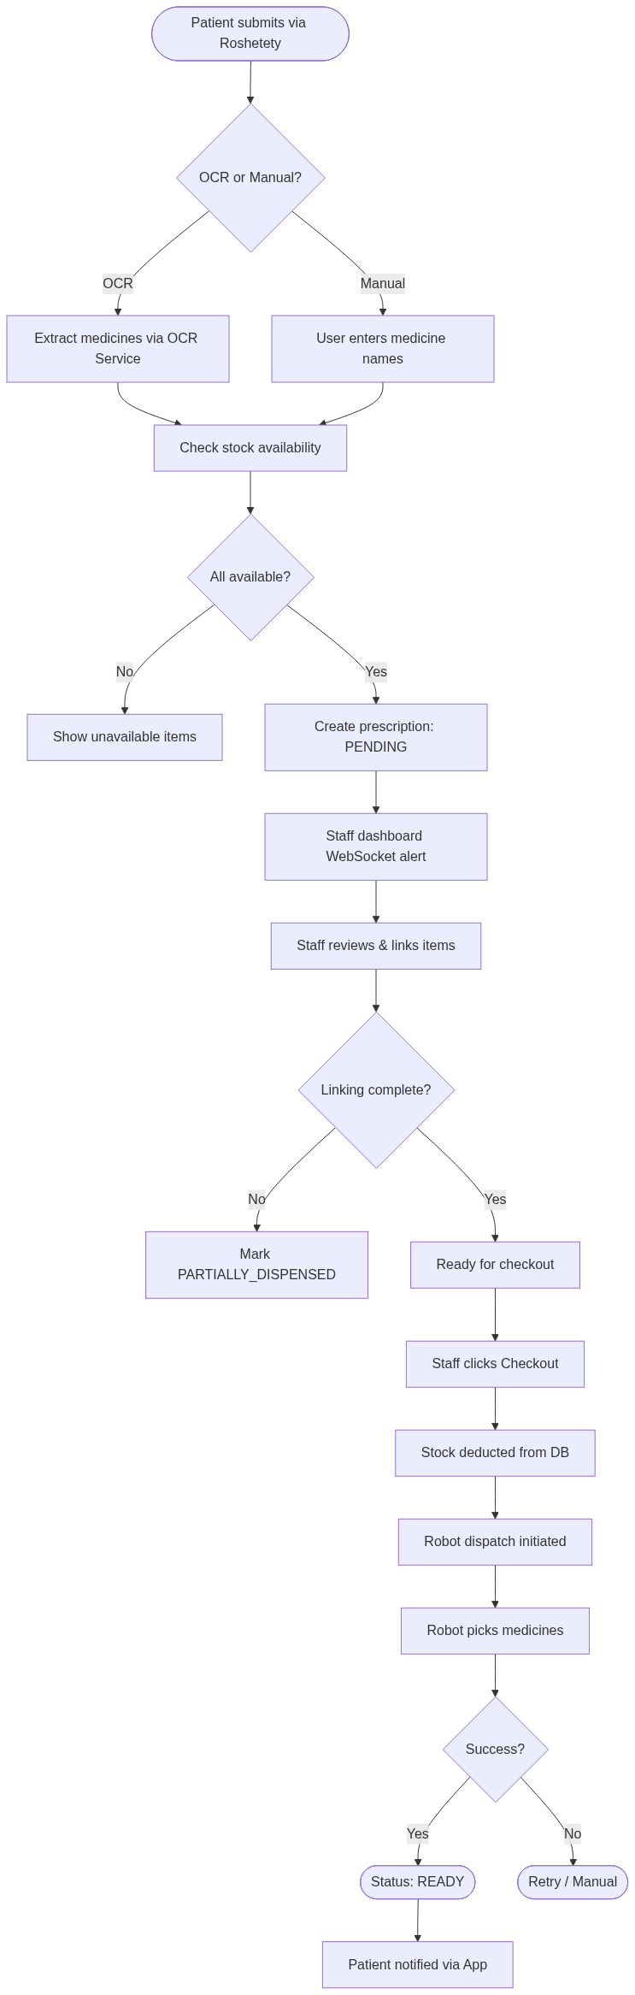
03 Problem: Inventory & Communication Losses
Medicines expire on shelves because they are hidden in the back
Pharmacies run out of essential drugs without any warning
Patients travel to the pharmacy only to find medicine is unavailable
No direct digital communication channel between patient and staff

Slide 7
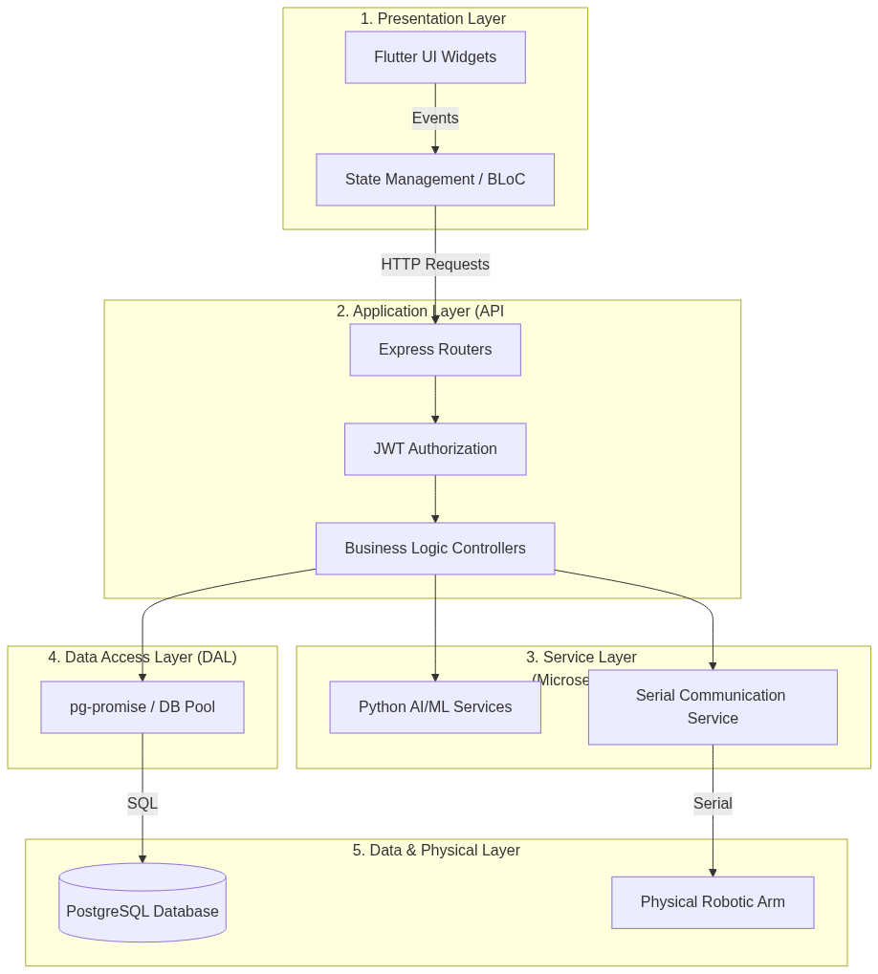
04 Available Solutions: Why Existing Systems Fail
Current systems are mostly basic cash-registers
They do not include AI predictions or smart OCR
They rely on cloud servers which can compromise patient privacy
They cannot connect to physical dispensing robots natively

Slide 8
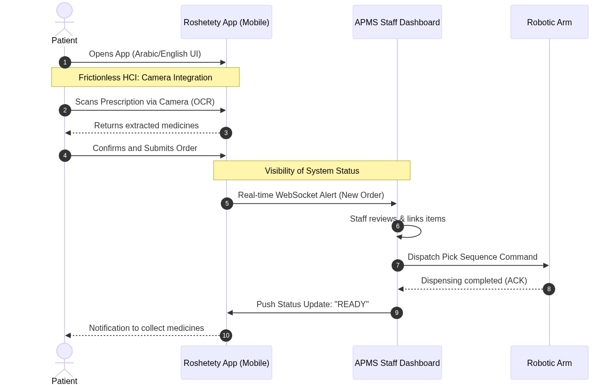
04 Proposed Solution: Roshetety Patient App
A mobile app (Roshetety) for patients to use at home
Patients take a photo of the prescription using their phone
The app checks if the pharmacy has the medicine in stock instantly
Supports Arabic language fully for the Egyptian market

Slide 9
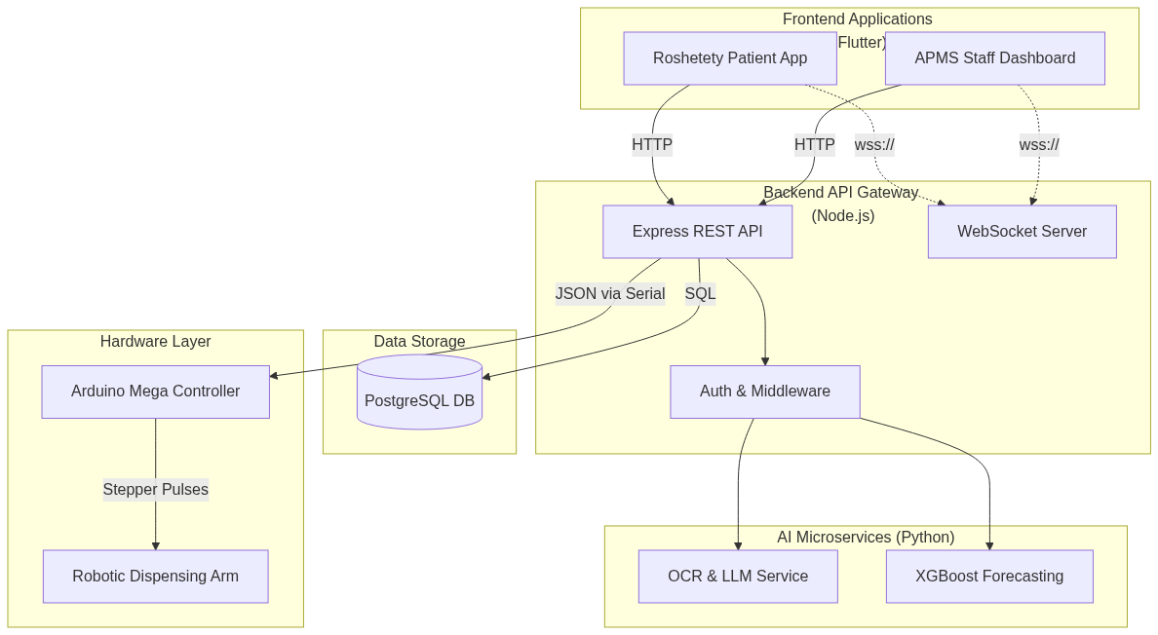
04 Proposed Solution: APMS Staff Dashboard & Robot
A smart dashboard (APMS) for the pharmacy staff to manage orders
Automatically reads the patient's prescription using AI
Sends a command directly to a physical robot to bring the medicine
Provides managers with AI reports on what to buy next

Slide 10
05 User Analysis: Understanding Our Users
Manager (Dr. Ahmed): Needs AI insights, profit reports, and control
Staff (Mariam): Needs a very fast, simple screen during rush hours
Patient (Khaled): Needs convenience, Arabic language, and order tracking
System designed specifically to solve their unique pain points

Slide 11
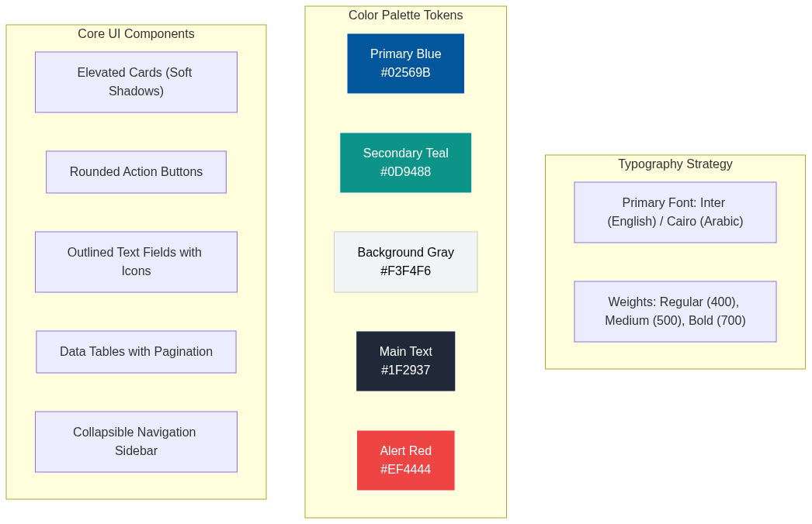
05 Design Requirements: Making it Simple
Large buttons and clear text so staff can work fast without errors
Colors tell a story: Green (In Stock), Red (Expired), Yellow (Low)
Step-by-step guides inside the app so anyone can use it
Focus on a clean and professional medical aesthetic

Slide 12
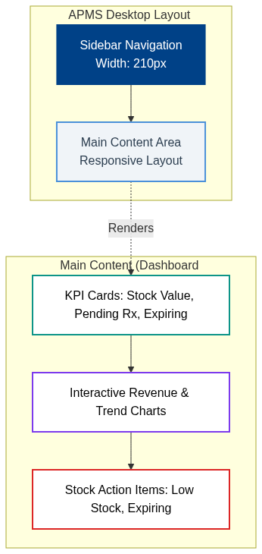
05 Design Requirements: Screen Flows
Navigation is flat and intuitive so users don't get lost
Real-time tracking visually shows order status (Pending -> Ready)
Quick access sidebars for managers to view analytics
Seamless transition from mobile app to desktop dashboard

Slide 13
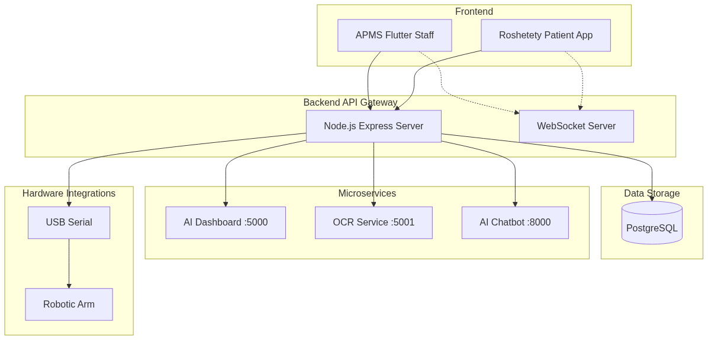
06 Literature Review: Pharmacy Systems
Reviewed standard Pharmacy Management Systems globally
Found a gap in local, offline-first smart systems
Studied how AI can improve stock turnover rates
Analyzed the integration of robotics in community pharmacies

Slide 14
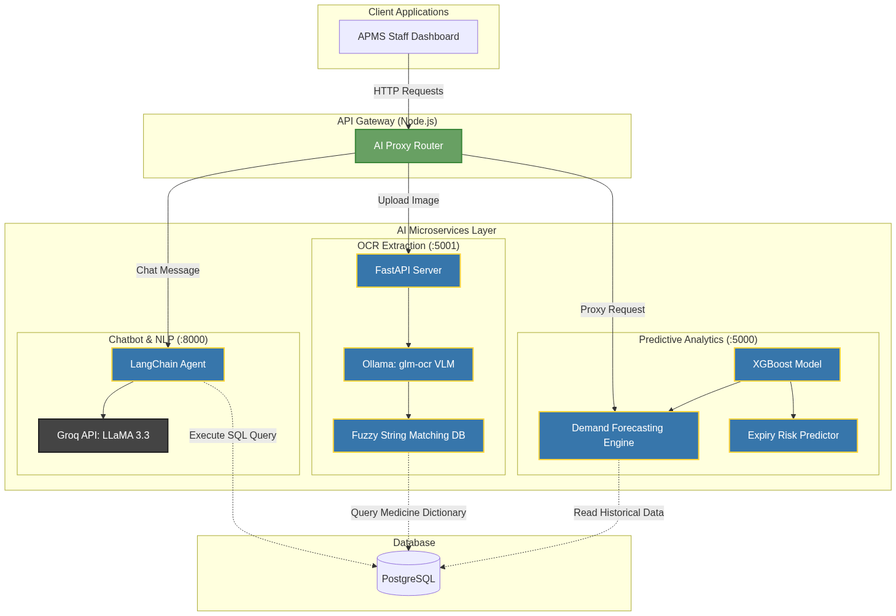
06 Literature Review: OCR & Machine Learning
Evaluated top OCR engines for reading difficult texts
Researched XGBoost and Neural Networks for demand prediction
Studied fuzzy-matching algorithms to fix spelling mistakes
Applied the best open-source AI tools for local LAN networks

Slide 15
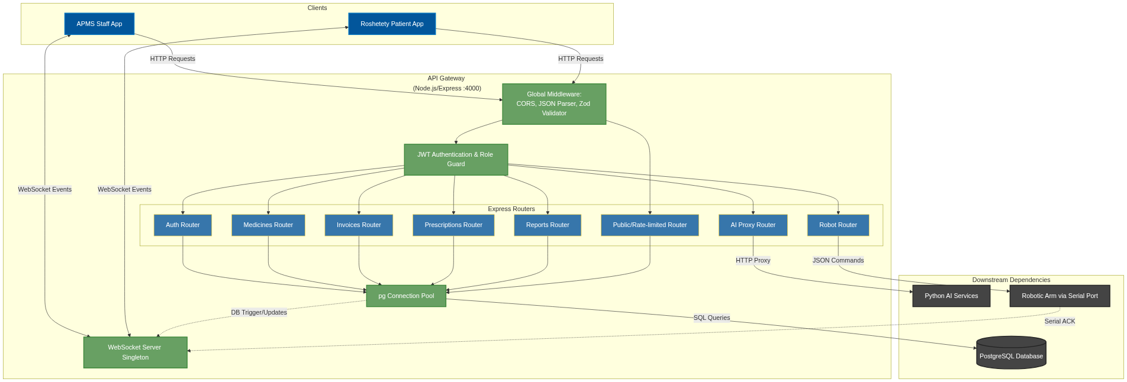
07 Methodology: The System Blueprint
Built a central brain (API Gateway) that handles all data requests
Created a secure Database to store all invoices, users, and stock
Added an AI command center that runs locally to protect privacy
Used a microservices architecture so if one part fails, the rest works

Slide 16
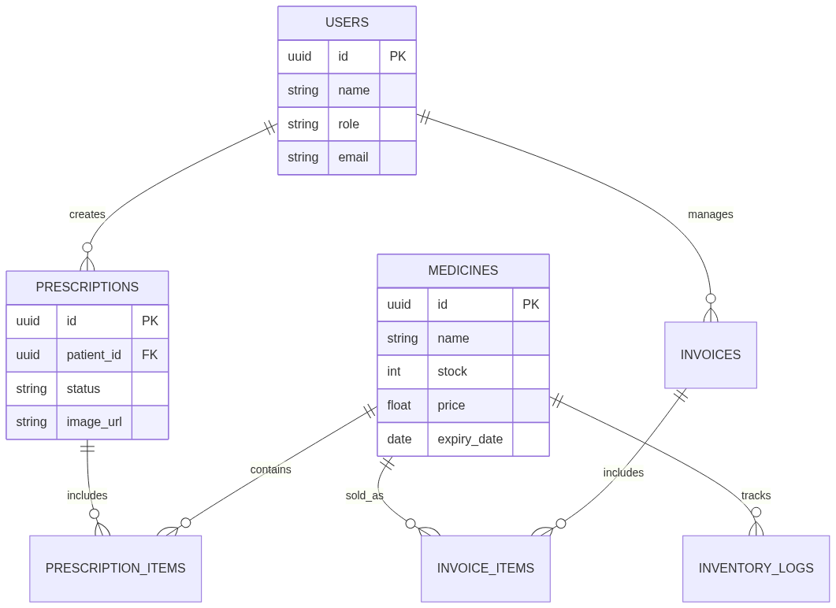
07 Design: Database and Secure Flow
10 core tables designed to track every pill and transaction
Strict security rules ensuring only authorized staff can manage stock
Real-time event streaming using WebSockets (No refreshing needed)
Offline-first design ensures pharmacies work even if the internet drops

Slide 17
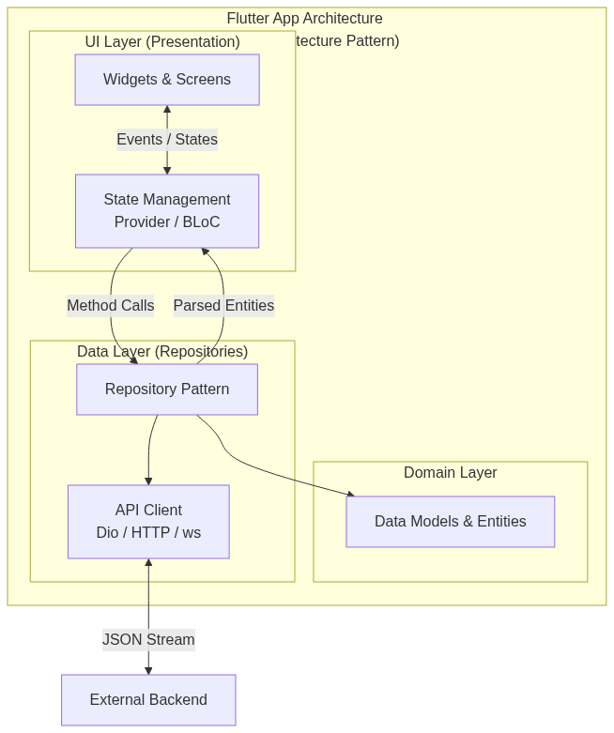
08 Implementation: Building the Apps
Developed the Patient App and Staff Dashboard using Flutter technology
Flutter allows one codebase to run on Android, iOS, and Windows
Built beautiful, responsive screens that adapt to mobile and desktop
Integrated secure login and JWT authentication

Slide 18
08 Implementation: The Smart AI Brain
Built a Python AI service that fixes spelling mistakes in OCR reading
Implemented an AI Chatbot where managers can type questions
Example query: 'Which medicines are expiring next month?'
AI predicts future sales based on historical data automatically

Slide 19
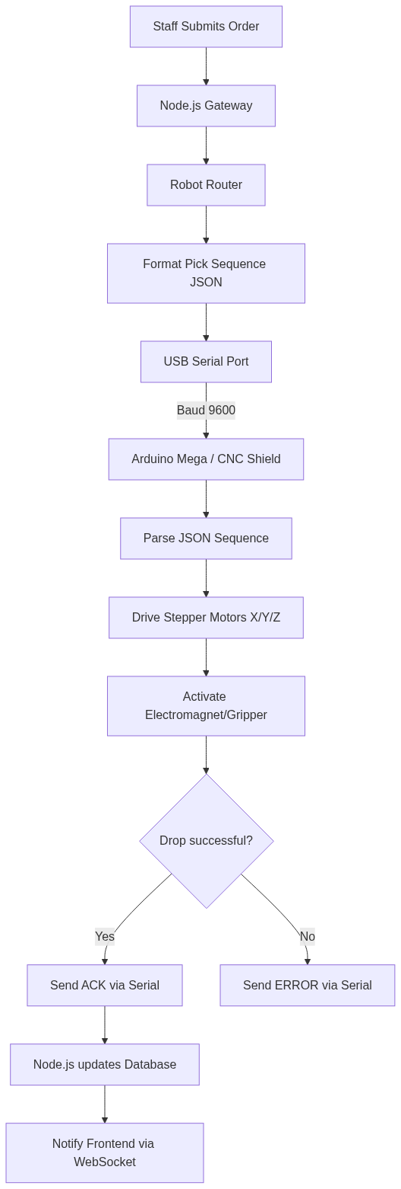
08 Implementation: Physical Robot Connection
Successfully connected the software to a hardware Robot Arm
The system sends specific X/Y/Z coordinates via a Serial Port
The robot physically moves to the shelf, picks the box, and dispenses it
Real-time tracking tells the staff when the robot is done

Slide 20
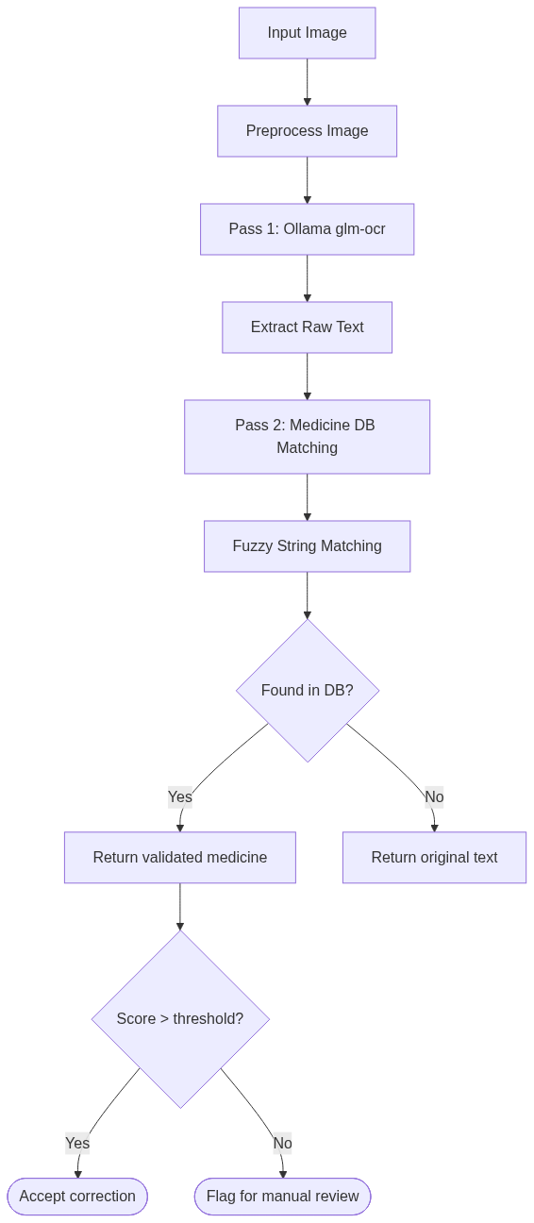
09 Evaluation: OCR Accuracy and Speed
Tested the system on dozens of real, messy prescriptions
The two-pass OCR system successfully extracted the correct medicine names
The system is extremely fast, responding in less than 1 second
Staff saved hours previously spent on manual data entry

Slide 21
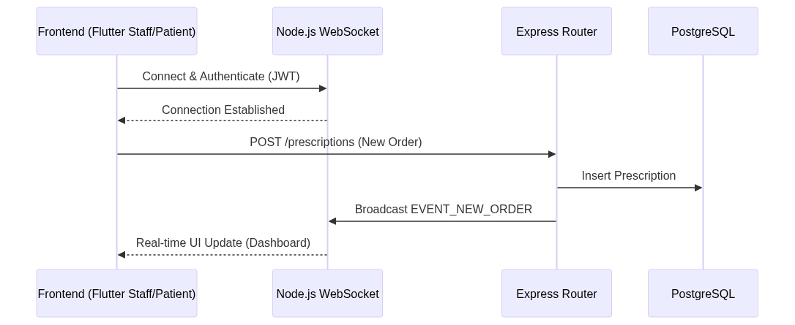
09 Evaluation: Robot Success & Optimization
The Robot successfully dispensed the correct medicine consistently
The AI accurately highlighted medicines at risk of expiring
System significantly reduced stockouts by warning managers early
Seamless end-to-end test from patient phone to physical delivery

Slide 22
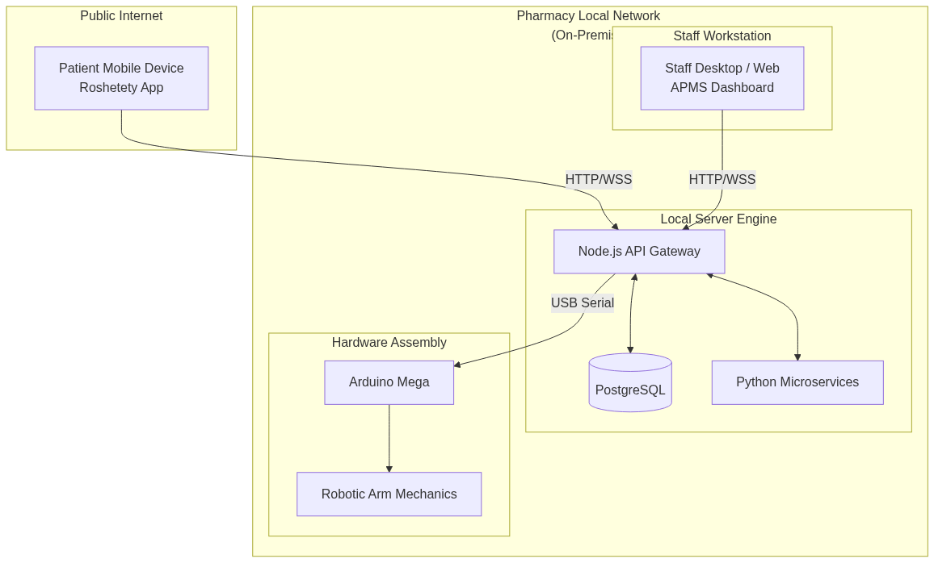
10 Future Work: Network Expansion
Connecting multiple pharmacy branches into one massive network
Allowing patients to find their medicine in the nearest branch
Implementing enterprise cloud synchronization
Scaling the database to handle millions of transactions

Slide 23
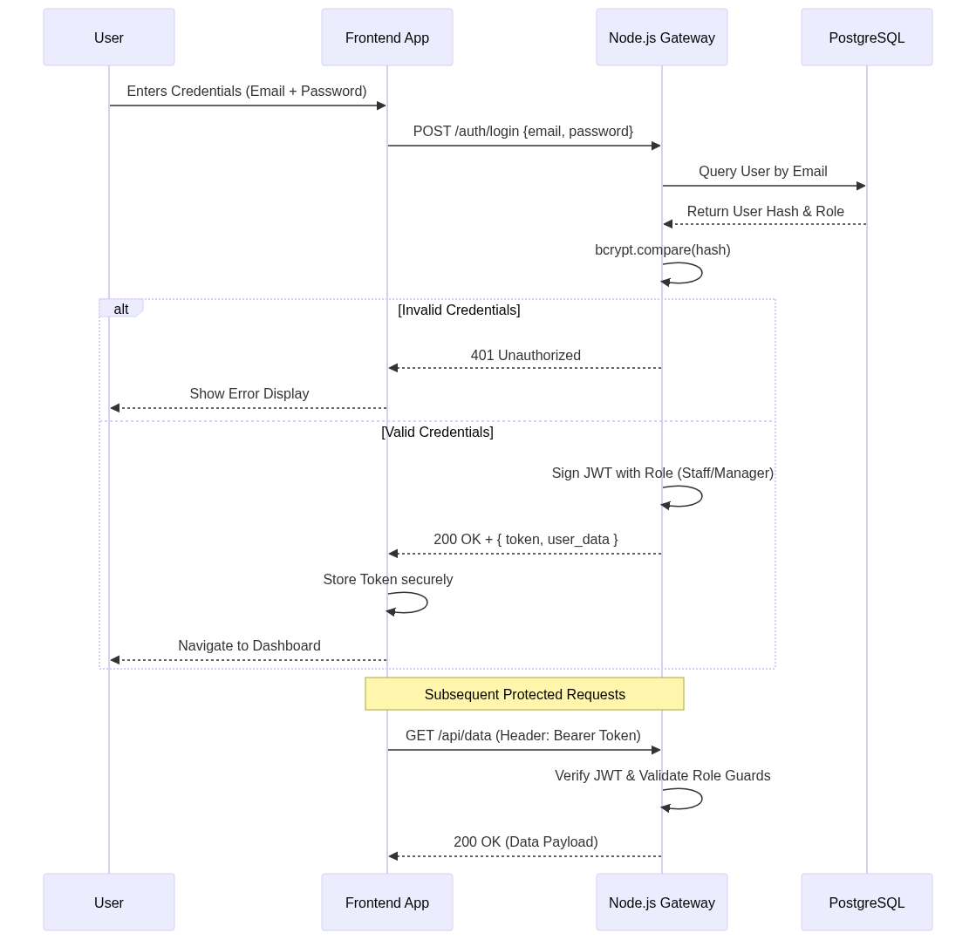
10 Future Work: Payments & Vision
Adding online payment directly inside the Roshetety patient app
Using cameras to double-check that the robot picked the right box
Expanding the AI Chatbot to provide medical advice to pharmacists
Adding deeper integrations with national health insurance systems

