Slide 1
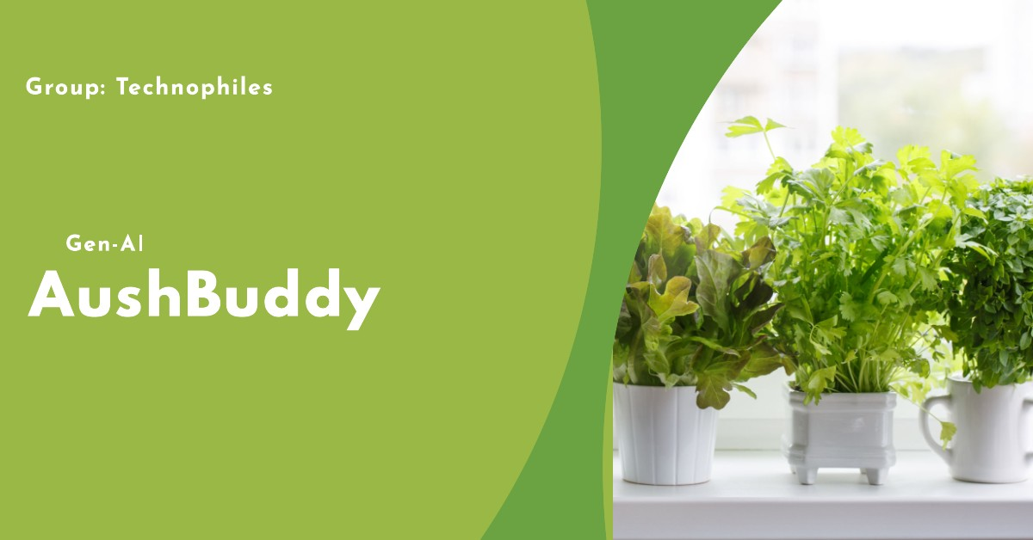

Slide 2
Introduction
Welcome to our presentation on transforming conventional medicines into herbal remedies by the usage of AI. We’ll show how AI can create personalised herbal recipes, offering natural alternatives to traditional medicines using advanced technologies like NLP, and machine learning. Discover the future of herbalism powered by AI.

Slide 3
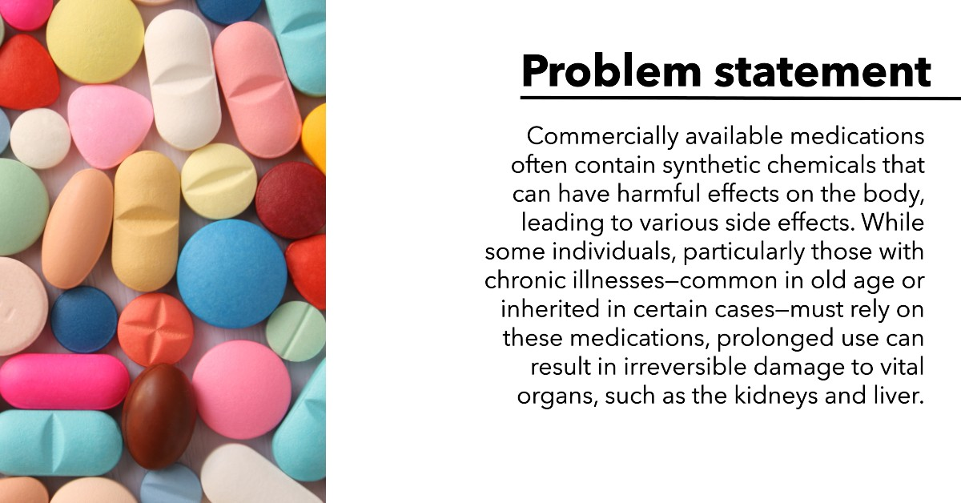
Problem statement
Commercially available medications often contain synthetic chemicals that can have harmful effects on the body, leading to various side effects. While some individuals, particularly those with chronic illnesses—common in old age or inherited in certain cases—must rely on these medications, prolonged use can result in irreversible damage to vital organs, such as the kidneys and liver.

Slide 4
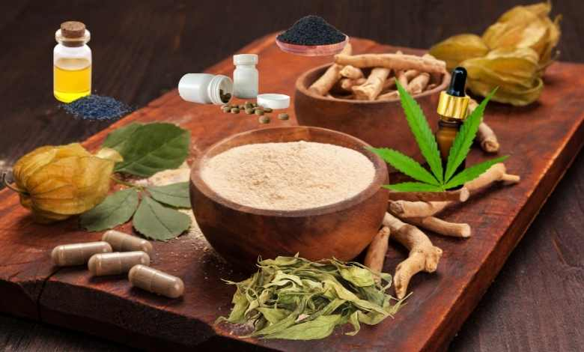
Proposed Solution
To address this issue, we’ve planned to develop a platform that allows users to input the name of a conventional medicine. Our AI module then identifies equivalent herbal alternatives, providing not only these substitutes but also suggesting healthy recipes and optimal consumption techniques using those herbs. This solution leverages the power of large language models (LLMs), natural language processing (NLP), and machine learning to deliver accurate, tailored, and effective recommendations that promote natural healing and well-being. Moreover , this solution is also Eco-friendly and sustainable.

