Slide 1


Slide 2
Introduction
Welcome to our presentation on transforming conventional medicines into herbal remedies by the usage of AI. We’ll show how AI can create personalised herbal recipes, offering natural alternatives to traditional medicines using advanced technologies like NLP, and machine learning. Discover the future of herbalism powered by AI.

Slide 3
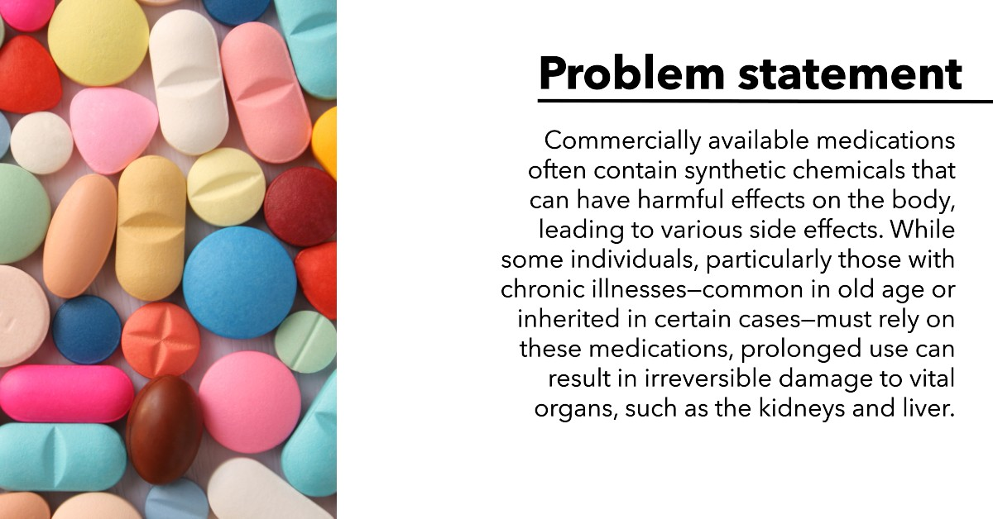
Problem statement
Commercially available medications often contain synthetic chemicals that can have harmful effects on the body, leading to various side effects. While some individuals, particularly those with chronic illnesses—common in old age or inherited in certain cases—must rely on these medications, prolonged use can result in irreversible damage to vital organs, such as the kidneys and liver.

Slide 4
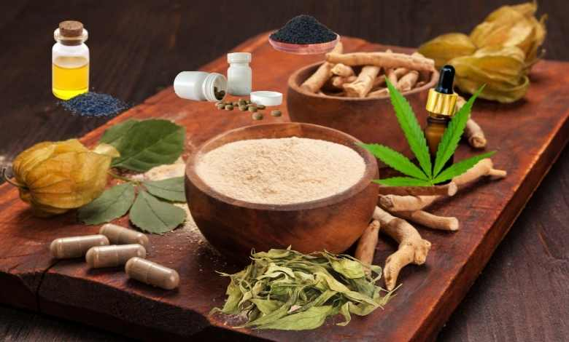
Proposed Solution
To address this issue, we’ve planned to develop a platform that allows users to input the name of a conventional medicine. Our AI module then identifies equivalent herbal alternatives, providing not only these substitutes but also suggesting healthy recipes and optimal consumption techniques using those herbs. This solution leverages the power of large language models (LLMs), natural language processing (NLP), and machine learning to deliver accurate, tailored, and effective recommendations that promote natural healing and well-being. Moreover , this solution is also Eco-friendly and sustainable.

Slide 5
Method of Implementation
Research and Data collection:
1) Herbal Database: Gather information on herbs and their medicinal properties by consulting herbal medicine books, and research papers, or collaborating with a herbalist.
2) Mapping Diseases to Medicines and Herbs: Create a database that links diseases to conventional medicines and then to herbal alternatives.
Technical Architecture:
1) Design an intuitive UI using HTML, CSS, and JavaScript.
2) Ensuring that our website complies with health-related regulations, such as HIPAA and implementation of SSL for secure data transition.
3) Developing an API that allows the frontend to communicate with the database.
Target Audience:
1) Individuals seeking natural remedies.
2) Someone with chronic disease or inherited diseases who need continued medication throughout their life.
3) Healthcare providers.

Slide 6
Feasibility
Technical Feasibility:
1) Using widely adopted technologies (Flask, React) ensures ease of implementation.
2) Access to free/affordable tools (e.g., VS Code, GitHub, Heroku) supports development.
Resource Feasibility:
1) Project divided into phases (learning, development, testing) with realistic timelines.
2) Minimal initial costs; potential expenses include domain, hosting, and APIs.
3) Clear task allocation based on skill sets.
Market Feasibility:
1) Targeting users interested in natural remedies and alternative medicine.
2) Differentiation through user-friendly design and focused herbal alternatives.

Slide 7
Feasibility
Business Scalabilit:
1) User Growth: Infrastructure designed to scale with growing user base..
2) Feature Expansion: Architecture allows for adding new features like user accounts or forums.
3) Geographical Reach: Potential to support multiple languages and regions.
Financial Scalability:
1) Monetization: Options include premium memberships, ads, and partnership.
2) Cost Management: Start with low-cost setup; increase infrastructure investment as revenue grows

Slide 8
Impact
Health Awareness:
1) Provides users with knowledge about herbal alternatives, promoting informed health choices.
Cost-Effective Healthcare:
1) Offers lower-cost herbal options compared to conventional medicines, making healthcare more accessible..
2) Potentially decreases dependency on expensive pharmaceutical drugs.
Cultural Preservation:
1) Revives and preserves knowledge of herbal remedies and traditional medicine practices.
2) Encourages the use of locally sourced herbs, supporting local farmers and small businesses.
Cost-Effective Healthcare:
1) Offers lower-cost herbal options compared to conventional medicines, making healthcare more accessible..
2) Potentially decreases dependency on expensive pharmaceutical drugs.

Slide 9
Impact
Environmental Sustainability:
1) Encourages the use of natural, sustainable resources, reducing the environmental impact of synthetic pharmaceuticals.
2) Promotes the cultivation and conservation of medicinal plants
Cost-Effective Healthcare:
1) Offers lower-cost herbal options compared to conventional medicines, making healthcare more accessible..
2) Potentially decreases dependency on expensive pharmaceutical drugs.
Innovation in Healthcare:
1) Introduces a modern platform that bridges the gap between traditional and conventional medicine.
2) Offers personalized recommendations, enhancing user experience and treatment effectiveness.

