Slide 1



Project TRAVELEASE

Slide 2



TRAVELEASE
Introduction
The TravelEase Project aims to develop an integrated online platform designed to enhance the travel experience for tourists and streamline operations for tour operators. This comprehensive tourist website will offer users the ability to discover, book, and review tours, while providing tour operators with tools to manage their offerings efficiently. Key features include user registration and authentication, tour management, booking and review systems, and robust search and filtering options. The TravelEase Project aspires to create a user-friendly, scalable, and secure platform that meets the evolving needs of the tourism industry.
03 | 30 MARCH 2023

Slide 3
TRAVELEASE
Functional Requirements
User Registration
User Login
Tour Management
Booking Management
Tour Guide Management
Location Management
04 | 30 MARCH 2023

Slide 4

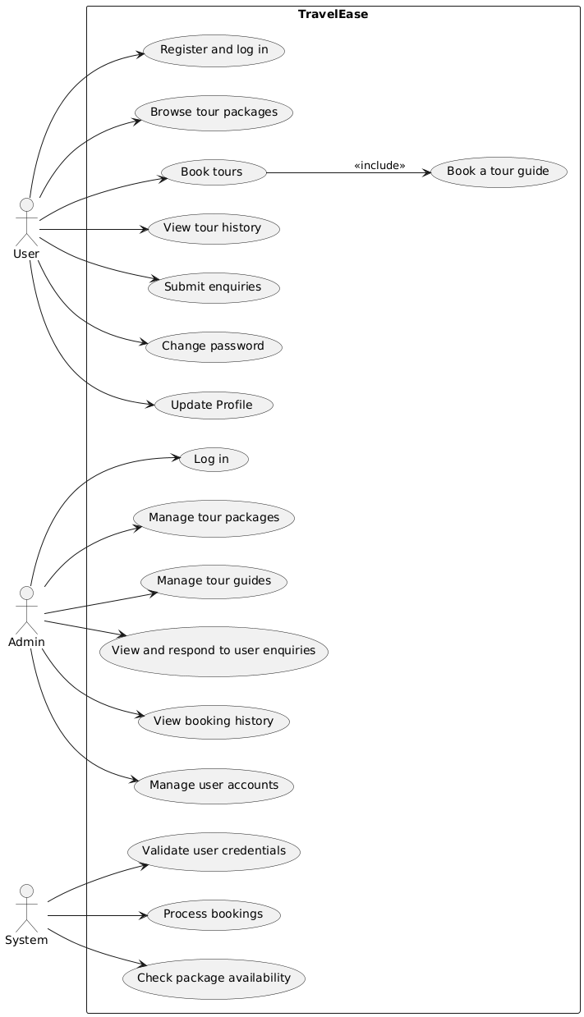
Use Case Diagram
TRAVELEASE

Slide 5

TRAVELEASE
Database Design
04 | 30 MARCH 2023

Slide 6

TRAVELEASE
Tools & Technology
Tools
Language
VS Code
Xampp
Html
CSS
PHP
Javascript

Slide 7
TRAVELEASE
Website Demo

Slide 8

TRAVELEASE
THANK
YOU

