Slide 1
Introduction to data mining and decision making in Python
Nadia Udler

Slide 2
Books and links
[1]Charles Severance, Python for everybody, 2016
https://www.py4e.com/
[2]Mark Pilgrim, Dive into Python 3
https://diveintopython3.problemsolving.io/
[3]Bernd Klein
https://www.python-course.eu/python_books.php
[4]Mark Lutz, Learning Python, 5th edition, 2013
http://www.amazon.com/Learning-Python-Edition-Mark-Lutz/dp/1449355730
[5]Wes, McKinney, Python for data analysis, 2012
http://www.amazon.com/Python-Data-Analysis-Wrangling-IPython/dp/1449319793/ref=sr_1_1?s=books&ie=UTF8&qid=1422825912&sr=1-1&keywords=python+for+data+analysis
[6]Eli Bressert , SciPy and NumPy: An overview for developers,2012
http://www.amazon.com/SciPy-NumPy-An-Overview-Developers/dp/1449305466#reader_1449305466
[7]Allen Downey, How to think like computer scientist (2002, Python 2)
http://www.greenteapress.com/thinkpython/thinkCSpy.pdf
[8]Python documentation 3.8 and 3.9
https://www.python.org/doc/
https://docs.python.org/3.9/whatsnew/3.9.html
[9]W.Punch, R.Enbody, Practice of Computing using Python, Pearson, 3RD edition, 2017

Slide 3
Books and links: Quantitative finance
[10]Matthew Dixon, Igor Halperin, Paul Bilokon, Machine Learning in Finance: From Theory to Practice, Springer, 2020
https://docs.python.org/3/library/exceptions.html#base-classes
[11]Yves, Hilpisch, Python for Finance
https://www.goodreads.com/book/show/22221113-python-for-finance
[12]Robert Tibshirani, Introduction to statistical learning
http://faculty.marshall.usc.edu/gareth-james/ISL/
[13]Pandas Tutorial
https://pandas.pydata.org/docs/user_guide/index.html
[14] MIT Opencourseware Python Lectures
https://ocw.mit.edu/courses/electrical-engineering-and-computer-science/6-0001-introduction-to-computer-science-and-programming-in-python-fall-2016/
[15] Object Oriented programming in Python
https://realpython.com/python3-object-oriented-programming/

Slide 4
Key Topics
Development environment: Anaconda/Spyder
My first Python program
Built-in data types and data structures:
numerical, string, tuple, list, dictionary, set, type conversion
Memory Management: Deep and Shallow copies
Other useful data types
NumPy array , Pandas DataFrame and Series
Arithmetic operators, Comparison operators
Control statements: Assignments, Conditionals, Loops
Input and output (console, file, connecting to database),
Error handling
Functions, modules, scope of variables.
Testing
Regular Expressions
Web scraping
Reading real-time market data
Object Oriented Design
Closures and Decorators
Generators and Iterators

Slide 5
Development Environment
Online Python interpreter
https://repl.it/@enaard/Python-3#main.py
Anaconda - collection of powerful packages for Python
Enables large-scale data management, analysis, visualization for Business Intelligence, Scientific Analysis, Engineering, Machine Learning, and more.
Spyder - Scientific PYthon Development EnviRonment:
powerful interactive development environment for the Python language with advanced editing, interactive testing, debugging and introspection features
numerical computing environment: supports IPython (enhanced interactive Python interpreter) and popular Python libraries such as NumPy (linear algebra), SciPy (signal and image processing) or matplotlib (interactive 2D/3D plotting).

Slide 6
First program
First exercise: ‘Hello, world’ program
Go to Start menu and run Spyder
Type the following:
print (‘Hello, world’)
Save file
Press F5 (or green arrow) to run a program
Press F8 to activate code analysis ( check code style, see errors and warnings)

Slide 7
Data types and variables: Introduction
Variable:
- way of referring to a memory location used by a computer program.
- symbolic name for this physical location.
- container to store certain values
Access to variables:
. While the program is running, variables are accessed and sometimes changed, i.e. a new values are assigned to them
Strongly typed (C,C++,Java) languages vs weakly typed (Python)
Differs in a way it deals with types.
In strongly-typed languages every variable must have a unique data type.
E.g. if a variable is of type integer, solely integers can be saved in the variable. Every variable has to be declared before it can be used. Declaring a variable means binding it to a data type.
Python:
Declaration of variables is not required
Not only the value of a variable may change during program execution but the type as well.

Slide 8
Assignment statement
Example:
In the following line of code, we assign the value 42 to a variable i:
i=42
Assignment statement: ‘=‘ (means ‘set to’)
in our example : "the variable i is set to 42".
Increase the value of variable I by 1:
i = i + 1
print (i)

Slide 9

Variables, identifiers and Python key words
Variables vs identifiers :
The name of a variable is an identifier,
Variable has: name, type, value.
Identifier denotes: variables, types, labels, subroutines , functions, packages
Python rules for naming identifiers: A valid identifier is a non-empty sequence of characters of any length with:
the start character can be the underscore "_" or a capital or lower case letter
the letters following the start character can be anything which is permitted as a start character plus the digits.
Identifiers are case-sensitive
Python keywords are not allowed as identifier names
Python keywords: and, as, assert, break, class, continue, def, del, elif, else, except, finally, for, from, global, if, import, in, is, lambda, nonlocal, not, or, pass, raise, return, try, while, with, yield
The type of a variable can change during the execution of the script.
Example:

Slide 10
Type annotations
Added in Python 3.5 (PEP 484)
https://www.python.org/dev/peps/pep-0484/
Does not affect the code at runtime
Used as a hint to someone reading the code
X : int = 5
def myfunct() -> int:
pass

Slide 11


Memory Management in Python
Everything is an object in Python!
https://realpython.com/pointers-in-python/#objects-in-python
Example:
first assignment :memory location for x is chosen and integer value 3 is saved there
second assignment: y points to the memory location of x (differs from our intuition and the ways of C and C++)
third assignment y is set to the integer value 2 (and x still has 3 )
identity function id() :
every instance (object or variable) has an identity, i.e. an integer which is unique within the script or program,
i.e. other objects have different identities.

Slide 12
What is new in Python 3.8: Walrus operator
- Added in Python 3.8
- Assignment and return in the same expression
Example:
walrus=5
print (walrus)
same as
print (walrus := 5)
https://realpython.com/lessons/assignment-expressions/

Slide 13
Numbers
Integers
Normal integers e.g. 4321
Octal literals (base 8)
Hexadecimal literals (base 16) Hexadecimal literals have to be prefixed either by "0x" or "0X". example: hex_number = 0xA0F print hex_number returns 2575
Long integers these numbers are of unlimeted size e.g.42000000000000000000L
Floating-point numbers for example: 42.11, 3.1415e-10
Complex numbers Complex numbers are written as <real part> + <imaginary part>j examples: x = 3 + 4j y = 2 - 3j z = x + y print (z) returns (5+1j)

Slide 14
Strings
Single quotes ('), double quotes ("), triple quotes, both single (''') and (""") are allowed to mark strings String - sequence of characters - letters, numbers, and special characters
Character - string of size one.
Counting the indices :
from the right. - negative numbers are used, starting with -1 for the most right character.
from the le - positive numbers are used, starting with 0 for the most left character.
Operators and functions for strings:
Concatenation Strings can be glued together (concatenated) with the + operator: "Hello" + "World" -> "HelloWorld"
Repetition String can be repeated or repeatedly concatenated with the asterisk operator "*": "*-*" * 3 -> "*-**-**-*"
Indexing "Python"[0] -> "P"
Slicing "Python"[2:4] -> "th"
Size len("Python") ->
Like strings in Java and unlike C or C++, Python strings cannot be changed. Trying to change an indexed position will raise an error
s = "Some things are immutable!"
s[1]=“r”
Will return error:
TypeError: 'str' object does not support item assignment = "."

Slide 15


Input from keyboard
In version 3.x : built-in function input([promtp string]).
Note:
Python 3.x function input() behaves like raw_input() in v.2.x.
There is no more raw_input function.
To get evaluated input in version 3.x, one should call eval(input())

Slide 16
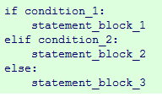
Conditional statements
Purpose:
to perform different computations or actions depending on whether a condition evaluates to true or false.
Example: dog years (this might be an approximate algorithm to relate dog years to human years)
A one year old dog roughly corresponds to a fourteen year old human
A dog who is two years old corresponds to a 22 year old human
Every further dog year corresponds to five human years
age = eval(input(‘age of the dog'))
if age < 0:
print('this can hardly be true')
if age == 1:
print('about 14 human years')
if age >= 2:
print(22+(age-2)*5)
Python objects evaluated to False: numerical zero values (0, 0L, 0.0, 0.0+0.0j), the Boolean value False, empty strings, empty lists and empty tuples, empty dictionaries, the special value None. All other values are considered to be True.

Slide 17
Conditional statements (cont.)
Abbreviated If statement example:
maximum = a if (a > b) else b
it corresponds to the following if statement.
if a > b:
maximum = a
else:
maximum = b

Slide 18
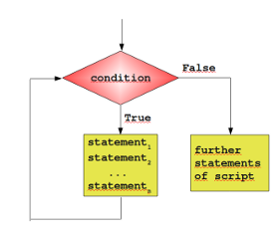
Loops
Purpose:
to carry out a sequence of statements repeatedly.
Types of loops:
while loop and the for loop.
Counter : integer variable that keeps track of the iterations in the loop.
Simple while loop:
The following script calculates the sum of numbers from 1 to 100
n = 100
i = 0
s = 0
while i <= n:
s =s + i
i = i + 1
print(s)

Slide 19
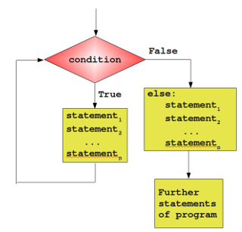
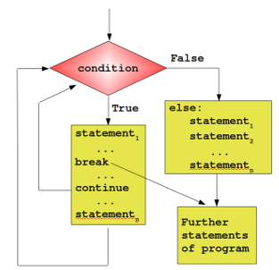
Loops
Another form of while loop:
while condition: statement_1 ... statement_n else: statement_1 ... statement_n
Example: use together with break statement
If a loop is left by break, the else part is not executed.

Slide 20
Loops: guessing number game example
Guessing number game. A human player has to guess a number between a range of 1 to n. The player inputs his guess. The program informs the player if this number is larger, smaller or equal to the secret number, i.e. the number which the program has randomly created. If the player wants to give up, he or she can input 0 or negative number.
import random
n = 20
#the number that computer thinks of
to_be_guessed = int(n * random.random()) + 1
#my guess
guess = 0
print ('please enter integer number between 1 and ',n+1 )
print ('you have 5 attempts ')
counter = 0
#Examples continues on the next page

Slide 21
Loops: guessing number game example
while guess != to_be_guessed:
counter = counter + 1
if counter > 5:
answer = input('do you want to continue? enter Y or N ')
if answer == 'N':
break
counter = 0
try:
guess = input('enter a number:' )
print('line 21: ',guess)
guess=int(guess)
print(guess)
except ValueError:
print('enter number next time')
continue
if guess <= 0 or guess >= 22:
print ("Number should be between 1 and 21")
elif guess > to_be_guessed:
print ("Number too large")
elif guess < to_be_guessed:
print ("Number too small")
else:
print ("Correct! the number is ",to_be_guessed )

Slide 22
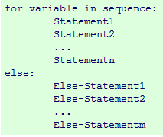



Loops
for loop: to go through elements of a list or perform an operation over a series of numbers
example:
output:
built-in function range() -to iterate over a sequence of numbers.
Example: range(10) will produce [0, 1, 2, 3, 4, 5, 6, 7, 8, 9]
range(begin,end), range(begin,end,step)
Range() can be used with for loop:

Slide 23
Loops: example
Compute Pythagorean numbers: triples (a,b,c) for which
n = eval(input('please enter integer number:'))
for a in range(1,n):
for b in range(a,n):
for c in range(1,n):
if (a**2 + b**2 == c**2):
print(a,b,c)
Note: same result using list comprehension
res=[(x,y,z) for x in range(1,30) for y in range(x,30) for z in range(y,30) if x**2 + y**2 == z**2]
print res
Will produce
[(3, 4, 5), (5, 12, 13), (6, 8, 10), (7, 24, 25), (8, 15, 17), (9, 12, 15), (10, 24, 26), (12, 16, 20), (15, 20, 25), (20, 21, 29)]
Another example - Iterating over lists with range():
fibonacci=[0,1,1,2,3,5,8,13,21]
for i in range(len(fibonacci)):
print(fibonacci[i])

Slide 24
Sequential data types
List: mutable examples :
Languages = ["Python", "C", "C++", "Java", "Perl"]
group = ["Bob", 23, "George", 79, "Myriam", 29]
complex_list = [["a",["b",["c","x"]]],42]
Tuples: immutable,faster than lists.
Example of a tuple:
t = ("tuples", "are", "immutable")
Sequence type operators:
Indexing, slicing, length, concatenation of sequences, checking if element is in, repetition.

Slide 25
Sequential data types: slicing
Strings
str = "Python is great“
first_six = str[0:6]
print first_six
starting_at_five = str[5:]
print starting_at_five
a_copy = str[:]
print a_copy
without_last_five = str[0:-5]
print without_last_five
Lists
languages = ["Python", "C", "C++", "Java", "Perl"]
some_languages = languages[2:4]
print some_languages
without_perl = languages[0:-1]
print without_perl

Slide 26


Functions
Purpose:
to structure programs.
def function-name(parameter list):
body
[return]
parameter list :none or more parameters, can be mandatory or optional, optional parameters (zero or more) must follow the mandatory parameters.
body : gets executed every time the function is called.
return: ends the execution of the function call and "returns" the result to the caller.
None value: returned if function has no return statement or return statement without an expression
result:

Slide 27

Functions
optional parameters (default parameters) : do not have to be specified.
Example: this function greets a person. If no name is given, it will greet everybody:
The output Hello Peter!
Hello everybody!
The first statement in the body of the above function is a string, which can be accessed with function_name.__doc__ This statement is called Docstring.
print ("The docstring of the function Hello: ", Hello.__doc__)
The output:
The docstring of the function Hello: Greets a person

Slide 28

Functions
Keyword parameters and positional parameters.
Using keyword parameters is an alternative way to make function calls. The definition of the function doesn't change. An example:
Keyword parameters can only be those which are not used as positional arguments. We can see the benefit in the example. If we hadn't keyword parameters, the second call to function would have needed all four arguments, even though the c needs just the default value:
print(sumsub(42,15,0,10))
https://realpython.com/python-kwargs-and-args/

Slide 29
Functions
args and kwargs
* - unpacking operator
*arg – unpack iterable
**kwarg – unpack dictionary
https://realpython.com/python-kwargs-and-args/

Slide 30
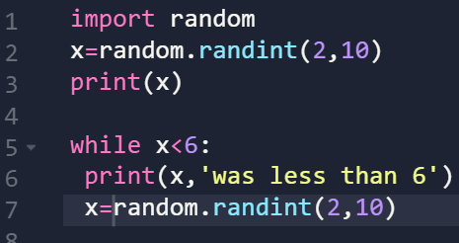
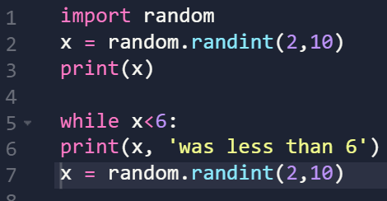
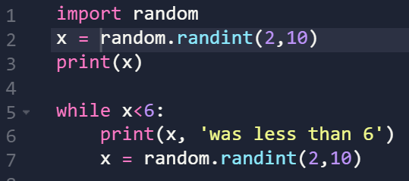
Conditionals, loops, functions - examples
While loop example: correct syntax incorrect syntax
While loop example, correct syntax, better readability

Slide 31
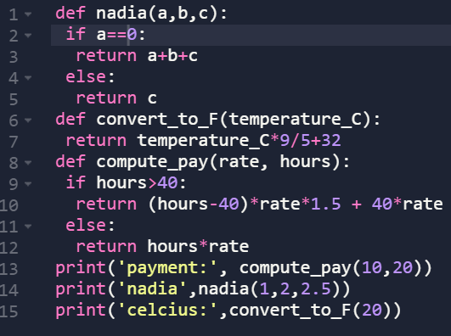
Conditionals, loops, functions - examples
Functions and conditional statements – correct syntax

Slide 32
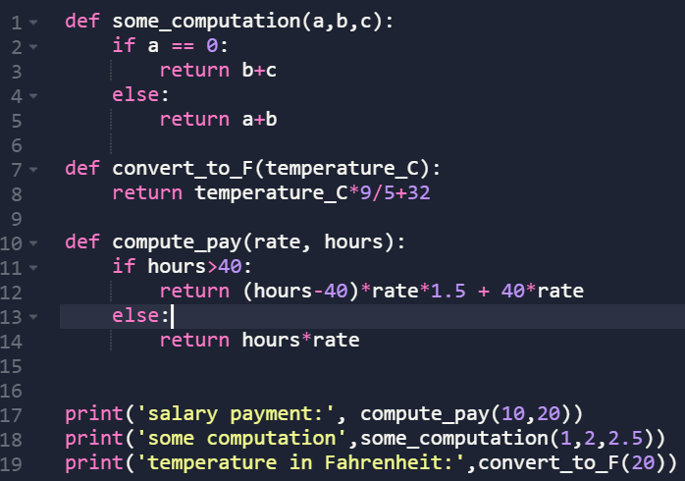
Conditionals, loops, functions - examples
Functions and conditional statements – correct syntax, good style

Slide 33
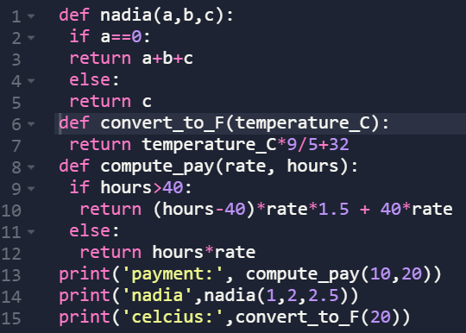
Conditionals, loops, functions - examples
Functions and conditional statements – incorrect syntax

Slide 34
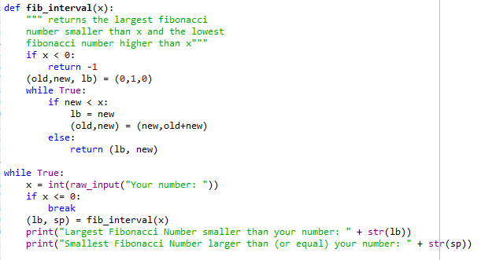
Functions: returning multiple values
Example (returns 2-tuple)
calculating the Fibonacci boundary for a positive number, The first returned element is the Largest Fibonacci Number smaller than x and the second component is the Smallest Fibonacci Number larger than x. The return value is immediately stored via unpacking into the variables lub and sup:
(Fibonacci sequence F is a sequence of integer numbers , n-th number defined recursively as a sum of 2 previous numbers: F(n)=F(n-1)+F(n-2), and where first 2 numbers are 0 and 1 :F(1)=0, F(2)=1))

Slide 35
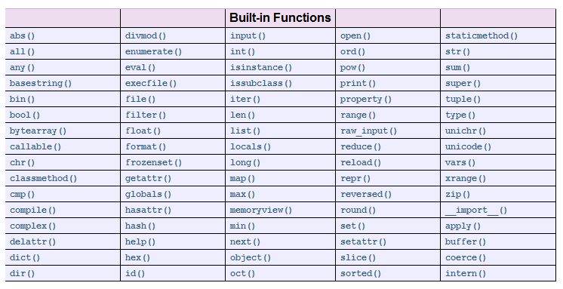
Standard Python built-in functions

Slide 36
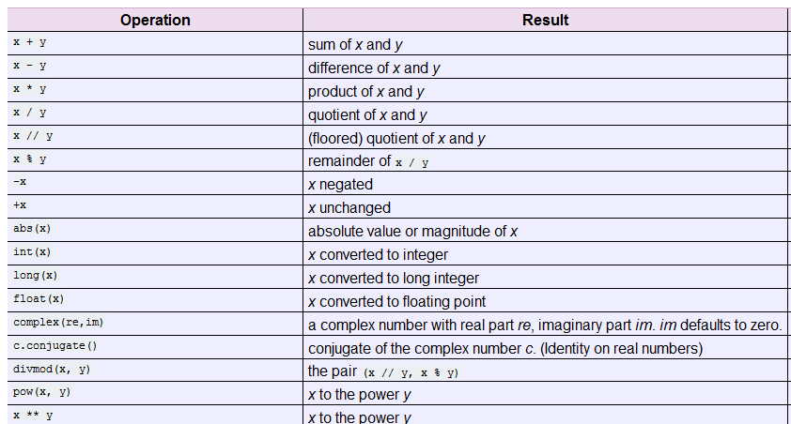
Built-in numeric types support the following operations

Slide 37
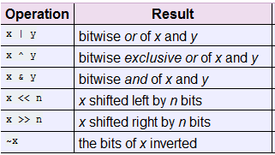
Bitwise Operations on Integer Types

Slide 38
List comprehensions
It is a way to create lists
Example1:Given a list of N numbers, use a single list comprehension to produce a new list that only contains even numbers from among those elements in the original list that have even indices
For example, if list[2] contains a value that is even, that value should be included in the new list, since it is also at an even index in the original list. However, if list[3] contains an even number, that number should not be included in the new list since it is at an odd index in the original list.
[l[x] for x in range(0,8,2) if l[x]%2 == 0]
Another version
[x for x in l[::2] if x%2 == 0]
Example 2:creating Pythagorean triples
trples = [(x,y,z) for x in range(1,30) for y in range(x,30) for z in range(y,30) if x**2 + y**2 == z**2]
print trples
will print
[(3, 4, 5), (5, 12, 13), (6, 8, 10), (7, 24, 25), (8, 15, 17), (9, 12, 15), (10, 24, 26), (12, 16, 20), (15, 20, 25), (20, 21, 29)]

Slide 39
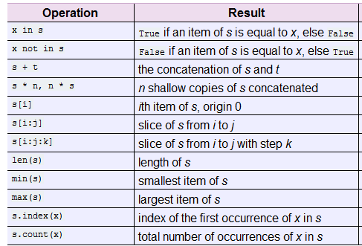
Sequence types
strings, Unicode strings, lists, tuples, bytearrays, buffers, and xrange objects
This following table lists the sequence operations sorted in ascending priority. In the table, s and t are sequences of the same type; n, i and j are integers
Strings and tuples are immutable sequence types: such objects cannot be modified once created.

Slide 40
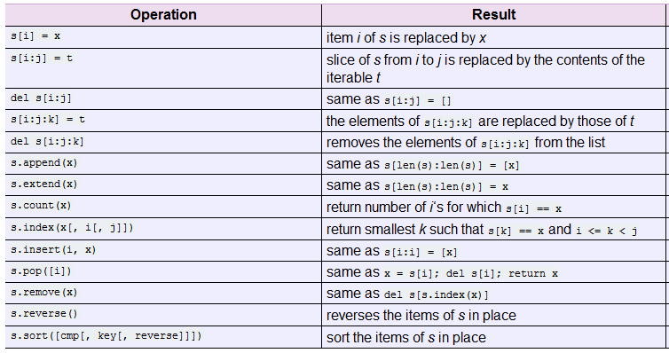
Mutable sequence types
List and bytearray objects support additional operations that allow in-place modification of the object. The following operations are defined on mutable sequence types (where x is an arbitrary object):

Slide 41
Dictionaries
Dictionary is a mapping data type. Dictionaries are mutable. Dictionaries can be contained in lists and vice versa. Lists are ordered sets of objects. Dictionaries are unordered sets of objects. Items in dictionaries are accessed via keys and not via their position (like in lists). A dictionary is an associative array (also known as hashes). Any key of the dictionary is associated (or mapped) to a value. The values of a dictionary can be any Python data type. So dictionaries are unordered key-value-pairs. Only immutable data types can be used as keys. Example of an empty dictionary:
empty = {}
RedFlowers = {“rose" : 1,“poppy" : 1, “narcissus" : 2, “tulip” :1, “carnation” :1, “jasmine”: 2}
RedFlowers[“rose”] returns 1
If you try to access a key which doesn't exist, you will get an error message.
w.clear() returns empty dictionary
Iterate over a dictionary:
for key in d:
print key
Iterate over keys:
for key in d.iterkeys():
print key
Iterate over values:
for val in d.itervalues():
print val
The above is equivalent to:
for key in d:
print d[key]
40

Slide 42
Dictionaries
It's possible to create lists from dictionaries by using the methods items(), keys() and values()
w={"house":“dom","cat":“kot","red":“krasny"}
w.items() will return [ ('house', ‘dom'), ('red', ‘krasny'), ('cat', ‘kot')]
w.keys() will return ['house', 'red', 'cat']
w.values() will return [‘dom', ‘krasny', ‘kot']
Even though this list of 2-tuples has the same information, the efficiency of both approaches is completely different. The dictionary data type provides highly efficient methods to access, delete and change elements of the dictionary, while in the case of lists these functions have to be implemented by the programmer.
Dictionaries from lists
Example:
dishes = ["pizza", "sauerkraut", "paella", "Hamburger"]
countries = ["Italy", "Germany", "Spain", "USA"]
Dictionary in a list form:
country_specialities = zip(countries, dishes)
print country_specialities
Result
[('Italy', 'pizza'), ('Germany', 'sauerkraut'), ('Spain', 'paella'), ('USA', 'Hamburger')]
Real dictionary:
country_specialities_dict = dict(country_specialities)
print country_specialities_dict
Result:
{'Germany': 'sauerkraut', 'Spain': 'paella', 'Italy': 'pizza', 'USA': 'Hamburger'}
In zip(), if one of the two argument lists contains more elements than the other one superfluous elements will not be used.
41

Slide 43
Sets
The data type "set" is a collection type, it contains an unordered collection of unique and immutable objects. Sets unlike lists or tuples can't have multiple occurrences of the same element.
x = set("A Python Tutorial")
print x
Returns
set(['A', ' ', 'i', 'h', 'l', 'o', 'n', 'P', 'r', 'u', 't', 'a', 'y', 'T'])
Only unique values are allowed in sets:
cities = set(("Paris", "Lyon", "London","Berlin","Paris","Birmingham"))
print cities
result:
set(['Paris', 'Birmingham', 'Lyon', 'London', 'Berlin'])
Sets are implemented in a way, which doesn't allow mutable objects. The following example demonstrates, that we cannot include for example lists as elements:
cities = set((["Python","Perl"], ["Paris", "Berlin", "London"]))
Will generate error:
TypeError: unhashable type: 'list‘
Though sets can't contain mutable objects, sets are mutable:.
Frozensets are like sets except, that they cannot be changed, i.e. they are immutable.
cities = frozenset(["Frankfurt", "Basel“, "Freiburg"])
cities.add("Strasbourg")
AttributeError: 'frozenset' object has no attribute 'add'
42

Slide 44
Range
Range type represents an immutable sequence of numbers and is commonly used for looping a specific number of times in for loops.
class range(stop)
class range(start, stop[, step])
The advantage of the range type over a regular list or tuple is that a range object will always take the same (small) amount of memory, no matter the size of the range it represents (as it only stores the start, stop and step values, calculating individual items and subranges as needed).
Examples
list(range(10))
[0, 1, 2, 3, 4, 5, 6, 7, 8, 9]
list(range(1, 11))
[1, 2, 3, 4, 5, 6, 7, 8, 9, 10]
list(range(0, 30, 5))
[0, 5, 10, 15, 20, 25]
list(range(0, 10, 3))
[0, 3, 6, 9]
list(range(0, -10, -1))
[0, -1, -2, -3, -4, -5, -6, -7, -8, -9]
list(range(0))
[]
list(range(1, 0))
[]
43

Slide 45

Recursive functions
Function is recursive if it calls itself.
Example: computing factorial
n! = n * (n-1)! for n > 0 (n – integer)
0!=1
For n>1 we can write nonrecursive form n! = n * (n-1)*...*1
Numerical example:
4! = 4 * 3! 3! = 3 * 2! 2! = 2 * 1
or
4! = 4 * 3 * 2 * 1
Implementation in Python. Let’s assume that it computes that n>1. Next exercise would be to handle n=0.
Individual project on recursion
http://openbookproject.net/thinkcs/python/english3e/recursion.html
44

Slide 46
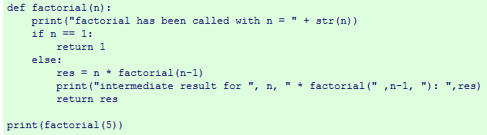
Recursive functions
Adding print statements :
Output:
factorial has been called with n = 5
factorial has been called with n = 4
factorial has been called with n = 3
factorial has been called with n = 2
factorial has been called with n = 1
intermediate result for 2 * factorial( 1 ): 2
intermediate result for 3 * factorial( 2 ): 6
intermediate result for 4 * factorial( 3 ): 24
intermediate result for 5 * factorial( 4 ): 120
45

Slide 47

Recursive functions
Iterative version:
print iterative_factorial(5)
46

Slide 48
Example: Walking through all directories on your computer
os module – provides functions for working with files and directories
#returns the name of the current directory
import os
cwd = os.getcwd()
print(cwd)
#Compute number of files in the folder
#Print a file’s full name and size.
#the string “.” represents the current directory
count = 0
for dirname, dirs.,files in os.walk(“.”):
for filesname in files:
if filename.endswith(‘.txt’):
thefile = os.path.join(dirname,filename)
print(thefile)
count = count + 1
print(count)
47

Slide 49
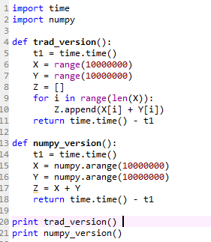
More on NumPy and SciPy
If you already have Python and NumPy installed, you can install (or reinstall) Scipy from here:
http://sourceforge.net/projects/scipy/files/scipy/
NumPy is an open source extension module for Python. The module NumPy provides fast precompiled functions for numerical routines. It adds support to Python for large, multi-dimensional arrays and matrices. Besides that it supplies a large library of high-level mathematical functions to operate on these arrays.
One of the main advantages of NumPy is its advantage in time compared to standard Python.
Result
6.10699987411
0.1890001297

Slide 50
Arrays in NumPy
Arrays constitute the central component of the module NumPy. The main difference from standard Python lists is that the elements of a NumPy array have to be of the same type, usually float or int. NumPy arrays are by far more efficient than lists of Python.The number of elements have to be known a priori, i.e. when the array is created. It can't be changed afterwards. Arrays of NumPy are of any dimension. A NumPy Array can be generated from a list or a tuple with the array-method, as shown in the following example:
import numpy as np
x = np.array([42,47,11], int)
print x
Result :
([42, 47, 11])
The array method transforms sequences of sequences into two dimensional arrays:
x = np.array( ((11,12,13), (21,22,23), (31,32,33)) )
print x
Result:
[[11 12 13] [21 22 23] [31 32 33]]
Correspondingly, it converts sequences of sequences of sequences into three dimensional arrays:
x = np.array( ( ((111,112), (121,122) ), ((211,212),(221,222)) ) )
print x
[[[111 112] [121 122]] [[211 212] [221 222]]]
print x[1][0][1]
212
print x[1][1][1]
222

Slide 51
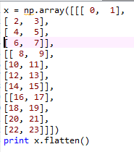
Arrays in NumPy
The attribute ndim gives number of dimensions of an array:
x = np.array( ((11,12,13), (21,22,23) ))
print x.ndim
2
The method shape() gives the length of each dimension:
x = np.array( ((7,3,0), (7,11,9), (15,3,7),(12,4,8) ))
print x.ndim
2
print x.shape
(4, 3)
Reshaping arrays with flatten() and ravel()
returns

Slide 52
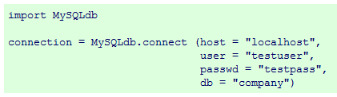
Connection to Database: SQLite
SQLite is a part of core Python. If Python is installed, then SQLite is also installed.
SQLite is a simple relational data base system, which saves its data in regular data files or even in the internal memory of the computer, i.e. the RAM. It was developed for embedded applications, like Mozilla-Firefox (Bookmarks), Symbian OS or Android. SQLITE is fast, even though it uses a simple file. It can be used for large data bases as well. If you want to use SQLite, you have to import the module sqlite3. To use a database, you have to create first a Connection object. The connection object will represent the database. The argument of connection - in the following example "companysdb" - functions both as the name of the file, where the data will be stored, and as the name of the database. If a file with this name exists, it will be opened.
This is how python connects to DB:
import MySQLdb module
Open a connection to the SQL server
Sending and receiving commands
Closing the connection to SQL

Slide 53
Pandas
- built on top of Numpy, used for data manipulation and analysis.
- provides special data structures, Series and DataFrame, and operations for the manipulation of numerical tables and time series.
Series
A Series is a one-dimensional array-like object containing an array of data, which can be any NumPy data type, and an associated array of data labels, functioning as its index.
A simple example:
import pandas as pd
S = pd.Series([11, 28, 72, 3, 5, 8])
print(S)
two columns are returned: the indices on the left side and the values on the right side. Pandas uses a default indexing starting with 0 going to 5, which is the length of the data minus 1.
print(S.index)
print(S.values)
Output
Int64Index([0, 1, 2, 3, 4, 5], dtype='int64')
[11 28 72 3 5 8]
52

Slide 54
Pandas
Compare to creating an array in numpy:
import numpy as np
X = np.array([11, 28, 72, 3, 5, 8])
print(X)
print(S.values)
print(list(S.values) == list(X) )
Output: [11 28 72 3 5 8]
[11 28 72 3 5 8]
True
53

Slide 55
Pandas
DataFrame: the underlying idea - spreadsheets
contains an ordered collection of columns
each column consists of a unique data type, but different columns can have different types, e.g. the first column may consist of integers, while the second one consists of boolean values and so on.
has a row and column index; it's like a dict of Series with a common index.
cities = {"name“ : ["London", "Berlin", "Madrid", "Rome", "Paris", "Vienna", "Bucharest",
"Hamburg", "Budapest", "Warsaw", "Barcelona", "Munich", "Milan"],
"population": [8615246, 3562166, 3165235, 2874038, 2273305, 1805681, 1803425,
1760433, 1754000, 1740119, 1602386, 1493900, 1350680],
"country“ : ["England", "Germany", "Spain", "Italy", "France", "Austria", "Romania",
"Germany", "Hungary", "Poland", "Spain", "Germany", "Italy"]}
city_frame = pd.DataFrame(cities)
print(city_frame)
54

Slide 56
Pandas
- index (0,1,2, ...) has been automatically assigned to the DataFrame.
- can also assign a custom index to the DataFrame object:
ordinals = ["first", "second", "third", "fourth", "fifth", "sixth", "seventh", "eigth", "ninth", "tenth", "eleventh", "twelvth", "thirteenth"]
city_frame = pd.DataFrame(cities, index=ordinals)
print(city_frame)
- define or rearrange the order of the columns.
city_frame = pd.DataFrame(cities, columns=["name",
"country",
"population"],
index=ordinals)
print(city_frame)
- calculate the sum of all the columns of a DataFrame or the sum of certain columns:
city_frame.sum()
55

Slide 57
Pandas
Calculate the sum of all the columns of a DataFrame or the sum of certain columns:
print(city_frame.sum() )
print(city_frame["population"].sum())
Calculate cumulative sum:
x = city_frame["population"].cumsum()
x is a Pandas Series. We can reassign it to the population column:
city_frame["population"] = x
print(city_frame)
Include a column name which is not contained in the dictionary. In this case, all the values of this column will be set to NaN:
city_frame = pd.DataFrame(cities, columns=["name", "country", "area", "population"],
index=ordinals)
56

Slide 58
Pandas
There are two ways to access a column of a DataFrame. The result is in both cases a Series:
# in a dictionary-like way:
print(city_frame["population"])
# as an attribute
print(city_frame.population)
print(type(city_frame.population))
p = city_frame.population
p["first"] = 9000000
print(city_frame)
"p" is a view on the data of city_frame.
To access the rows directly,
city_frame.ix['fourth']
57

Slide 59
Pandas
To set all elements of the column to the same value:
city_frame["area"] = 1572
print(city_frame)
To assign the exact area to the cities,
# area in square km:
area = [1572, 891.85, 605.77, 1285, 105.4, 414.6, 228, 755, 525.2, 517, 101.9, 310.4, 181.8]
city_frame["area"] = area
print(city_frame)
- list with area values needs to have the same length as the number of rows in our DataFrame.
To sort DataFrame according to the city area:
city_frame = city_frame.sort(columns="area", ascending=False)
Let's assume, we have only the areas of London, Hamburg and Milan.
The areas are in a series with the correct indices. We can assign this series as well:
city_frame = pd.DataFrame(cities, columns=["name", "country", "area", "population"],
index=ordinals)
some_areas = pd.Series([1572, 755, 181.8],
index=['first', 'eigth', 'thirteenth'])
city_frame['area'] = some_areas
58

Slide 60
Pandas
A nested dictionary of dicts can be passed to a DataFrame as well. The indices of the outer dictionary are taken as the
columns and the inner keys. i.e. the keys of the nested dictionaries are used as the row indices:
growth = {"Switzerland": {"2010": 3.0, "2011": 1.8, "2012": 1.1, "2013": 1.9}, "Germany": {"2010": 4.1, "2011": 3.6, "2012": 0.4, "2013": 0.1}, "France": {"2010":2.0, "2011":2.1, "2012": 0.3, "2013": 0.3}, "Greece": {"2010":-5.4, "2011":-8.9, "2012":-6.6, "2013": -3.3}, "Italy": {"2010":1.7, "2011": 0.6, "2012":-2.3, "2013":-1.9} }
growth_frame = pd.DataFrame(growth)
Transpose the data:
growth_frame.T
To reindex:
growth_frame = pd.DataFrame(growth)
growth_frame.reindex(["2013", "2012", "2011", "2010"])
Filling a DataFrame with random values:
df = pd.DataFrame(np.random.randn(10, 5), columns=['a', 'b', 'c', 'd', 'e’])
To read in a csv file with the population data of all countries (July 2014).
pop = pd.read_csv("countries_population.csv", quotechar="'", sep=" ", thousands=",")
59

Slide 61
Testing
Tutorial on testing:
https://realpython.com/python-testing/#testing-your-code
60

Slide 62
Application Examples
61

Slide 63

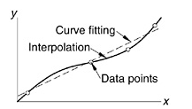
Interpolation and curve fitting
Discrete data sets, or tables of the form
are commonly involved in technical calculations ( so called black box functions)
Data source : experimental observations or numerical computations.
interpolation vs curve fitting:
interpolation: construct a curve through the data points (implicitly assume that the data points are accurate and distinct)
curve fitting : apply to data that contain scatter (noise), usually due to measurement errors (find a smooth curve that approximates the data in some sense, thus the curve does not necessarily hit the data points.)
For example, curve fitting is an essential tool in predictive modeling, used in trading (prediction of future price of stock), marketing, engineering, etc.

Slide 64
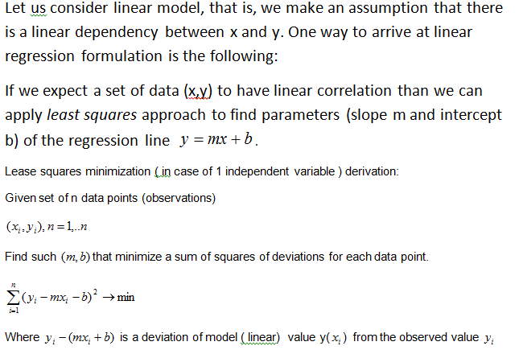
linear regression

Slide 65
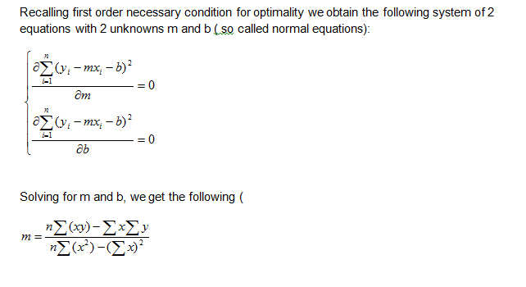
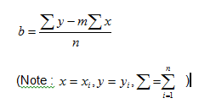
linear regression

Slide 66
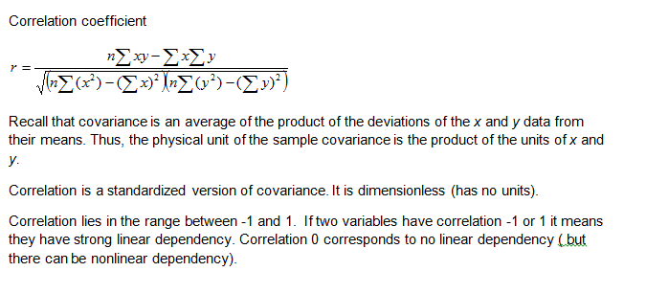
linear regression

Slide 67
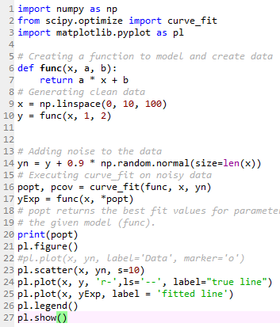
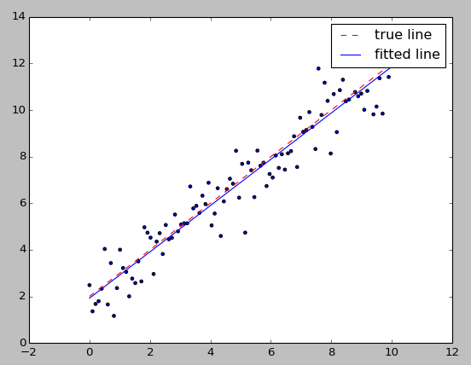
Linear regression
When we model data as a linear function, it is called “linear regression.”

Slide 68
Linear regression
Modifications:
Change the number of input data points.
Increase the noise in the data
Print axes names

Slide 69
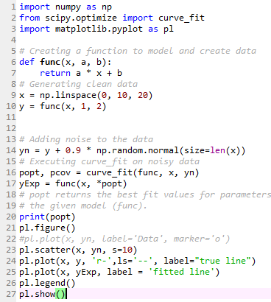
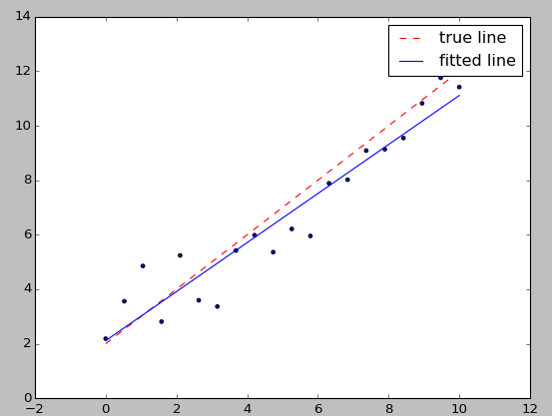
Linear regression
Compare with this version (20 data points).

Slide 70

Simulating data
Consider this line:
This is a simulation of normally distributed random vector with mean 0 and variance 0.9 around the given line.
The function random.normal() returns a standard normal variable (with mean 0 and standard deviation 1).

Slide 71
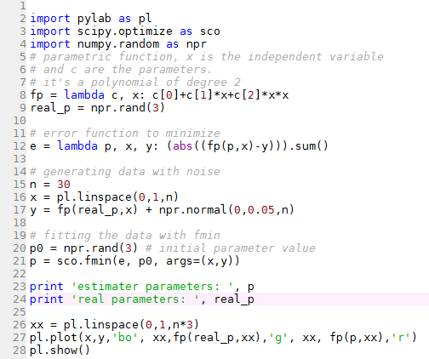
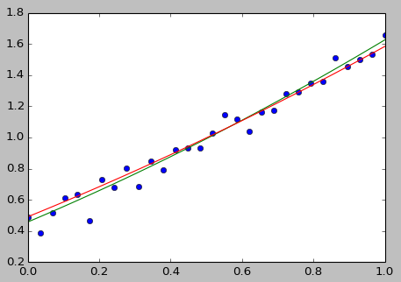
Linear regression with lambda function

Slide 72
Curve fitting models: questions
Questions:
When we perform multiple linear regression, we usually are interested in
answering a few important questions.
1. Is at least one of the predictors X1,X2, . . . , Xp useful in predicting
the response?
2. Do all the predictors help to explain Y , or is only a subset of the
predictors useful?
3. How well does the model fit the data?
4. Given a set of predictor values, what response value should we predict,
and how accurate is our prediction?
When we fit a linear regression model to a particular data set, many problems
may occur. Most common among these are the following:
1. Non-linearity of the response-predictor relationships.
2. Correlation of error terms.
3. Non-constant variance of error terms.
4. Outliers.
5. High-leverage points.
6. Collinearity.

Slide 73
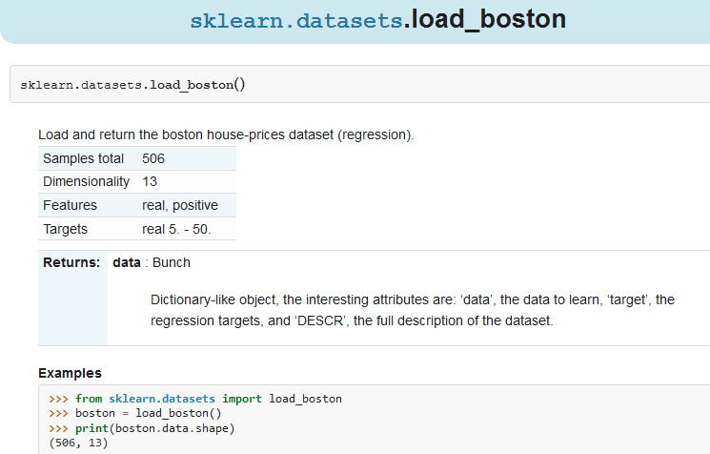
Scikit-learn: datasets
http://scikit-learn.org/stable/datasets/

Slide 74
Scikit-learn: Regression on Housing data
Here you’ll learn:
How to instantiate a scikit-learn regression model
How to train a regressor by calling the fit(...) method
How to predict new labels by calling the predict(...) method
To solve a sample regression problem: learning a continuous value from a set of features.
To use the simple Boston house prices set, available in scikit-learn. This records measurements of 13 attributes of housing markets around Boston, as well as the median price. The question is: can you predict the price of a new market, given its attributes?

Slide 75
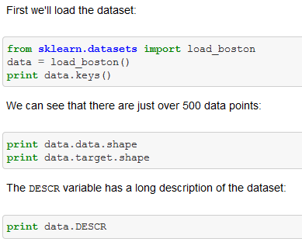
Scikit-learn: Regression on Housing data

Slide 76
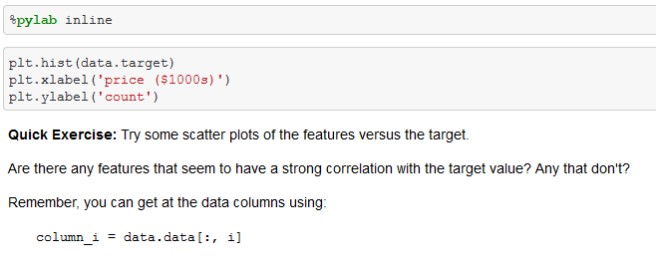
Scikit-learn: Regression on Housing data
It often helps to quickly visualize pieces of the data using histograms, scatter plots, or other plot types. Here we'll load pylab and show a histogram of the target values: the median price in each neighborhood.
This is a manual version of a technique called feature selection.
Sometimes, in Machine Learning, it is helpful to use feature selection to decide which features are most useful for a particular problem. Automated methods exist which quantify this sort of exercise of choosing the most informative features.

Slide 77
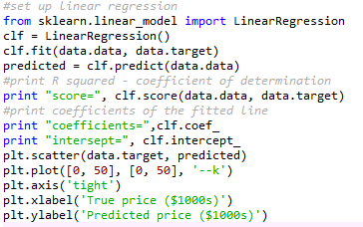
Scikit-learn: Regression on Housing data
Predicting Home Prices: a Simple Linear Regression
http://scikit-learn.org/stable/modules/generated/sklearn.linear_model.LinearRegression.html
Now we'll use scikit-learn to perform a simple linear regression on the housing data. There are many possibilities of regressors to use. A particularly simple one is LinearRegression: this is basically a wrapper around an ordinary least squares calculation.
We'll set it up like this:
The prediction at least correlates with the true price, though there are clearly some biases. We could imagine evaluating the performance of the regressor by, say, computing the RMS residuals between the true and predicted price
More examples of regression-type problems in machine learning
Sales: given consumer data, predict how much they will spend
Advertising: given information about a user, predict the click-through rate for a web ad.
Collaborative Filtering: given a collection of user-ratings for movies, predict preferences for other movies & users
Astronomy: given observations of galaxies, predict their mass or redshift

Slide 78
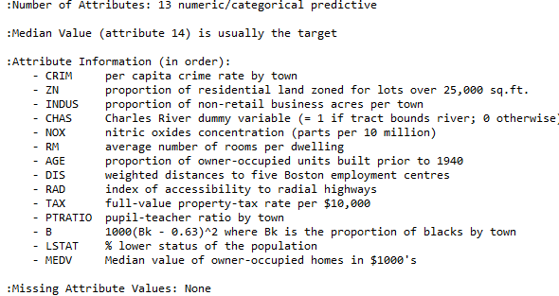
Scikit-learn: Regression on Housing data
Output from
print data.DESCR

Slide 79
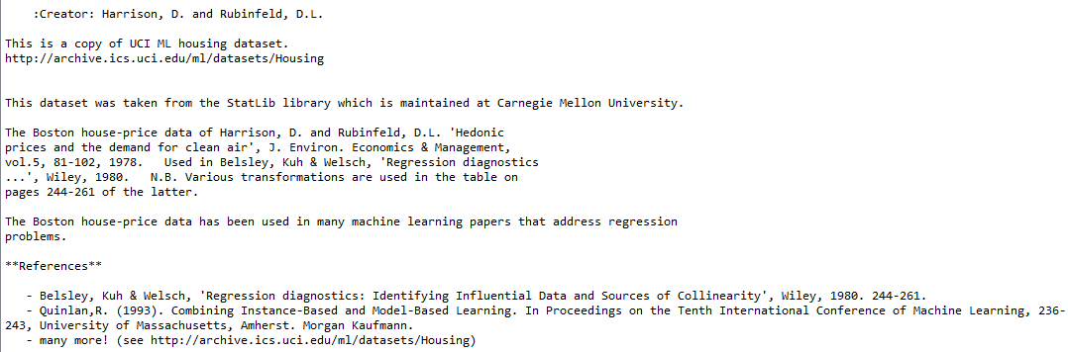
Scikit-learn: Regression on Housing data
Output from
print data.DESCR (cont.)

Slide 80

Scikit-learn: Regression on Housing data
Output from
print “score=”, clf.score
Output from
Print “coefficients=“, clf.coef_ :
Output from
Print “intercept=“,clf.intercept_

Slide 81
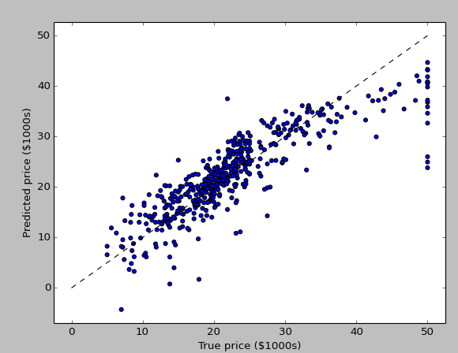
Scikit-learn: Regression on Housing data
graph output

