Slide 1
Python for Machine Learning (ML)
Nadia Udler
Lecture 3
Spring 2023

Slide 2
Applications of ML
In this lecture..
Conditional probabilities
Bayes Theorem
Naïve Bayes Classification
Maximum Likelihood estimation
Gaussian Mixture Model
Bayesian Gaussian Mixture Model
Expectation maximization algorithm
Evaluating the model performance

Slide 3
Mathematics of ML : Definitions
Two events E and F are independent, if both E and F have positive probability and if
P(E|F) = P(E) and P(F|E) = P(F)
P(A|B) - conditional probability of A given B, or "the probability of A under the condition B",
i.e. the probability of some event A under the assumption that the event B took place.
When in a random experiment the event B is known to have occurred, the possible outcomes of the experiment are reduced to B, and hence the probability of the occurrence of A is changed from the unconditional probability into the conditional probability given B.
The Joint probability is the probability of two events in conjunction. That is, it is the probability of both events together. There are three notations for the joint probability of A and B. It can be written as
P(A∩B)
P(AB) or
P(A,B)
The conditional probability is defined by P(A|B)=P(A∩B) / P(B)
=
i

Slide 4
Mathematics of ML : Example
There are about 8.4 million people living in Switzerland. About 64 % of them speak German. There are about 7500 million people on earth.
If some aliens randomly beam up an earthling,
what are the chances that he is a German speaking Swiss?
We have the events S: being Swiss, GS: German Speaking, The probability for a randomly chosen person to be Swiss:
P(S) = 8.4 / 7500 = 0.00112
If we know that somebody is Swiss, the probability of speaking German is 0.64.
This corresponds to the conditional probability P(GS|S) = 0.64
Probability of the earthling being Swiss and speaking German can be calculated by the formula P(GS|S) = P(GS∩S) / P(S)
Inserting the values from above: 0.64 = P(GS∩S) / 0.00112 and P(GS∩S) = 0.0007168
So the aliens end up with a chance of 0.07168 % of getting a German speaking Swiss person.
=
i

Slide 5
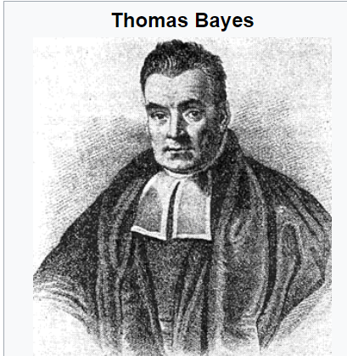
Mathematics of ML : Bayes Theorem
P (GS|S) - conditional probability that a person speaks German, if he or she is known to be Swiss.
joint probability of person to be Swiss and speak German is computed from this equation:
P (GS|S) = P (GS, S) / P(S)
P (S|GS) - probability that somebody is Swiss under the assumption that the person speaks German
The equation looks like this:
P (S|GS) = P(GS,S) / P(GS)
Let's isolate on both equations P (GS,S):
P (GS,S) = P(S|GS)P(GS)
P (GS,S) = P(GS|S)P(S)
This equation can be transformed into Bayes’ Theorem:
P(S|GS) = P(GS|S)P(S) / P(GS)
Good reading ob Baesian statistics! :
Probabilistic-Programming-and-Bayesian-Methods-for-Hackers/Ch1_Introduction_PyMC_current.ipynb at master · CamDavidsonPilon/Probabilistic-Programming-and-Bayesian-Methods-for-Hackers (github.com)
1701 – 1761, England
=
i

Slide 6
Mathematics of ML: Bayes Theorem
from our previous exercise :P(GS|S) = 0.64 and P(S) = 0.00112
The number of German native speakers in the world corresponds to 101 million, so P(GS) = 101 / 7500 = 0.0134667
P(S|GS) is computed by substituting the values in Bayes Formula equation:
P(S|GS) = P(GS|S)P(S) / P(GS) = 0.64∗ 0.00112 / 0.0134667 = 0.0532276

Slide 7
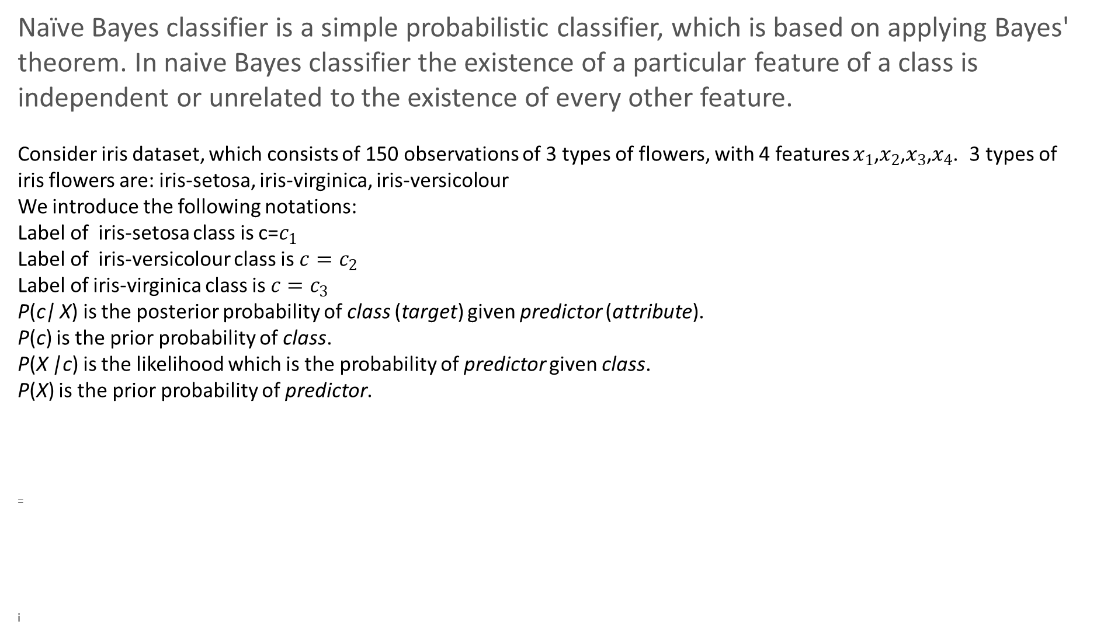
Mathematics of ML : Naïve Bayes Classifier
Naïve Bayes classifier is a simple probabilistic classifier, which is based on applying Bayes' theorem. In naive Bayes classifier the existence of a particular feature of a class is independent or unrelated to the existence of every other feature.
Consider iris dataset, which consists of 150 observations of 3 types of flowers, with 4 features $x_{1}$,$x_{2}$,$x_{3}$,$x_{4}$. 3 types of iris flowers are: iris-setosa, iris-virginica, iris-versicolour
We introduce the following notations:
Label of iris-setosa class is c=$c_{1}$
Label of iris-versicolour class is $c=c_{2}$
Label of iris-virginica class is ${c=c}_{3}$
P(c| X) is the posterior probability of class (target) given predictor (attribute).
P(c) is the prior probability of class.
P(X |c) is the likelihood which is the probability of predictor given class.
P(X) is the prior probability of predictor.
=
i

Slide 8
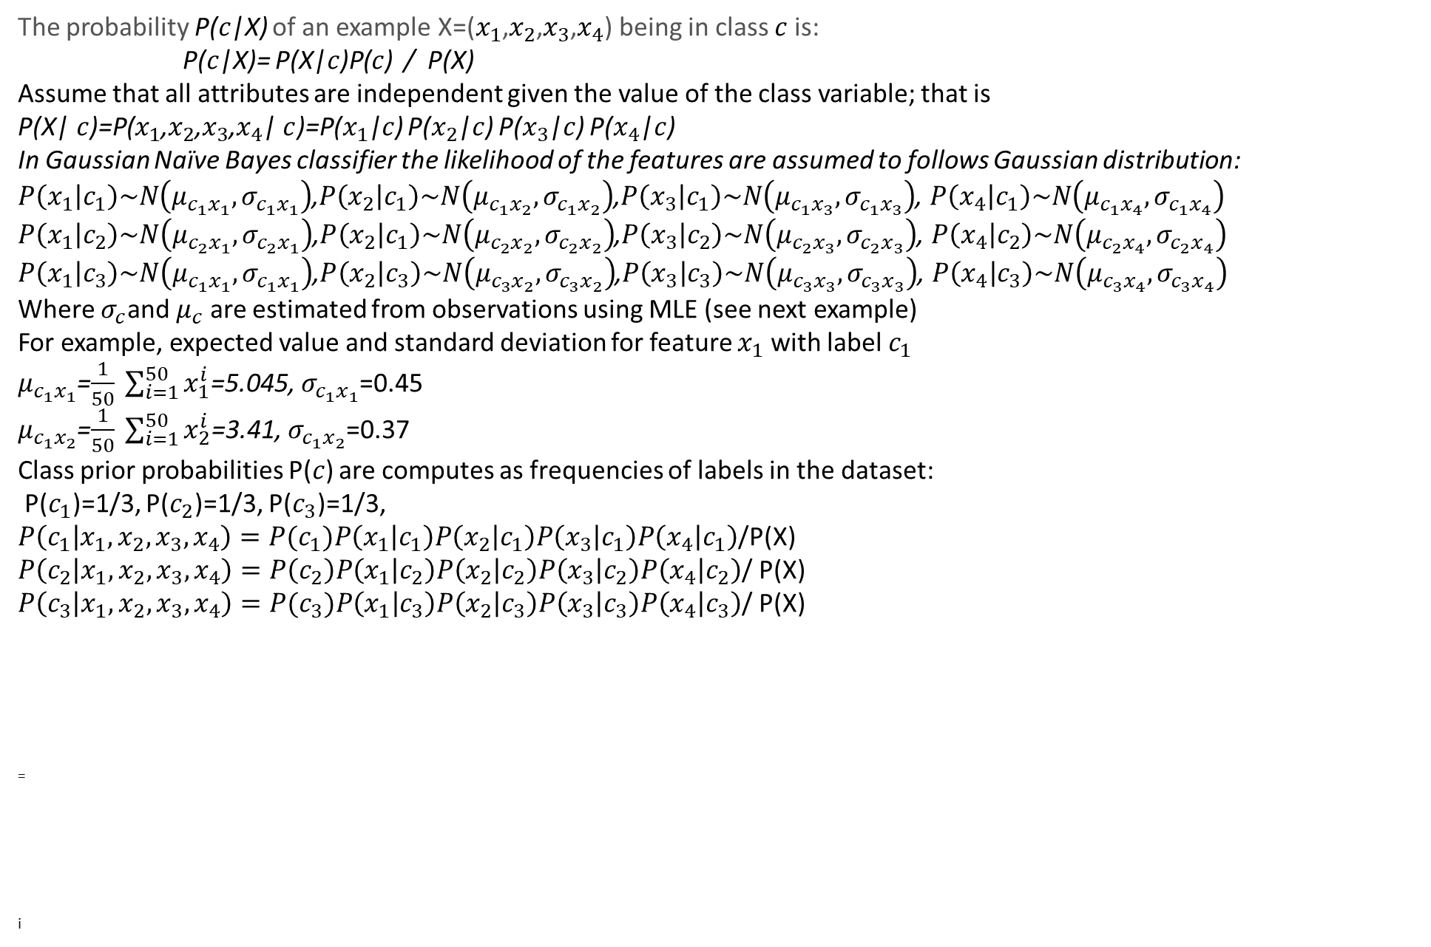
Mathematics of ML : Naïve Bayes Classifier
The probability P($c$|X) of an example X=($x_{1}$,$x_{2}$,$x_{3}$,$x_{4}$) being in class $c$ is:
P($c$|X)= P(X|$c$)P($c$) / P(X)
Assume that all attributes are independent given the value of the class variable; that is
P(X|$c$)=P($x_{1}$,$x_{2}$,$x_{3}$,$x_{4}$|$c$)=P($x_{1}$|$c$) P($x_{2}$|$c$) P($x_{3}$|$c$) P($x_{4}$|$c$)
In Gaussian Naïve Bayes classifier the likelihood of the features are assumed to follows Gaussian distribution:
$P\left(x_{1} | c_{1}\right)\sim N\left(μ_{c_{1}x_{1}},σ_{c_{1}x_{1}}\right)$,$P\left(x_{2} | c_{1}\right)\sim N\left(μ_{c_{1}x_{2}},σ_{c_{1}x_{2}}\right)$,$P\left(x_{3} | c_{1}\right)\sim N\left(μ_{c_{1}x_{3}},σ_{c_{1}x_{3}}\right)$, $P\left(x_{4} | c_{1}\right)\sim N\left(μ_{c_{1}x_{4}},σ_{c_{1}x_{4}}\right)$
$P\left(x_{1} | c_{2}\right)\sim N\left(μ_{c_{2}x_{1}},σ_{c_{2}x_{1}}\right)$,$P\left(x_{2} | c_{1}\right)\sim N\left(μ_{c_{2}x_{2}},σ_{c_{2}x_{2}}\right)$,$P\left(x_{3} | c_{2}\right)\sim N\left(μ_{c_{2}x_{3}},σ_{c_{2}x_{3}}\right)$, $P\left(x_{4} | c_{2}\right)\sim N\left(μ_{c_{2}x_{4}},σ_{c_{2}x_{4}}\right)$
$P\left(x_{1} | c_{3}\right)\sim N\left(μ_{c_{1}x_{1}},σ_{c_{1}x_{1}}\right)$,$P\left(x_{2} | c_{3}\right)\sim N\left(μ_{c_{3}x_{2}},σ_{c_{3}x_{2}}\right)$,$P\left(x_{3} | c_{3}\right)\sim N\left(μ_{c_{3}x_{3}},σ_{c_{3}x_{3}}\right)$, $P\left(x_{4} | c_{3}\right)\sim N\left(μ_{c_{3}x_{4}},σ_{c_{3}x_{4}}\right)$
Where $σ_{c}$and $μ_{c}$ are estimated from observations using MLE (see next example)
For example, expected value and standard deviation for feature $x_{1}$ with label $c_{1}$
$μ_{c_{1}x_{1}}$=$\frac{1}{50} \sum_{i=1}^{50}{x_{1}^{i}}$=5.045, $σ_{c_{1}x_{1}}$=0.45
$μ_{c_{1}x_{2}}$=$\frac{1}{50} \sum_{i=1}^{50}{x_{2}^{i}}$=3.41, $σ_{c_{1}x_{2}}$=0.37
Class prior probabilities P($c$) are computes as frequencies of labels in the dataset:
P($c_{1}$)=1/3, P($c_{2}$)=1/3, P($c_{3}$)=1/3,
$P\left(c_{1} | x_{1},x_{2},x_{3},x_{4}\right)=P(c_{1})P\left(x_{1} | c_{1}\right)P\left(x_{2} | c_{1}\right)P\left(x_{3} | c_{1}\right)P\left(x_{4} | c_{1}\right)$/P(X)
$P\left(c_{2} | x_{1},x_{2},x_{3},x_{4}\right)=P\left(c_{2}\right)P\left(x_{1} | c_{2}\right)P\left(x_{2} | c_{2}\right)P\left(x_{3} | c_{2}\right)P\left(x_{4} | c_{2}\right)$/ P(X)
$P\left(c_{3} | x_{1},x_{2},x_{3},x_{4}\right)=P(c_{3})P\left(x_{1} | c_{3}\right)P\left(x_{2} | c_{3}\right)P\left(x_{3} | c_{3}\right)P\left(x_{4} | c_{3}\right)$/ P(X)
=
i

Slide 9
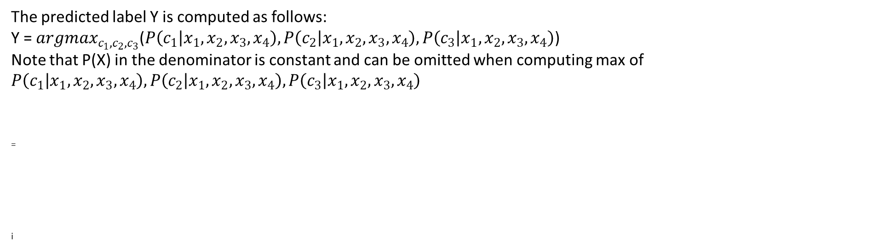
Mathematics of ML : Naïve Bayes Classifier
The predicted label Y is computed as follows:
Y = ${argmax}_{c_{1},c_{2},c_{3}}$($P\left(c_{1} | x_{1},x_{2},x_{3},x_{4}\right),P\left(c_{2} | x_{1},x_{2},x_{3},x_{4}\right),P\left(c_{3} | x_{1},x_{2},x_{3},x_{4}\right)$)
Note that P(X) in the denominator is constant and can be omitted when computing max of $P\left(c_{1} | x_{1},x_{2},x_{3},x_{4}\right), P\left(c_{2} | x_{1},x_{2},x_{3},x_{4}\right), P\left(c_{3} | x_{1},x_{2},x_{3},x_{4}\right)$
=
i

Slide 10
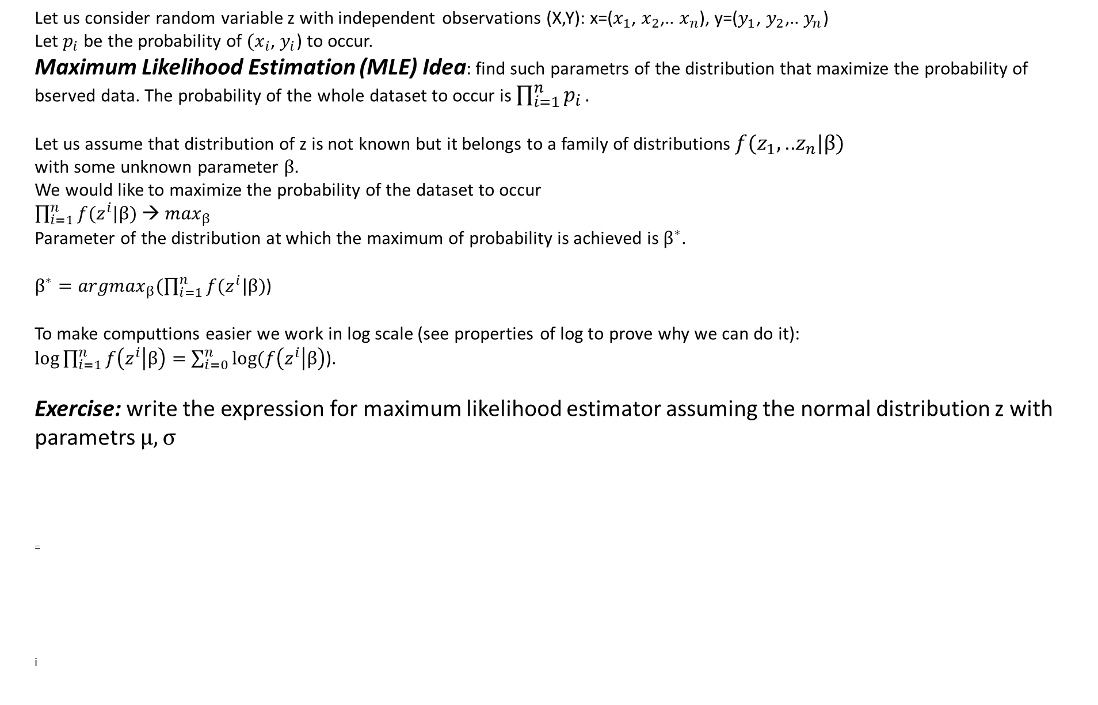
Mathematics of ML: Maximum Likelihood Estimation
Let us consider random variable z with independent observations (X,Y): x=($x_{1}$, $x_{2}$,.. $x_{n}$), y=($y_{1}$, $y_{2}$,.. $y_{n}$)
Let $p_{i}$ be the probability of ${(x}_{i}$, $y_{i}$) to occur.
Maximum Likelihood Estimation (MLE) Idea: find such parametrs of the distribution that maximize the probability of bserved data. The probability of the whole dataset to occur is $\prod_{i=1}^{n}{p_{i}}.$
Let us assume that distribution of z is not known but it belongs to a family of distributions $f(z_{1},\text{..}z_{n}|β)$
with some unknown parameter $β.$
We would like to maximize the probability of the dataset to occur
$\prod_{i=1}^{n}{f(z^{i}|β)}$ → $\max_{β}$
Parameter of the distribution at which the maximum of probability is achieved is $β^{∗}$.
$β^{∗}={argmax}_{β}(\prod_{i=1}^{n}{f(z^{i}|β)}$)
To make computtions easier we work in log scale (see properties of log to prove why we can do it):
$log⁡\prod_{i=1}^{n}{f\left(z^{i} | β\right)=}$ $\sum_{i=0}^{n}{log⁡(f\left(z^{i} | β\right)}$).
Exercise: write the expression for maximum likelihood estimator assuming the normal distribution z with parametrs $μ, σ$
=
i

Slide 11
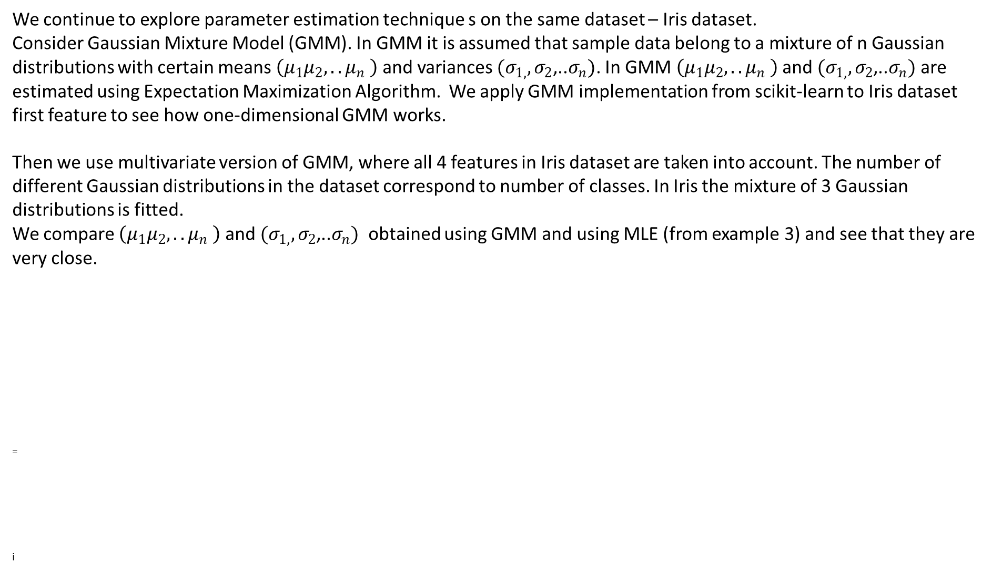
Mathematics of ML : Gaussian Mixture Models
We continue to explore parameter estimation technique s on the same dataset – Iris dataset.
Consider Gaussian Mixture Model (GMM). In GMM it is assumed that sample data belong to a mixture of n Gaussian distributions with certain means $\left(μ_{1}μ_{2},..μ_{n} \right)$and variances ${(σ}_{1,},σ_{2}$,..$σ_{n})$. In GMM $\left(μ_{1}μ_{2},..μ_{n} \right)$ and ${(σ}_{1,},σ_{2}$,..$σ_{n})$ are estimated using Expectation Maximization Algorithm. We apply GMM implementation from scikit-learn to Iris dataset first feature to see how one-dimensional GMM works.
Then we use multivariate version of GMM, where all 4 features in Iris dataset are taken into account. The number of different Gaussian distributions in the dataset correspond to number of classes. In Iris the mixture of 3 Gaussian distributions is fitted.
We compare $\left(μ_{1}μ_{2},..μ_{n} \right)$ and ${(σ}_{1,},σ_{2}$,..$σ_{n})$ obtained using GMM and using MLE (from example 3) and see that they are very close.
=
i

Slide 12
Mathematics of ML : Bayesian Gaussian Mixture Models
Bayesian Gaussian Mixture is another mixture model that assumes that data belong to a mixture of Gaussian Distributions and uses Bayesian inference to fit the model. We apply BGMM from scikit-learn to compare the results to GMM and EML.
See scikit-learn documentation for further details on GMM [2] and BGMM [3] implementation
References
https://scikit-learn.org/stable/modules/naive_bayes.html
[2]https://scikit-learn.org/stable/modules/generated/sklearn.mixture.GaussianMixture.html#sklearn.mixture.GaussianMixture
[3]https://scikit-learn.org/stable/modules/generated/sklearn.mixture.BayesianGaussianMixture.html#sklearn.mixture.BayesianGaussianMixture
i

Slide 13
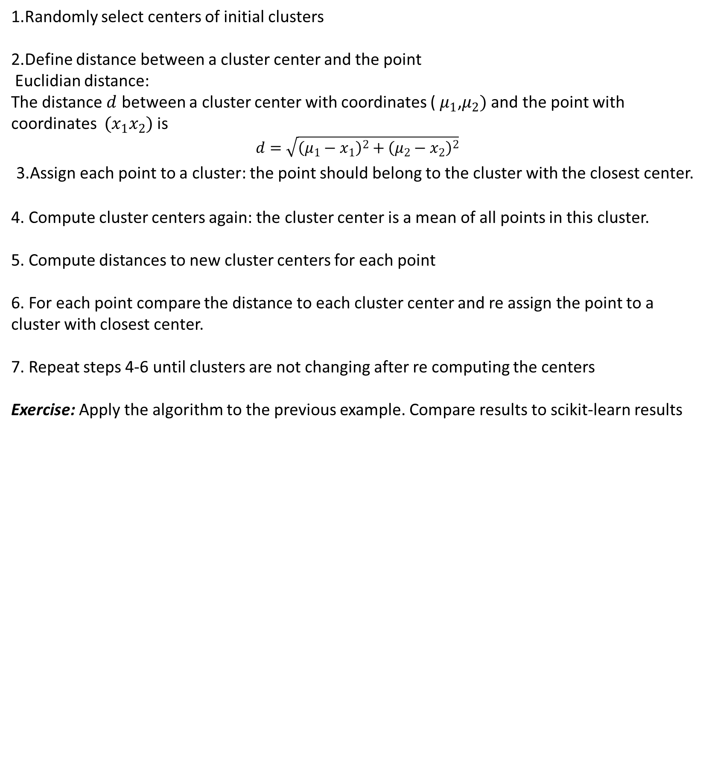
Variant of EM algorithm
1.Randomly select centers of initial clusters
2.Define distance between a cluster center and the point
Euclidian distance:
The distance $d$ between a cluster center with coordinates ( $μ_{1}$,$μ_{2})$and the point with coordinates $(x_{1}x_{2})$ is
$$d=\sqrt{{\left(μ_{1}−x_{1}\right)}^{2}+{\left(μ_{2}−x_{2}\right)}^{2}}$$
3.Assign each point to a cluster: the point should belong to the cluster with the closest center.
4. Compute cluster centers again: the cluster center is a mean of all points in this cluster.
5. Compute distances to new cluster centers for each point
6. For each point compare the distance to each cluster center and re assign the point to a cluster with closest center.
7. Repeat steps 4-6 until clusters are not changing after re computing the centers
Exercise: Apply the algorithm to the previous example. Compare results to scikit-learn results

Slide 14
Evaluating Estimator Performance
Learning the parameters of a prediction function and testing it on the same data is a methodological mistake: a model that would just repeat the labels of the samples that it has just seen would have a perfect score but would fail to predict anything useful on yet-unseen data. This situation is called overfitting.
Cross-validation: the training set is split into k smaller sets.
for each of the k “folds”:
1.A model is trained using (k-1) of the folds as training data;
2. The resulting model is validated on the remaining part of the data (i.e., it is used as a test set to compute a performance measure such as accuracy).
The performance measure reported by k-fold cross-validation is then the average of the values computed in the loop

