Slide 1
Cooperative Games and Shapley Vector
Example of cooperative game
Example of cooperative game:
3 musicians playing in subway:
A - (vocal)
B - (guitar)
C - (drums)
V() –payoff function
Performing together they make $180 each day.
V(ABC) = $180
How should they divide this payoff between themselves?
Some additional info:
Musicians can also perform in smaller groups, with following payoffs:
V(A) = $60, V(B) = $30, V(C) = $12
V(AB) = $108, V(AC) = $90, V(BC) = $60,
$180 should be divided between A,B and C in such a way that all three still want to stay in the group. In other words, no coalitions with smaller number of people may make more money than when they perform together.

Slide 2
Cooperative Games and Shapley Vector
Example of cooperative game - cont
This means that we need to find such X(A),X(B),X(C) that satisfy following conditions:
X(A)+X(B)+X(C) =V(ABC),
X(A) >= V(A),
X(B) >= V(B),
X(C) >= V(C),
X(A)+X(B) >= V(AB)
X(A)+X(C) >= V(AC)
X(B)+X(C) >= V(BC)
Rewriting in more convenient form:
V(ABC)-V(BC) >= X(A) >= V(A),
V(ABC)-V(AC) >= X(B) >= V(B),
V(ABC)-V(AB) >=X(C) >= V(C),
In cooperative game theory the set of solutions (vectors of payoff allocations among players) that satisfy the above conditions is called core. Core is convex polyhedron on Rn.
120>=X(A)>=60
90>=X(B)>=30
72>=X(C)>=12
,

Slide 3
Cooperative Games and Shapley Vector
Example of cooperative game - cont
This means that we need to find such X(A),X(B),X(C) that satisfy following conditions:
X(A)+X(B)+X(C) =V(ABC),
X(A) >= V(A),
X(B) >= V(B),
X(C) >= V(C),
X(A)+X(B) >= V(AB)
X(A)+X(C) >= V(AC)
X(B)+X(C) >= V(BC)
Rewriting in more convenient form:
V(ABC)-V(BC) >= X(A) >= V(A),
V(ABC)-V(AC) >= X(B) >= V(B),
V(ABC)-V(AB) >=X(C) >= V(C),
In cooperative game theory the set of solutions (vectors of payoff allocations among players) that satisfy the above conditions is called core. Core is convex polyhedron on Rn.
120>=X(A)>=60
90>=X(B)>=30
72>=X(C)>=12
,

Slide 4
Cooperative Games and Shapley Vector
Example2 – cooperative game with empty core
3 gangsters are dividing gold deposits. Cost of the deposits is $1000000.
They have equal strengths, and so each pair can take over the whole mine.
V(ABC)=1000000,
V(A)= V(B)= V(C)=0
V(AB)= V(BC)= V(AC)=1000000
These are the conditions for payoff allocations:
X(A)+X(B)+X(C) =V(ABC)=1000000,
X(A)+X(B) >= 1000000
X(B)+X(C) >= 1000000
X(A)+X(C) >= 1000000
This system does not have solution, so core is empty

Slide 5
Cooperative Games and Shapley Vector
Example3 – how to change musicians game so it has empty core
Let’s change payoffs to the following:
V(ABC) = $120
V(A) = $18, V(B) = $12, V(C) = $6
V(AB) = $114, V(AC) = $108, V(BC) = $30,
X(A)+X(B)+X(C) =V(ABC),
X(A) >= V(A),
X(B) >= V(B),
X(C) >= V(C),
X(A)+X(B) >= V(AB)
X(A)+X(C) >= V(AC)
X(B)+X(C) >= V(BC)
Then
X(A)+X(B)+X(C) =120
90 >= X(A) >= 18,
12 >= X(B) >= 12,
6 >= X(C) >=6 ,
X(A)+X(B) >= 114
X(A)+X(C) >= 108
X(B)+X(C) >= 30
By simplifying we get:
X(B)=12,X(C)=6, =>X(A)=120-12-6=102,
But X(A) has to be between 18 and 90,
The system does not have a solution, so core is empty
,

Slide 6
Cooperative Games and Shapley Vector
Shapley vector, or Shapley allocations – works when core is empty!
For 3 musicians game let’s find contributions of each musician into group’s payoff by the following algorithm:
1.Let musician A enter the room and perform, and record how much money he earns – V1(A)
2.Let musician B enter the room and perform together with A, record how much they earn together- V1(AB), and subtract V1(A) : V1(B)=V1(AB)-V1(A) – this is contribution of B into payoff V1(AB)
3.Let musician C enter the room and perform together with A and B, record how much they earn together- V1(ABC), and subtract V1(A) and V1(B) : V1(C)=V1(ABC)-V1(AB)) – this is contribution of C into payoff V1(ABC)
Steps 1-3 should be performed n! times, for each sequence of A,B,C, to get n! vectors of possible payoff allocations between players.
Then these allocations are averaged ( their sum is divided by n!) to get Shapley Vector.
A should get 70, B -28, C-22
 | A | B | C
ABC | 18 | 96 | 6
ACB | 18 | 12 | 90
CBA | 90 | 22 | 6
CAB | 102 | 12 | 6
BAC | 102 | 12 | 6
BCA | 90 | 12 | 18
sum | 420 | 166 | 132
Shapley | 70 | 27.66667 | 22

Slide 7
Shapley Vector Computation
Averaging all possible allocations over the set of players – difficult to compute!
While these values have many advantages, including their theoretical guarantees, they are however really hard to calculate. Indeed, the complexity increases exponentially with the dimension (the number of variables)
Accelerates schemas:
1.Monte-Carlo[2]
2.Stochastic Gradient Descent[2,3]

Slide 8
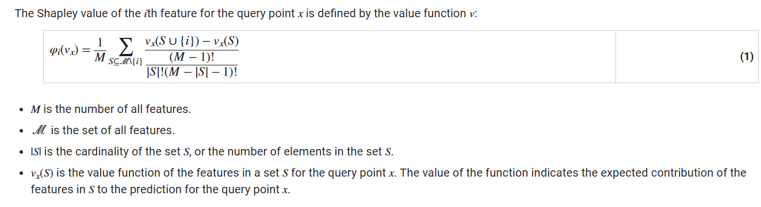
SHAP library for Python
Explaining machine learning models with Shapley values.
Explainable AI with Shapley values — SHAP latest documentation (shap-lrjball.readthedocs.io)
Shapley Values for Machine Learning Model - MATLAB & Simulink (mathworks.com)
In game theory, the Shapley value of a player is the average marginal contribution of the player in a cooperative game. That is, Shapley values are fair allocations, to individual players, of the total gain generated from a cooperative game. In the context of machine learning prediction, the Shapley value of a feature for a query point explains the contribution of the feature to a prediction (the response for regression or the score of each class for classification) at the specified query point. The Shapley value corresponds to the deviation of the prediction for the query point from the average prediction, due to the feature. For each query point, the sum of the Shapley values for all features corresponds to the total deviation of the prediction from the average.

Slide 9
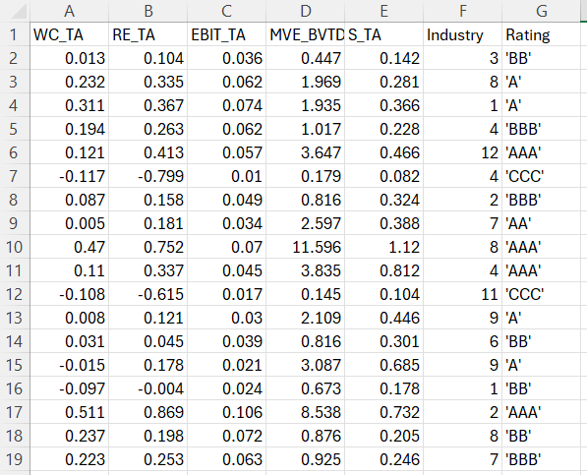
Input Data
Columns = Features, Rating column - Label

Slide 10
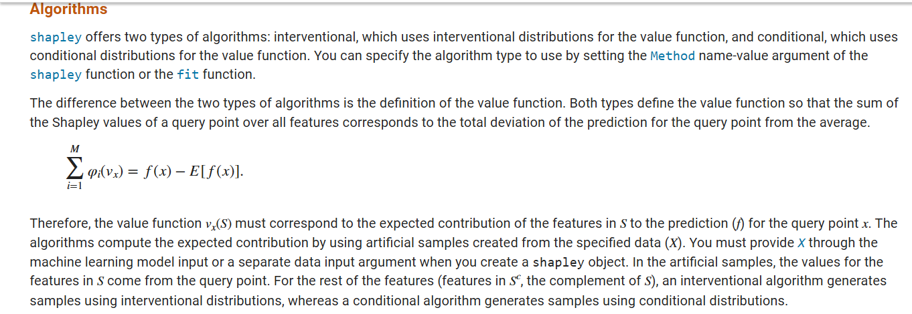
Result

Slide 11
Example - logistic regression model with features X1,X2,X3
computing Shapley indexes
this demonstration code is created by chatGPT
import numpy as np
from itertools import permutations
# create dataset and train logistic regression model
np.random.seed(42)
X = np.random.rand(100, 3)
y = np.random.randint(2, size=100)
from sklearn.linear_model import LogisticRegression
model = LogisticRegression()
model.fit(X, y)
# function for computing model predictions
def predict_proba_with_mask(model, mask, baseline):
features = np.zeros_like(baseline)
features[mask] = baseline[mask]
return model.predict_proba([features])[0][1]

Slide 12
Example - logistic regression model with features X1,X2,X3
computing Shapley indexes
this demonstration code is created by chatGPT
C
# computing Shapley indexes
shapley_values = np.zeros(X.shape[1])
baseline = np.mean(X, axis=0) # Базовое значение признаков
# try all permutations of features
for perm in permutations(range(X.shape[1])):
for i in range(X.shape[1]):
mask = np.zeros(, dt)
mask[list(perm)[:i + 1]] = True
marginal_contribution = (
predict_proba_with_mask(model, mask, baseline) -
predict_proba_with_mask(model, mask[:-1], baseline)
)
shapley_values[i] += marginal_contribution / (i + 1)
shapley_values /= np.math.factorial(X.shape[1])
print("Shapley Values:", shapley_values)

Slide 13
References
[1] Grah Simon, Thouvenot Vincent , A Projected Stochastic Gradient Algorithm for Estimating Shapley Value Applied in Attribute Importance,2020
https://inria.hal.science/hal-03414720v1/document
[2] Lauren Watson, Zeno Kujawa, Rayna Andreeva, Hao-Tsung Yang, Tariq Elahi, Rik Sarkar,Accelerated Shapley Value Approximation for Data Evaluation,023
https://arxiv.org/abs/2311.05346
[3] Scott M. Lundberg , Su-In Lee , A Unified Approach to Interpreting Model Predictions
https://proceedings.neurips.cc/paper_files/paper/2017/file/8a20a8621978632d76c43dfd28b67767-Paper.pdf
[4]Christophe Molnar, Interpretable machine learning, 2024
https://christophm.github.io/interpretable-ml-book/
https://christophm.github.io/interpretable-ml-book/shapley.html
[5] Lars Henry Berge Olsen,Ingrid Kristine Glad, Martin Jullum, Kjersti Aas, A comparative study of methods for estimating model-agnostic Shapley value explanations,2024,Springer
s10618-024-01016-z.pdf

