Slide 1
Python for Machine Learning
Spring 2023

Slide 2
In this lecture..
Documents representation
Cosine similarity
Bag of words
TF-IDF

Slide 3
Digital representation of text data
Input Documents are converted to digital format using the following model:
Documents are preprocessed – stop words are removed. Frequency of occurrence of each word or sequence of words is used as a feature for training a classifier.
bag of words model:
Order of words in the document is not important
Frequency of words is important
N-gram model
An n-gram is a contiguous sequence of n items from a given sample of text or speech. Items can be words, letters, etc.
It extends a bag of words model.

Slide 4
Cosine similarity
cosine similarity between samples X and Y - normalized dot product of X and Y
K(X, Y) = <X, Y> / (||X||*||Y||).
This is L2-normilized product of vectors
This is called cosine similarity, because Euclidean (L2) normalization projects the vectors onto the unit sphere, and their dot product is then the cosine of the angle between the points denoted by the vectors
Application Example:
create movie recommendation system based on movie dataset. Unsupervise learning method. User enters the name of the movie and system returns 5 most similar movies. Similarity I based on keywords, cast, genres and director

Slide 5
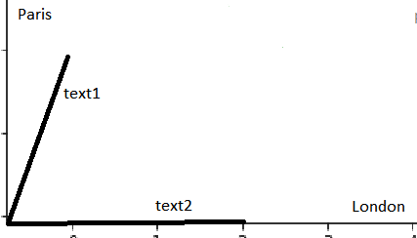
Bag of Words model
Examples.
Two texts are given, text1 and text2
text1: ’London, Paris, Paris’
text2: ’London, London, London’
how similar are they?
The quantification of similarity will be based on the following model:
Dictionary of all possible words in the documents is represented by multidimensional space of vectors. Axes represent words in the dictionary. Each document is represented by a vector with n coordinates, where each coordinate represents a word from a dictionary. If certain word appears in document m times than the component of the vector along this coordinate has length m.
If certain word from the dictionary is not found in this text the corresponding component of document vector is 0.
In the example above, text1 will have two non zero components, London and Paris:
text1: (1,2), whereas text2: will have one nonzero component, London: (3,0)
Similarity between text1 and text2 can be measured using
cosine similarity metric: K(X, Y) = <X, Y> / (||X||*||Y||).
Dot product of text1 and text2: <text1,text2> = 1*3+2*0=3
||text1||=sqrt(5), ||text2||=3
K(text1,text2)=1/sqrt(5)=0.4472
Exercise: compute cosine similarity using scikit-learn

Slide 6
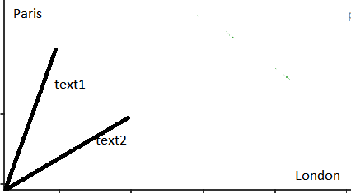
Bag of Words Model
Another Example
Two texts are given, text1 and text2
text1: ’London, Paris, Paris’
text2: ’London, Paris, London’
Again, the dictionary consists of 2 words, ‘London’ and ‘Paris’
In the example above, text1 and text2 have two non zero components, London and Paris:
text1: (1,2), text2: (2,1)
Similarity between text1 and text2 can be measured using
cosine similarity metric
K(X, Y) = <X, Y> / (||X||*||Y||)
Dot product of text1 and text2: <text1,text2> = 1*2+2*1=4
||text1||=sqrt(5), ||text2||=sqrt(5), K(text1,text2)=4/5=0.8
from sklearn.metrics.pairwise import cosine_similarity
import numpy as np
text1=np.array([1,2]).reshape(1,-1)
text2=np.array([2,1]).reshape(1,-1)
res=cosine_similarity(text1, text2) # res=0.8

Slide 7
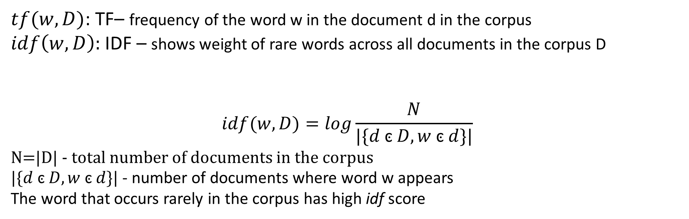
Term Frequency – Inverse Document Frequency (TF-IDF)
$tf(w,D)$: TF– frequency of the word w in the document d in the corpus
$idf\left(w,D\right):$ IDF – shows weight of rare words across all documents in the corpus D
$$idf(w,D)=log\frac{N}{|\{d \text{ͼ} D, w \text{ͼ} d\}|}$$
N=|D| - total number of documents in the corpus
$|\{d \text{ͼ} D, w \text{ͼ} d\}|$ - number of documents where word w appears
The word that occurs rarely in the corpus has high idf score

Slide 8
Term Frequency – Inverse Document Frequency (TF-IDF)
$$Example:$$
A; the car is driven on the road
B: the truck is driven on the highway

Slide 9
Topic Modeling – Mathematical Model
Topic modeling: a type of statistical modeling for discovering the abstract “topics” that occur in a collection of documents.
Latent Dirichlet Allocation (LDA) is an example of topic model and is used to classify text in a document to a particular topic. It builds a topic per document model and words per topic model, modeled as Dirichlet distributions.
Bi-clustering, soft-clustering and fuzzy clustering of the corpus of documents are terms that are often used to describe the mathematic model behind topic modeling.
‘

Slide 10
Tools in scikit-learn
Data preprocessing:
CountVectorizer
sklearn.feature_extraction.text.CountVectorizer — scikit-learn 0.24.2 documentation
TfIdfVectorizer
sklearn.feature_extraction.text.TfidfVectorizer — scikit-learn 0.24.2 documentation
Topic Modeling
LDA
sklearn.decomposition.LatentDirichletAllocation — scikit-learn 0.24.2 documentation
‘

Slide 11
Links:
1. Topic modeling in Python
https://towardsdatascience.com/topic-modeling-and-latent-dirichlet-allocation-in-python-9bf156893c24
2. Topic modeling (Duke University) – video
https://www.youtube.com/watch?v=IUAHUEy1V0Q
3. What is LDA,LSA,PLSA
https://ppasupat.github.io/a9online/wtf-is/lsa-plsa-lda.html
4. Topic modeling - video
https://www.youtube.com/watch?v=DDq3OVp9dNA
‘

Slide 12
Topic Modeling
Look at the following tutorial:
https://blog.mlreview.com/topic-modeling-with-scikit-learn-e80d33668730
Example: given a set of various marketing ads classify them into specific groups according to types of goods and services they advertise.
Input: (60 or more ads)
1. You could save 15%. More than auto insurance. Call us today and get a free quote.
2. This is the best insurance in the world
3. Get mortgages at no time with quick application process (less than 5 minutes) and enjoy your new home.
4. Think Positive and apply on your new SURE THING Credit Card with interest as low as 22%! It may also give you a return of 1% or more on all your purchases. Apply NOW!!!
5. Anybody ordered a bank? Our banking services now comes to you. Call our advisors and they will bring you all of our financial solutions.
6. Citizens Bank has the highest savings rate of 5%. Open an account today!
7. Simple way to get your retirement investment started: index mutual funds.
8. The Long-Term Performance of Mid Caps Might Surprise You. Given the resiliency of mid caps, why are they so often overlooked?
9. Get wild Alaskan caught salmon and other seafood favorites delivered right to your door. Wild-caught, never farmed, processed and caught in USA.
……………………………..

Slide 13
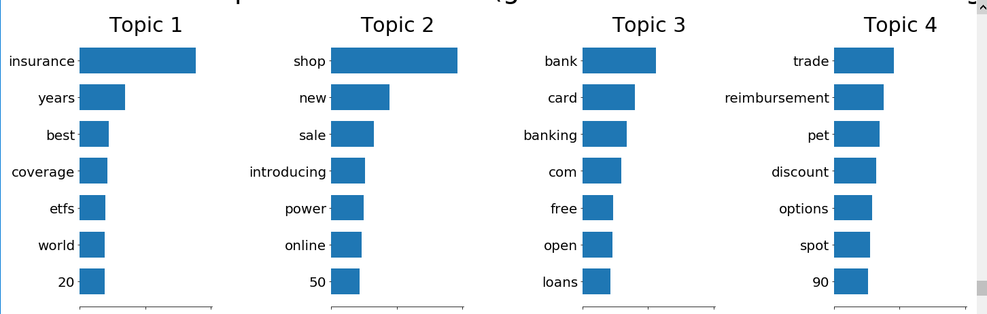
Topic Modeling
Example: given a set of various marketing ads classify them into specific groups according to what they advertise.
Output:

