Slide 1
Python for Machine Learning
Spring 2023

Slide 2
In this lecture..
Proximal Algorithms

Slide 3
State-of-the-art optimization algorithms
Stochastic Gradient Descent
Newton’s method
Genetic Algorithm
Nelder and Mead

Slide 4
Problems with state-of-the-art optimization algorithms
Difficult to implement
Slow
Do not work with non-smooth functions
Proximal algorithms offer a trade-off!

Slide 5
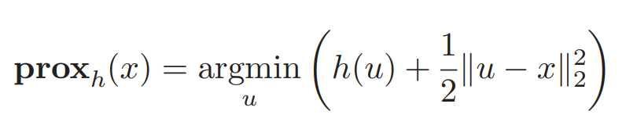
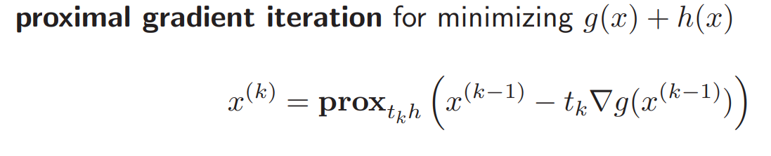
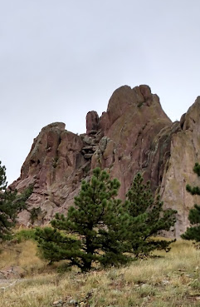
Proximal Operator

Slide 6
Software
PyProximal
https://pyproximal.readthedocs.io/en/stable/
This Python library provides all the needed building blocks for solving non-smooth convex optimization problems using the so-called proximal algorithms.
Tensorflow
Proximal AdaGrad algorithm
https://www.tensorflow.org/addons/api_docs/python/tfa/optimizers/ProximalAdagrad
MatLab
ProximalPolicyOptimization
https://www.mathworks.com/help/reinforcement-learning/ug/ppo-agents.html
ChatGPT – uses proximal Policy Optimization algorithm for training

Slide 7
References
Stephen Boyd, Proximal Algorithms
https://web.stanford.edu/~boyd/papers/pdf/prox_algs.pdf
Connection between EM algorithm and Proximal Algorithms
https://arxiv.org/abs/1201.5907

