Slide 1
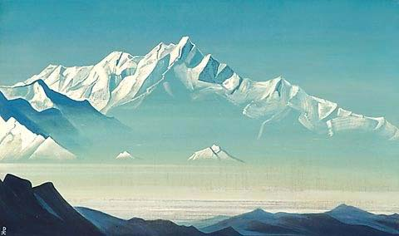
Reinforcement Learning in Engineering
Nadia Udler

Slide 2
Questions
What is learning (machine learning, robotics)
Is this a subfield of computer science?
Is this an engineering field?
What is supervised, unsupervised and
reinforcement learning?
Learning becomes an engineering tool!

Slide 3
Example
Identification device for distinguishing cats from dogs
Security device that lets in employees
What is the difference between the algorithms that control these two devices

Slide 4
Examples
Robot searching for the goal
Automatic design of experiments
for optimizing qualities of alloys
Algorithms for search and optimization –
engineering tools for learning!

Slide 5
Objectives
Introduce a concept of learning under high uncertainty ( low level of information)
using examples from engineering fields
Individual learning and group learning process
Introduce a concept of black box function and black box optimization
Introduce following optimization methods:
Nelder and Mead optimization
Coordinate and Pattern Search
Neural Networks
Genetic Algorithm
PSO algorithm
Bat algorithm
Pollination Algorithm

Slide 6
Objectives
Introduce a concept of learning under high uncertainty ( low level of information)
using examples from engineering fields
Individual learning and group learning process
Introduce a concept of black box function and black box optimization
Introduce following optimization methods:
Nelder and Mead optimization
Coordinate and Pattern Search
Neural Networks
Genetic Algorithm
PSO algorithm
Bat algorithm
Pollination Algorithm

Slide 7
How does human or machine learn?
1. Supervised Learning
Learn from data provided externally
Supervised methods such as linear regression, logistic regression, support vector machine, neural networks
Supervised machine learning algorithms can apply what has been learned in the past to new data using labeled examples to predict future events
2. Unsupervised learning
unsupervised machine learning algorithms are used when the information used to train is neither classified nor labeled. Draw inferences from datasets to describe hidden structures from unlabeled data. k-mean clustering is an example of unsupervised learning method

Slide 8
How does machine learn?
3. Online learning
Used in real time systems. Method in which data becomes available in a sequential order and is used to update the best prediction for future data at each step, as opposed to batch learning techniques which generate the best predictor by learning on the entire training data set at once. Neural network is a convenient model for online learning because training samples in neural network are processes one at a time.
4. Reinforcement learning
learning method that interacts with its environment by producing actions and discovers errors or rewards. Trial and error search and delayed reward are the most relevant characteristics of reinforcement learning.
Learn from its own experience
Black box optimization methods. Black box strategies.
Black box optimization competition
https://www.ini.rub.de/PEOPLE/glasmtbl/projects/bbcomp/index.html

Slide 9
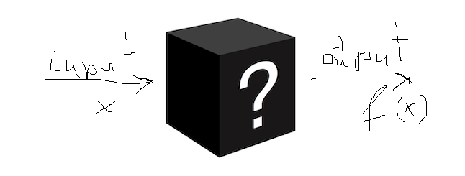
Black box optimization
We are looking for optimal (minimum) value of a function.
The function is black box (the analytical form of the function is not known)
Naïve approach:
Compute values of functions in many points and choose a point with smallest function value
Example: Random search
Better Approach:
Compute values of functions in several points and analyze the result
Based on this analysis design a strategy for a next step: which points should be evaluated in order to improve the function value?
Example: Nelder and Mead algorithm, Coordinate search, Pattern search

Slide 10
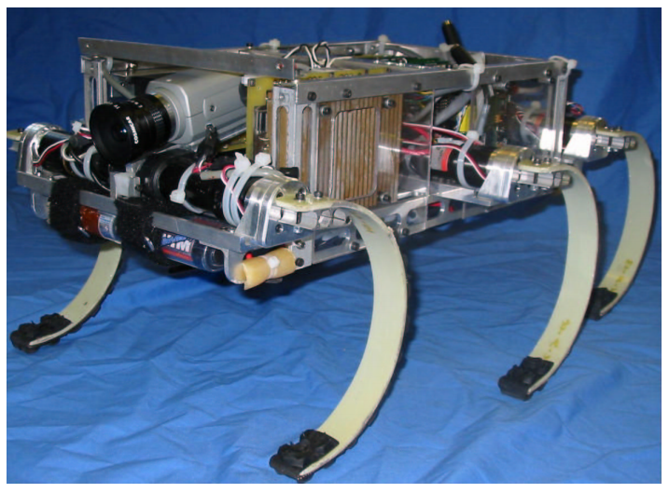
Legged Robot Gait Optimization
Gait Generation and Optimization for Legged Robots, Joel D. Weingarten, Martin Buehler, Richard E. Groff, Daniel E. Koditschek,
Automated Gait Adaptation for Legged Robots , Joel D. Weingarten, Gabriel A. D. Lopes, Martin Buehler, Richard E. Groff, Daniel E. Koditschek,
RHex is a power- and computation-autonomous robotic hexapod, featuring compliant legs and a simple mechanical design. The chassis measures 48cm×22cm×12.5cm, and the distance from hip to ground in normal standing posture is 15.5cm.

Slide 11
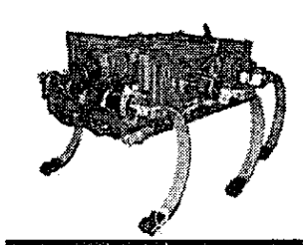
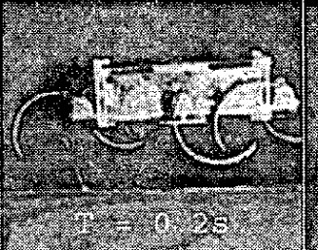
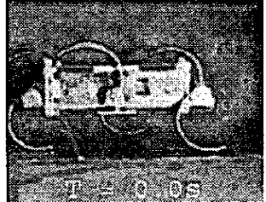
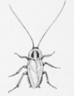
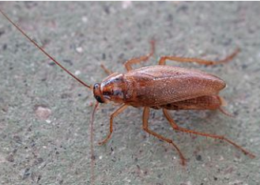
Legged Robot Gait Optimization
Important parameter to adjust: leg joint angle, Objective : efficiency
Efficiency measure 1: Average Specific Resistance (SR)
Efficiency measure 2.Speed weighted version of SR which combines the desirable properties of specific resistance with the desire to find faster gaits.
Models locomotion of cockroach:

Slide 12
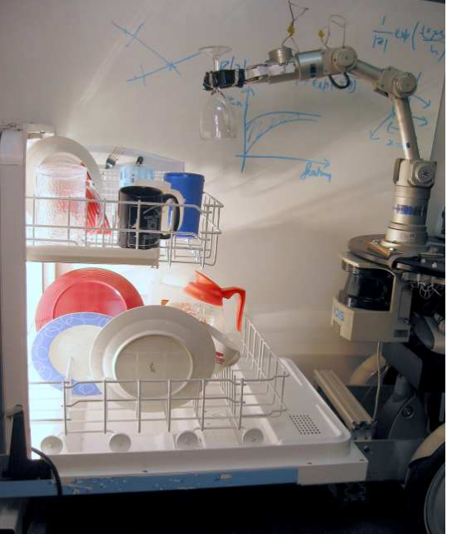
Automatic Grasping Arm Parameter Optimization
Application of Hybrid Nelder-Mead Bat Algorithm to Improve the Grasp Quality during the Automated Robotic Grasping, Golak Bihari Mahantaa, Amruta Routa , Gunji Bala Muraliaa , BBVL Deepaka , BB Biswala
Robotic Grasping of Novel Objects using Vision, Ashutosh Saxena, Justin Driemeyer, Andrew Y. Ng
Robot unloading items from a dishwasher.

Slide 13
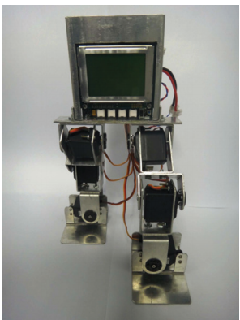
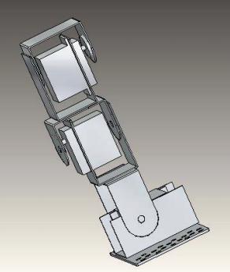
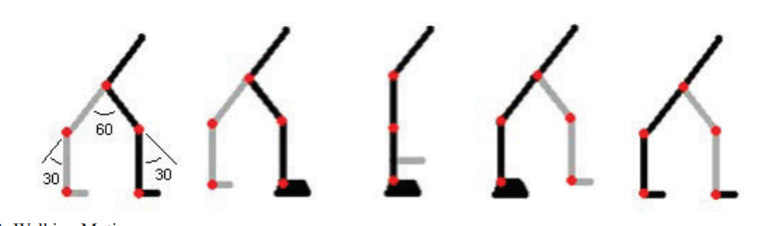
Bipedal Walking Robot
Bipedal Walking Robot – A Development Design, Sujan Warnakulasooriyaa , Amin Bagheria , Nathan Sherburnb , Madhavan Shanmugavel
Robot Parameters
M- mass of the robot
L - distance from mass center to joint
C - time taken by motor to bring center of mass directly above it
t - time
Walking Robot
Leg Assembly
Walking Motion

Slide 14
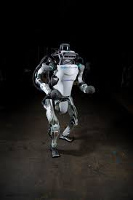
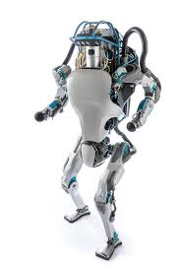
Atlas Robot created by Boston Dynamics
https://www.cnet.com/news/this-robot-can-do-crossfit-better-than-you-atlas-boston-dynamics-google/

Slide 15

Gait Parameters for
Bipedal Walking Robot
Direction of moving
A
$$α$$
B
B
C
C

Slide 16
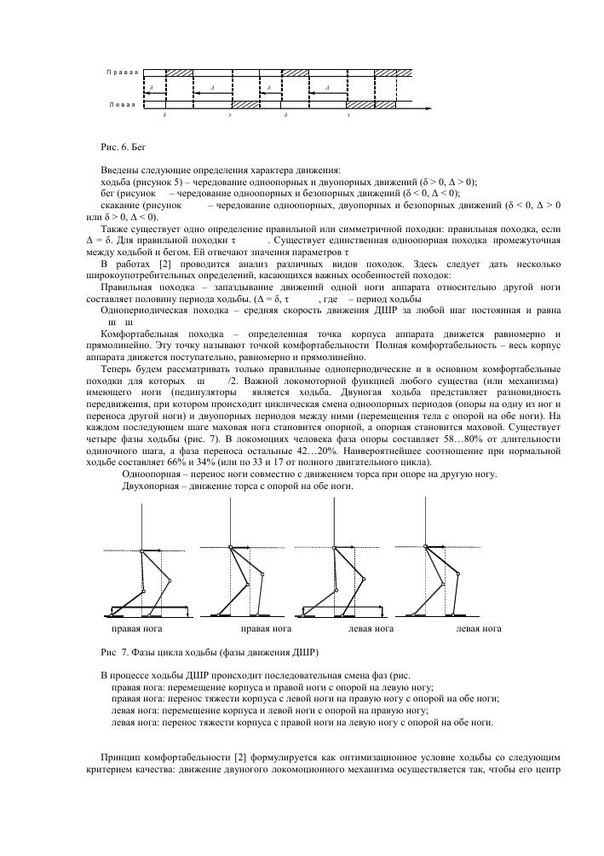
Phases of the Walking Cycle
for 2 Legged Walking Robot
Right leg
Right leg
Left leg
Left leg
Source: https://cyberleninka.ru/article/n/dvizhenie-dvunogogo-shagayuschego-robota/viewer

Slide 17


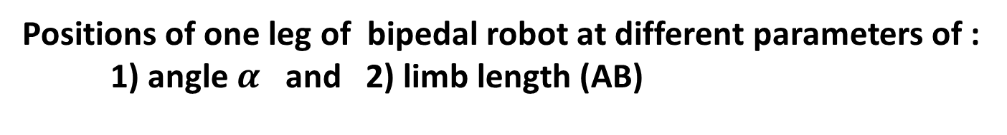

Positions of one leg of bipedal robot at different parameters of :
1) angle $α$ and 2) limb length (AB)
Direction of moving
A
$$α$$
$$α$$
$$α$$
B
B
B
B
B
C
C
C
C

Slide 18
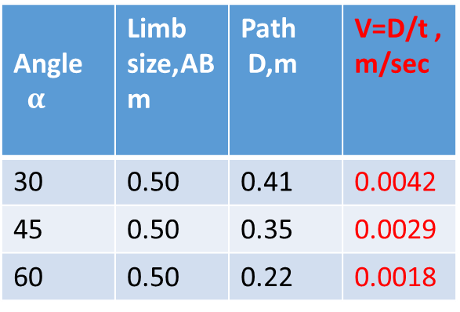
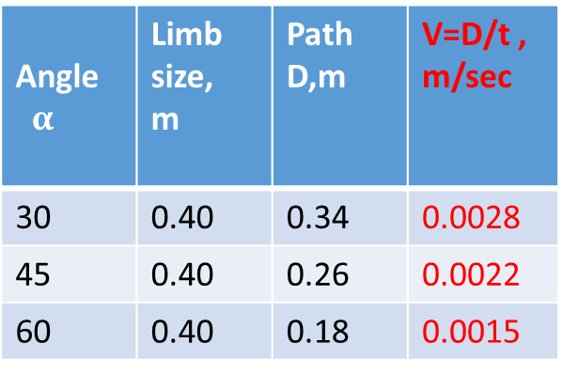
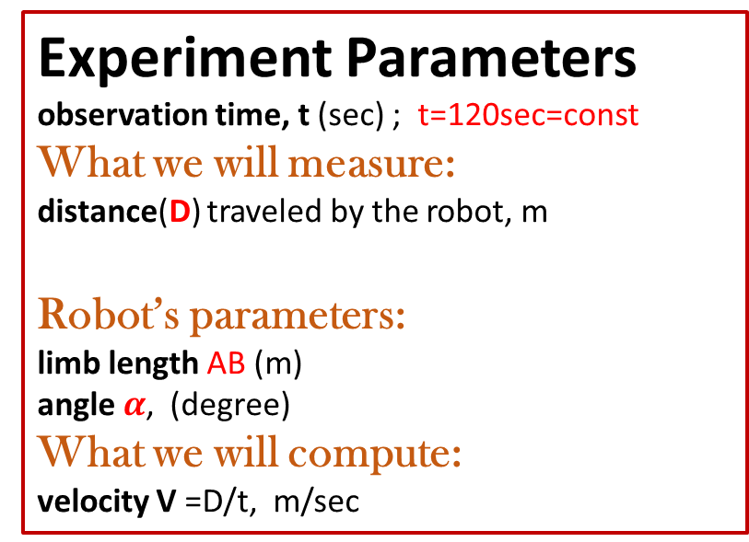
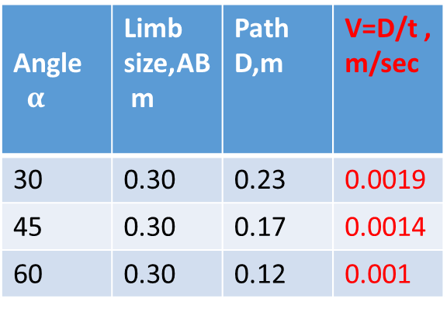
Experiment Parameters
observation time, t (sec) ; t=120sec=const
What we will measure:
distance(D) traveled by the robot, m
Robot’s parameters:
limb length AB (m)
angle $α$, (degree)
What we will compute:
velocity V =D/t, m/sec
-- What is your goal?
-- To compare velocity
Angle$α$ | Limb size,AB m | Path D,m | V=D/t , m/sec
30 | 0.30 | 0.23 | 0.0019
45 | 0.30 | 0.17 | 0.0014
60 | 0.30 | 0.12 | 0.001
Angle$α$ | Limb size, m | Path D,m | V=D/t , m/sec
30 | 0.40 | 0.34 | 0.0028
45 | 0.40 | 0.26 | 0.0022
60 | 0.40 | 0.18 | 0.0015
Angle$α$ | Limb size,AB m | Path D,m | V=D/t , m/sec
30 | 0.50 | 0.41 | 0.0042
45 | 0.50 | 0.35 | 0.0029
60 | 0.50 | 0.22 | 0.0018

Slide 19
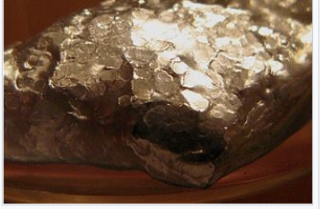
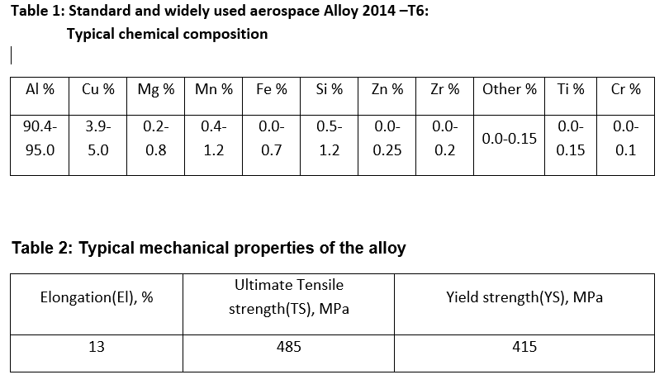
Alloy design

Slide 20
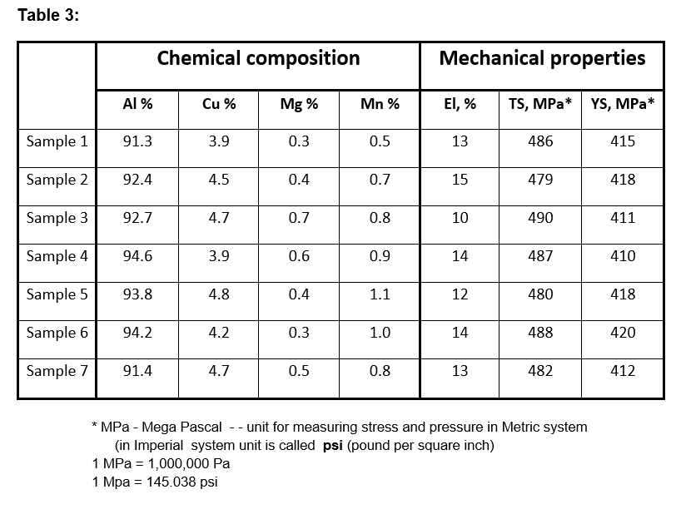
Alloy design

Slide 21
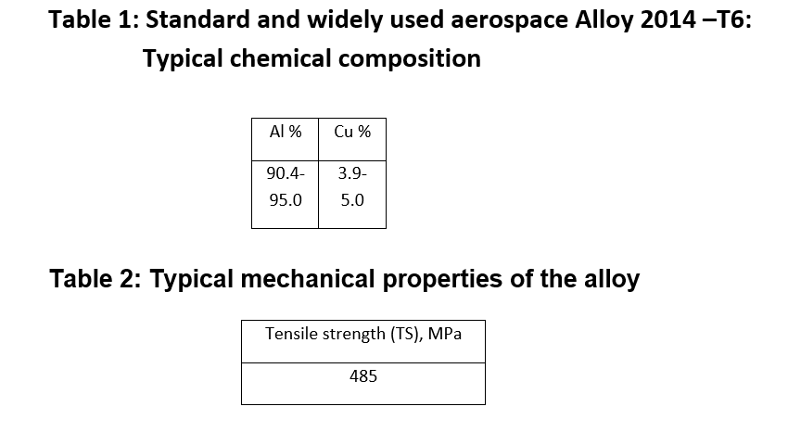
Alloy design - simplified example

Slide 22
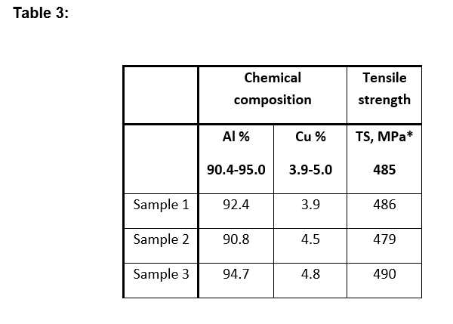
Alloy design - simplified example

Slide 23
Alloy design - simplified example
Data for Fig.1
 | AL,% | Cu,% | TS,MPa
Sample 1 | 90.8 | 4.0 | 983
Sample 2 | 91.4 | 4.0 | 985
Sample 3 | 93.4 | 4.0 | 984
Sample 4 | 94.3 | 4.0 | 981
Sample 5 | 94.7 | 4.0 | 978

Slide 24
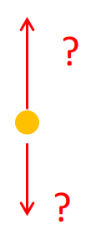
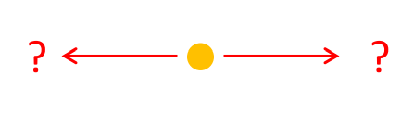
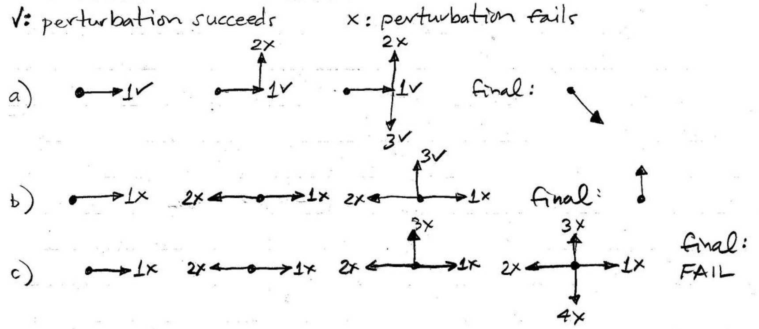
Hooke - Jeeves (Pattern Search ) Method

Slide 25
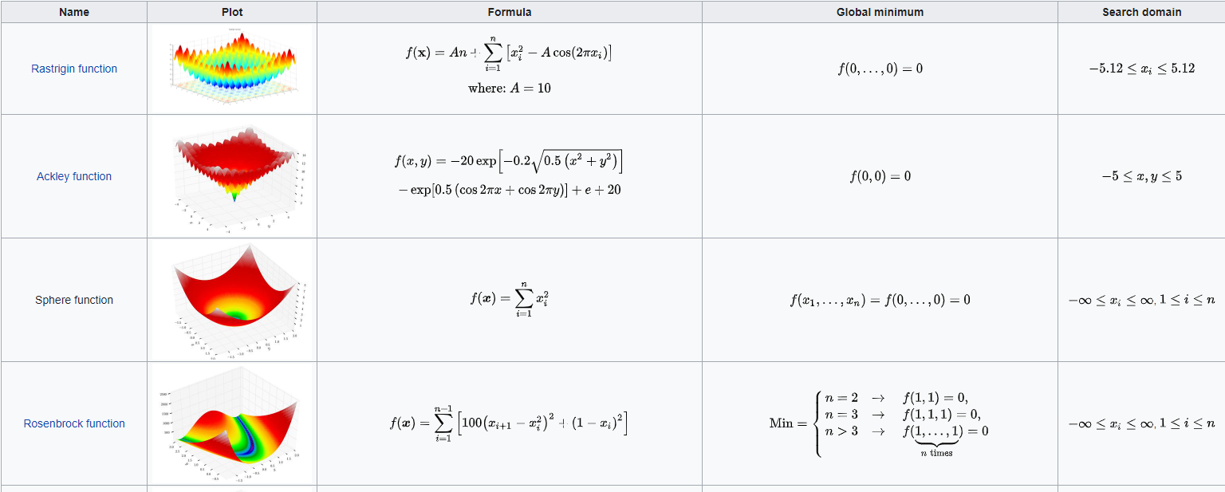
Test Functions (Artificial Landscapes)
test the behavior of global optimization methods
https://en.wikipedia.org/wiki/Test_functions_for_optimization

Slide 26
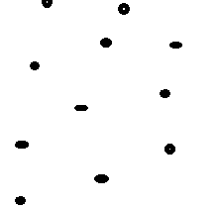
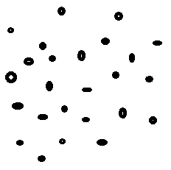
Population-based methods
Random search (1960s)
https://en.wikipedia.org/wiki/Random_search
Simulated Annealing (1953)
https://en.wikipedia.org/wiki/Simulated_annealing
https://docs.scipy.org/doc/scipy-0.14.0/reference/generated/scipy.optimize.anneal.html
Genetic algorithm (1970s)
https://en.wikipedia.org/wiki/Genetic_algorithm
Particle Swarm Optimization Algorithm (1990s)
https://en.wikipedia.org/wiki/Particle_swarm_optimization
Differential Evolution (1997)
https://en.wikipedia.org/wiki/Differential_evolution
https://docs.scipy.org/doc/scipy/reference/generated/scipy.optimize.differential_evolution.html
Bat Algorithm (2010)
https://en.wikipedia.org/wiki/Bat_algorithm
https://www.mathworks.com/matlabcentral/fileexchange/74768-the-standard-bat-algorithm-ba
Flower Pollination Algorithm(2012)
https://link.springer.com/chapter/10.1007/978-3-642-32894-7_27
https://www.mathworks.com/matlabcentral/fileexchange/74765-the-standard-flower-pollination-algorithm-fpa
Jason Brownlee, Clever Algorithms

Slide 27
NM and HJ algorithm in Engineering Tools
Matlab
https://www.mathworks.com/help/gads/patternsearch.html
https://www.mathworks.com/help/matlab/ref/fminsearch.html
https://www.mathworks.com/matlabcentral/answers/127499-parameter-determination-using-nelder-mead-method
https://www.mathworks.com/matlabcentral/answers/493893-nelder-and-mead-algorithm
Maple
https://www.maplesoft.com/applications/view.aspx?SID=4401&view=html
https://www.maplesoft.com/applications/view.aspx?SID=4401
Mathematica
https://mathworld.wolfram.com/Nelder-MeadMethod.html
https://reference.wolfram.com/language/tutorial/ConstrainedOptimizationGlobalNumerical.html
Wikipedia
https://en.wikipedia.org/wiki/Nelder%E2%80%93Mead_method

Slide 28
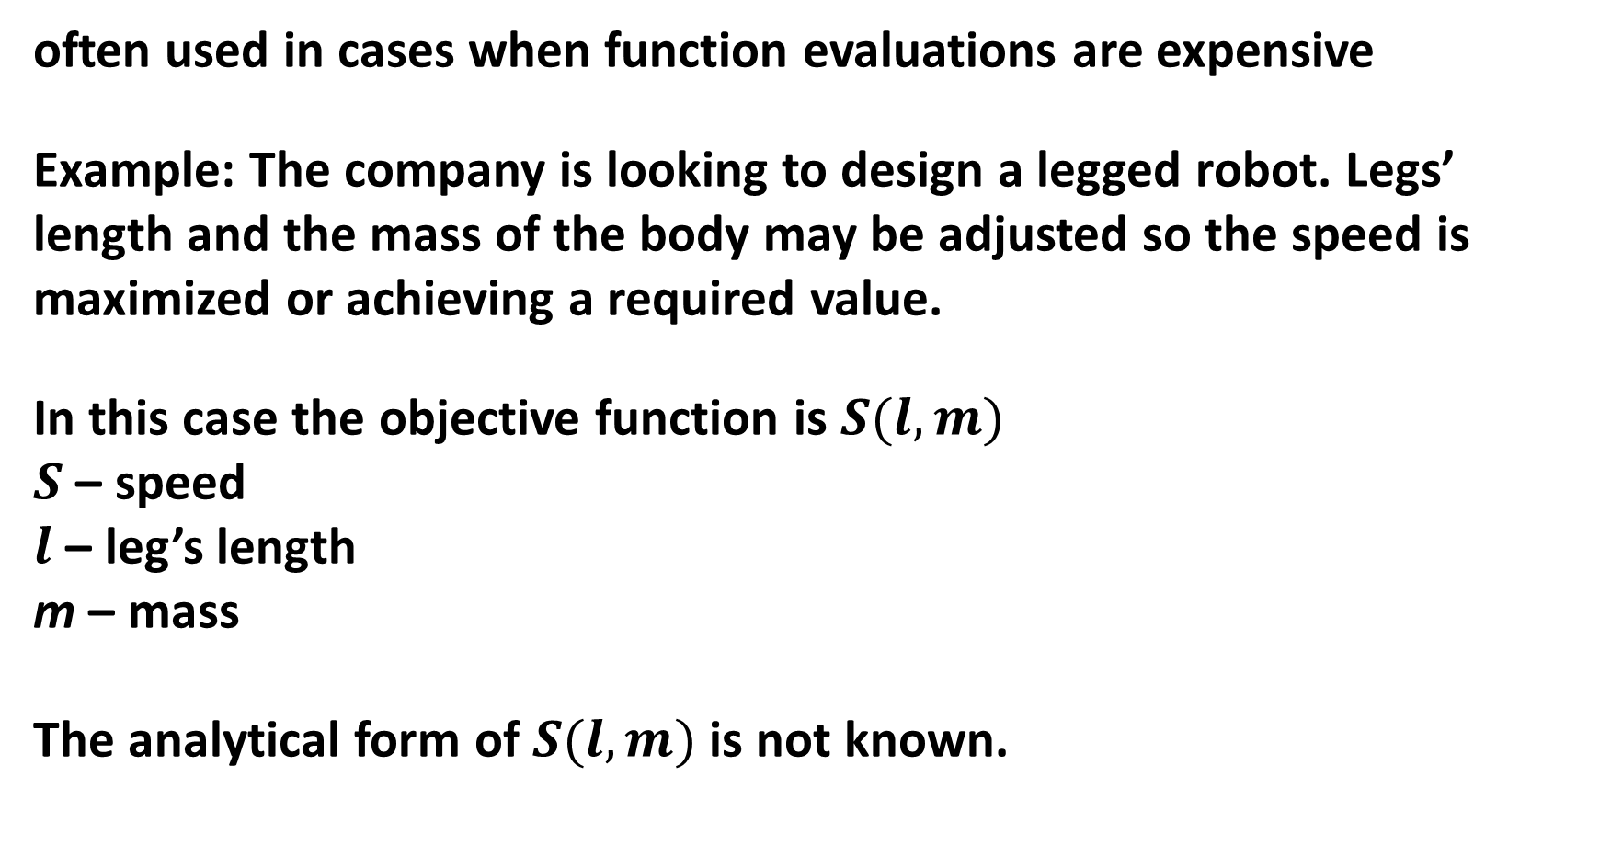
Nelder and Mead algorithm: simple application
often used in cases when function evaluations are expensive
Example: The company is looking to design a legged robot. Legs’ length and the mass of the body may be adjusted so the speed is maximized or achieving a required value.
In this case the objective function is $S(l,m)$
$S$ – speed
$l$ – leg’s length
m – mass
The analytical form of $S(l,m)$ is not known.

Slide 29
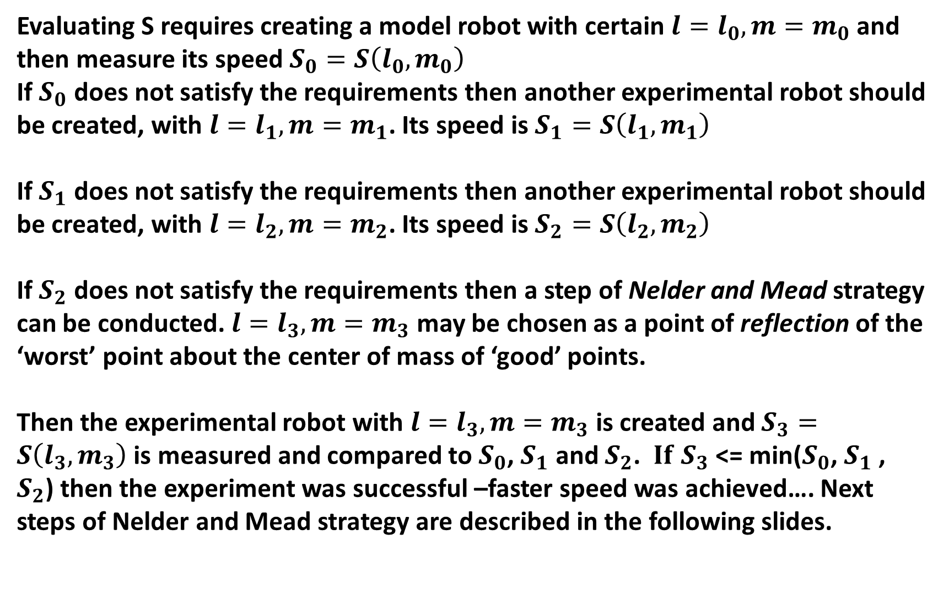
Nelder and Mead algorithm: simple application
Evaluating S requires creating a model robot with certain $l=l_{0},m=m_{0}$ and then measure its speed $S_{0}=S\left(l_{0},m_{0}\right)$
If $S_{0}$ does not satisfy the requirements then another experimental robot should be created, with $l=l_{1},m=m_{1}$. Its speed is $S_{1}=S\left(l_{1},m_{1}\right)$
If $S_{1}$ does not satisfy the requirements then another experimental robot should be created, with $l=l_{2},m=m_{2}$. Its speed is $S_{2}=S\left(l_{2},m_{2}\right)$
If $S_{2}$ does not satisfy the requirements then a step of Nelder and Mead strategy can be conducted. $l=l_{3},m=m_{3}$ may be chosen as a point of reflection of the ‘worst’ point about the center of mass of ‘good’ points.
Then the experimental robot with $l=l_{3},m=m_{3}$ is created and $S_{3}=S\left(l_{3},m_{3}\right)$ is measured and compared to $S_{0}$, $S_{1}$ and $S_{2}$. ${ If S}_{3}$ <= min($S_{0}$, $S_{1}$ , $S_{2}$) then the experiment was successful –faster speed was achieved…. Next steps of Nelder and Mead strategy are described in the following slides.

Slide 30
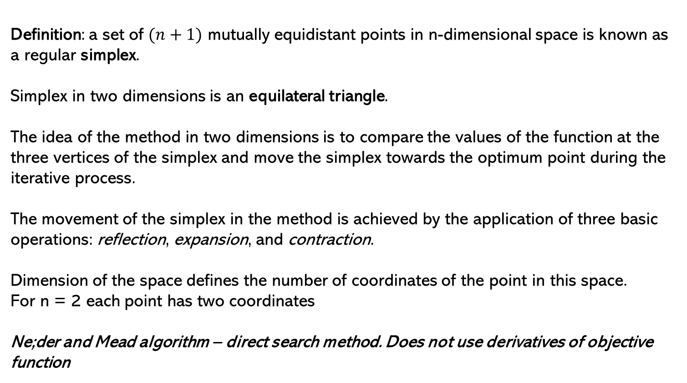
Nelder and Mead algorithm
Definition: a set of $(n+1)$ mutually equidistant points in n-dimensional space is known as a regular simplex.
Simplex in two dimensions is an equilateral triangle.
The idea of the method in two dimensions is to compare the values of the function at the three vertices of the simplex and move the simplex towards the optimum point during the iterative process.
The movement of the simplex in the method is achieved by the application of three basic operations: reflection, expansion, and contraction.
Dimension of the space defines the number of coordinates of the point in this space.
For n = 2 each point has two coordinates
Ne;der and Mead algorithm – direct search method. Does not use derivatives of objective function

Slide 31
Nelder and Mead algorithm
extension of the simplex method of Spendley, Hext, and Himsworth.
very robust direct search that is extremely powerful provided that the number of variables does not exceed five or six.
Uses function evaluations at different points to produce strategy for the next step (black box method)
Implemented in optimization software tools
such as Matlab fminsearch() function
Python scipy.optimize.fmin() function
NAG nag_opt_uncon_simplex (e04cb)
Works for functions with categorical values
(function values may be categorized as ‘better’ or ’worse’. Exact values may not be given)
https://en.wikipedia.org/wiki/Nelder–Mead_method
Heuristic meaning: this strategy finds the ‘worst’ place in function domain (in terms of values) and jumps out of it.
For minimization problems ‘worst’ place is where function has largest value
For maximization problems ‘worst’ place is where function has smallest value

Slide 32
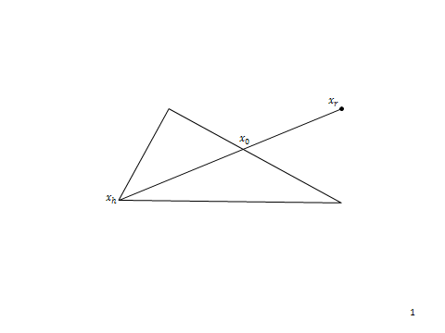

Nelder and Mead algorithm
Given a function $f(x)$ we need to find its minimum value and corresponding value of the argument
Algorithm:
1. Start with 3 points $x_{1},{ x}_{2},{ x}_{3}$ with the following values:
$f_{1}=f(x_{1})$ , $f_{2}=f\left(x_{2}\right),$ $f_{3}=f(x_{3})$
2. Sort the points by their function value and find the highest function value $f_{h}$ , the next highest function value $f_{g}$, the lowest function value $f_{l}$, and the corresponding points $x_{h}, x_{g }$ , and $x_{l }.$
3. Find the centroid $x_{0}$ of all “best”
$x_{0}={(x}_{g}+x_{l})/2$ (4.15)
and “second best” points and compute $f\left(x_{0}\right)=f_{0}$ .
4. It would seem reasonable to try to move away from the “worst” point $x_{h}$. We reflect $x_{h}$ in $x_{0}$ to find $x_{r}$ and find $f\left(x_{r}\right)=f_{r}$ .
If $α> 0$ is the reflection coefficient we find $x_{r}$ such that $x_{r}−x_{0 }= α(x_{0 }−x_{h})$
i.e., $x_{r}=\left(1+α\right)x_{0 }−αx_{h}$ (4.16)
where $α=\left|x_{r}−x_{0 }\right|/\left|x_{0 }−x_{h}\right|$
Picture: Reflection step

Slide 33
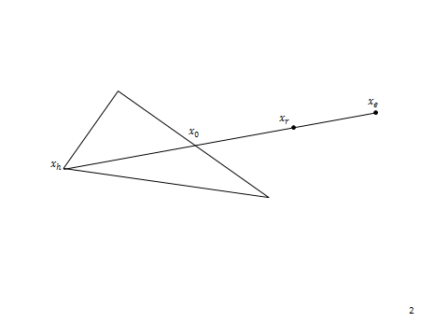

Nelder and Mead algorithm
5. We now compare $f_{r}$ with $f_{l }$ .
a. If $f_{r}$ $< f_{l }$, we have obtained the lowest function value yet. The direction from $x_{0 }$to $x_{r}$ appears to be a good one to move along. We therefore make an expansion in this direction to find $x_{e}$ and evaluate $f_{e}=f\left(x_{e}\right)$. Let the expansion factor be$γ>1$ . Then we have
$x_{e}−x_{0 }= γ(x_{r}−x_{0 })$
i.e., $x_{e}=γx_{r}+\left(1−γ\right)x_{0 }$ (4.17)
where $γ=\left|x_{e}−x_{0 }\right|/\left|x_{r}−x_{0 }\right|$
i. If $f_{e}< f_{l }$, replace $x_{h}$ by $x_{e}$ and test all three points of the simplex for convergence to the minimum (see step 9). If we have converged, then stop; if not return to step (2).
ii. If $f_{e}≮ f_{l }$we abandon $x_{e}$ . We have evidently moved too far in the direction $x_{0 }$ to $x_{r}.$ Instead replace $x_{h}$ by $x_{r}$ which we know gave an improvement [step (5)(i) ], test for convergence and if not return to step (B)(2).
b. If $f_{r}> f_{l }$ but $f_{r}≯f_{g}$ , $x_{r}$ is an improvement on the two worst points of the simplex and we replace $x_{h}$ by $x_{r}$ , test for convergence and if not return to step (2); i.e.(i)(b)above.
c. If $f_{r}> f_{l }$and $f_{r}> f_{g}$ proceed to step (6).
Picture: expanding the simplex

Slide 34
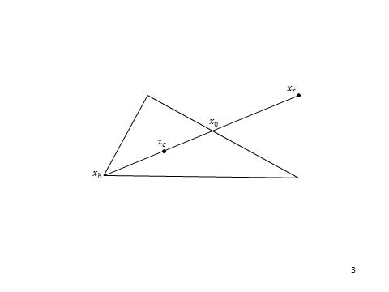
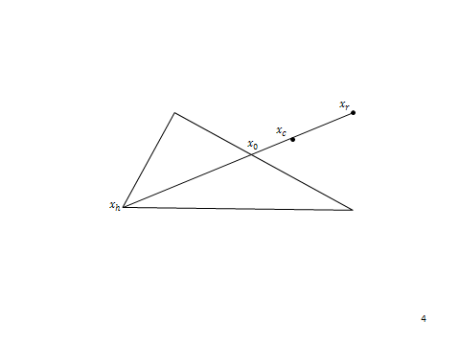

Nelder and Mead algorithm
6. We next compare $f_{r}$and $f_{h}$ .
a. If $f_{r}> f_{h}$, proceed directly to the contraction step 6b. If $f_{r}< f_{h}$, replace $x_{h}$ with $x_{r}$ . Remember $f_{r}> f_{g}$ from step 5c above.
Then proceed to step 6b.
b. In this case $f_{r}> f_{h}$ , so it would appear that we have moved too far in the direction $x_{h }$ to ${ x}_{0}.$ We try to rectify this by finding $x_{c}$ (and then $f_{c}$ ) by a contraction step, which is illustrated in Figure 4.12.
If $f_{r}> f_{h}$, we proceed directly to the contraction and find $x_{c}$ from $x_{c}−x_{0 }= β (x_{h}−x_{0 })$ where$β$ (0$< β< 1)$ is the contraction coefficient. Thus,
$x_{c}=βx_{h}+(1−β)x_{0 }$. (4.18)
If, however, $f_{r}>f_{h}$, we first replace $x_{h}$ by $x_{r}$ and then contract. Thus, we find $x_{c}$ from
${x_{c}−x}_{0 }= β (x_{r}−x_{0 })$ (4.19)
i.e.,
$x_{c}=β x_{r}+\left(1−β \right)x_{0 }$
Picture: expanding the simplex
Picture: contraction of the simplex

Slide 35
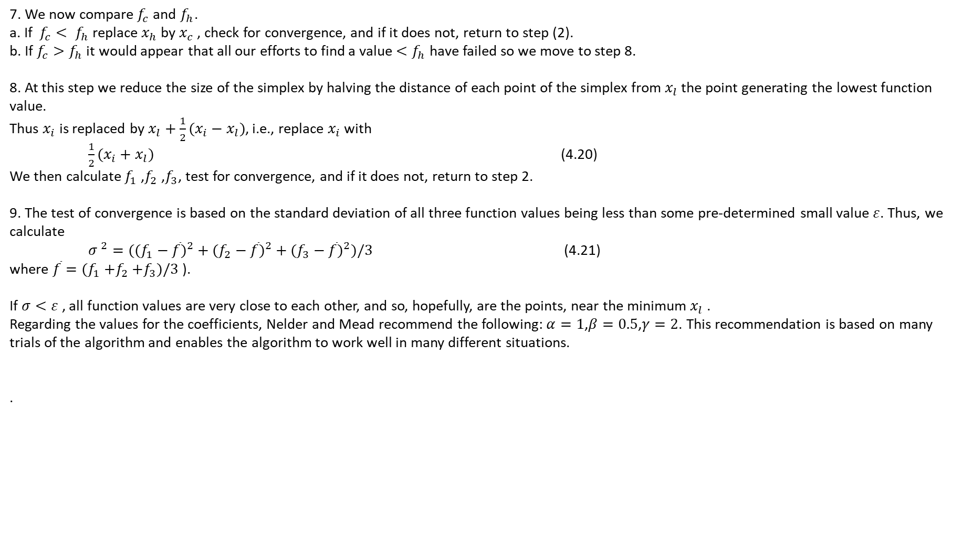
Nelder and Mead algorithm
7. We now compare $f_{c}$and $f_{h}$.
a. If $f_{c}< f_{h}$ replace $x_{h}$ by $x_{c}$ , check for convergence, and if it does not, return to step (2).
b. If $f_{c}>f_{h}$ it would appear that all our efforts to find a value $<f_{h}$ have failed so we move to step 8.
8. At this step we reduce the size of the simplex by halving the distance of each point of the simplex from $x_{l}$the point generating the lowest function value.
Thus $x_{i}$ is replaced by $x_{l}+\frac{1}{2}(x_{i}−x_{l})$, i.e., replace $x_{i}$ with
$\frac{1}{2}(x_{i}+x_{l})$ (4.20)
We then calculate $f_{1}$ ,$f_{2}$ ,$f_{3}$, test for convergence, and if it does not, return to step 2.
9. The test of convergence is based on the standard deviation of all three function values being less than some pre-determined small value $ε$. Thus, we calculate
${σ }^{2}=(({f_{1}−\overline{f})}^{2}+({f_{2}−\overline{f})}^{2}+({f_{3}−\overline{f})}^{2})/3$ (4.21)
where $\overline{f}=(f_{1}{+f}_{2}+f_{3})/3$ ).
If $σ<ε$, all function values are very close to each other, and so, hopefully, are the points, near the minimum $x_{l}$ .
Regarding the values for the coefficients, Nelder and Mead recommend the following: $α=1$,$β=0.5$,$γ=2$. This recommendation is based on many trials of the algorithm and enables the algorithm to work well in many different situations.
.

Slide 36
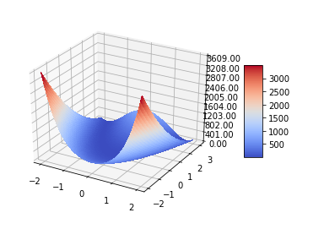
Nelder and Mead algorithm
implemented in the Python module SciPy.optimize
Minimize a function using the downhill simplex algorithm.
scipy.optimize.fmin(func, x0, args=(), xtol=0.0001, ftol=0.0001, maxiter=None, maxfun=None, full_output=0, disp=1, retall=0, callback=None, initial_simplex=None)
#Rosenbrock function:
def rosenbrock(x,y):
return (1-x)**2 + 100* ((y-x**2))**2
This is the code for plotting Rosenbrock function
from mpl_toolkits.mplot3d import Axes3D
from matplotlib import cm
from matplotlib.ticker import LinearLocator, FormatStrFormatter
import matplotlib.pyplot as plot
import numpy as np
fig = plot.figure()
ax = fig.gca(projection='3d')
s = 0.05 # Try s=1, 0.25, 0.1, or 0.05
X = np.arange(-2, 2.+s, s) #Could use linspace instead if dividing
Y = np.arange(-2, 3.+s, s) #evenly instead of stepping...
#Create the mesh grid(s) for all X/Y combos.
X, Y = np.meshgrid(X, Y)
Z = (1.-X)**2 + 100.*(Y-X*X)**2
surf = ax.plot_surface(X, Y, Z, rstride=1, cstride=1, cmap=cm.coolwarm,
linewidth=0, antialiased=False) #Try coolwarm vs jet
ax.zaxis.set_major_locator(LinearLocator(10))
ax.zaxis.set_major_formatter(FormatStrFormatter('%.02f'))
fig.colorbar(surf, shrink=0.5, aspect=5)
plot.show()
Minimum of Rosenbrock function is 0 and is achieved at the beginning of the long narrow “valley”, at (1.0,1.0)

Slide 37
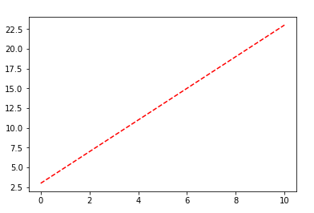
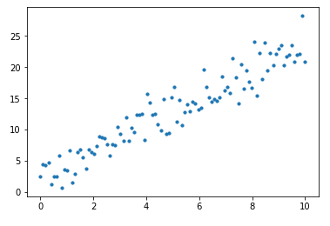
Nelder and Mead algorithm
def cost(w,x,y):
return np.dot(y-w[0]*x-w[1],y-w[0]*x-w[1])
def func_line(x, params):
return params[0] * x + params[1]
Artificially generated data: generate 100 real values equally spaced between 1 and 10 (we get 0, 0.10, 0.20, 0.30 ,…).
x = np.linspace(0, 10, 100)
Then we generate 100 points on the line with slope 2.0 and intercept
y_true = func_line(x, [2, 3])
creating ‘noise’ around the line:
y = y_true + np.random.normal(0,2,size=len(x))

Slide 38
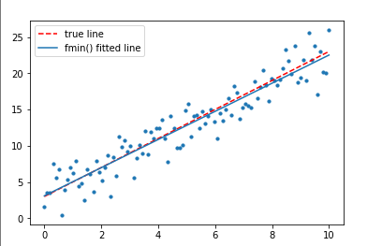
Nelder and Mead algorithm
Find such a line that minimizes cost function
data should fit a line close to the originally created line (with slope 2.0 and intercept 3.0)
start minimization by Nelder and Mead at [2.0,3.0] Initial cost function value (at [2,3]):
print('cost = ',cost([2,3],x,y))
cost = 159.90592300890907
xopt = so.fmin(cost, [2,3],(x,y))
This is the result:
Optimization terminated successfully.
Current function value: 157.768110
Iterations: 33
Function evaluations: 64
[2.02391368 2.75195135]
If we start minimization at [1,4]: cost = 2607.423083254721
Optimization terminated successfully.
Current function value: 212.777430
Iterations: 45
Function evaluations: 89
[2.04444748 2.60818586]

Slide 39
Artificial Intelligence Concepts
Artificial Intelligence (AI) is a broad term used to describe systems capable of making certain decisions on their own.
Machine Learning (ML) is a specific subject within the broader AI area, describing the ability for a machine to improve its ability by practicing a task or being exposed to large data sets.
ML – using data to improve decisions
Automatic devices
perform predefined actions
Adaptive devices
learn from their own experience
adjust their behavior as they learn
Example: Chess playing program: a programmer defined the rules of chess but did not specify a winning strategies. However, the program as able to win grandmaster!

Slide 40
Concepts
Machine Learning, Artificial Intelligence
Supervised, Unsupervised, Reinforcement learning, Classification and Regression
Artificial Neural Networks (ANN) , Deep Learning, Deep Neural Networks
Feed Forward ANN, Recurrent ANN, Convolutional ANN, Drop out ANN
Black Box optimization, Adaptive Strategies, Online Learning, Real-Time Applications
Data-Driven Models vs Analytical Models
Games

