Slide 1
Python for Machine Learning (ML)
Nadia Udler
Lecture 2
Spring 2023

Slide 2
In this lecture
Recommended reading and videos
Unsupervised methods
K-means clustering
Mixed dataset – categorical and numerical data
Hyper parameters of the method
Selecting number of clusters – elbow method
Estimating the quality of the method
Principal Component Analysis
Distance between data vectors: Euclidian distance, Cosine similarity
NLP: Bag of Words document representation

Slide 3
Recommended reading and videos
K-means clustering – customers data
https://towardsdatascience.com/customer-segmentation-with-machine-learning-a0ac8c3d4d84
K-means clustering tutorial – weather data
https://towardsdatascience.com/clustering-with-k-means-1e07a8bfb7ca
Mix of categorical and numerical data
https://machinelearningmastery.com/why-one-hot-encode-data-in-machine-learning/
Stanford university Andrew Ng machine learning
K-means clustering
https://www.youtube.com/watch?v=O9vCb30sHBA
Principal Component Analysis on Handwritten digits dataset
Digit Classification - PCA (charlesreid1.github.io)
Stanford University, Christopher Manning Lectures on Natural Language Processing
https://www.youtube.com/watch?v=8rXD5-xhemo&list=PLoROMvodv4rOhcuXMZkNm7j3fVwBBY42z&index=1

Slide 4
Unsupervised learning
K-means
Principal Component Analysis
Agglomerative clustering
DBSCAN
Kernel Density Estimation
Mean-Shift
Read more:
2. Unsupervised learning — scikit-learn 0.24.2 documentation

Slide 5
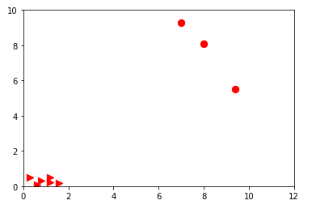
Unsupervised learning: k-means clustering
Consider the following nine points in the 2D space
Circles comprise one cluster
Triangles comprise another cluster
Points are represented by their coordinates only.
We apply k-means clustering algorithm to identify the clusters
K-means is unsupervised learning method – no labels are given
7 | 9.3
7.7 | 16
8 | 8.1
6.7 | 7.3
1.2 | 0.5
0.3 | 0.5
0.6 | 0.1

Slide 6
Unsupervised learning: k-means clustering
Example 1:
Given the following 7 points in 2D space
apply k-means clustering to identify two clusters
Variant 1: use scikit-learn
from sklearn.cluster import KMeans
import numpy as np
X = np.array([[7, 9.3], [7.7, 16], [8, 8.1], [6.7, 7.3], [1.2,0.5],[0.3,0.5],[0.6,0.1]])
m0 = np.array([[3,4],[1,1]])
kmeans = KMeans(n_clusters=2, init=m0,verbose=1,random_state=0).fit(X)
res=kmeans.predict([[7, 9.3]]
Variant 1: use a variant of expectation maximization (EM) algorithm
7 | 9.3
7.7 | 16
8 | 8.1
6.7 | 7.3
1.2 | 0.5
0.3 | 0.5
0.6 | 0.1

Slide 7
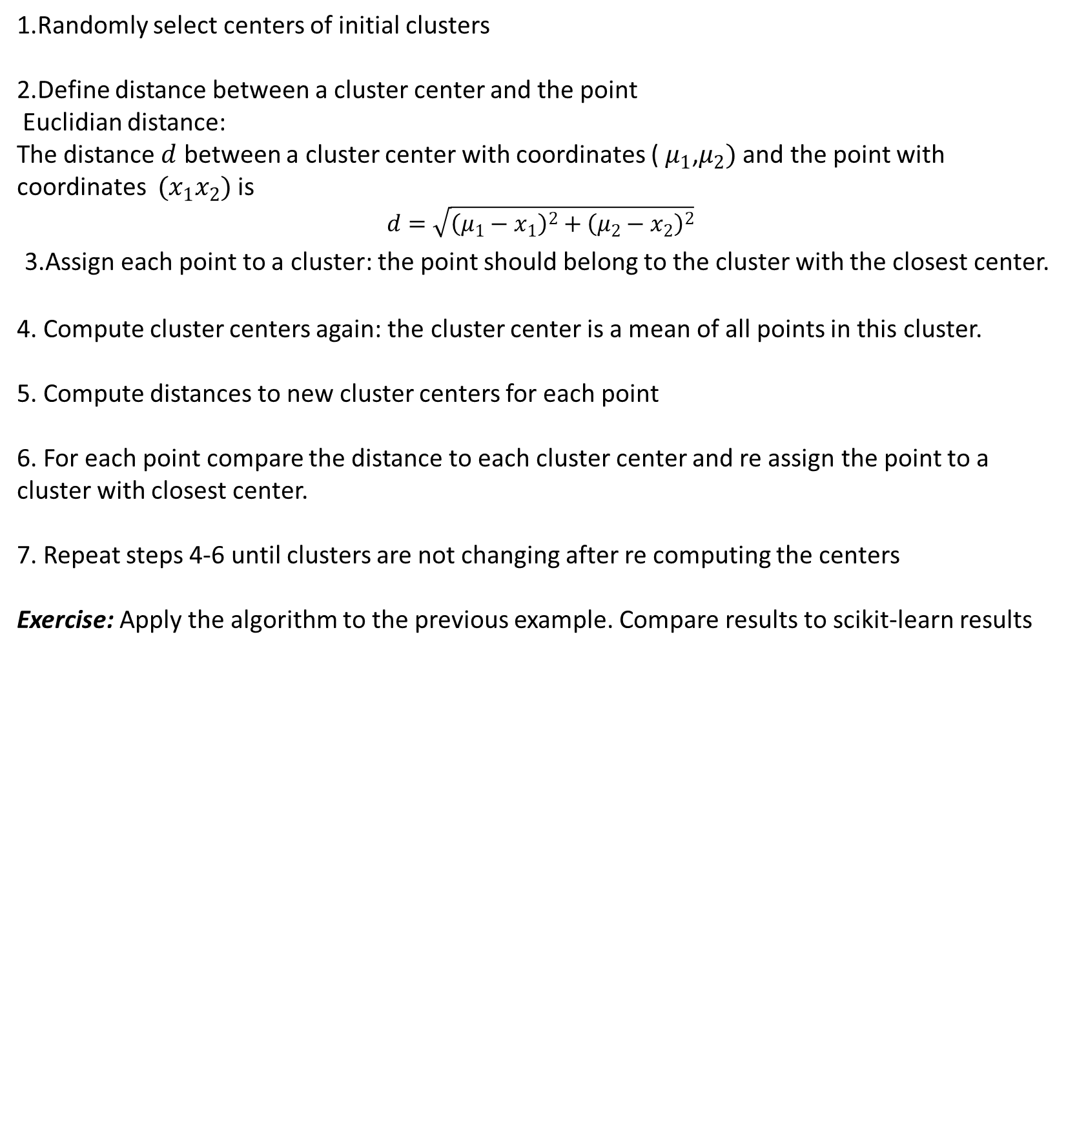
Unsupervised learning: variant of EM algorithm
1.Randomly select centers of initial clusters
2.Define distance between a cluster center and the point
Euclidian distance:
The distance $d$ between a cluster center with coordinates ( $μ_{1}$,$μ_{2})$and the point with coordinates $(x_{1}x_{2})$ is
$$d=\sqrt{{\left(μ_{1}−x_{1}\right)}^{2}+{\left(μ_{2}−x_{2}\right)}^{2}}$$
3.Assign each point to a cluster: the point should belong to the cluster with the closest center.
4. Compute cluster centers again: the cluster center is a mean of all points in this cluster.
5. Compute distances to new cluster centers for each point
6. For each point compare the distance to each cluster center and re assign the point to a cluster with closest center.
7. Repeat steps 4-6 until clusters are not changing after re computing the centers
Exercise: Apply the algorithm to the previous example. Compare results to scikit-learn results

Slide 8
Mix of categorical and numerical data
Euclidian distance – good for numerical data
How to measure distance if data has mixed values, categorical and numerical
One-hot encoding
https://machinelearningmastery.com/why-one-hot-encode-data-in-machine-learning/
Disadvantage – increasing number of features
A dataset with continues and binary data should be standardized
(see standardScaler in scikit-learn)

Slide 9
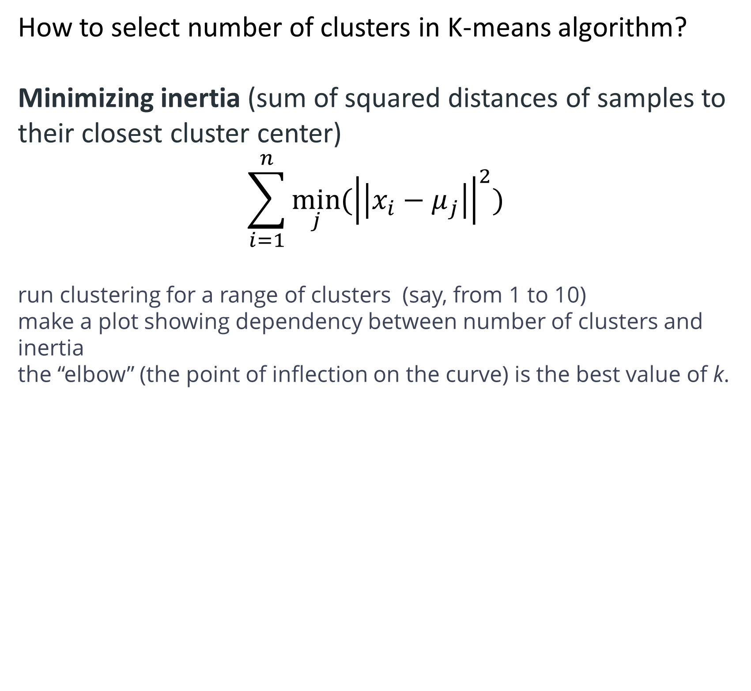
Unsupervised learning: Elbow method
How to select number of clusters in K-means algorithm?
Minimizing inertia (sum of squared distances of samples to their closest cluster center)
$$\sum_{i=1}^{n}{\min_{j}{({\left|\left|x_{i}−μ_{j}\right|\right|}^{2})}}$$
run clustering for a range of clusters (say, from 1 to 10)
make a plot showing dependency between number of clusters and inertia
the “elbow” (the point of inflection on the curve) is the best value of k.

Slide 10
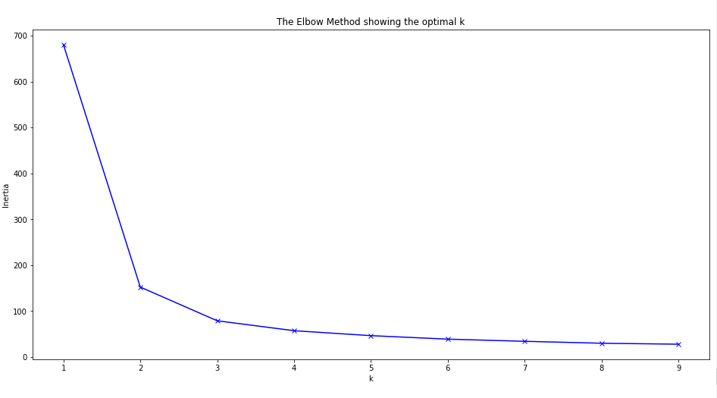
Unsupervised learning: Elbow method
Example: what is the optimal number of clusters for Iris dataset?

Slide 11
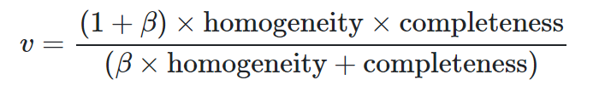
Unsupervised learning: accuracy metrics
comparing with labeled data:
homogeneity: each cluster contains only members of a single class.
completeness: all members of a given class are assigned to the same cluster.
v_measure (mutual information)
comparing with labeled data:
Silhouette - Compute the mean Silhouette Coefficient (SC) of all samples.
For each sample the (SC) is (b - a) / max(a, b)
where
a is the mean intra-cluster distance,
b is the mean nearest-cluster distance (distance between a sample and the nearest cluster that the sample is not a part of)
SC is defined if number of labels is 2 <= n_labels <= n_samples - 1.

Slide 12
Natural Language Processing: document representation
Euclidian distance vs.Cosine similarity
Bag of Words model
Simple movie recommendation system
Twenty newsgroups documents classification

Slide 13
Cosine similarity
cosine similarity between samples in X and Y - normalized dot product of X and Y
K(X, Y) = <X, Y> / (||X||*||Y||).
This is L2-normilized product of vectors
This is called cosine similarity, because Euclidean (L2) normalization projects the vectors onto the unit sphere, and their dot product is then the cosine of the angle between the points denoted by the vectors

Slide 14
Example: movie recommendation system
create movie recommendation system based on movie dataset. Unsupervise learning method. User enters the name of the movie and system returns 5 most similar movies. Similarity I based on keywords, cast, genres and director
import pandas as pd
import numpy as np
from sklearn.feature_extraction.text import CountVectorizer
from sklearn.metrics.pairwise import cosine_similarity
#from sklearn.metrics.pairwise import polynomial_kernel
df = pd.read_csv('moviedata.csv')
features = ['keywords','cast','genres','director']
def combine_features(row):
return row['keywords']+' '+row['cast']+' '+row['genres']+''+row['director']

Slide 15
Example: movie recommendation system
for feature in features:
df[feature] = df[feature].fillna('') #filling all NaNs with blank string
#applying combined_features() method over each rows of dataframe and storing the combined string in “combined_features” column
df['combined_features'] = df.apply(combine_features,axis=1)
cv = CountVectorizer() #creating new CountVectorizer() object
count_matrix = cv.fit_transform(df['combined_features']) #feeding combined strings(movie contents) to CountVectorizer() object
cosine_sim = cosine_similarity(count_matrix)
def get_title_from_index(index):
return df[df.index == index]['title'].values[0]
def get_index_from_title(title):
return df[df.title == title]['index'].values[0]

Slide 16
Example: movie recommendation system
#Users may enter their favorite movie and see the list of similar movies
movie_user_likes = 'Avatar'
movie_index = get_index_from_title(movie_user_likes)
#accessing the row corresponding to given movie to find all the similarity scores for that movie and then enumerating over it
similar_movies = list(enumerate(cosine_sim[movie_index]))
sorted_similar_movies = sorted(similar_movies,key=lambda x:x[1],reverse=True)[1:]
i=0
print('Top 5 similar movies to '+movie_user_likes+' are:\n')
for element in sorted_similar_movies:
print(get_title_from_index(element[0]))
i=i+1
if i>5:
break

Slide 17
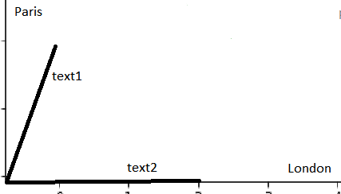
Documents representation
Examples.
Two texts are given, text1 and text2
text1: ’London, Paris, Paris’
text2: ’London, London, London’
how similar are they?
The quantification of similarity will be based on the following model:
Dictionary of all possible words in the documents is represented by multidimensional space of vectors. Axes represent words in the dictionary. Each document is represented by a vector with n coordinates, where each coordinate represents a word from a dictionary. If certain word appears in document m times than the component of the vector along this coordinate has length m.
If certain word from the dictionary is not found in this text the corresponding component of document vector is 0.
In the example above, text1 will have two non zero components, London and Paris:
text1: (1,2), whereas text2: will have one nonzero component, London: (3,0)
Similarity between text1 and text2 can be measured using
cosine similarity metric: K(X, Y) = <X, Y> / (||X||*||Y||).
Dot product of text1 and text2: <text1,text2> = 1*3+2*0=3
||text1||=sqrt(5), ||text2||=3
K(text1,text2)=1/sqrt(5)=0.4472
Exercise: compute cosine similarity using scikit-learn

Slide 18
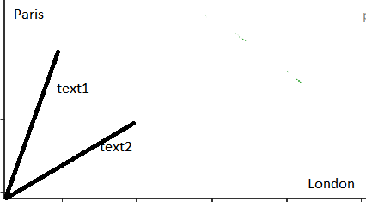
Documents representation
Another Example
Two texts are given, text1 and text2
text1: ’London, Paris, Paris’
text2: ’London, Paris, London’
Again, the dictionary consists of 2 words, ‘London’ and ‘Paris’
In the example above, text1 and text2 have two non zero components, London and Paris:
text1: (1,2), text2: (2,1)
Similarity between text1 and text2 can be measured using
cosine similarity metric
K(X, Y) = <X, Y> / (||X||*||Y||)
Dot product of text1 and text2: <text1,text2> = 1*2+2*1=4
||text1||=sqrt(5), ||text2||=sqrt(5), K(text1,text2)=4/5=0.8
from sklearn.metrics.pairwise import cosine_similarity
import numpy as np
text1=np.array([1,2]).reshape(1,-1)
text2=np.array([2,1]).reshape(1,-1)
res=cosine_similarity(text1, text2) # res=0.8

