Slide 1
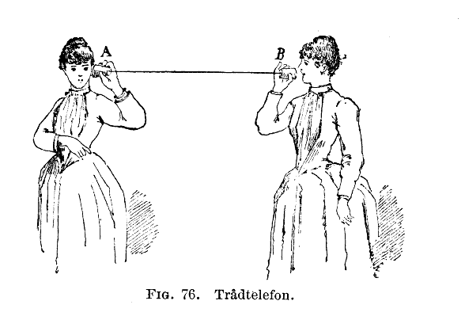
Quantifying the Qualitative:
Examining Relationships in Literary Texts
Adam J. Kneeland
Lindsey Seatter
Nadia Timperio

Slide 2
Research Questions
Adam: To what degree do non-human characters participate in the social networks of Mary Russell Mitford’s Our Village, and how does that speak to Mitford’s preservationist project?
Lindsey: Can the social relationships in Austen’s novels be successfully modeled? More specifically, how can Austen’s novels be successfully transformed into a quantitative data set that allows the interrogation of the types of social structures reflected in her canon?
Nadia: What role does emotion play in Richard Wright’s Native Son? What do the moments of slippage between the main character’s emotions reveal about the narration as a whole?

Slide 3
Why Come Together as a Panel?
Characters in Austen’s Mansfield Park and Emma
Characters and actions in Mitford’s Our Village
Social
Relationships
Emotions in Wright’s Native Son

Slide 4
Parameters & Data
Networks, or more specifically social networks, are comprised of two different features
Nodes
Edges

Slide 5
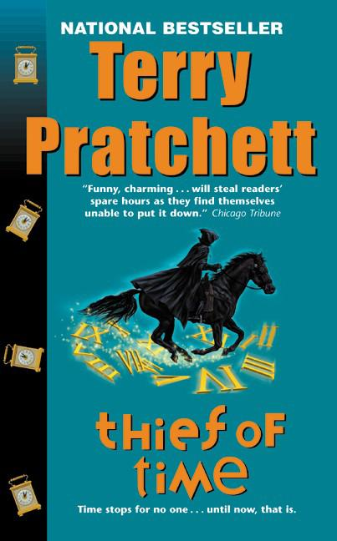


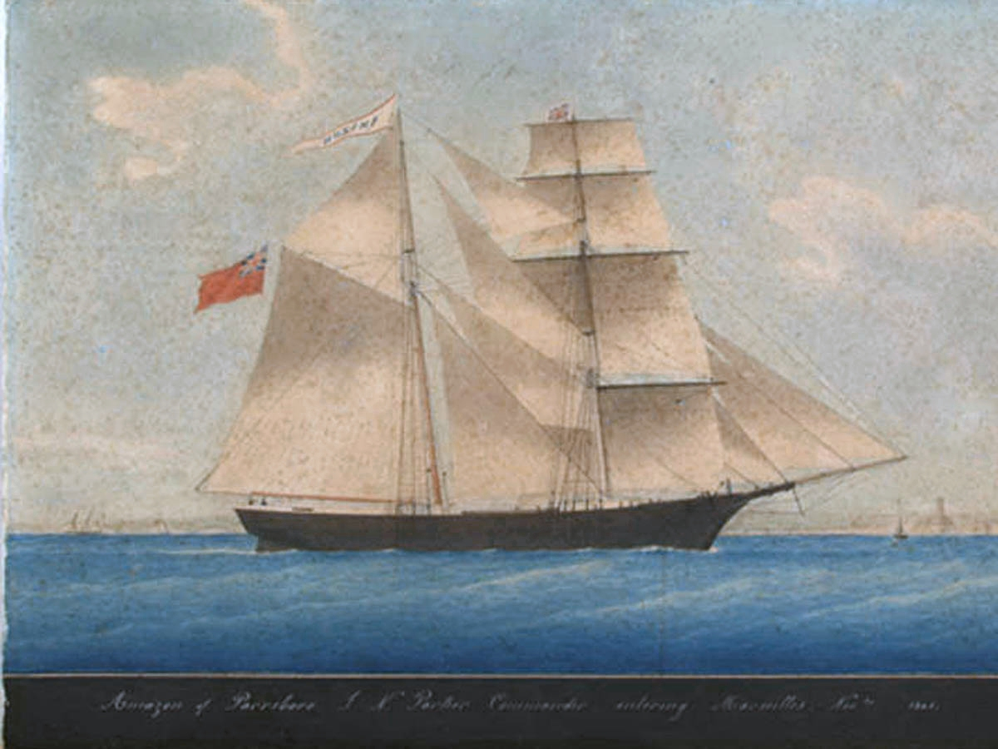

Parameters & Data
Nodes

Slide 6
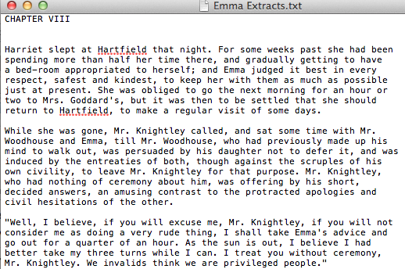
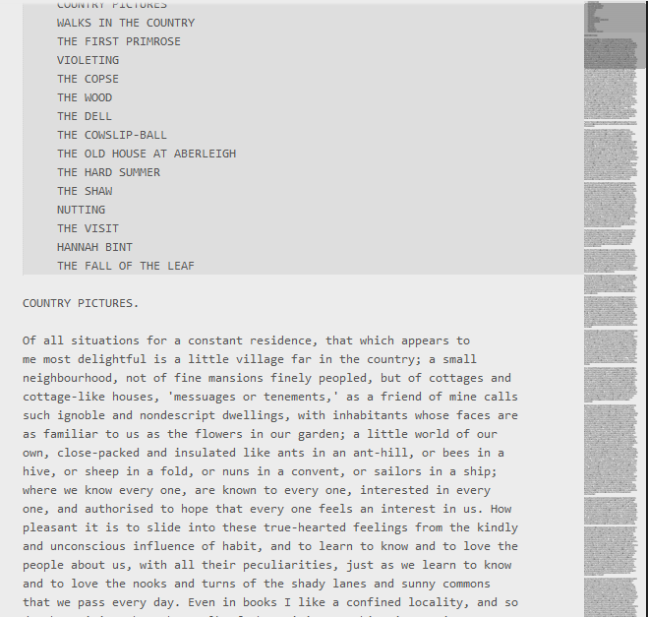
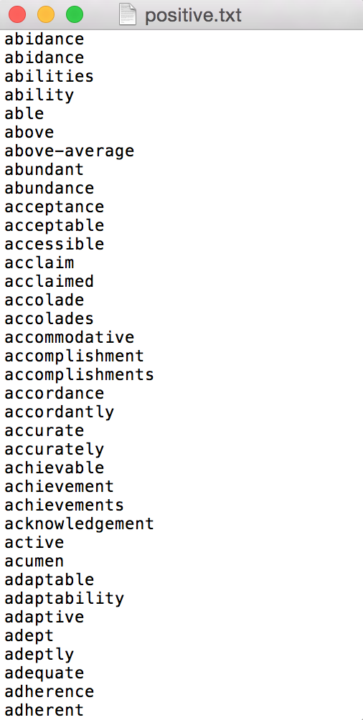
Parameters & Data
Adam: verbs and proper nouns
Lindsey: characters present in a given chapter
Nadia: moments when the narrator explicitly mentions the emotions a character is experiencing

Slide 7
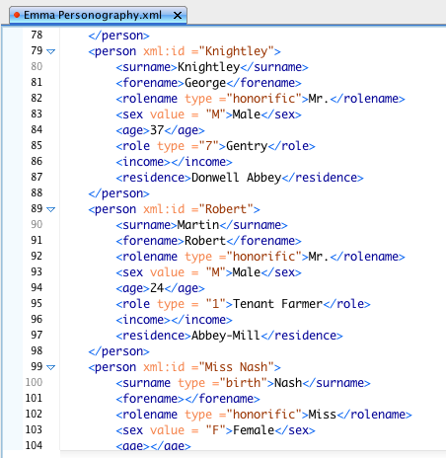
Parameters & Data
How do you retain the dynamic qualities of a character (integral to Austen’s style) when networks nodes are flat, static, and relatively unimportant features in a network?
Supplemented the network with TEI → used XML personography to do this in a detailed, yet distilled and formulaic, manner

Slide 8





Parameters & Data
Relationships

Slide 9
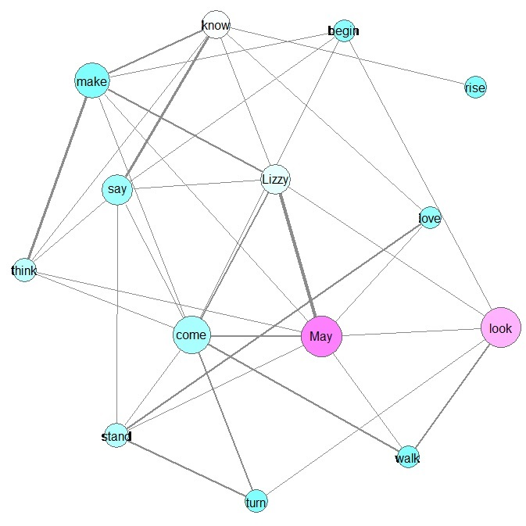
Parameters & Data
Adam: co-occurrence of verbs and proper nouns within a given paragraph
Lindsey: interactions between characters in a given chapter
Nadia: what happens between identifications of emotion. The journey between emotions, as narrated by an unidentified third-person omniscient, intrusive narrator

Slide 10
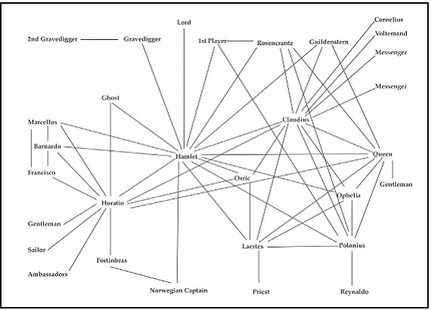
Parameters & Data
Network of characters who exist on stage together in Hamlet
Moretti, Franco. “Network Theory, Plot Analysis.” New Left Review 68 (2011): 80-102. Print.

Slide 11
Parameters & Data
To weight or not to weight, that is the question…
To weight...that is the answer
In using a method that is reductive by nature on objects that are infinitely complex, it is important to leverage each function of the network to display significant information on the relationships at work in the text
Weight is another avenue to communicate information within a heavily distilled graphic

Slide 12
Methods
Prototype
Literary text
Computational methods
Literary analysis

Slide 13
Methods
Network analysis
Network analysis
Sentiment analysis
Austen’s Mansfield Park & Emma
Mitford’s Our Village
Wright’s Native Son
CSV; Gephi
khcoder
CSV; Python
Literary analysis

Slide 14
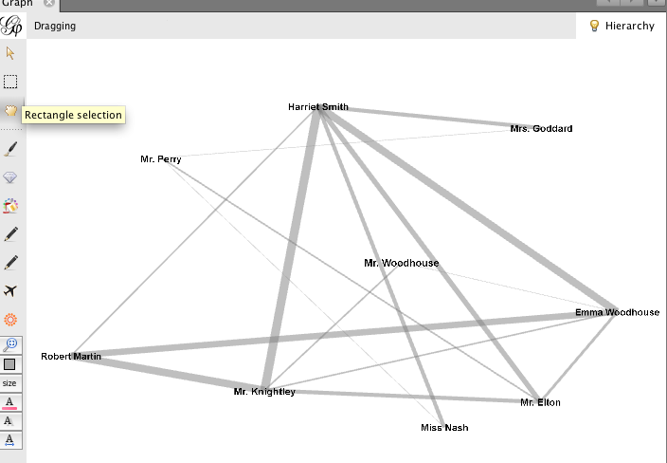
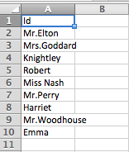
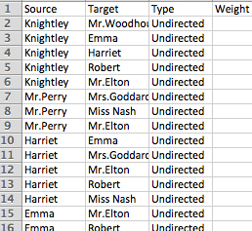
Methods
Gephi
CSV

Slide 15
Methods
Major challenges in qualitative data analysis are:
Collecting and managing the data
Turning the text into numbers of some sort
Analyzing the numbers

Slide 16
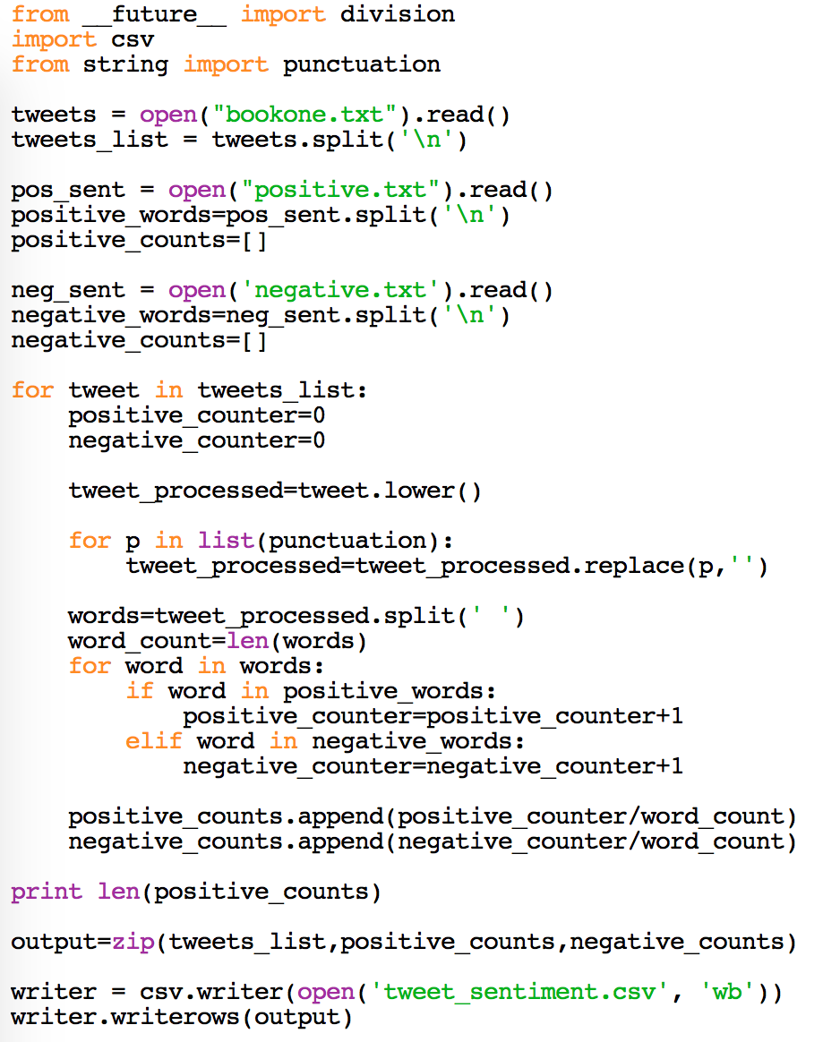
Methods
Python
Import modules
Open the following local files:
“Book One: Fear” of Native Son (.txt)
Sentiment Dictionary - Positive (.txt)
Sentiment Dictionary - Negative (.txt)
Output results in .csv

Slide 17
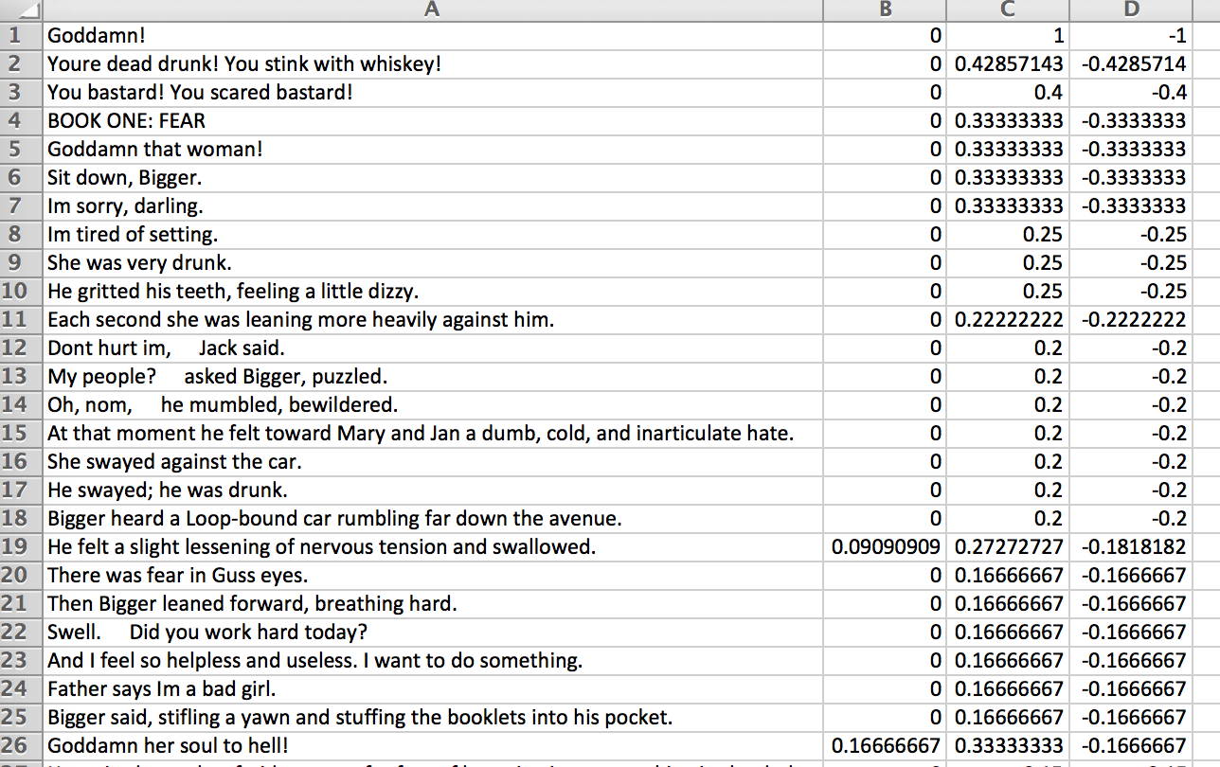
Methods
Positive Sentiment Value
Negative Sentiment Value
Net Value
Expected passages with strong sentiment values to direct to rich passages in the text
… Not the case!

Slide 18
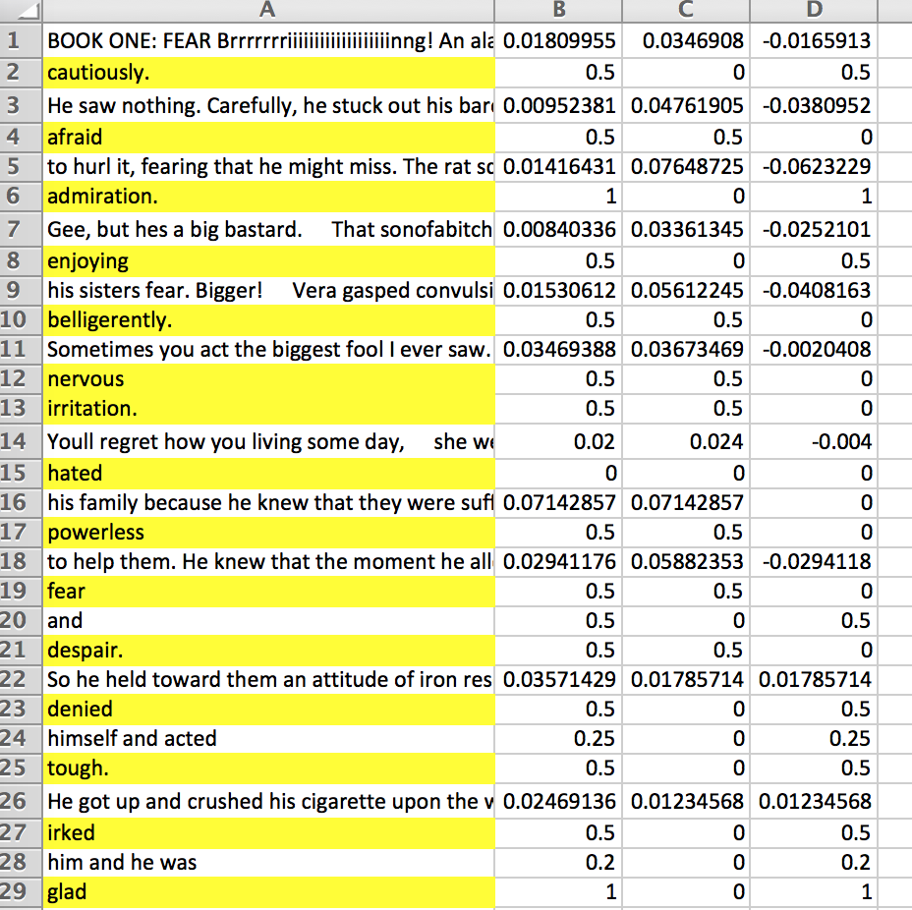
Methods
Positive Sentiment Value
Negative Sentiment Value
Net Value
New organization of text in .txt
Line breaks before and after the narrator identifies the central character’s feelings
Example:
“He grew / angry. / Why had he come to take this goddamn job? He could have stayed among his own people and escaped feeling this / fear / and / hate. / This was not his world; he had been / foolish / in thinking that he would have liked it.” (Wright 44)

Slide 19


Limitations-- Size of Corpus
← breadth
vs.
depth
↓
Or….

Slide 20

Black Boxing
How do computational analysis and critical analysis differ in terms of process transparency?
Lauren Klein: “The critic’s involvement in the design and implementation—or at the least, the selection and application—of digital tools demands an acknowledgment of his or her critical agency” (668).

Slide 21
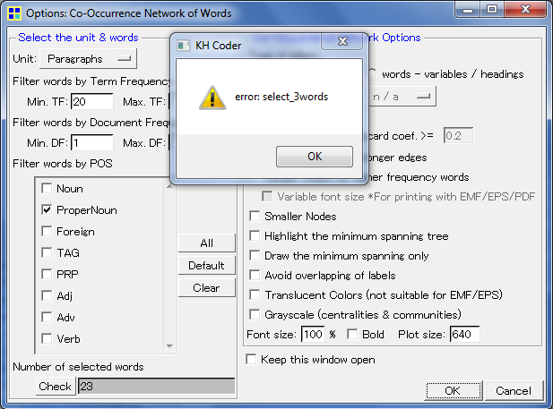
The element of…
… surprise!
an obstacle and an asset

Slide 22
References
Caren, Neal. “An introduction to text analysis with Python, Part 1.” Neal Caren. University of North Carolina, 4 Apr. 2012. Web. 20 Mar. 2015.
---. “An introduction to text analysis with Python, Part 2.” Neal Caren. University of North Carolina, 6 Apr. 2012. Web. 20 Mar. 2015.
---. “An introduction to text analysis with Python, Part 3.” Neal Caren. University of North Carolina, 10 Apr. 2012. Web. 20 Mar. 2015.
Felski, Rita. “Critique and the Hermeneutics of Suspicion.” M/C Journal 15.1 (2011). Web. 30 Mar. 2015.
Hogue, W. Lawrence. “Can the Subaltern Speak? A Postcolonial, Existential Reading of Richard Wright’s Native Son.” Southern Quarterly: A Journal of the Arts in the South 46.2 (2009): 9-39. Web. 4 Mar. 2015.
Klein, Lauren F. “The Image of Absence: Archival Silence, Data Visualization, and James Hemings.” American Literature 85.4 (2013): 662-688. Web. 30 Mar. 2015.
Moretti, Franco. “Network Theory, Plot Analysis.” New Left Review 68 (2011): 80-102. Print.
Weingart, Scott. “Demystifying Networks, Part I & II.” Journal of Digital Humanities 1 (2011). Web. 21 March. 2015. Wright, Richard. Native Son. New York: Perennial Classics, 1998. Print.

