Slide 1


Topic: Presentation on Artificial Intelligent Game Proposal with Min-max Algorithm
Course No: CSE 4110
Course Title: Artificial Intelligence
Submitted By:
Nadim Bin Hossain
Roll: 1807045
Year: 4th Semester: 1st
Dept of CSE,KUET

Slide 2
Game Name => Chomp: Fill Wise & Be Win
Chomp is a two-player strategy game played on a rectangular grid made up of smaller square cells
The players take cells in turns to choose one block and “eat it” (remove from the board)
Together with those that are below it and to its right
The top left block is “poisoned” and the player who eats it loses the game

Slide 3
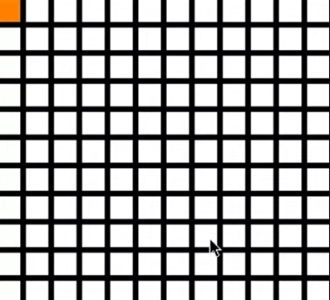
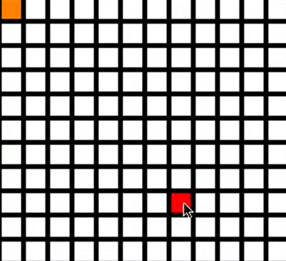
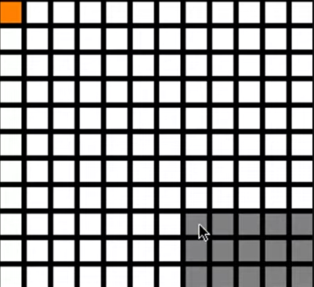
Visual Representation:
Fig-1: Starting Phase
Yellow block= poison
Fig-2: First Player’s turn
Selected square=red
Fig-3:Blocks own by player-1

Slide 4
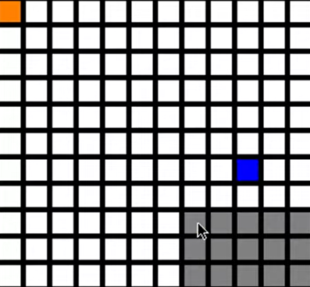
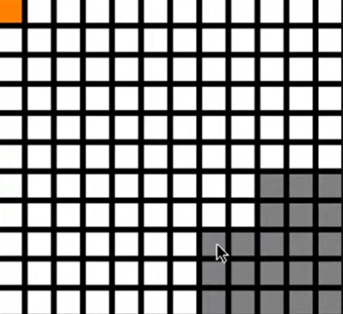
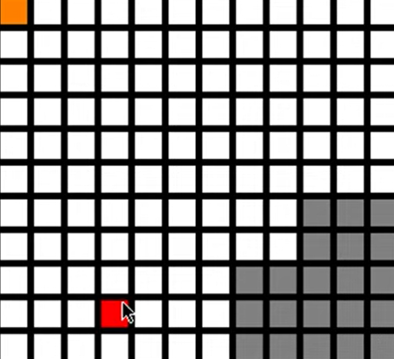
Visual Representation(cntd.)
Fig-4:Second player’s turn
Selected square = blue
Fig-5: Allocated blocks after second player’s move
Fig-6: Again First player’s turn

Slide 5
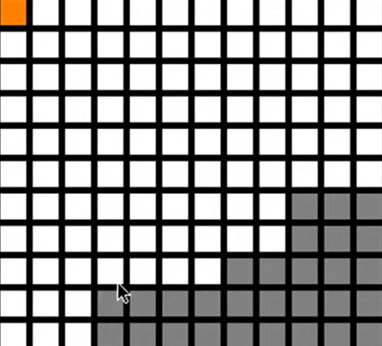
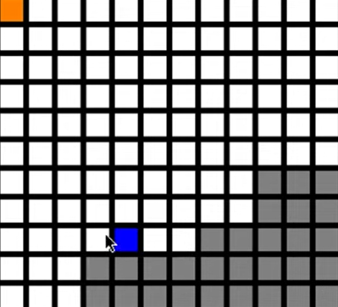
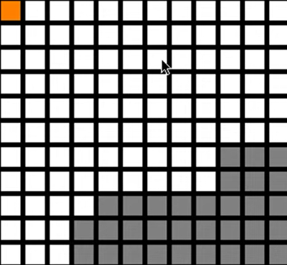
Visual Representation(cntd.)
Fig-7: Selected blocks after first player’s move
Fig-8:Again second player’s turn
Fig-9: Selected blocks after second player’s move

Slide 6
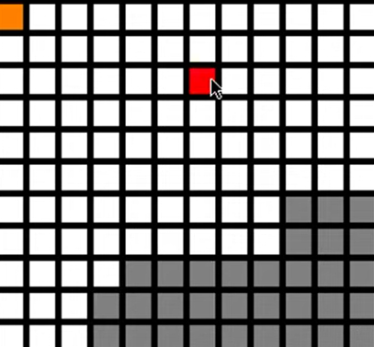
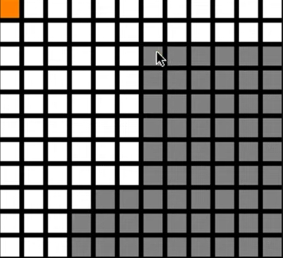
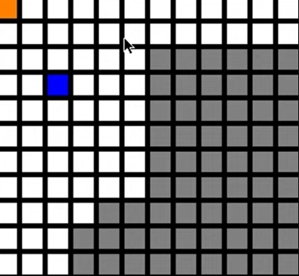
Visual Representation(cntd.)
Fig-11: first player’s allocated blocks
Fig-12: Second player’s move
Fig-10: first player’s move

Slide 7
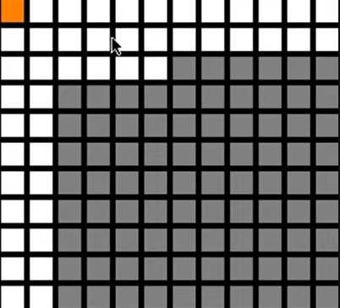
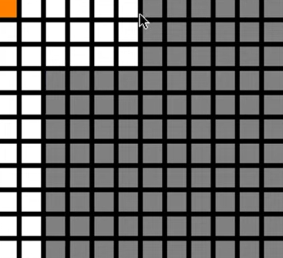
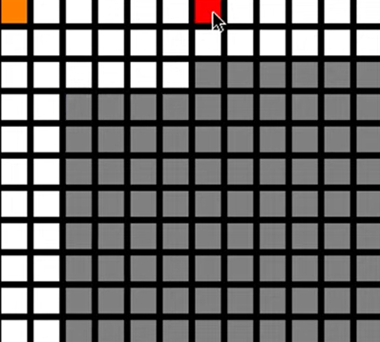
Visual Representation(cntd.)
Fig-13: First player’s move
Fig-14:Second player’s move
Fig-15:First player’s move

Slide 8
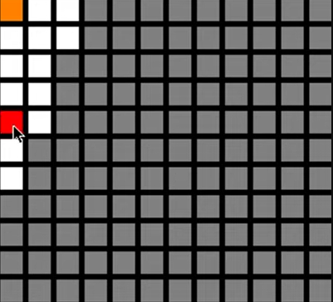
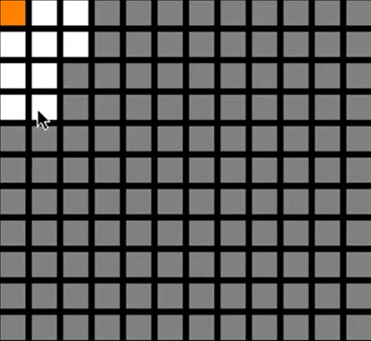
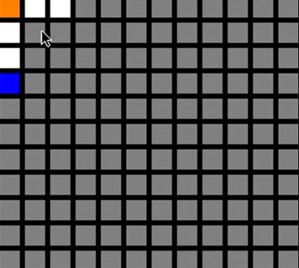
Visual Representation(cntd.)
Fig-16: First player’s move
Fig-17: Blocks own by First player
Fig-18: Second player’s move

Slide 9
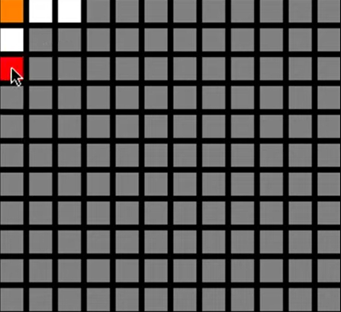
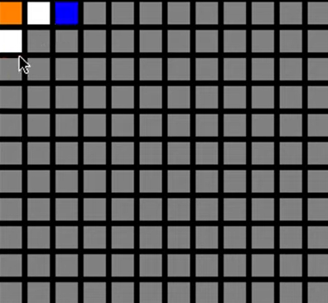
Visual Representation(cntd.)
Fig-20: second player wins!
Fig-19: first player’s move

Slide 10
THANK YOU

