Slide 1

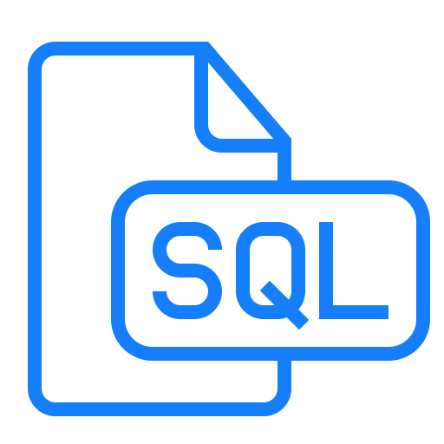

MongoDB VS SQL

Slide 2

Introduction SQL
SQL is a standard language for accessing and manipulating databases.
SQL Databases are typically used as Relational Databases. In addition to high-performance analytics, they provide various features for accessing, adding, managing, and processing data.

Slide 3
What We Can Do With SQL ?
SQL can execute queries against a database,retrieve data from a database
can insert records in a database,update records in a database
delete records from a database and create new databases
also can create new tables in a database
And can create stored procedures in a database,create views in a database
And SQL can set permissions on tables, procedures, and views

Slide 4
Introduction MongoDB
MongoDB is an open source NoSQL database management program. NoSQL is used as an alternative to traditional relational databases. NoSQL databases are quite useful for working with large sets of distributed data.

Slide 5
Use Cases MongoDB
Integrating large amounts of diverse data
Describing complex data structures
Delivering data in high-performance applications
Supporting hybrid and multi-cloud applications
Supporting agile development and collaboration

Slide 6


MongoDB vs SQL : In comparison to the SQL server, MongoDB is faster and more scalable. While the SQL server supports JOIN and Global transactions, MongoDB does not. The MS SQL server does not accommodate large amounts of data, however MongoDB does

