Slide 1

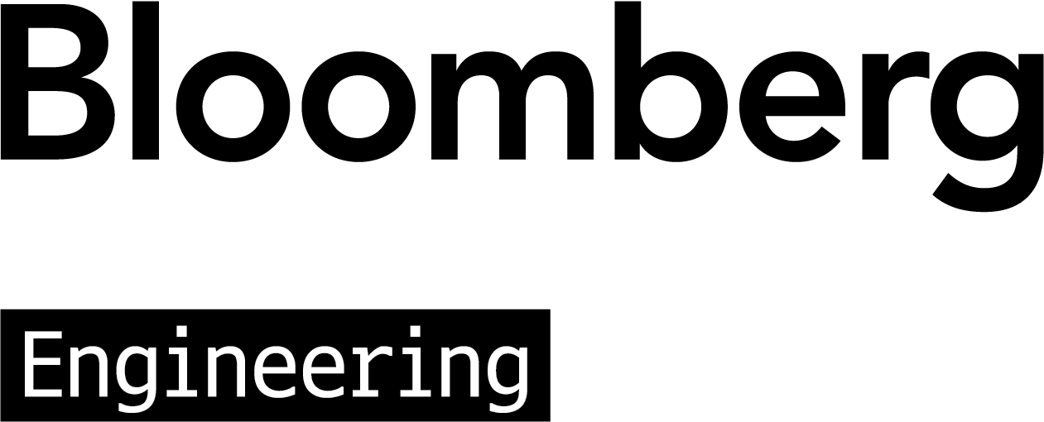
Right for the Right Reason: Information Extraction for Trustworthy Tabular Inference
https://tabevidence.github.io/
Vivek Gupta^{1*}, Shuo Zhang², Alakananda Vempala², Yujie He² Temma Choji² , Vivek Srikumar¹
¹University of Utah; ²Bloomberg
*Bloomberg Ph.D. Fellow (2021-2022)
*on academic job market
© 2022 Bloomberg Finance LP. All rights reserved.

Slide 2
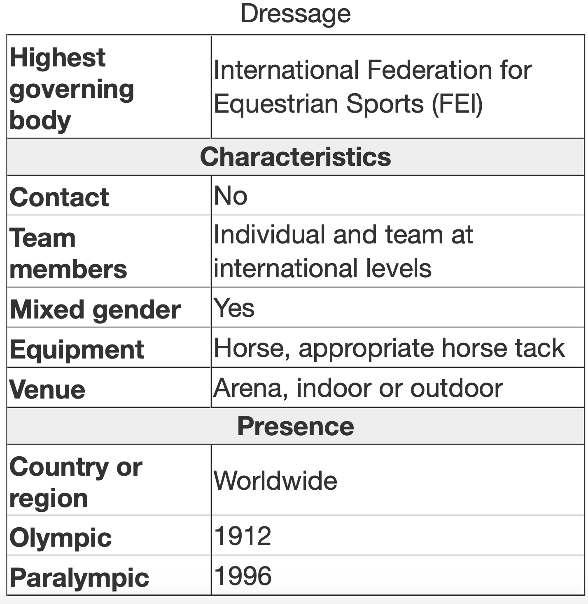
TABULAR INFERENCE
The tabular natural language inference problem is similar to standard NLI
But here, the premises are tabular data
Task: to decide whether a given hypothesis is true (entailment), false (contradiction), or undetermined (neutral) given a premise table
H1: Both men and women can complete in the contactless sport of Dressage →
Check out InfoTabS (Gupta et al., 2020) https://infotabs.github.io
Entail
© 2022 Bloomberg Finance LP. All rights reserved.

Slide 3
THE PROBLEM
Both men and women
can compete in the contactless
sport of Dressage (entail)
But why entail? assume the model is
→ attention at evidence (relevant rows)
→ correct reasoning (logical inference)
black box problem
“model doesn’t provide the highlighted evidence and the reasoning steps”
© 2022 Bloomberg Finance LP. All rights reserved.

Slide 4
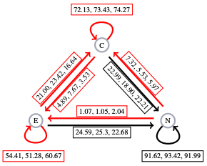
THE PROBLEM
remove the key “contact” from the table
Both men and women can compete in the contactless sport of Dressage (entail)
ideally prediction: (entail) → (neutral)
Check out Systematic
Tabular Probing (Gupta et al., 2022, TACL)
© 2022 Bloomberg Finance LP. All rights reserved.

Slide 5
It is not enough for a model to be merely right, but also it must be right for the right reasons.
Identifying the relevant elements of input as the
right reasons is essential for tabular reasoning.
© 2022 Bloomberg Finance LP. All rights reserved.

Slide 6
OUR CONTRIBUTIONS
Tabular reasoning models ignore the evidence table rows
Model should not be just right, but right for the right reasons
Case study on InfoTabS
Tabular Reasoning → Trustworthy Tabular Reasoning
Inference Task → Evidence Extraction + Inference Task
Two benefits of the trustworthy tabular reasoning:
make the model trustworthy and benefit the reasoning task
© 2022 Bloomberg Finance LP. All rights reserved.

Slide 7
EVIDENCE EXTRACTION
Both men and women can compete in the contactless sport of Dressage
Model Predictions
label : entailment
evidence : relevant rows
→ mixed gender :: both men and women
→ contact :: contactless
© 2022 Bloomberg Finance LP. All rights reserved.

Slide 8
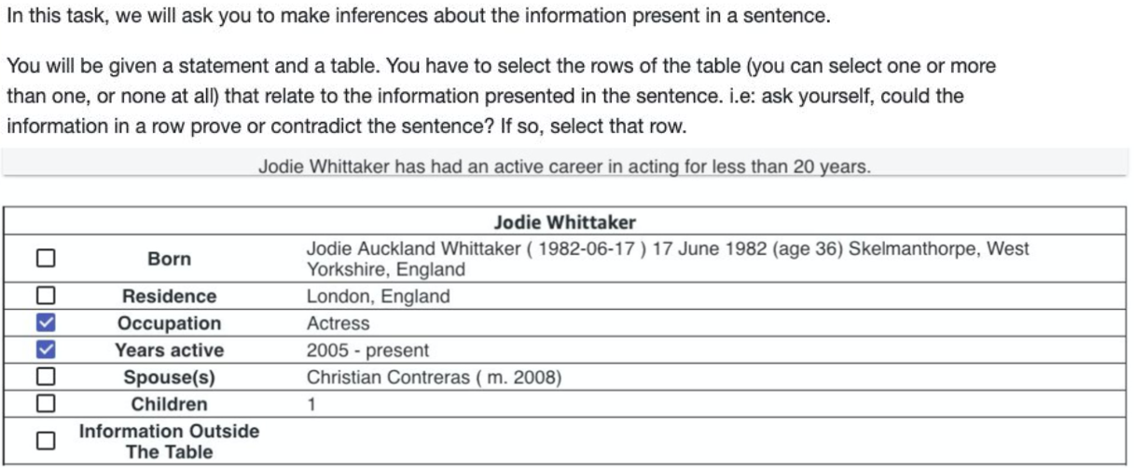
HUMAN PERFORMANCE
© 2022 Bloomberg Finance LP. All rights reserved.

Slide 9
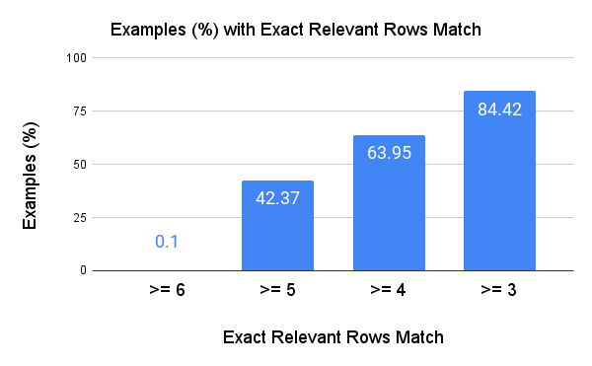
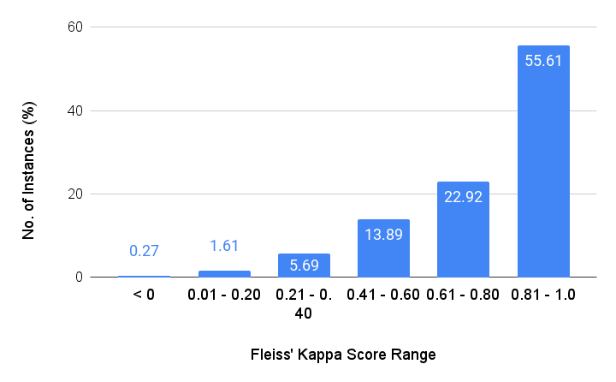
 | Precision | Recall | F1-Score
Avg-Micro | 89.88 | 91.57 | 90.06
Avg-Macro | 89.24 | 89.75 | 89.48
Mean: 0.79
Perfect 42% F1 Score:
>= 80% F1 for 85.01%
>= 85% F1 for 70.26%
>= 90% F1 for 61.88%
Perfect 59% precision, 60% recall
© 2022 Bloomberg Finance LP. All rights reserved.

Slide 10
OUR APPROACH (TRUSTWORTHY TABULAR INFERENCE)
TABLE TITLE
KEY A | VALUE A
KEY B | VALUE B
KEY C | VALUE C
KEY D | VALUE D
KEY E | VALUE E
TABLE TITLE
KEY A | VALUE A
KEY D | VALUE D
Evidence Extraction
HYPOTHESIS
NLI (h)
Tabular Premise
NLI LABEL
Evidence Extraction
Inference Prediction
© 2022 Bloomberg Finance LP. All rights reserved.

Slide 11
RESULTS AND ANALYSIS
Two-stage sequential prediction
Evidence extraction
Unsupervised : DRR (Neeraja et al., 2021), WMD (Gupta et al., 2020), SimAlign (Sabet et al., 2020), SimCSE (Gao et al., 2021)
Supervised : Binary classification (for each row in table)
→ f(row,hypothesis) → {relevant, non-relevant}
→ Hard negative via unsupervised methods
Inference prediction
for more details refer the paper
© 2022 Bloomberg Finance LP. All rights reserved.

Slide 12
RESULTS AND ANALYSIS
InfoTabS dataset splits:
α1 contains table from same domain (similar to dev & train set)
α2 has examples from same domain but entail-contradict label (e.g., ‘over’ to ‘under’) flipped by minimal change (i.e., adversarial).
α3 is zero-shot cross domain tables (exclusive from train set domains)
Check out InfoTabS: https://infotabs.github.io
© 2022 Bloomberg Finance LP. All rights reserved.

Slide 13
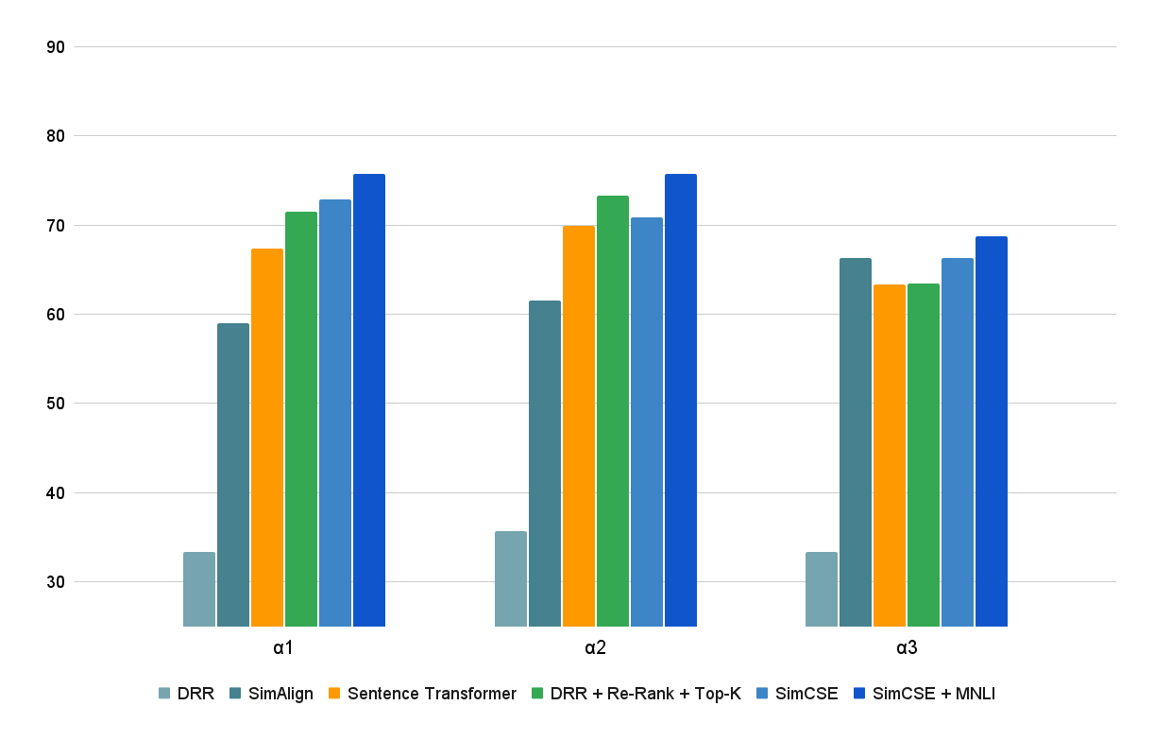

UNSUPERVISED EXTRACTION
Baseline Models
Bad precision
Good recall
→ Poor F1-score
© 2022 Bloomberg Finance LP. All rights reserved.

Slide 14
UNSUPERVISED EXTRACTION
DRR and Alignment
Re-Rank
→ exact matching (key and hypothesis)
Dynamic Top-K
Overall
Precision → F1-Score
Zero-shot (α3) is hard
© 2022 Bloomberg Finance LP. All rights reserved.

Slide 15
UNSUPERVISED EXTRACTION
Transformer Models
Better performance
Hypo-Title Swap: confounding of <TITLE> similarity
Re-Rank and Dynamic Top-K
© 2022 Bloomberg Finance LP. All rights reserved.

Slide 16
UNSUPERVISED EXTRACTION
Distant supervision via MNLI help
© 2022 Bloomberg Finance LP. All rights reserved.

Slide 17
Human performance
UNSUPERVISED
EXTRACTION
Human Outperforms
© 2022 Bloomberg Finance LP. All rights reserved.

Slide 18
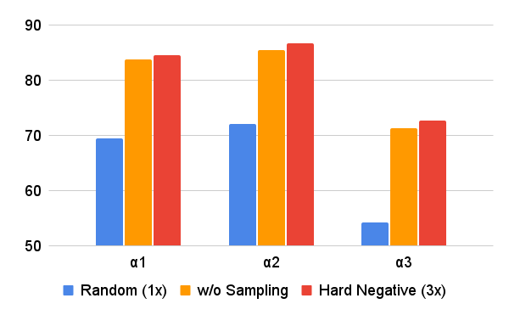
SUPERVISED
EXTRACTION
Human performance
No sampling > Random sampling
Adding hard negative benefits
Humans outperform models especially on zero-shot (α3)
© 2022 Bloomberg Finance LP. All rights reserved.

Slide 19
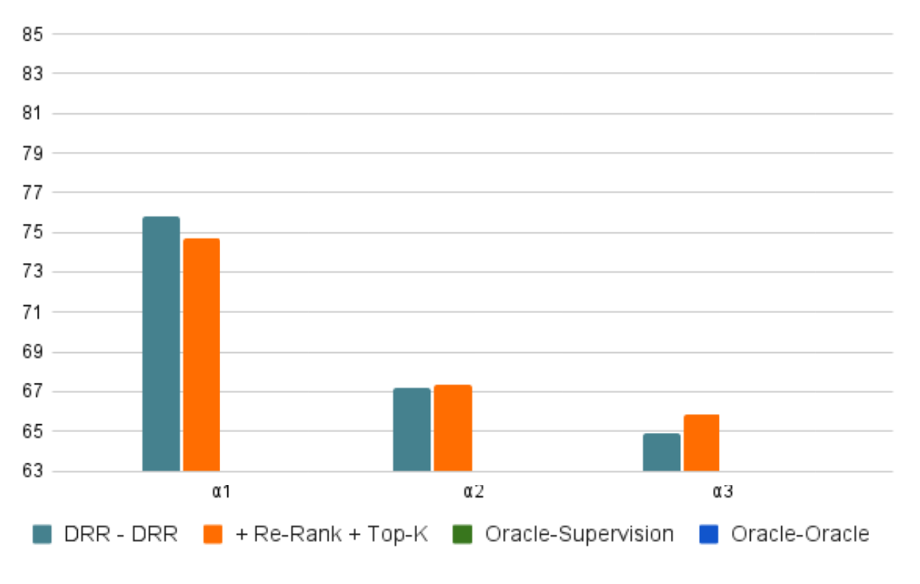
INFERENCE
Re-Ranking & Dynamic Top 1,2 effect
no effect on in-domain set (i.e., α1 and α2)
benefit zero-shot (i.e., α3)
© 2022 Bloomberg Finance LP. All rights reserved.

Slide 20
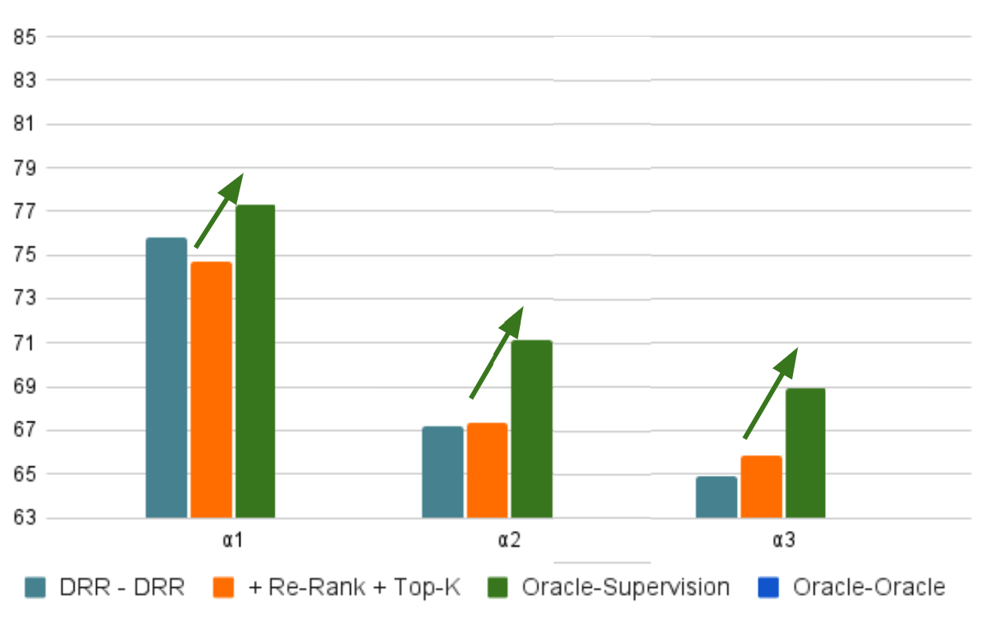
INFERENCE
With and without extraction
Supervision Help
In-domain (α1)
adversarial (α2)
zero-shot (α3)
© 2022 Bloomberg Finance LP. All rights reserved.

Slide 21
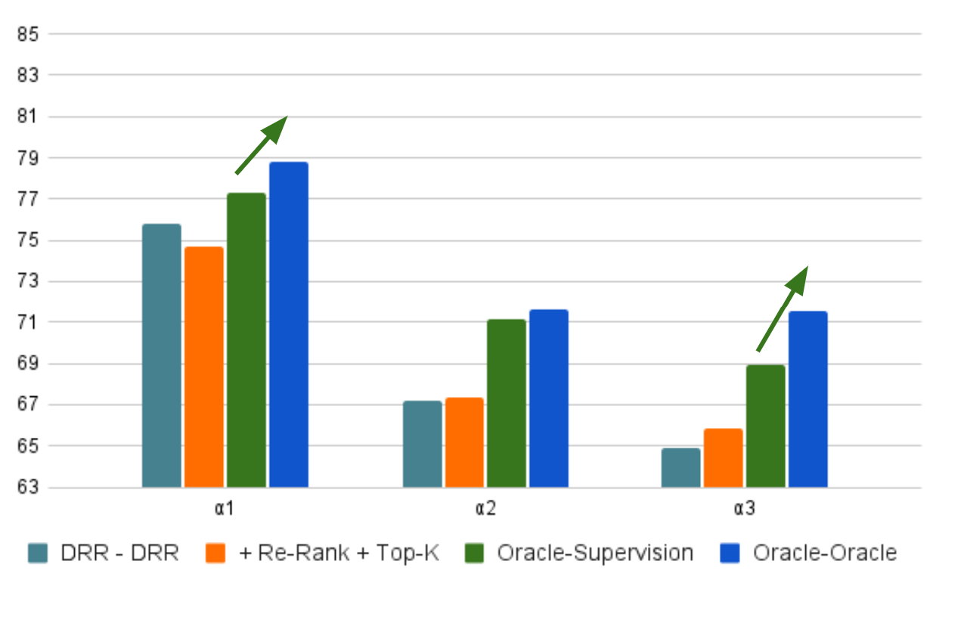
INFERENCE
Human vs. Model
Human extraction better
Especially for zero-shot (α3)
© 2022 Bloomberg Finance LP. All rights reserved.

Slide 22
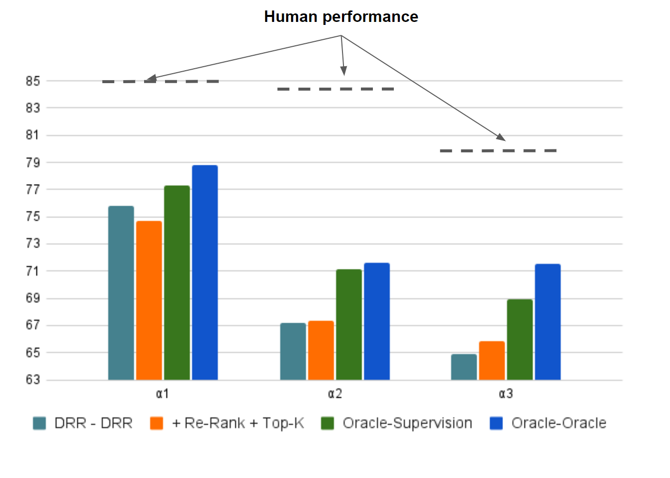
INFERENCE
Human
Extraction vs. Direct NLI
© 2022 Bloomberg Finance LP. All rights reserved.

Slide 23
TAKE AWAYS
Tabular reasoning models ignore the evidence table rows
Model should not be just right, but right for the right reasons
Case study on InfoTabS
Tabular Reasoning → Trustworthy Tabular Reasoning
Inference Task → Evidence Extraction + Inference Task
Two benefits of the trustworthy tabular reasoning
make the model trustworthy and benefit the reasoning task
© 2022 Bloomberg Finance LP. All rights reserved.

