Slide 1
CODEBLOCKS CODER
NADIM NAWSHAD
MD. FAHIM KABIR CHOWDHURY
SANJANA AHMED SHUSME
MD ASHIKUZZAMAN SRESTO
TAHASEN HOSSAIN
Notes:
nadim

Slide 2
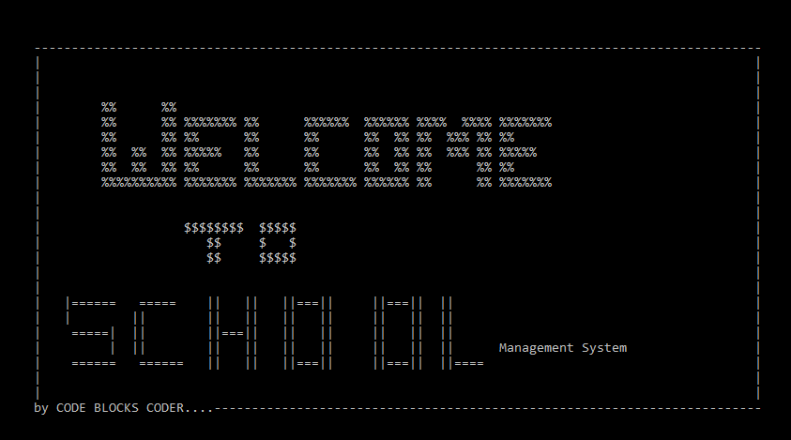
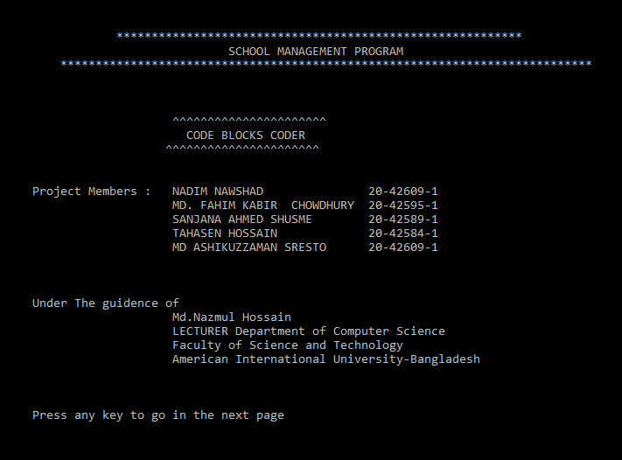
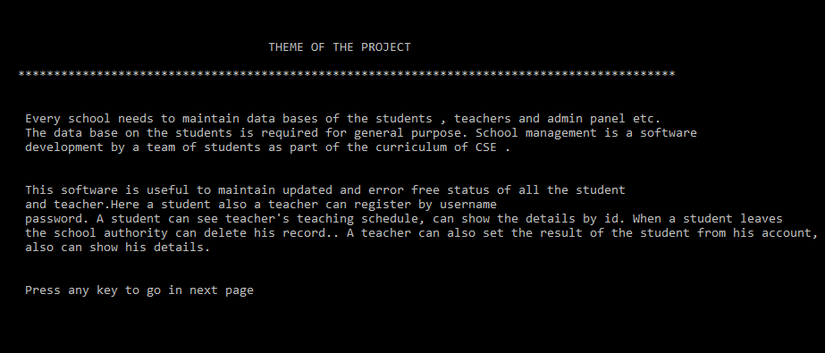
Project Introduction

Slide 3
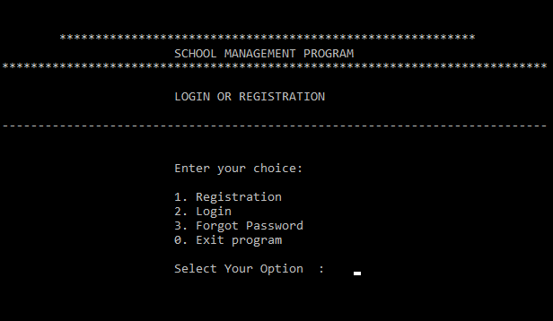
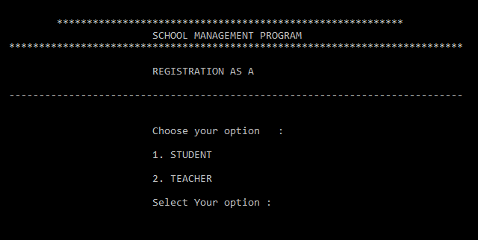
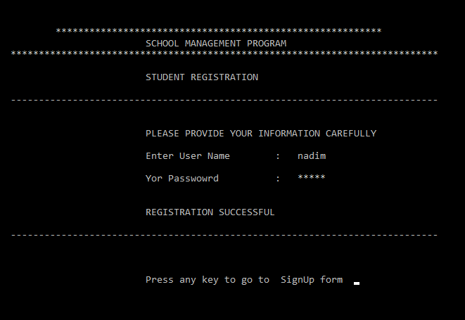
Registration
If a student or teacher want to Admit in the school then he/she needs to register first.

Slide 4
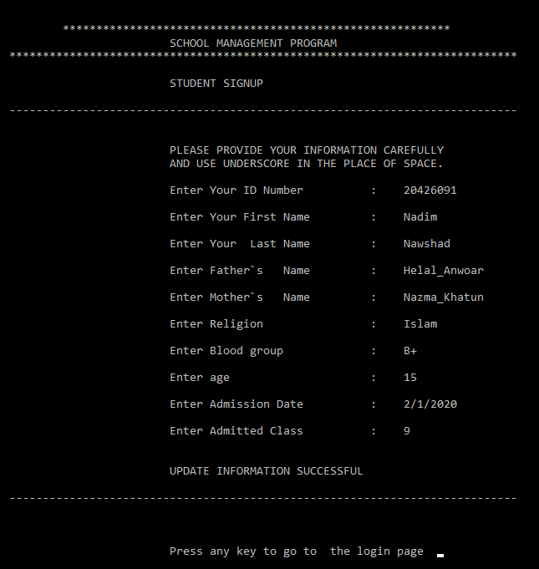
Sign Up
After completing the registration he/she has to fill the sign up from.

Slide 5
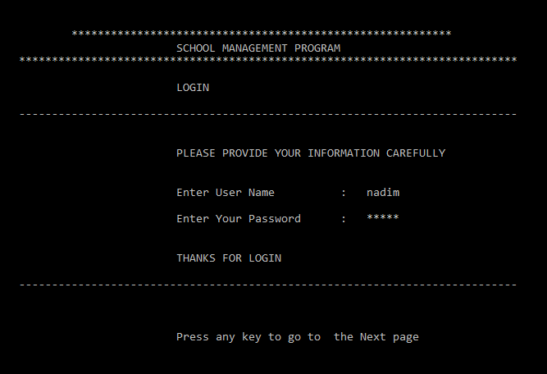
Log In
When he/she complete the sign up form then he/she can login by giving his/her username and password. System will detect automatically weather he/she is a student, teacher or admin to the School Management System.

Slide 6
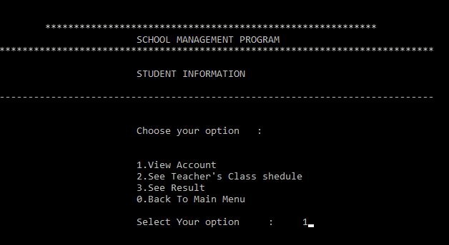
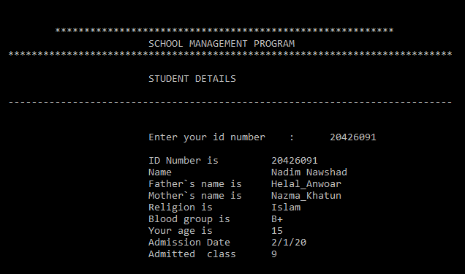
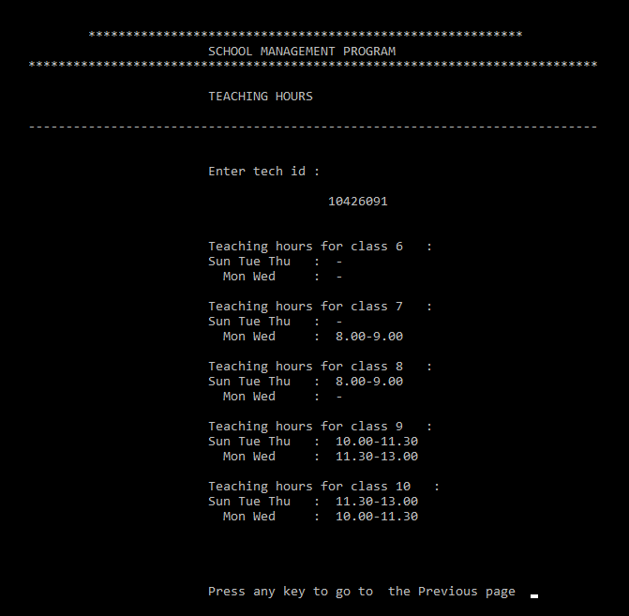
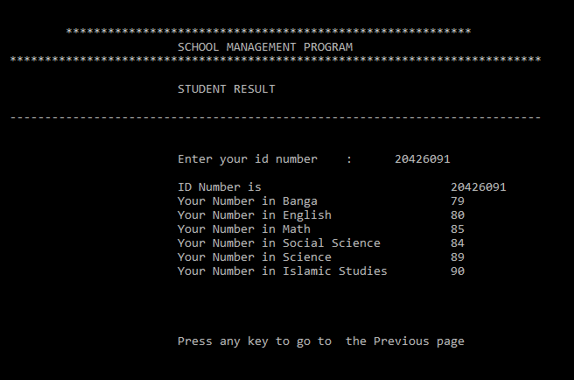
Student
When a student will login, he/she can view his/her account. Also can see his/her teacher’s teaching schedule. And also can see his/her result. He/she needs to provide his Id number to find his details

Slide 7
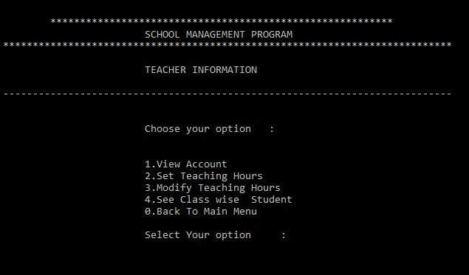
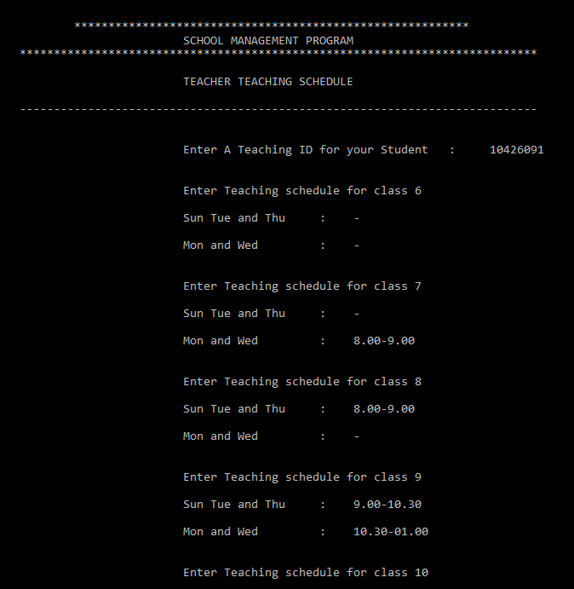
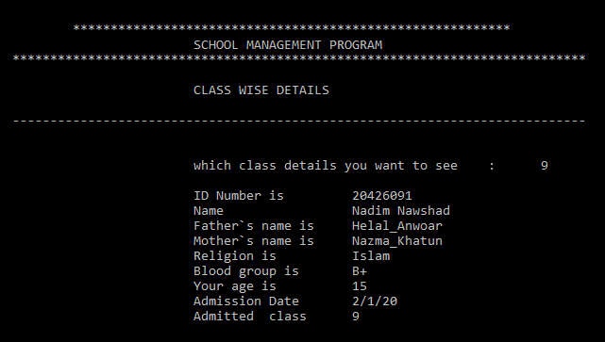
Teacher
When a teacher will login, he/she can view his/her account. Also set a teaching schedule
and can modify his/her teaching schedule. And also can see his/her student in every class. He/she needs to provide a new Unique Id number so that student can find his teaching schedule.

Slide 8
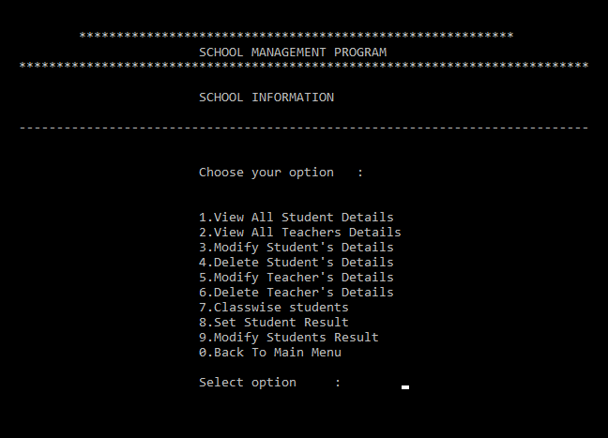
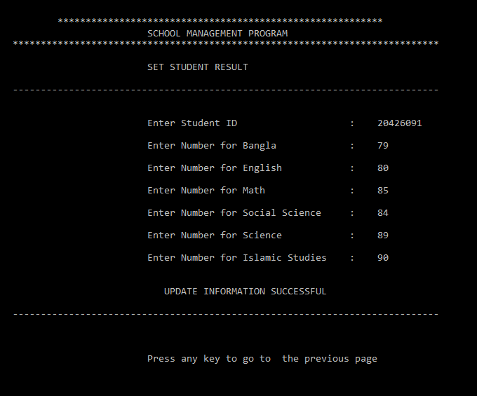
Admin
When a student will login, he/she can view his/her account. Also can see his/her teacher’s teaching schedule. And also can see his/her result. He/she needs to provide his Id number to find his details

Slide 9
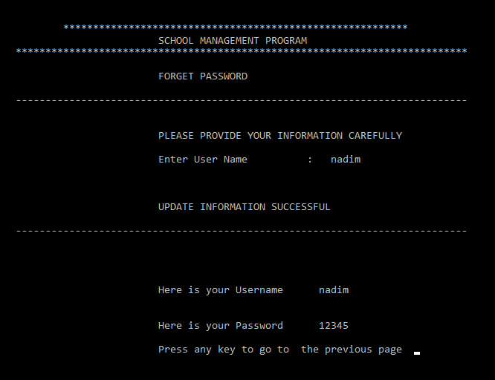
Forget Password

Slide 10
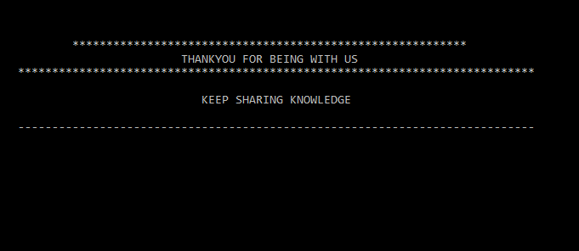
Exit Program

Slide 11

THANKS!

