Slide 1
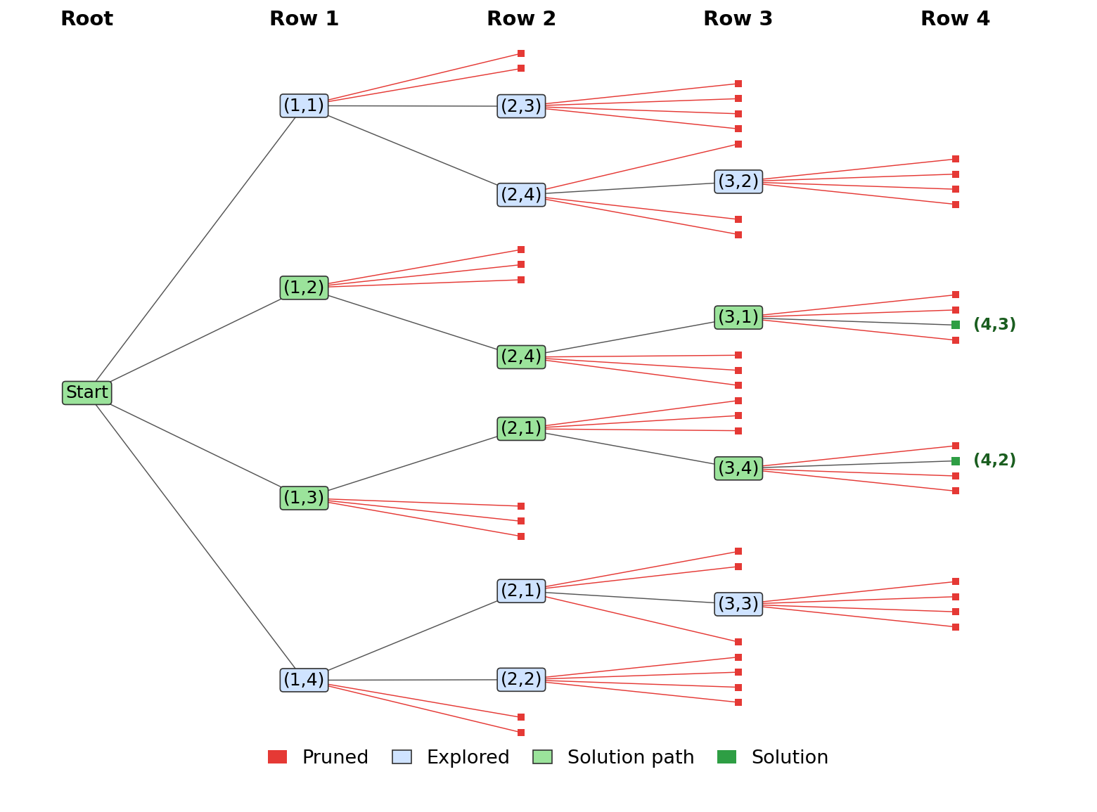
Project 10: N-Queens using Backtracking
Unit IV – Backtracking | Group 1 | 24WH1A0533
Problem
Place 4 queens on a 4 × 4 board so that no two queens attack each other.
Safe check
(r, c) is safe if c ≠ col and |c − col| ≠ |r − row| for every earlier queen.
Logic
One queen per row. Prune a column if it is unsafe; backtrack when a row has no safe column.
Prompt used
“Visualize the state space tree for N=4 queens, marking invalid branches in red.”
Result
2 solutions: columns (2, 4, 1, 3) and (3, 1, 4, 2). Only 61 of 341 possible nodes examined; red nodes are pruned.
Repo: DAA-macro-project-G1

