Slide 1
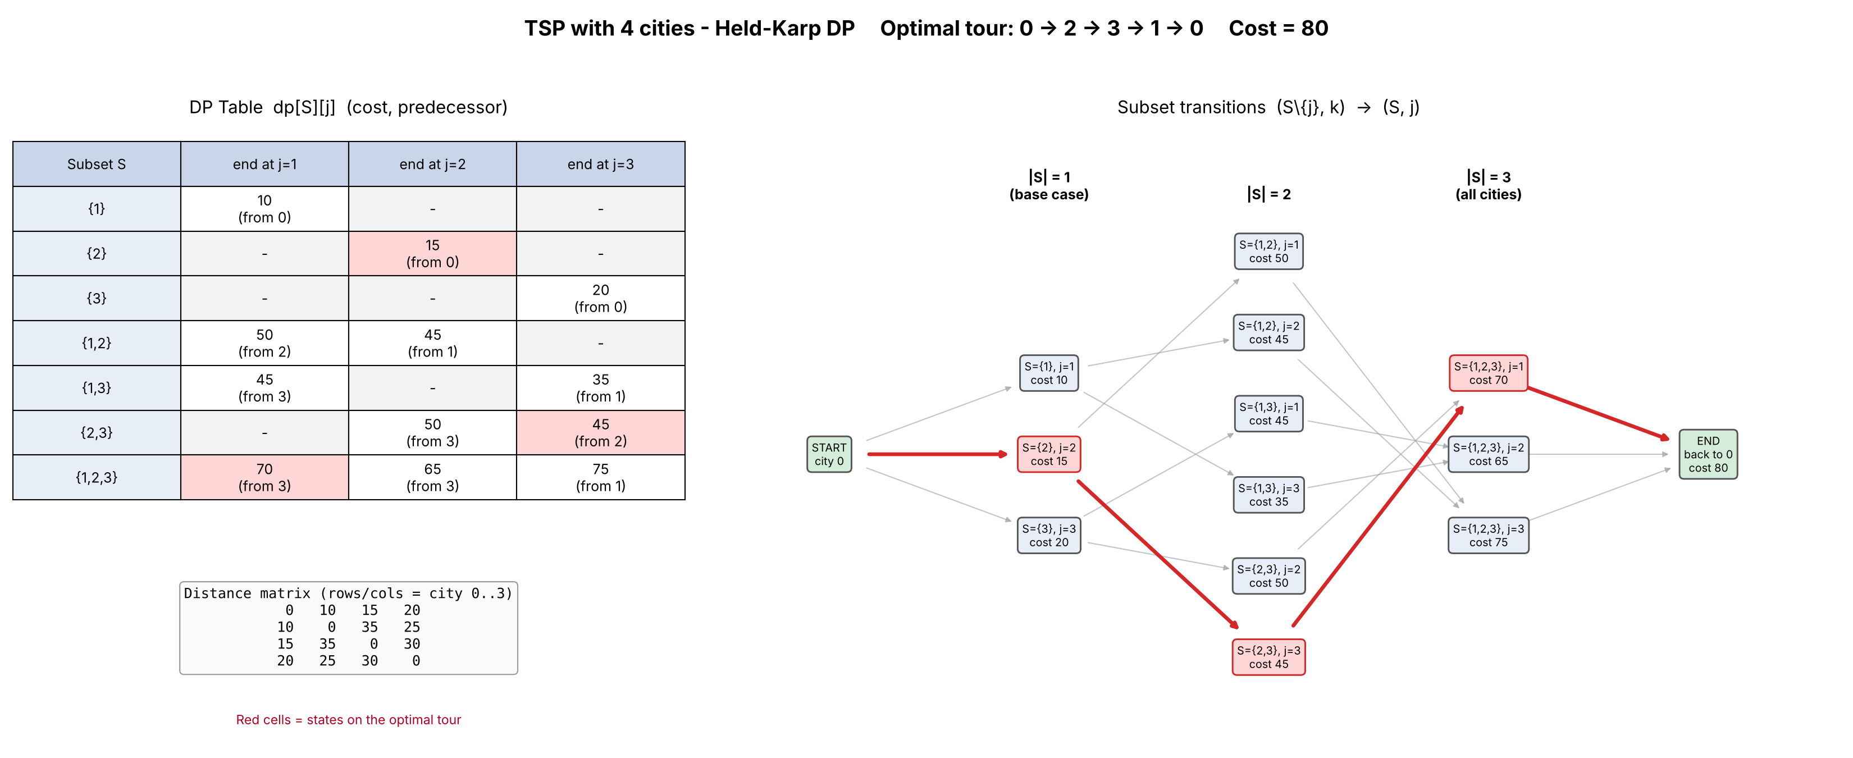
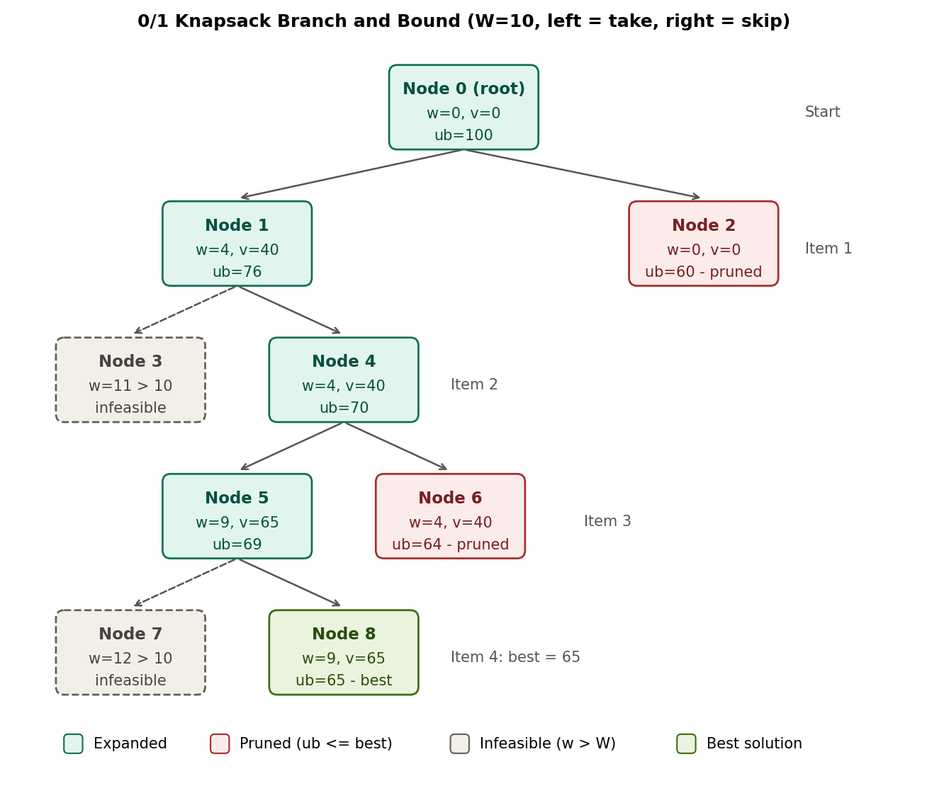
Project 7: Traveling Salesperson DP Table (Held-Karp)
Unit III: Dynamic Programming | Group 1 | Roll No: 24WH1A0517
Problem / Input
4 cities (0 to 3), start and end at city 0. Distances: 0-1: 10, 0-2: 15, 0-3: 20, 1-2: 35, 1-3: 25, 2-3: 30.
Algorithm Logic
dp[S][j] = min cost to start at 0, visit set S, end at j.
dp[S][j] = min over k in S\{j} of dp[S\{j}][k] + d[k][j]
Answer = min over j of dp[all][j] + d[j][0]. Time O(n²·2ⁿ) vs O(n!) brute force.
Prompt Used
“Visualize DP state transitions for TSP with 4 cities.”
Result
optimal tour 0 → 2 → 3 → 1 → 0, cost 80 (matches brute force).
Left: DP table with cost and predecessor for each (subset, end city). Right: transitions from |S|=1 to |S|=3; the red path is the optimal tour.
Repo: github.com/nadimpallinavya-varma/DAA-Macro-Project-Group01

