Slide 1
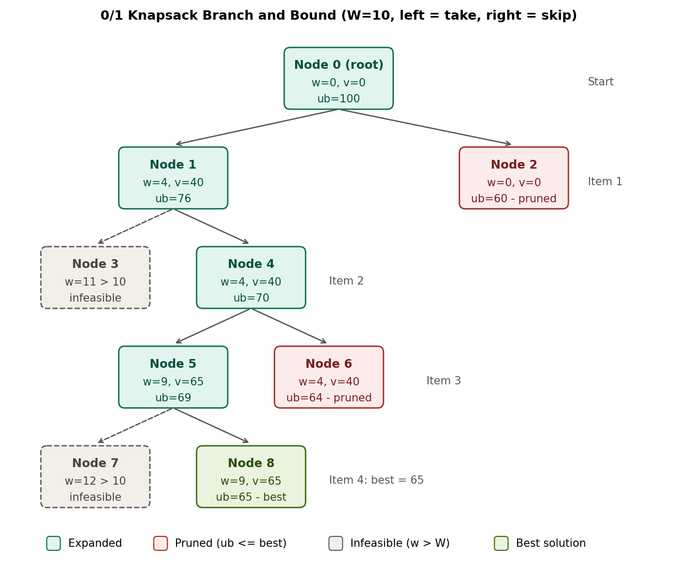
Project 13: 0/1 Knapsack using Branch and Bound
Unit V – Branch and Bound | Group 1 | Your Name
Problem
Capacity W = 10; items (w, v): (4,40), (7,42), (5,25), (3,12)
Upper bound
ub = v + (W − w) × (v_next / w_next)
Logic
Best-first search. Discard a node if w > W. Prune it if ub ≤ best value found.
Prompt used
“Illustrate bounding and pruning in 0/1 Knapsack using node values.”
Result
Max value = 65 (items 1 and 3). Only 9 of 31 nodes generated; Nodes 2 and 6 pruned (ub 60 and 64 ≤ 65).
Repo: github.com/<your-group-repo>/Unit5_BranchAndBound

