Slide 1
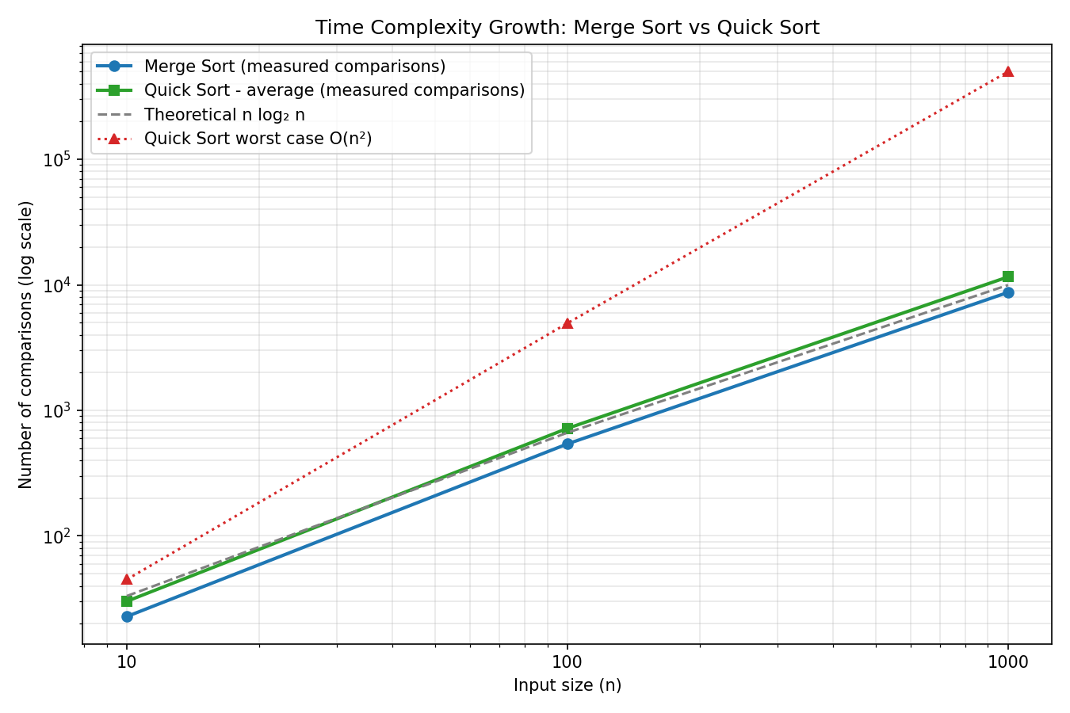
Project 1: Sorting Complexity Visualizer
Unit I – Algorithm Analysis | Group 1 | 24WH1A0508
Problem
Compare Merge Sort and Quick Sort for n = 10, 100, 1000 by counting comparisons.
Complexity
Merge Sort: T(n) = 2T(n/2) + n → O(n log n) in all cases. Quick Sort: O(n log n) average, O(n²) worst case.
Logic
Divide and conquer. Merge Sort splits at the midpoint, sorts halves, merges. Quick Sort partitions around a random pivot. Each size is averaged over 20 random arrays and plotted on log-log axes.
Prompt used
“Generate a graph comparing time complexity of Merge, and Quick Sort for n = 10, 100, 1000.”
Result
At n = 1000: Merge Sort 8,711 vs Quick Sort 11,570 comparisons, both close to n log₂n = 9,966. Quick Sort worst case would need 499,500.
Merge Sort vs Quick Sort: comparisons (log-log)
Repo: github.com/nadimpallinavya-varma/DAA-Macro-Project-Group01

