Slide 1
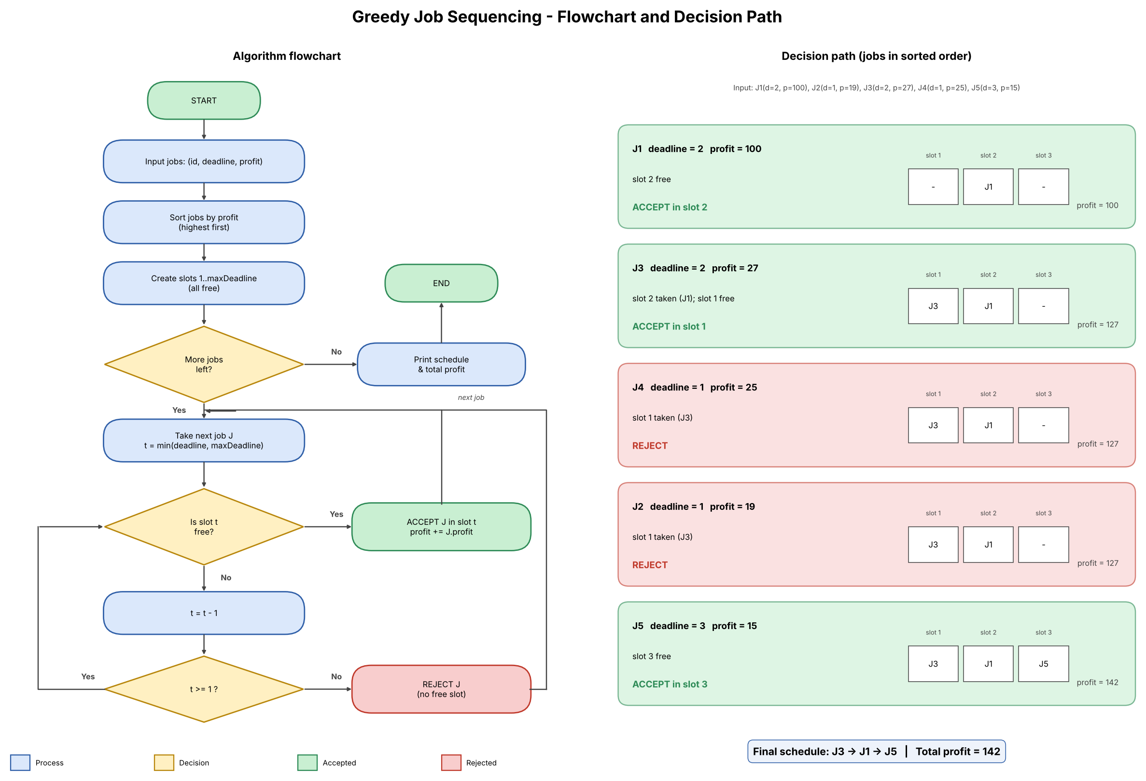
Project 4: Greedy Job Sequencing with Deadlines
Unit II – Divide and Conquer / Greedy | Group 1 | 24WH1A0517
Problem
5 jobs (id, deadline, profit): J1 (2,100), J2 (1,19), J3 (2,27), J4 (1,25), J5 (3,15). Each job takes 1 unit of time.
Greedy rule
Take jobs in order of highest profit. Place each in the latest free slot on or before its deadline.
Logic
Sort by profit. If no slot is free on or before the deadline, reject the job; otherwise accept it.
Prompt used
“Create a flow diagram showing job selection based on deadlines and profits.”
Result
Schedule J3 → J1 → J5, total profit = 142. J4 and J2 are rejected because slot 1 is already taken.
Repo: github.com/nadimpallinavya-varma/DAA-Macro-Project-Group01

