Slide 1
ML4DevOps. Anomaly detection based on OpenShift cluster resource utilization metrics.
Nadiya Kochura : nkochura@us.ibm.com

Slide 2
Environment.
RedHat OpenShift container platform 3.11 on RHEL 7
Cluster is created and configured with one master node and one worker node.
OCP 3.11. Prometheus.
OCP 3.11. Grafana dashboards
IBM Watson studio @IBM cloud

Slide 3
Problem statement.
Large volume of metrics is collected by the cluster metrics collector services .
Manual rule sets for alerts not manageable.
For example, If CPU is greater than 80% it’s an anomaly. However, some thresholds might not be right for all server nodes and might different during the day for the same server node.
Some very effective (and non-machine learning techniques) algorithms do exist to capture these complex criteria, such as dynamic thresholding and “seasonality & trend decomposition”. However even those techniques are not able to capture the full array of scenarios

Slide 4
Scope and objectives.
ML Approach.
Applying ML for identifying anomalies and ISSUE ALERTS using LARGE scaled DATASET of cluster resource utilization metrics .
Submission Scope:
Identifying architecture of integrating ML component into the cluster metering framework.
Producing as POC. ML model for the anomaly detection in the cluster resource’s utilization metrics. .

Slide 6
Data Collection.
Metrics collected over Open Shift cluster deployed on the RedHat OpenShift container platform 3.11 on RHEL 7.
For simplicity, we create following metrics dataset:
Metrics Tracking CPU Utilization: “container_cpu_usage_seconds_total”
Metrics Tracking total HTTP requests: “http_requests_total”
Data are collected for a certain period of time while sample application was deployed and running in the cluster.
Note. For the demo I used Grafana export function for exporting metrics data in the csv format.

Slide 7
Implementation features.
Evaluated various anomaly detection algorithms using collected metrics datasets. Produce two python notebooks.
K-Means can detect patterns in n-dimensional space and to generalize to more complex situation.
Isolation forests
OneClass SVM

Slide 8
Submission_1 notebook.
Illustrates anomaly detection by building models using one dimensional dataset with CPU utilization metrics and corresponding timestamp.
Project categorizes the time data into 4 categories: “weekday Day”, “weekdayNight”, “weekendDay” and “weekendNight”.Project then clusters CPU metrics around identifies categories .
This model helps to investigate the seasonality factor as impact on CPU utilization over test container when test application usage depends on day/time/weekend /weekday as “seasonal” or temporal factors.

Slide 9
Submission_2 notebook.
Illustrates anomaly detection by building models using two dimensional dataset with CPU utilization and HTTP requests metrics . These two metrics are synchronized over corresponding timestamps.
Project categorizes the HTTP requests load into 3 categories: “low” , “moderate” and “high”. Project clusters CPU and HTTP metrics .
This model helps to investigate pattern of CPU usage correlation with HTTP requests load.

Slide 10
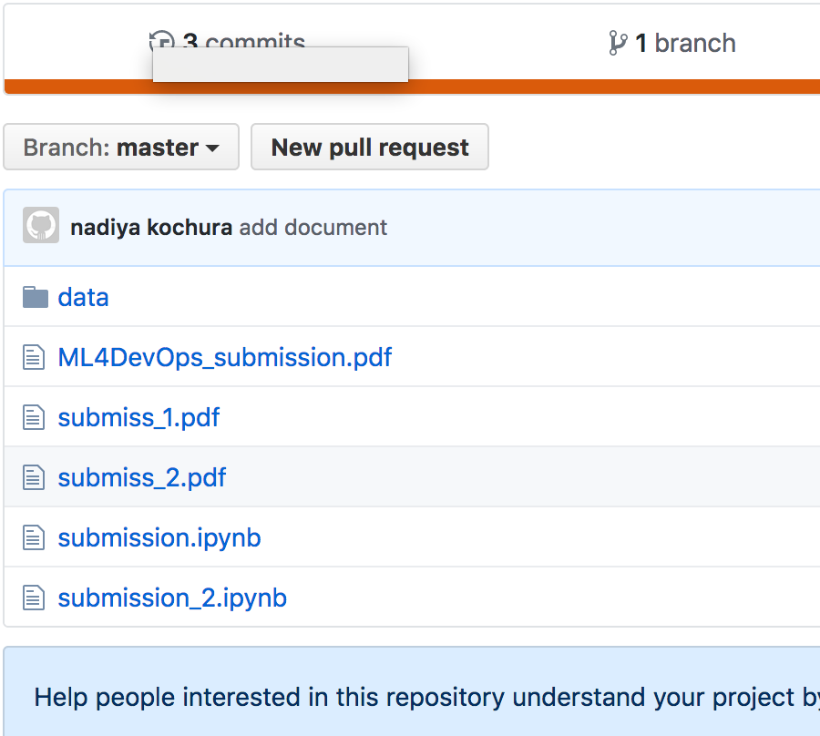
Project links .
Project Github: https://github.ibm.com/nkochura/https-github.ibm.com-ML4DevOps

Slide 11
Challenges and next steps.
complete application implementation according to the Diagram1 require the following steps:
Create and deploy application docker container in the Cluster, expose the analytics results through the service endpoints.
Store analytics data patterns results in the cluster persistent storage.
Integrate with Cluster Prometheus Alert manager.
Challenges:
Differentiating between normal and abnormal effectively.
Distinguishing between noise and anomaly.

Slide 12
Summary.
To overcome idenfied challenges would require extensive evaluation of various collected metrics datasets and identifying most prominent and typical use cases .
However ,building domain knowledge and producing effective ML models should progress naturally starting with simple use cases similar to the ones we described in our submission.

