Slide 1
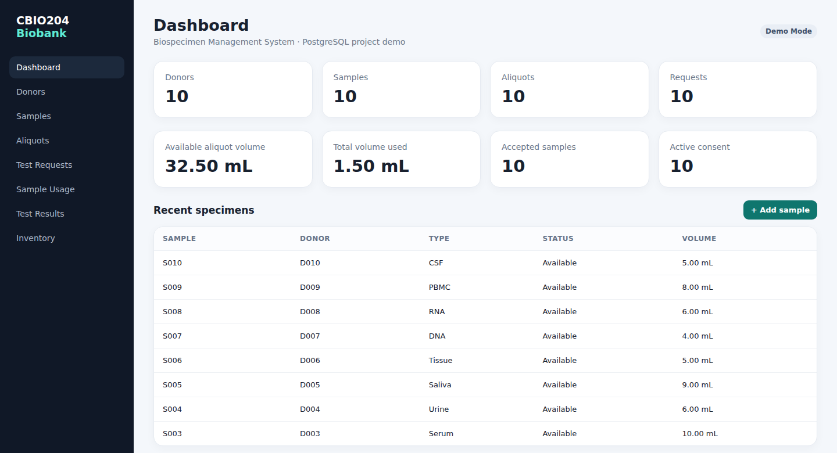
CBIO204
cbi0204-biobank.onrender.com/
Biobank & Biospecimen Management System
From relational database design to a deployed, working web application
DATABASE
LIVE APP
AUTHOR
PostgreSQL 15+ · 11 relations
cbi0204-biobank.onrender.com
Nadien Ahmed Shawky · ID 221002162

Slide 2
1 · FOUNDATION
Problem & Objective
Build a realistic relational database for a biomedical biobank that tracks the full lifecycle of a biospecimen — from donor consent to laboratory result — and prove the design works end to end.
Why a biobank needs strong data design
1
Traceability
Requirements
ER model
Relational schema
Every aliquot must be traced back to a donor, consent record and collection event.
3NF
Implementation
Testing
2
Integrity
What the system tracks
Volumes, statuses and references must never become inconsistent.
Donors & informed consent
Collection events & biospecimens
3
Reusability
Storage locations & aliquots
Researchers repeatedly draw on the same finite specimen inventory.
Researchers & test requests
Sample usage & lab results
CBIO204 · Biobank & Biospecimen Management System
02

Slide 3
1 · FOUNDATION
Scope & Business Rules
1
Anonymized identity
2
One event, one type
Donor identifiers are synthetic and anonymized — no direct personal data is stored.
Every biospecimen belongs to exactly one collection event and one sample type.
3
Divisible specimens
4
Many-to-many usage
A biospecimen may be divided into multiple aliquots for separate uses.
A test request can draw on multiple aliquots; SAMPLE_USAGE resolves the M:N relationship.
5
Volume can't be exceeded
6
Constraint-driven integrity
Usage quantity can never exceed the remaining aliquot volume — enforced in code and in the database.
PK, FK, UNIQUE, CHECK constraints and indexes enforce every rule above automatically.
CBIO204 · Biobank & Biospecimen Management System
03

Slide 4
2 · DATA MODEL
Main Entities
Eleven relational tables, grouped by the role they play in the biospecimen lifecycle.
People & Consent
Collection & Sample
Storage
Research Workflow
DONOR
COLLECTION_EVENT
STORAGE_LOCATION
TEST_REQUEST
CONSENT
SAMPLE_TYPE
ALIQUOT
SAMPLE_USAGE
RESEARCHER
BIOSPECIMEN
SAMPLE_TEST
CBIO204 · Biobank & Biospecimen Management System
04

Slide 5
2 · DATA MODEL
ER Design & Cardinality
DONOR
1 : N
CONSENT
DONOR
1 : N
COLLECTION_EVENT
COLLECTION_EVENT
1 : N
BIOSPECIMEN
SAMPLE_TYPE
1 : N
BIOSPECIMEN
BIOSPECIMEN
1 : N
ALIQUOT
RESEARCHER
1 : N
TEST_REQUEST
TEST_REQUEST
M : N
ALIQUOT (resolved by SAMPLE_USAGE)
CBIO204 · Biobank & Biospecimen Management System
05

Slide 6
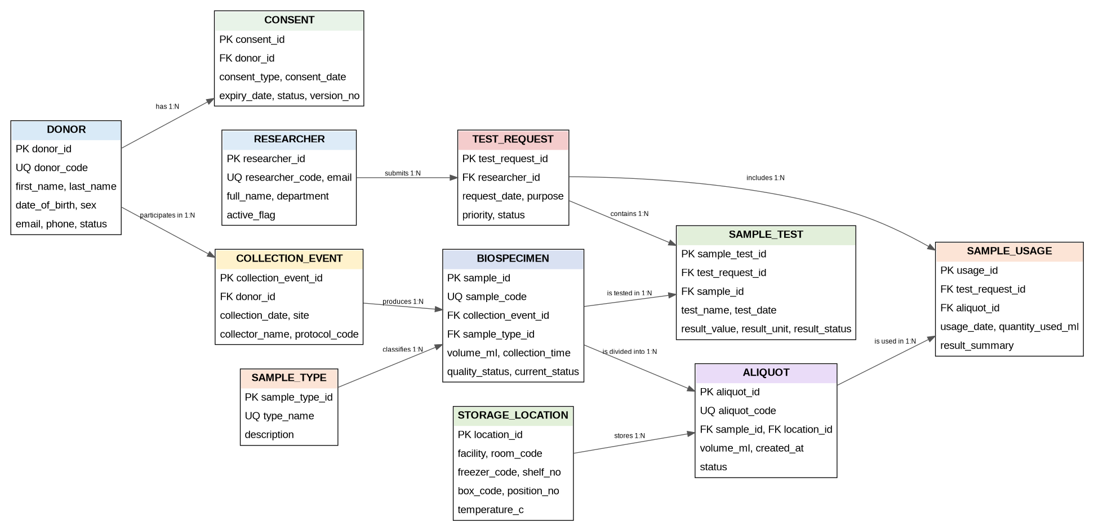
2 · DATA MODEL
Final ER Diagram
CBIO204 · Biobank & Biospecimen Management System
06

Slide 7
2 · DATA MODEL
Relational Schema & 3NF
Every relation carries a clear primary key and foreign keys to its parent entities.
1NF
2NF
3NF
Atomic attributes, no repeating groups.
Relationship-specific attributes are stored with the complete relationship key.
Lookup and descriptive facts are separated to remove transitive dependencies.
✓
Resolving the many-to-many relationship
SAMPLE_USAGE sits between TEST_REQUEST and ALIQUOT, turning the M:N relationship into two clean 1:N relationships. It carries its own attributes — usage_date, quantity_used_ml and result_summary — which belong to the usage event itself, not to either parent table. This is the textbook 3NF resolution taught in CBIO204, and it is exactly what the SAMPLE_USAGE screen in the live application implements (see slide 17).
CBIO204 · Biobank & Biospecimen Management System
07

Slide 8
3 · IMPLEMENTATION
Implementation & Tech Stack
11
10
4
100%
Relational tables
Synthetic records / table
Script categories
PK / FK / CHECK coverage
Database layer
Application layer (bonus)
PostgreSQL 15+
Python (standard-library HTTP server) backend
PK / FK, UNIQUE and CHECK constraints
SQLite storage layer for the live demo build
Indexes on lookup and join columns
Server-rendered HTML views — no framework dependency
Scripts split by concern: create_tables, load_data, queries, views, triggers/procedures
Deployed publicly on Render: cbi0204-biobank.onrender.com
Note: the classroom deliverable targets PostgreSQL 15+; the public Render demo uses the same schema and rules on SQLite so reviewers can try it from a browser with zero setup.
CBIO204 · Biobank & Biospecimen Management System
08

Slide 9
3 · IMPLEMENTATION
SQL Operations
01
02
03
Retrieval
Joins
Aggregation
Basic retrieval of available specimens by status and type.
Multi-table joins across donor, sample and storage information.
Grouping by sample type and by researcher.
04
05
06
Subqueries
Data changes
Business queries
Nested queries for business questions that need a two-step filter.
INSERT, UPDATE and DELETE examples against the live schema.
Inventory and consent-status queries written for real biobank questions.
CBIO204 · Biobank & Biospecimen Management System
09

Slide 10
3 · IMPLEMENTATION
Views & Advanced Database Objects
VIEW
VIEW
v_sample_inventory
v_research_activity
Donor, sample type, status, aliquot count and remaining aliquot volume in one queryable view.
Per-researcher request count, usage count and total volume used.
TRIGGER
FUNCTION
trg_validate_sample_usage
fn_donor_sample_count
Checks the requested volume against the aliquot's remaining volume and updates it automatically — the same rule the live app enforces (see slide 17).
Returns a single donor's biospecimen count on demand.
CBIO204 · Biobank & Biospecimen Management System
10

Slide 11
4 · VERIFICATION
Testing & Integrity
Duplicate codes
Invalid values
Invalid references
Rejected
Rejected
Rejected
UNIQUE constraints
CHECK constraints
Foreign keys
Valid usage
Excessive usage
Views & scripts
Accepted
Blocked
Verified
Aliquot volume decreases correctly
Trigger raises an exception
Re-run clean on a fresh database
CBIO204 · Biobank & Biospecimen Management System
11

Slide 12
BONUS · BEYOND THE ASSIGNMENT
From Schema to Software
The design isn't just a diagram — it's deployed. Every screen below is a live screenshot of the working application, backed by the same entities, keys and business rules from the sections above.
● cbi0204-biobank.onrender.com
12

Slide 13
5 · LIVE APPLICATION
Web App Architecture
Frontend
Server-rendered HTML + CSS
One consistent sidebar layout, generated per-request — no client build step needed.
Backend
Python (http.server)
Lightweight request handler routes GET/POST calls straight onto SQL statements.
Data
SQLite (demo) / PostgreSQL (course build)
Same schema, same constraints — donor → consent → collection → biospecimen → aliquot → usage.
Hosting
Render Web Service
Reads the PORT env variable, binds 0.0.0.0, health-checked at “/” — publicly reachable 24/7.
CBIO204 · Biobank & Biospecimen Management System
13

Slide 14
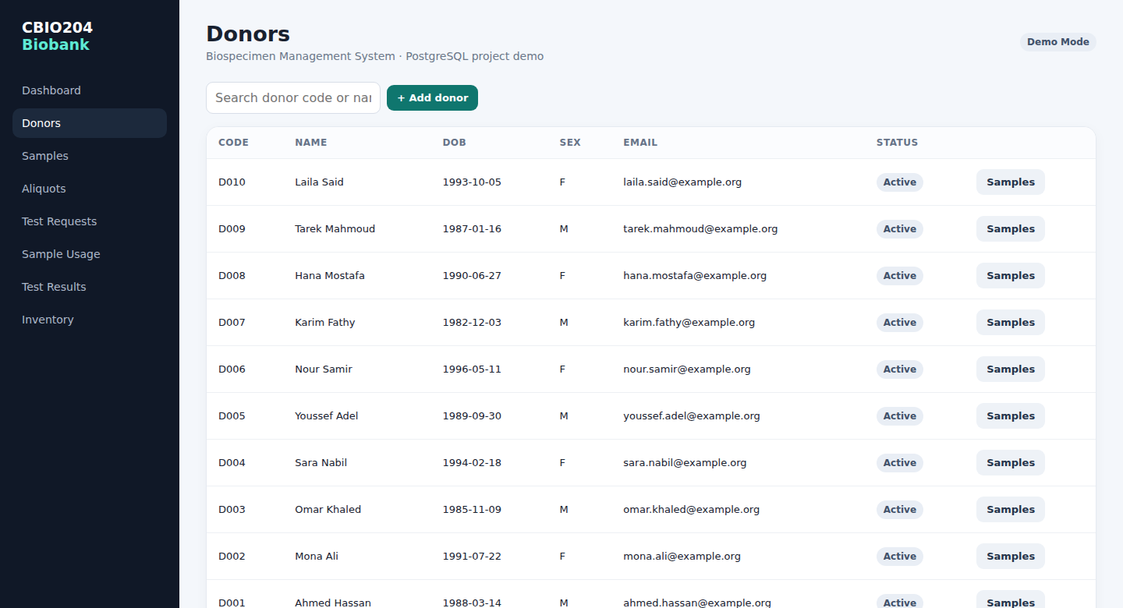
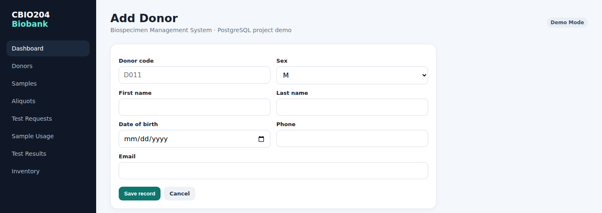
5 · LIVE APPLICATION
Donor Management
Search, list and register donors — backed directly by the DONOR table with server-side validation on required fields.
cbi0204-biobank.onrender.com/donors
cbi0204-biobank.onrender.com/donors/new
CBIO204 · Biobank & Biospecimen Management System
14

Slide 15
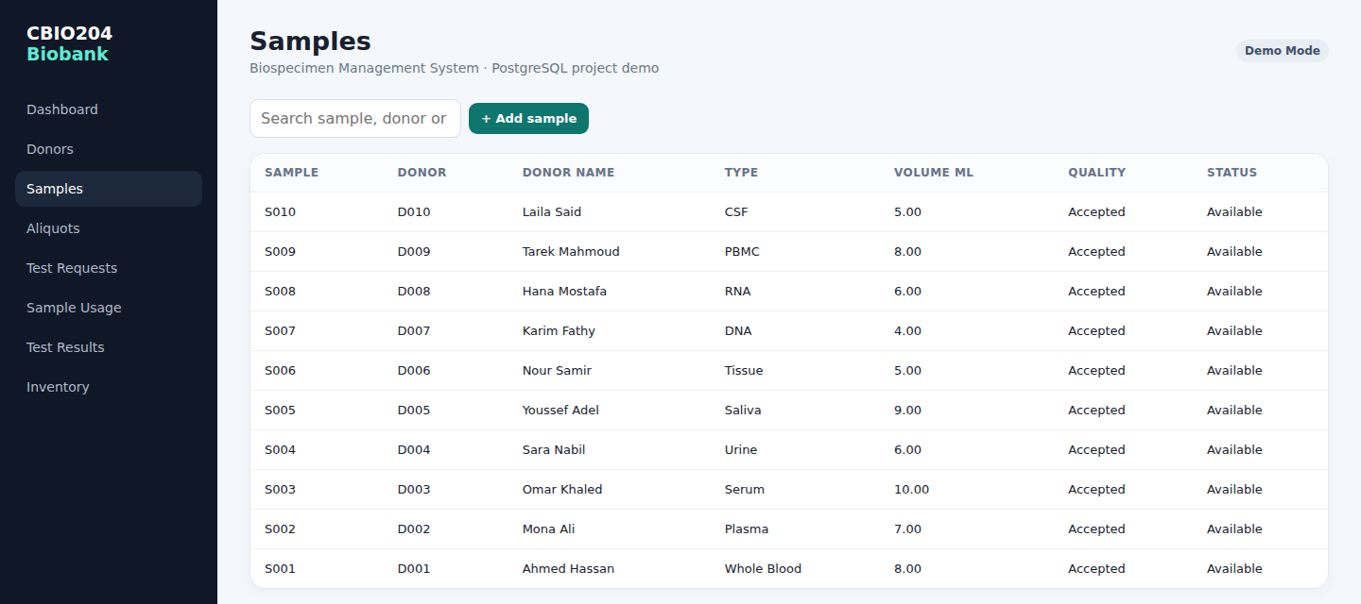
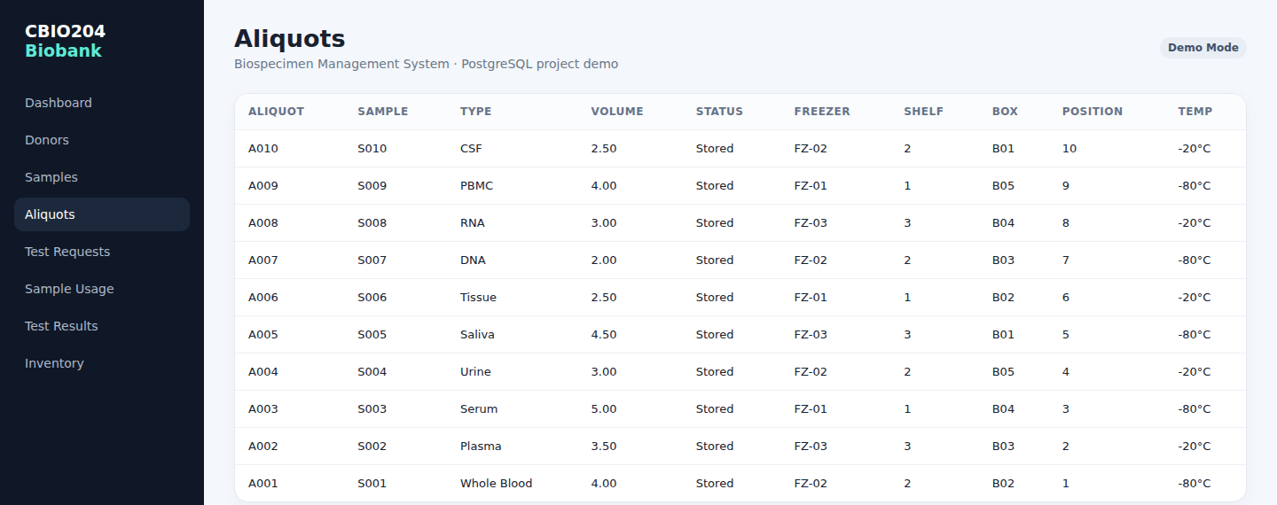
5 · LIVE APPLICATION
Sample & Aliquot Inventory
BIOSPECIMEN and ALIQUOT records, joined live with donor and storage-location data — freezer, shelf, box and temperature for every aliquot.
cbi0204-biobank.onrender.com/samples
cbi0204-biobank.onrender.com/aliquots
CBIO204 · Biobank & Biospecimen Management System
15

Slide 16
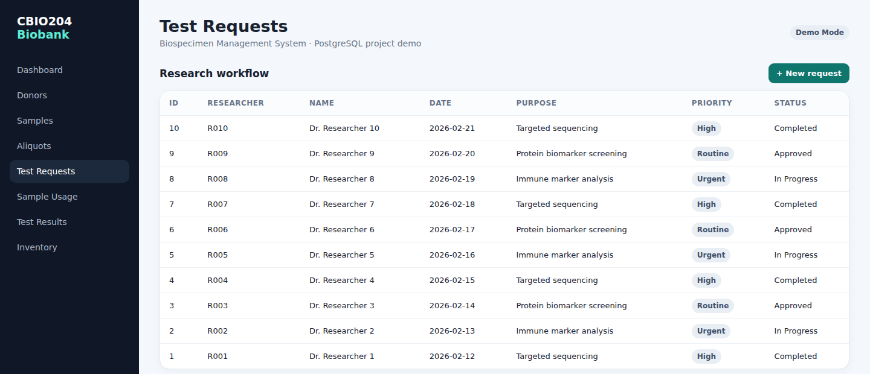
5 · LIVE APPLICATION
Research Workflow — Test Requests
Researchers submit test requests with a purpose and priority; each request is the anchor for the SAMPLE_USAGE and SAMPLE_TEST records that follow it.
cbi0204-biobank.onrender.com/requests
CBIO204 · Biobank & Biospecimen Management System
16

Slide 17
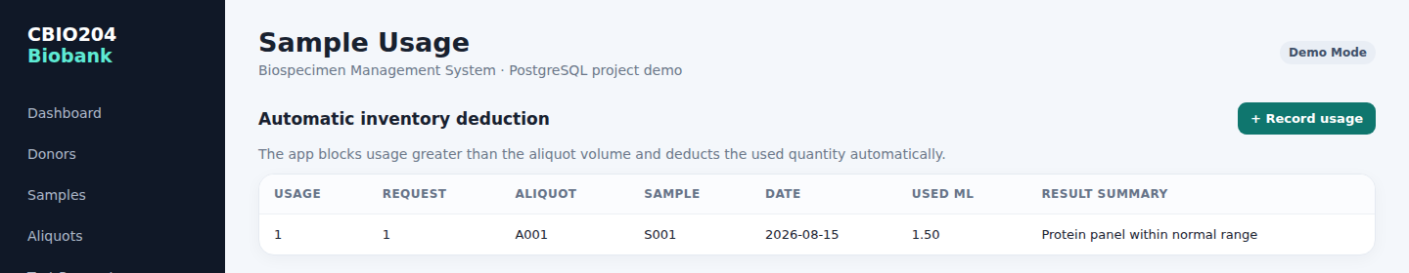
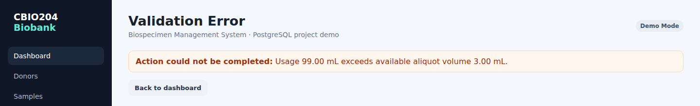
5 · LIVE APPLICATION
Business Rules, Enforced Live
The same trg_validate_sample_usage rule from slide 10 runs in the application layer: recording usage deducts the aliquot volume automatically, and an over-volume request is rejected with a clear error.
VALID USAGE — ACCEPTED
OVER-VOLUME USAGE — BLOCKED
cbi0204-biobank.onrender.com/usage
cbi0204-biobank.onrender.com/usage/new
“Usage 99.00 mL exceeds available aliquot volume 3.00 mL.”
This is the exact message returned when a request would deplete more than an aliquot actually holds — the application refuses the write instead of leaving inconsistent data, mirroring the trigger's behaviour at the database layer.
CBIO204 · Biobank & Biospecimen Management System
17

Slide 18
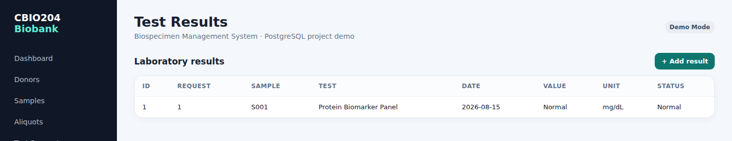
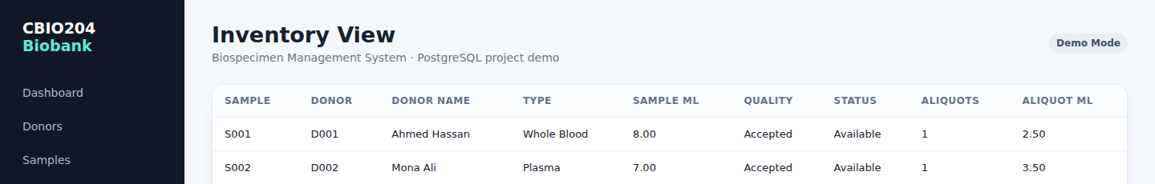
5 · LIVE APPLICATION
Lab Results & Inventory View
SAMPLE_TEST results feed back onto the specimen, and the inventory screen aggregates everything — donor, type, quality, status, aliquot count and remaining volume — in one queryable view.
LABORATORY RESULTS
cbi0204-biobank.onrender.com/tests
INVENTORY VIEW
cbi0204-biobank.onrender.com/inventory
CBIO204 · Biobank & Biospecimen Management System
18

Slide 19
6 · WRAP-UP
Demonstration Plan
Database walkthrough
Live application walkthrough
1
Create a clean database and run the scripts
1
Open cbi0204-biobank.onrender.com
2
Show table structure and sample data
2
Tour the dashboard metrics and recent specimens
3
Run a join and an aggregation query
3
Add a donor and a sample through the UI forms
4
Open both views
4
Submit a test request as a researcher
5
Demonstrate a valid sample usage
5
Record a valid sample usage — watch the volume update
6
Demonstrate an invalid over-volume usage and show the trigger error
6
Attempt an over-volume usage and show the live error
CBIO204 · Biobank & Biospecimen Management System
19

Slide 20
CONCLUSION
A database that works, on paper and in production
✓
Satisfies every core CBIO204 requirement: conceptual modeling, relational mapping, 3NF, implementation, SQL operations, views, an advanced database object, and testing.
✓
Goes further with a deployed web application on Render that exercises the same schema and the same business rules through a real browser UI.
✓
Demonstrated live: valid and invalid sample-usage scenarios both behave exactly as the trigger design intends.
FUTURE WORK
Role-based authentication, richer analytics dashboards, and audit-logged consent history for full regulatory traceability.
● cbi0204-biobank.onrender.com
Nadien Ahmed Shawky · ID 221002162

