Slide 1


AI Model Zoo Module for SPIDHIVE
NADINE ARABEL ANARETA & VAL RANDOLF MADRID
Notes:
Good day, everyone. My name is Nadine Anareta, and I will be presenting my Special Problem titled: 'AI Model Zoo Module for SPIDHIVE

Slide 2

Staple crops are highly vulnerable to pests and diseases, which severely disrupt our food supply
Notes:
In the Philippines, staple crops like rice and corn are highly vulnerable to pests and diseases, which severely disrupt our food supply. To build datasets of these threats, a companion application is utilized to collect raw field images, which are then centralized and stored within SPIDHIVE.

Slide 3

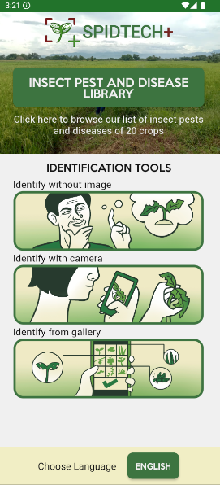
SPIDTECH+ allows farmers to remotely monitor and identify these threats using AI.
Notes:
For the actual diagnosis, farmers utilize the SPIDTECH+, which relies on AI models to instantly identify these pests and diseases. However, a critical limitation existed in this ecosystem.

Slide 4

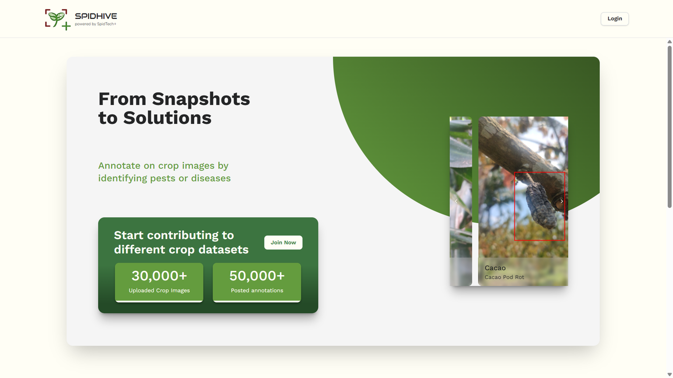
Data collected from the mobile app is sent to a centralized web platform called SPIDHIVE.
Notes:
While SPIDHIVE effectively managed the raw images, it lacked an existing, localized AI Model Zoo.

Slide 5
Lacked a centralized mechanism to manage, store, and deploy the actual AI models themselves
No streamlined pipeline to get an updated AI model from SPIDHIVE to SPIDTECH+
Notes:
Because there was no centralized repository to manage and store the AI models themselves, there was no streamlined way to make updated models easily accessible for deployment to SPIDTECH+.

Slide 6

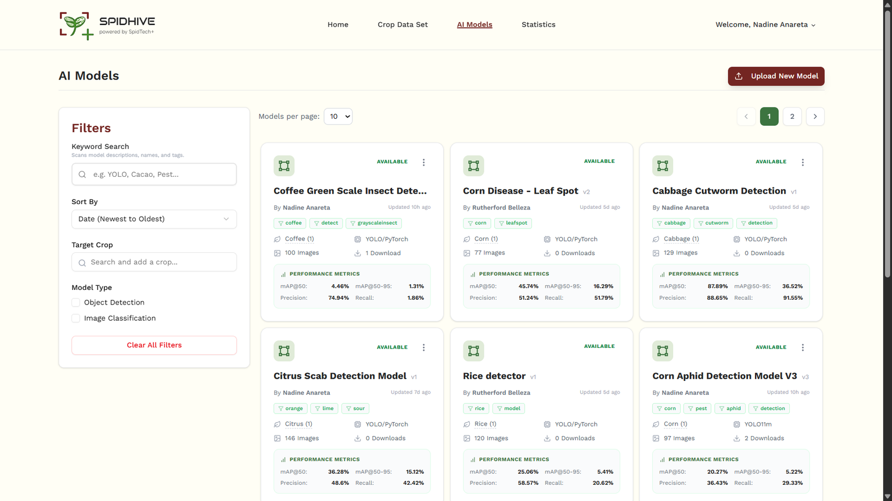
Localized AI Model Zoo integrated directly into SPIDHIVE
Notes:
Therefore, the objective of this study was to develop a localized 'AI Model Zoo' integrated directly into SPIDHIVE. This includes implementing an API to serve as a bridge for cross-platform synchronization and evaluating the system's usability with expert developers.

Slide 7


Controlling transboundary pests and diseases is essential to double agricultural productivity and ensure safe
Notes:
By accelerating the deployment of accurate crop diagnostic tools, SPIDHIVE directly advances SDG 2: Zero Hunger by empowering farmers to prevent devastating yield losses and secure the nation's food supply

Slide 8
Invasive pests and pathogens threaten terrestrial ecosystems
Notes:
Furthermore, the platform supports SDG 15: Life on Land by facilitating highly targeted pest management, which protects agricultural biodiversity and reduces the ecological harm caused by the excessive use of broad-spectrum pesticides

Slide 9






Notes:
To build this, I utilized ReactJS with VITE for the frontend and NodeJS with Express for the backend API. MySQL is used as the main database for SPIDHIVE. The most critical architectural decision was the integration of Supabase as a dedicated mobile backend.
This architecture minimizes payload delivery times and prevents our primary server from bottlenecks.

Slide 10
SPIDHIVE
SUPABASE
SPIDTECH+
Stores and Manages AI Models
Stores AI Models from SPIDHIVE and Syncs with SPIDTECH+
Fetches AI Models
downloads datasets and used for training
Available Datasets
validated by experts
Displays images for expert evaluation
Stores the images from SPIDTECH+ and Syncs with SPIDHIVE
Uses the models and generates feedback or report images
Notes:
The architecture functions as a bidirectional distribution hub:
Downstream: SPIDHIVE packages and pushes compiled .tflite AI models down to Supabase, where the SPIDTECH+ mobile app can immediately download them for offline, edge-based inference.
Upstream: Conversely, images captured by users in the field are sent up to Supabase, which are then mirrored back onto the SPIDHIVE web dashboard for expert annotation.

Slide 11
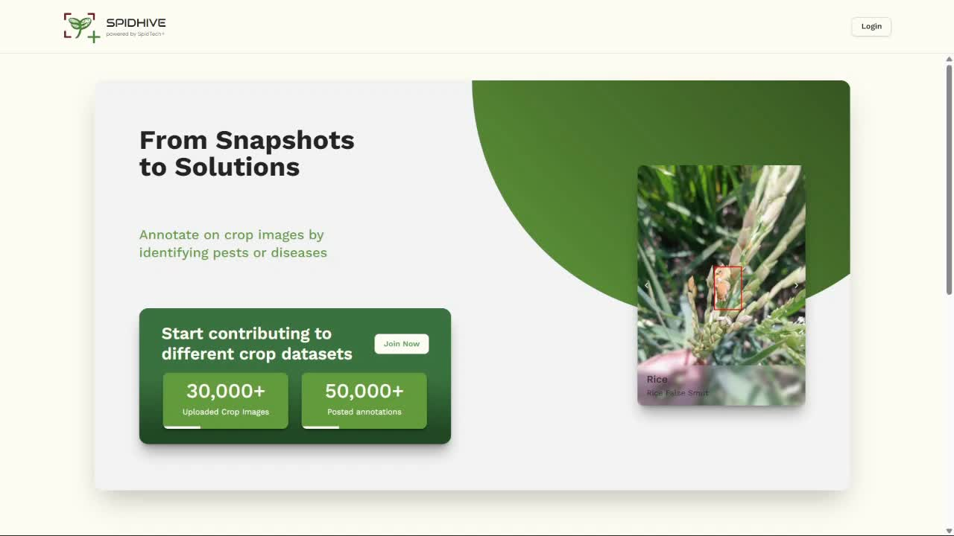
Notes:
To demonstrate how the AI developers utilize this system, here is a sample flow.
Before accessing the AI Model Zoo, users must log in through an upgraded authentication system. I implemented bcrypt for password encryption to resolve an existing vulnerability in the SPIDHIVE platform where passwords were previously stored as plain text. This upgrade ensures strict data security and prevents potential data breaches.
Additionally, I introduced a newly defined "AI Developer" user role, which is explicitly tailored for users who need to manage and deploy machine learning assets.

Slide 12
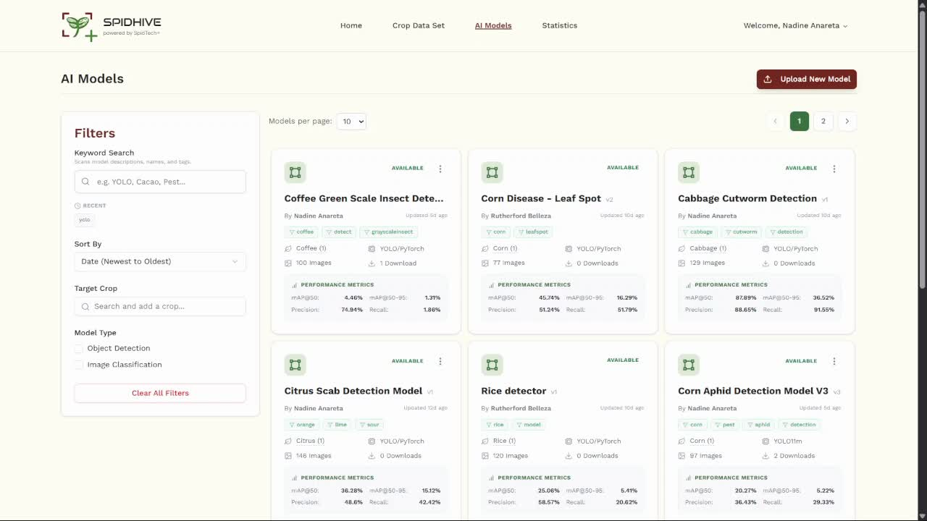
Notes:
To minimize the learning curve, the AI Model Zoo interface was designed using Shadcn UI and Tailwind CSS to perfectly match the existing SPIDHIVE aesthetic. On the left, we have a multi-attribute filter to quickly query models based on architecture, target crops, or model type.
Each model card previews essential metadata and provides deep-link navigation directly to specific module tabs, such as Images or Analytics.

Slide 13
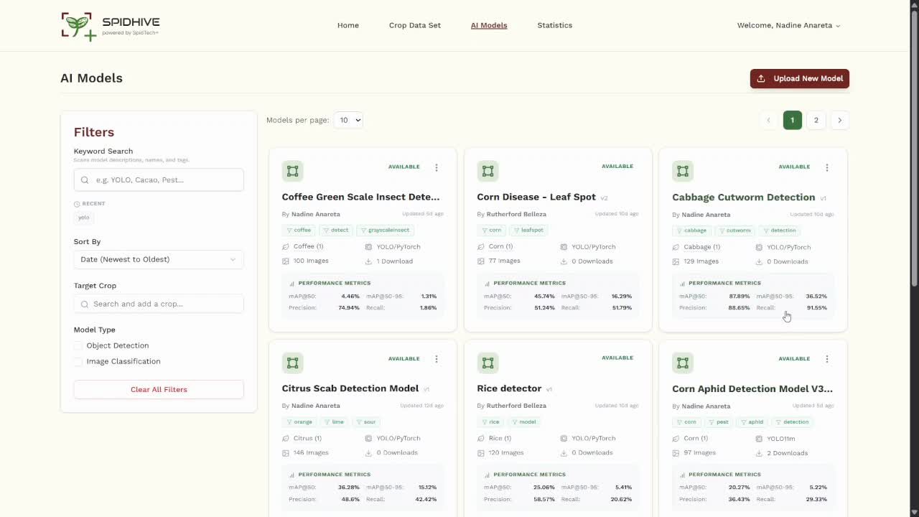
Notes:
A major focus of this study was reducing developer cognitive load. When a developer uploads a ZIP archive containing their training artifacts, the system automatically parses the files. As you can see, it automatically extracts the neural network architecture, the performance metrics, and the evaluation graphs without requiring manual data entry.
The developer can select the dataset used and the parent AI model, if necessary. They can also upload a README file or auto-generate a customized text for documentation

Slide 14
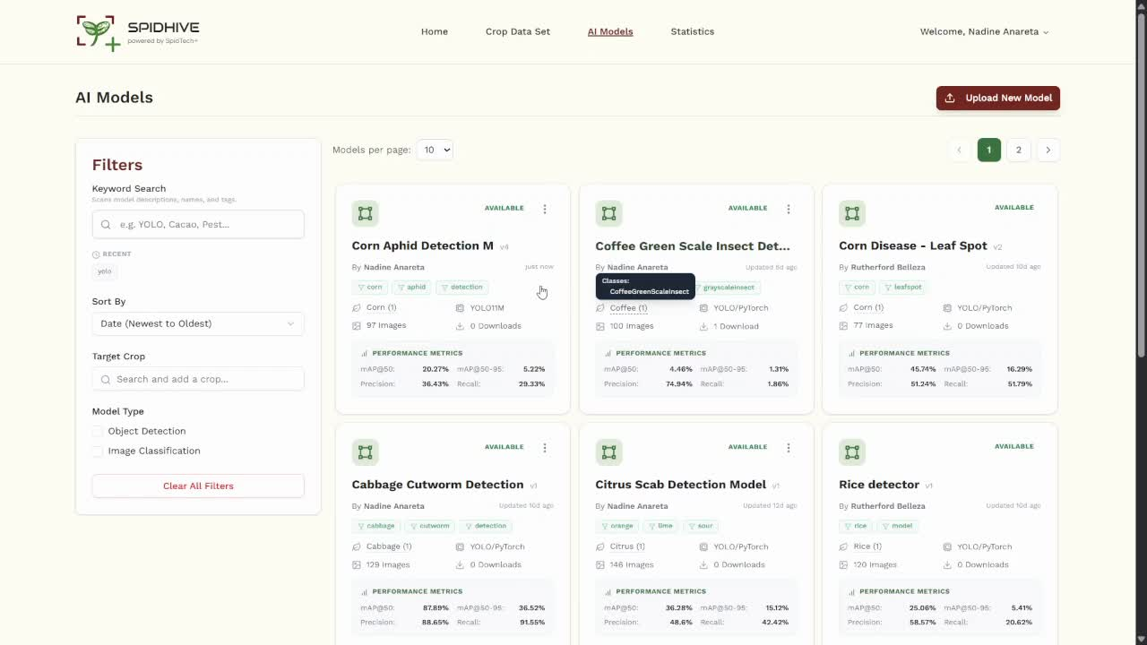
Notes:
Once published, we can view the model's specification page, including a direct download for the .tflite artifact. If we navigate to the Images tab, we can see the dataset used in the training of the AI Model.
To support iterative development, the Versions tab tracks the complete lineage of our models, showing exactly which parent models they were based on, and which descendants have been fine-tuned from them.
If we navigate to the Analytics tab, the system utilizes the Recharts library to dynamically visualize the model's performance metrics and evaluation graphs.

Slide 15
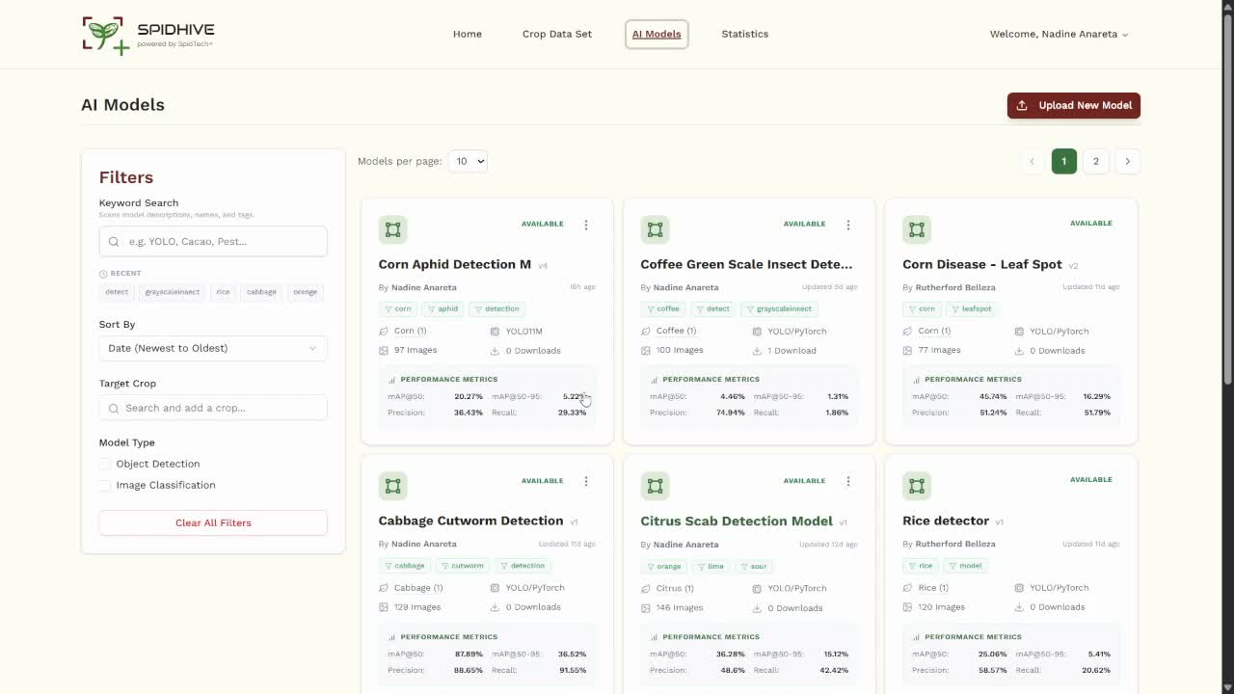
Notes:
To streamline the editing process, the interface automatically pre-populates all input fields with the model's current metadata. This maintains data continuity and perfectly mirrors the smooth, automated experience of the initial publishing workflow, allowing developers to quickly update details without having to re-enter information from scratch.

Slide 16
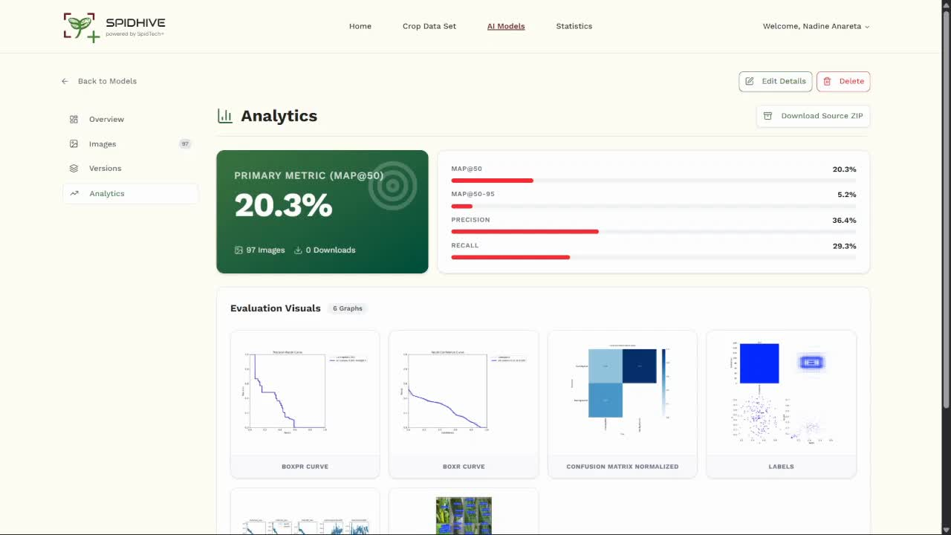
Notes:
To protect the integrity of the repository, only the original owner or creator of an AI model has the authority to delete it. Furthermore, because these AI models are valuable technical assets, I implemented a strict two-step authentication process for deletion. Before an artifact is permanently removed, the developer must explicitly re-enter their password to confirm the action, safely preventing any accidental data loss.

Slide 17

Notes:
To help administrators monitor the overall health and activity of the system, I developed a centralized Statistics dashboard. This page provides a clear, real-time summary report of SPIDHIVE's core operations, tracking datasets, user contributions, and AI model deployments. For offline tracking and reporting, stakeholders can easily download this entire summary as a fully formatted, multi-sheet Excel file with just one click.

Slide 18
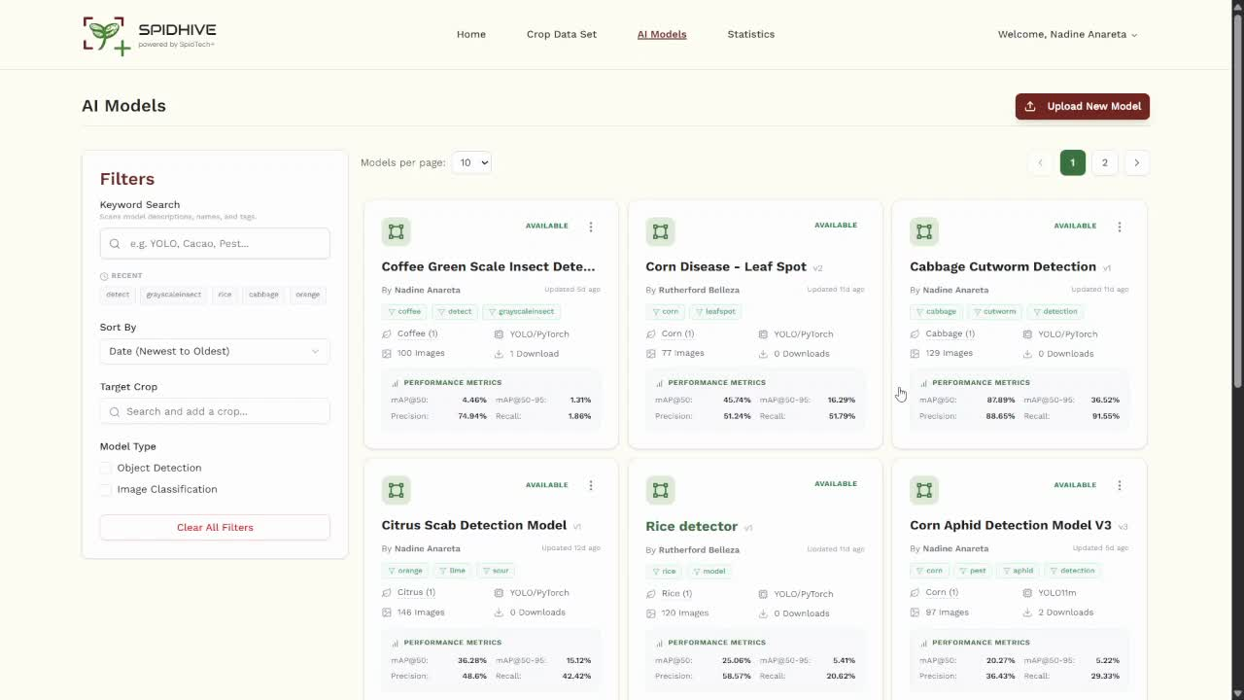
Notes:
Next, the "My Account" page was completely redesigned to guarantee visual consistency with the rest of the new modules.
General "Contributors" only see tools for images and annotations, whereas "AI Developers" access a specialized AI Models dashboard.
From here, users can seamlessly edit their profiles, and developers can view a complete table of their uploaded models, complete with a recovery function to instantly restore archived or deleted models back to public view.

Slide 19
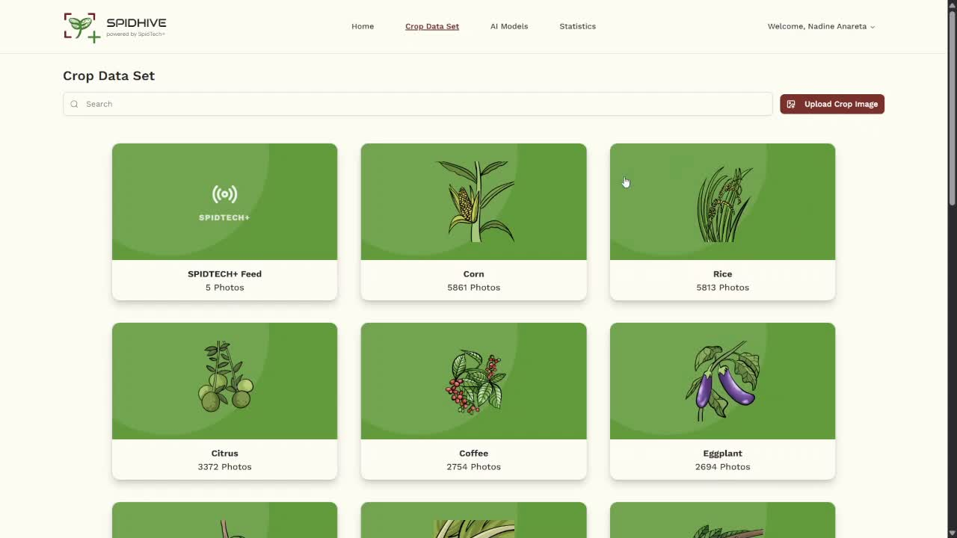
Notes:
Finally, for dataset compilation, developers can download custom ZIP archives. The system automatically partitions the raw images into randomized training, validation, and testing subsets to mitigate overfitting. Crucially, it also auto-generates a .yaml configuration file with fixed numerical class indices, which actively prevents class confusion when a developer retrains the model.

Slide 20
Workflow Automation
SUS
Information Architecture & User Interface
88
System Security and Data Privacy
Retrieval and Navigation
UI Density and Context
Excellent
Search Filtering
Granular Inspection
Notes:
To evaluate the functional efficiency of this platform, a purposive sample of five expert AI Developers tested the system using the Concurrent Think-Aloud protocol.
Following the testing, the system achieved an SUS score of 88.0. According to established benchmarks, this places the AI Model Zoo firmly in the 'Excellent' category.
Qualitatively, the testers specifically praised the workflow automation—such as the auto-parsing of .zip artifacts—and confirmed that the backend APIs successfully and securely managed the data fetching.

Slide 21

Centralized Management
Bidirectional Synchronization
Official deployment into the live SPIDHIVE
Notes:
In conclusion, this study successfully developed a centralized management platform that bridges the gap between web-based AI model development and practical, mobile field deployment.
The bidirectional architecture ensures that SPIDTECH+ users receive the latest diagnostic tools, while experts continuously receive fresh field data.
For future work, the immediate recommendation is the phased integration and database migration of this module from our secure staging environment into the live SPIDHIVE production server.

Slide 22
AI Model Zoo Module for SPIDHIVE
NADINE ARABEL ANARETA & VAL RANDOLF MADRID
Notes:
Thank you for your time. I am now open to your questions.

