Slide 1
Maximum Sum Sub Array
Divide and Conquer
By Nadine Amir
ID: 2221965
Presented to Dr. Islam Elshaarawy

Slide 2
Problem definition
In computer science, the maximum sum subarray problem, also known as the maximum segment sum problem, is the task of finding a contiguous subarray with the largest sum, within a given one-dimensional array A[1...n] of numbers.
Example:
Input: [-2, -5, 6, -2, -3, 1, 5, -6]
Output: 7
Explanation: [6, -2, -3, 1, 5] has the largest sum which is 7

Slide 3
Main
problem
Divide
Sub - Problem
Sub - Problem
Conquer
Solution of
Sub - Problem
Solution of
Sub - Problem
Combine
Solution of
Main
problem

Slide 4
$25k | $50k | $15k | $10k
$25k | $50k
$15k | $10k
$25k
$50k
$15k
$10k

Slide 5
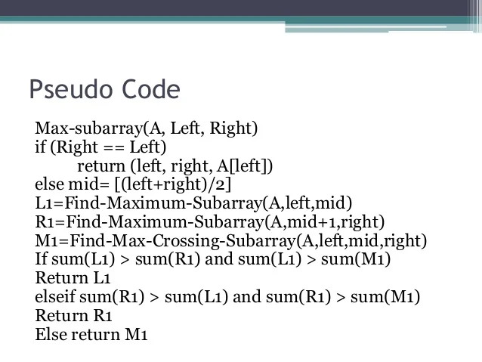
Algorithm PseudoCode

Slide 6
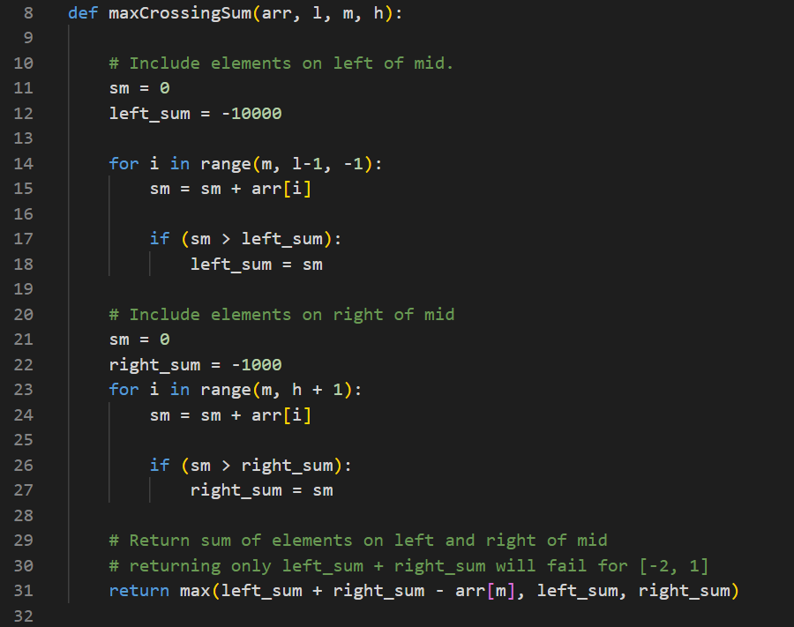
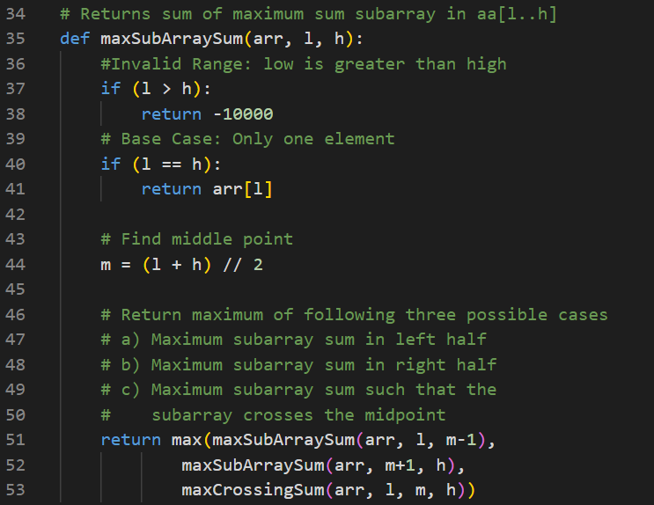
Algorithm Python Code

Slide 7
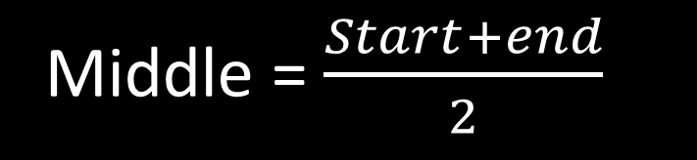
Implementation
Middle
-2 | -5 | 6 | -2 | -3 | 1 | 5 | -6
-2 | -5 | 6 | -2
-3 | 1 | 5 | -6
Left Half
Right Half
Middle = $\frac{Start+end}{2}$

Slide 8
Middle
-2 | -5 | 6 | -2 | -3 | 1 | 5 | -6
-2 | -5 | 6 | -2
-3 | 1 | 5 | -6
-2 | -5
6 | -2
-3 | 1
5 | -6
-2
-5
6
-2
-3
1
5
-6

Slide 9
Middle
-2 | -5 | 6 | -2 | -3 | 1 | 5 | -6
6
Calculations:
Middle = -2
LeftSum = -2
RightSum = -5
Cross sum calculations:
Left Sub sum = -2
Right sub sum = -5
CrossSum = -2-5 = -7
Max sum = Max(LeftSum, RightSum, CrossSum) = -2
Calculations:
Middle = -5
LeftSum = -2
RightSum = 6
Cross sum calculations:
Left Sub sum = Max(-2, -5-2) = -2
Right sub sum = Max(6, 6-2) = 6
CrossSum = -2+6 = 4
Max sum = Max(LeftSum, RightSum, CrossSum) = 6
Calculations:
Middle = 6
LeftSum = 6
RightSum = -2
Cross sum calculations:
Left Sub sum = 6
Right sub sum = -2
CrossSum = 6-2 = 4
Max sum = Max(LeftSum, RightSum, CrossSum) = 6
-2 | -5 | 6 | -2
-2
6
-2 | -5
6 | -2
-2
-5
6
-2

Slide 10
Middle
-2 | -5 | 6 | -2 | -3 | 1 | 5 | -6
Calculations:
Middle = 1
LeftSum = 1
RightSum = 5
Cross sum calculations:
Left Sub sum = Max(1, 1-3) = 1
Right sub sum = Max(5, 5-6) = 5
CrossSum = 1+5 = 6
Max sum = Max(LeftSum, RightSum, CrossSum) = 6
Calculations:
Middle = -3
LeftSum = -3
RightSum = 1
Cross sum calculations:
Left Sub sum = -3
Right sub sum = 1
CrossSum = -3+1 = -2
Max sum = Max(LeftSum, RightSum, CrossSum) = 1
Calculations:
Middle = 5
LeftSum = 5
RightSum = -6
Cross sum calculations:
Left Sub sum = 5
Right sub sum = -6
CrossSum = 5-6 = -1
Max sum = Max(LeftSum, RightSum, CrossSum) = 5
6
-3 | 1 | 5 | -6
1
5
-3 | 1
5 | -6
-3
1
5
-6

Slide 11
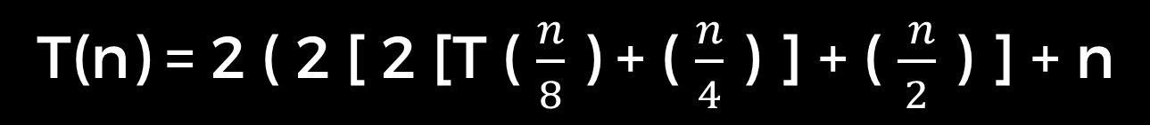
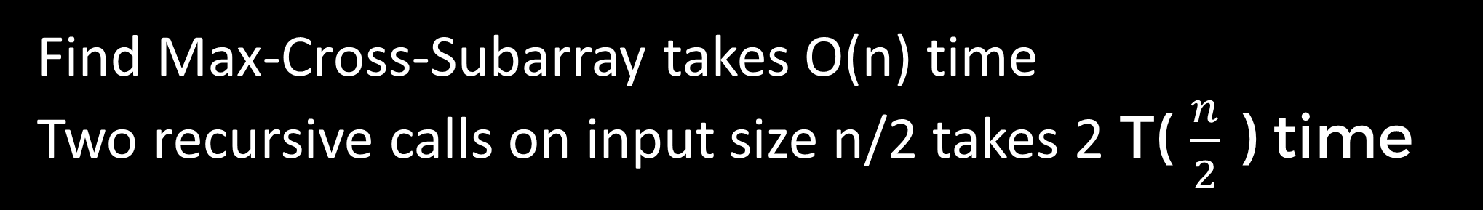
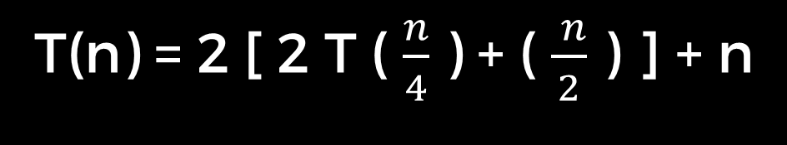
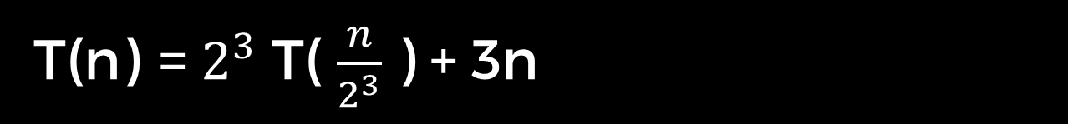
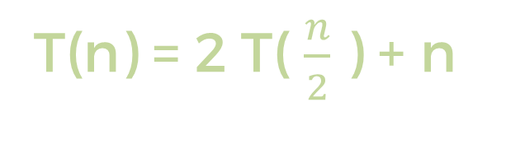
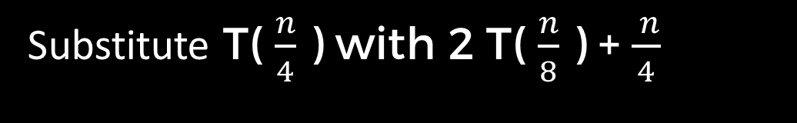
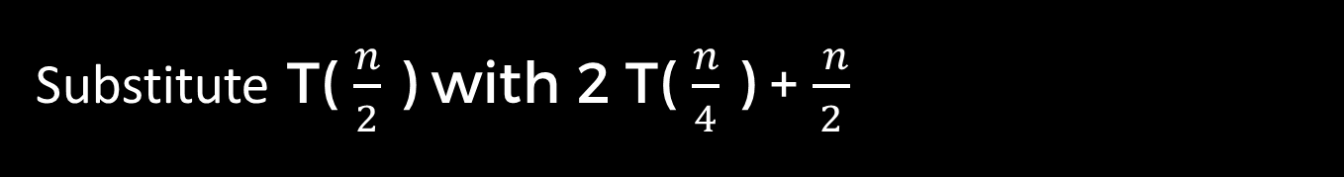
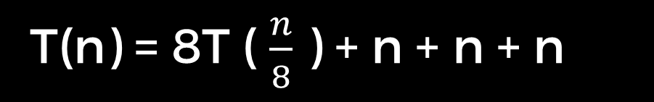
Time complexity analysis
Find Max-Cross-Subarray takes O(n) time
Two recursive calls on input size n/2 takes 2 T( $\frac{n}{2}$ ) time
T(n) = 2 T( $\frac{n}{2}$ ) + n
Substitute T( $\frac{n}{2}$ ) with 2 T( $\frac{n}{4}$ ) + $\frac{ n}{2}$
T(n) = 2 [ 2 T ( $\frac{n}{4}$ ) + ( $\frac{ n}{2}$ ) ] + n
Substitute T( $\frac{n}{4}$ ) with 2 T( $\frac{n}{8}$ ) + $\frac{ n}{4}$
T(n) = 2 ( 2 [ 2 [T ( $\frac{n}{8}$ ) + ( $\frac{n}{4}$ ) ] + ( $\frac{ n}{2}$ ) ] + n
T(n) = 8T ( $\frac{n}{8}$ ) + n + n + n
T(n) = $2^{3}$ T( $\frac{n}{2^{3}}$ ) + 3n

Slide 12
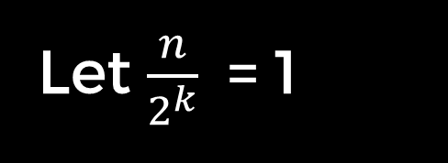
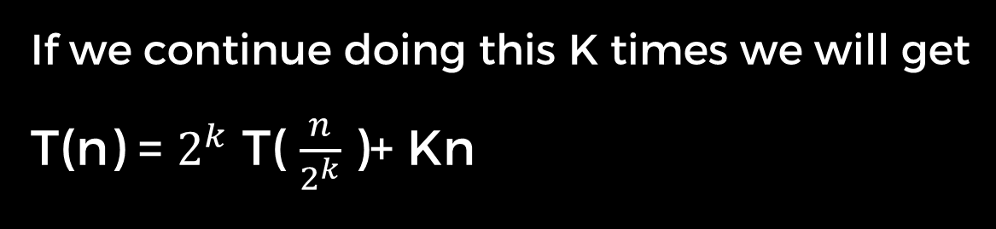
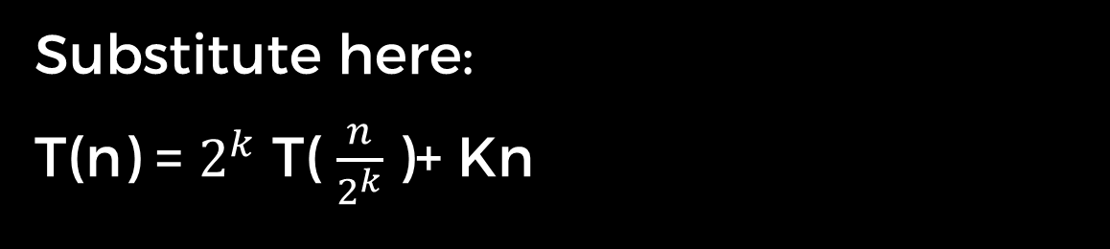
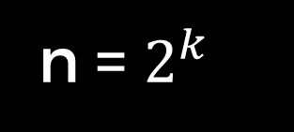
Time complexity analysis
Pattern? Generalize
If we continue doing this K times we will get
T(n) = $2^{k}$ T( $\frac{n}{2^{k}}$)+ Kn
Let $\frac{n}{2^{k}}$ = 1
n = $2^{k}$
K = log(n)
T(1) = 1
Substitute here:
T(n) = $2^{k}$ T( $\frac{n}{2^{k}}$)+ Kn
Therefore, Time complexity O(n)= nlog(n)
n * 1 + nlog(n)

Slide 13
References
https://www.khanacademy.org/computing/computer-science/algorithms/merge-sort/a/divide-and-conquer-algorithms#:~:text=Divide%20the%20problem%20into%20a,solution%20for%20the%20original%20problem.
https://doc.lagout.org/science/0_Computer%20Science/2_Algorithms/Introduction%20to%20the%20Design%20and%20Analysis%20of%20Algorithms%20%283rd%20ed.%29%20%5BLevitin%202011-10-09%5D.pdf
https://youtu.be/ohHWQf1HDfU?si=KqKYKQf9IsQwAVkm
https://en.wikipedia.org/wiki/Maximum_subarray_problem
https://youtu.be/1K9ebQJosvo?si=x1AQ7-DbomA9S95t
https://www.geeksforgeeks.org/maximum-subarray-sum-using-divide-and-conquer-algorithm/

Slide 14
THANK YOU

