Slide 1

MobileNets Efficient Convolutional Neural Networks for Mobile Vision Applications
Presented by :
Laabidi Nadine

Slide 2
Course Outline
Standard Convolutions VS Separable Convolutions
Depthwise Separable Convoltuion Layers
MobileNetV1 Architecture
Global Average Pooling
SoftMax Activation Function
Width Multiplier : Thinner Models
Resolution Multiplier : Reduced Representation
MobileNetV2 Convolutional Blocks
MobileNetV3
Limitation of MobileNets

Slide 3
1- Standard Convolutional Layers VS Separable Convolution Layers

Slide 4
Standard Convolutional Layers
There are basically two types of CNN:
Standard Convolutional Networks
Separable Convolutional Networks
Notes:
We know how useful convolutional neural networks are. CNNs have transformed image analytics. They are the most widely used building blocks for solving problems involving images. We have seen the standard convolutional networks in class but These come with some flaws and one of them is the time they take to train on huge datasets.

Slide 5
Standard Convolutional Layers
There are majorly two disadvantages of Standard Convolutional Networks when it comes to deploying them into mobile applications:
Θ It contains a large number of parameters => overfitting
Notes:
Many Convolutional neural networks which have shown their capability in many applications. But when we take computational speed and size as a criterion, accuracy is not only an efficient parameter to decide
In many real-world examples like self-Driving cars, augmented reality the convolutional network should perform better under the time constrain.
in wide range of cases we require to deploy them into mobile applications, for which we need to reduce the computations

Slide 6
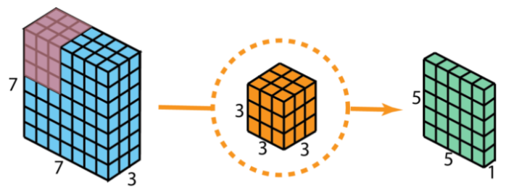
Standard Convolutions
Data size : (7*7*3) Conv2D Output size: (5*5*1)
128 Kernels of size : (3*3*3)
The number of operations performed per convolution will be KxKxM. So, the total number of operations is
(Number of operations per convolution)* (RxRxN) = (KxKxM)*(RxRxN).
Notes:
We consider our input layer to be of size 7 x 7 x 3 (height x width x channels). Our filter size is 3 x 3 x 3. We apply regular 2D convolution first as a sort of comparison. After applying 2D convolution with just one filter, we get a 5 x 5 x 1 output layer having only 1 channel.

Slide 7
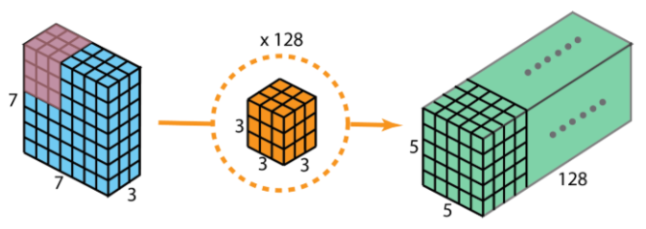
Standard Convolutions
Data size : (7*7*3) 128 Kernels Output size: (5*5*128)
128 Kernels of size : (3*3*3)
The number of multiplications required:
We have 128 3 x 3 x 3 filters moving 5 x 5 times ⇒we get 128 x 3 x 3 x 3 x 5 x 5 = 86,400 multiplications.
Notes:
After performing 128 2D convolutions, we get a total of 128 5 x 5 x 1 output layers. Let's stack all these layers into a big layer; that layer will have a size of 5 x 5 x 128. We are able to shrink the spatial dimensions which are the height and width (from 7 x 7 to 5 x 5). However, the depth increased from 3 layers to 128.

Slide 8
Standard Convolutional Layers
There are majorly two disadvantages of Standard Convolutional Networks when it comes to deploying them into mobile applications:
Θ It contains a large number of parameters => overfitting
ΘThey are computationally expensive because of the large number of computations => cannot be used for mobile applications.
⟹ To tackle these problems, we can use Separable Convolutions
Notes:
In many real-world examples like self-Driving cars, augmented reality the convolutional network should perform better under the time constrain.
in wide range of cases we require to deploy them into mobile applications, for which we need to reduce the computations
Separable Convolutions are helpful to tackle this problem.

Slide 9
Separable Convolutions
A Separable Convolution is a process in which a single convolution can be divided into two or more convolutions to produce the same output.
A single process is divided into two or more sub-processes to achieve the same effect.
Mainly there are two types of Separable Convolutions
Spatially Separable Convolutions.
Depth-wise Separable Convolutions.
Notes:
In many real-world examples like self-Driving cars, augmented reality the convolutional network should perform better under the time constrain.
in wide range of cases we require to deploy them into mobile applications, for which we need to reduce the computations
Separable Convolutions are helpful to tackle this problem.

Slide 10

Spatially Separable Convolutions
The kernel is broken into two smaller kernels and those kernels are multiplied sequentially with the input image to get the same effect of the full kernel.
For Example :
Kernel (3 * 3) Kernel (3*1) Kernel (1*3)
Notes:
In the conventional convolutions, if the kernel is 3 x 3 then the number of parameters would be 9. In spatially separable convolution we divide the kernel into two kernels of shapes 3 x 1 and 1 x 3. The input is first convolved with 3 x 1 kernel and then with 1 x 3, then the number of parameters would be 3 + 3 = 6. So less matrix multiplication is required.
An important thing to note here is that not every kernel can be separated. Because of this drawback, this method is used lesser compared to Depthwise separable convolutions.

Slide 11
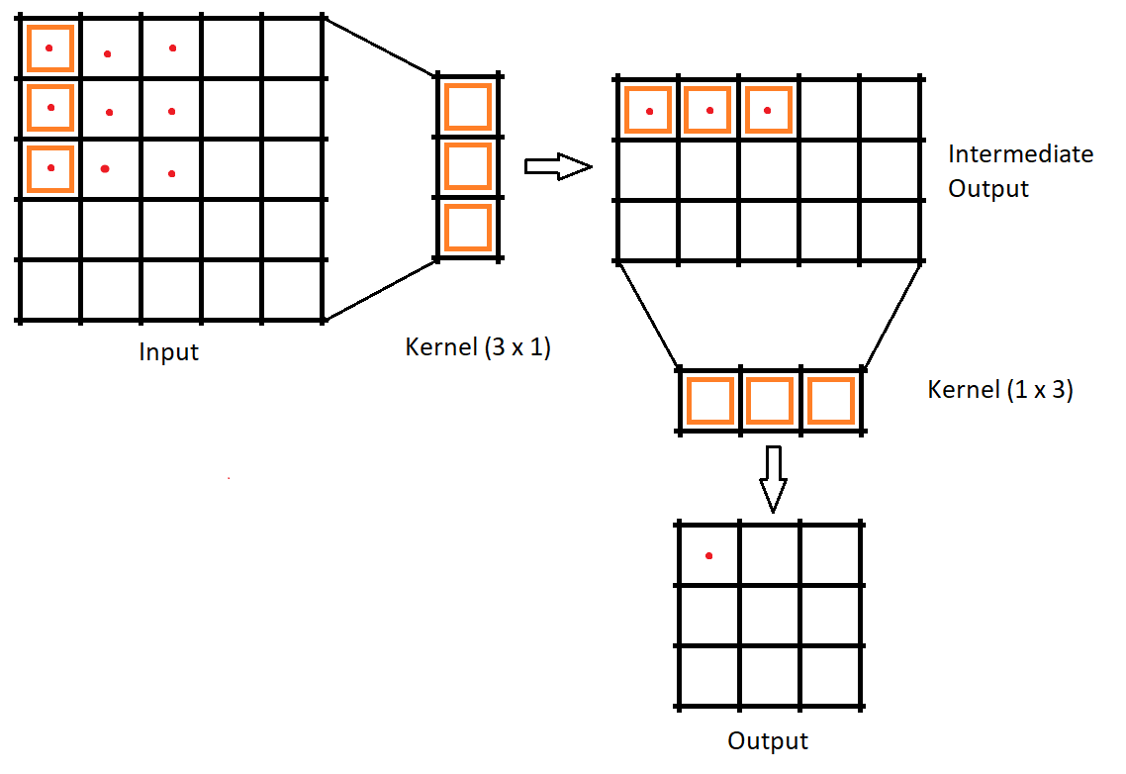
Spatially Separable Convolutions

Slide 12
2- Depthwise Separable Convolutions

Slide 13
Depthwise Separable Convolutions
It is particularly useful for mobile and embedded vision applications.
Smaller model size: Fewer number of parameters
Smaller complexity: Fewer Multiplications and Additions (Multi-Adds)
While standard convolution performs the channelwise and spatial-wise computation in one step, Depthwise Separable Convolution splits the computation into two convolutions :
Depthwise convolution
Pointwise convolution
Notes:
Unlike spatial separable convolutions, depthwise separable convolutions work with kernels that cannot be “factored” into two smaller kernels.
We will look into each of them one by one.

Slide 14
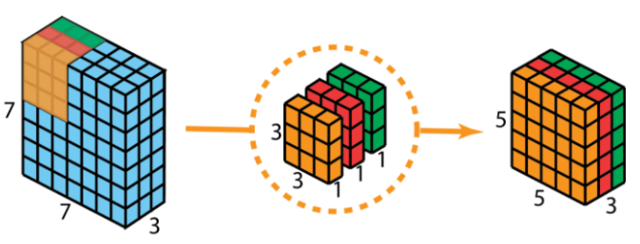
Depthwise Convolutions
Data size : (7*7*3) DepthwiseConv2D Output size: (5*5*1)
128 Kernels of size : (3*3*1)
Notes:
We use three seperate kernels of size 3 x 3 x 1 instead of using just one 3 x 3 x 3 used in the traditional convolution kernel. The three kernels interacts with just one channel of the input layer. Each of these three convolutions produces a map of size 5 x 5 x 1. Perform stacking again to generate a map of size 5 x 5 x 3. We observe that the spatial dimensions have shrunk while the depth remains the same.

Slide 15
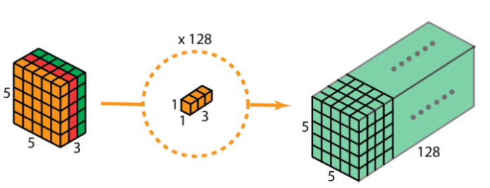
Pointwise Convolutions
Data size : (7*7*3) Pointwise Conv2D Output size: (5*5*1) *128
128 Kernels of size : (1*1*3)

Slide 16
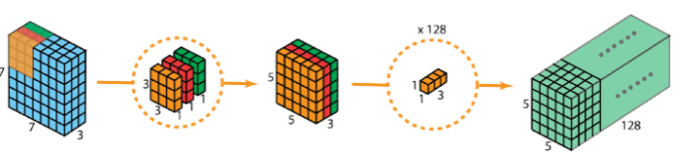
Depthwise Seperable Convolutions
The number of multiplications required:
We have 3 (3 x 3 x 1) filters moving 5 x 5 times ⇒we get 3 x 3 x 3 x 1 x 5 x 5 = 675 multiplications.
We have 128 (1 x 1 x 3 ) filters moving 5 x 5 times ⇒ we get 128 x 1 x 1 x 3 x 5 x 5 = 9,600
⇒ We get 675 + 9,600 = 10,275 multiplications.
12% of the total cost of the traditional 2D convolution!

Slide 17
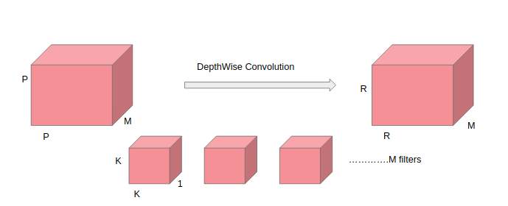
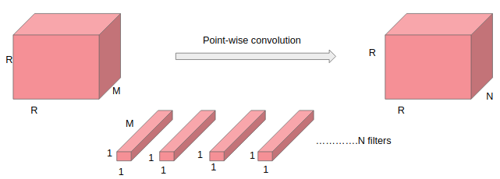
Depthwise Seperable Convolutions
Data size : (DF*DF*M) DepthwiseConv2D Output size: (R*R*M)
N Kernels of size : (DK*DK*1)
Data size : (R*R*M) point wise Conv2D Output size: (R*R*N)
N Kernels of size : (1*1*M))

Slide 18


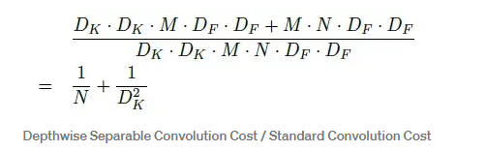
Depthwise Seperable Convolutions
Depthwise separable convolutions cost:
Standard convolutions computational cost :
Thus, the computation reduction is:

Slide 19
2- MobiNet Architecture

Slide 20
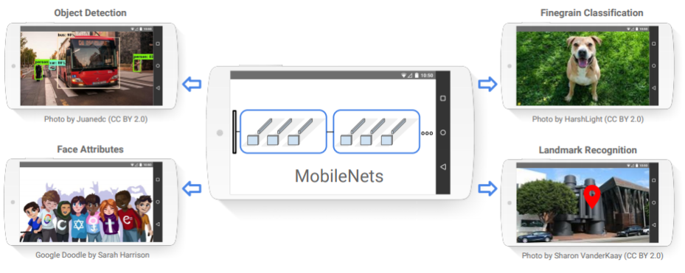
MobileNet Architecture
Notes:
MobileNet models can be applied to various recognition tasks for efficient on device intelligence.

Slide 21
MobileNet Architecture
MobileNets :
is a class of CNN that was open-sourced by Google
based on a streamlined architecture that uses Depthwise Separable Convolutions to build light weight deep neural networks.
reduce the number of parameters when compared to the network with regular convolutions with the same depth in the nets.
very small, low latency models that can be easily matched to the design requirements for mobile and embedded vision applications
There is actually more than one MobileNet. It was designed to be a family of neural network architectures.There are several hyperparameters that let you play with different architecture trade-offs.

Slide 22
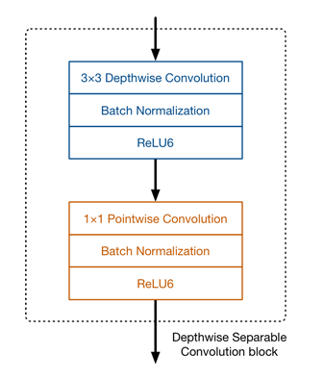
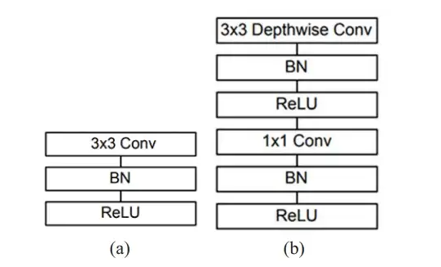
MobileNet Architecture
The main difference between MobileNet architecture and a traditional CNN instead of a single (3 x 3) convolution layer followed by the batch norm and ReLU. Mobile Nets split the convolution into a 3x3 depth-wise conv and a 1x1 pointwise convolution layer.
MobiNet conv dw
Traditional
Convolution unit
Notes:
MobileNet has 28 layers.
Together, the depthwise and pointwise convolutions form a “depthwise separable” convolution block. It does approximately the same thing as traditional convolution but is much faster. All the convolution layers are followed by batch normalization and an activation function ReLU6 with the exception of the final fully connected layer. This is like the well-known ReLU but it prevents activations from becoming too big. ReLU6 is more robust than regular ReLU when using low-precision computation.

Slide 23
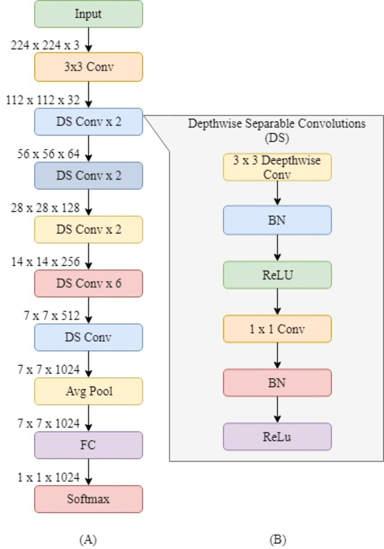
MobileNet Architecture
Notes:
The full architecture of MobileNet V1 consists of a regular 3×3 convolution as the very first layer, followed by 13 times the “depthwise separable” convolution block.There are no pooling layers in between these depthwise separable blocks. Instead, Down sampling is handled with strided convolution (stride =2 ) in the depthwise convolutions as well as in the first layer to reduce the spatial dimensions of the data.. When that happens, the corresponding pointwise layer also doubles the number of output channels. If the input image is 224×224×3 then the output of the network is a 7×7×1024 feature map.In a classifier based on MobileNet, there is typically a global average pooling layer at the very end, followed by a fully-connected classification layer or an equivalent 1×1 convolution, and a softmax.Counting depthwise and pointwise convolutions as separate layers, MobileNet has 28 layers.

Slide 24
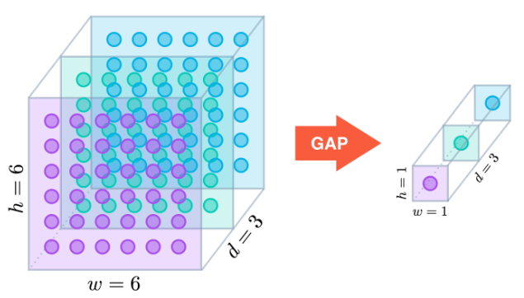
Global Average Pooling
Global Average Pooling is an operation that calculates the average output of each feature map in the previous layer. It replaces the Flatten layers in CNN. It generates one feature map for each corresponding category of the classification task in the last Conv layer.
Notes:
a tensor with dimensions h×w×d is reduced in size to have dimensions 1×1×d. GAP layers reduce each h×w feature map to a single number by simply taking the average of all hw values.

Slide 25
Global Average Pooling
removal of a large number of trainable parameters from the model
=> speeds up the training of your model
reduces the tendency of over-fitting
due to the averaging operation over the feature maps, the modelis more robust to spatial translations in the data.
Notes:
a tensor with dimensions h×w×d is reduced in size to have dimensions 1×1×d. GAP layers reduce each h×w feature map to a single number by simply taking the average of all hw values.

Slide 26
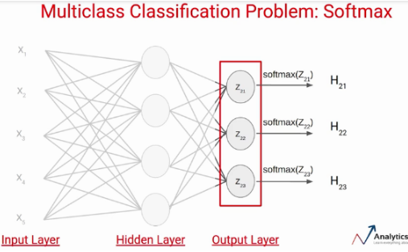

SoftMax Activation Function
The main advantage of the function is able to handle multiple classes.
SoftMax transforms the (unnormalised) output of K units (output of a FC layer) of a fully-connected layer to a probability distribution.

Slide 27
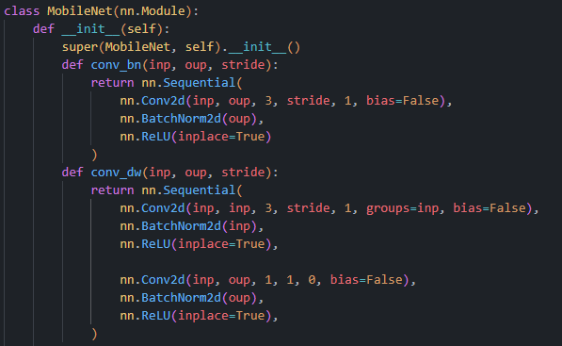

Slide 28
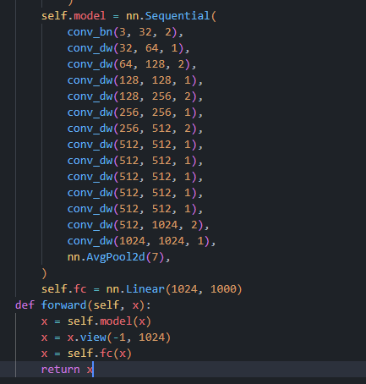

Slide 29
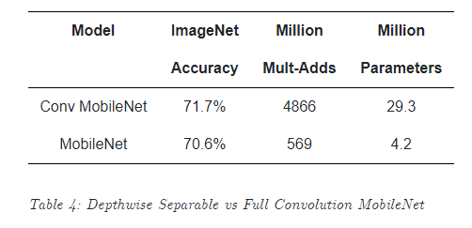
Experiments
we first investigate the effects of depthwise convolutions
We show results for MobileNet with depthwise separable convolutions compared to a model built with full convolutions.
Notes:
In Table 4 we see that using depthwise separable convolutions compared to full convolutions only reduces accuracy by 1%on ImageNet was saving tremendously on mult-adds and parameters.
MobileNet only got 1% loss in accuracy, but the Mult-Adds and parameters are reduced tremendously.
Two parameters are introduced so that MobileNet can be tuned easily: Width Multiplier α and Resolution Multiplier ρ

Slide 30
3- Width Multiplier & Resolution Multiplier

Slide 31
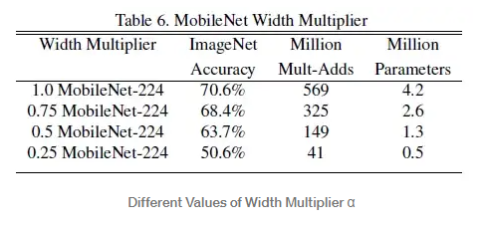

Width Multiplier α for Thinner Models
α controls the number of channels or channel depth => M become αM
α is between 0 to 1 , with typical settings of 1, 0.75, 0.5 and 0.25
The computational cost and the number of parameters can be reduced quadratically by roughly α².
Notes:
the depthwise separable convolution cost become
α=1 : the baseline MobileNet
Accuracy drops off smoothly from α=1 to 0.5 until α=0.25 which is too small.

Slide 32
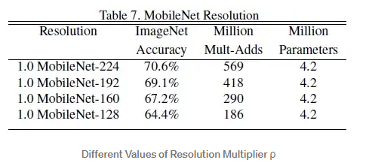

Resolution Multiplier ρ for reduced representation
ρ controls the input image resolution of the network
ρ is between 0 to 1
The input resolution is 224, 192, 160, and 128.
Notes:
The second hyper-parameter to reduce the computational cost of a neural network is a resolution multiplier ρ We apply this to the input image and the internal representation of every layer is subsequently reduced by the same multiplier.
the depthwise separable convolution cost become
ρ=1, it is the baseline MobileNet
Accuracy drops off smoothly across resolution from 224 to 128

Slide 33
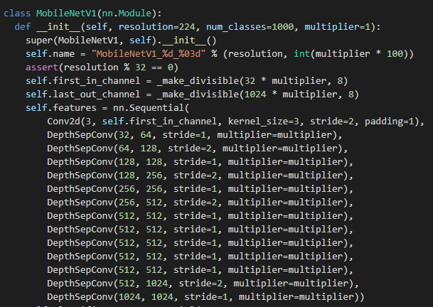
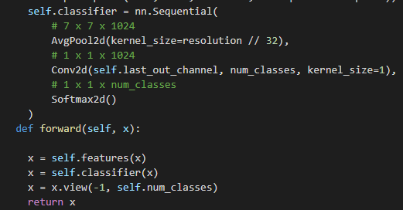

Slide 34
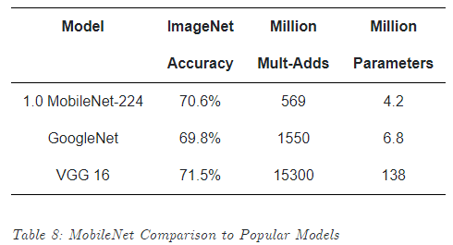
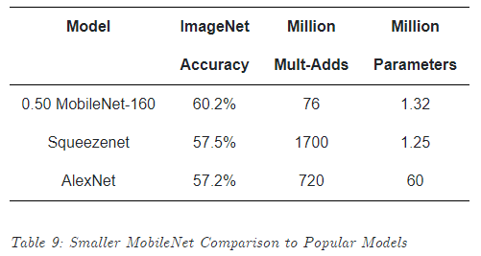
MobileNetV1 VS popular Models
⇒ MobileNets are small, low-latency, low-power models parameterized to meet the resource constraints of a variety of use cases (classification, detection, embedding and segmentation)
Notes:
We will compare full MobileNet to the original GoogleNet [30] and VGG16 [27]. MobileNet is nearly as accurate as VGG16 while being 32 times smaller and 27 times less compute intensive. It is more accurate than GoogleNet while being smaller and more than 2.5 times less computation.
We will compare a reduced MobileNet with width multiplier α=0.5and reduced resolution 160×160.Reduced MobileNet is 4%better than AlexNet [19] while being 45×smaller and 9.4×less compute than AlexNet. It is also 4%better than Squeezenet [12] at about the same size and 22×less computation.

Slide 35
4- MobileNetV2

Slide 36
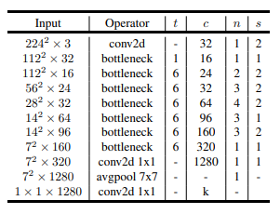
MobileNetV2 Convolutional Layers
MobileNet V2 still uses depthwise separable convolutions, but its main building block is different.
MobileNet V2 model has 53 convolution layers and 1 AvgPool
It has two main components:
Inverted Residual Block
Bottleneck Residual Block

Slide 37
BottleNeck Residual Block
MobileNetv2 still uses the deep separable convolution. But now it has a bottleneck residual block instead of just a deep separable convolution block.
There are 3 convolution layers in the bottleneck residual block.
The last two layers are the ones we already know: a depthwise convolution that filters the inputs, followed by a 1×1 pointwise convolution layer.
The first layer is new in the block. This is also a 1×1 convolution. Its purpose is to expand the number of channels in the data before it goes into the depthwise convolution.
Another important thing in the bottleneck residual block is a residual connection.
Notes:
However, this 1×1 layer now has a different job.In V1 the pointwise convolution either kept the number of channels the same or doubled them. In V2 it does the opposite: it makes the number of channels smaller.

Slide 38
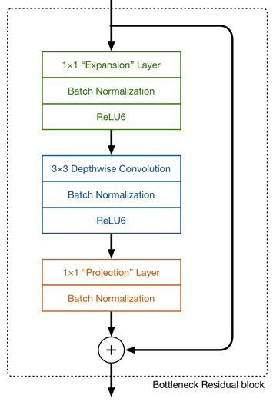
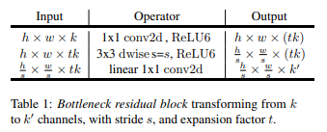
BottleNeck Residual Block

Slide 39
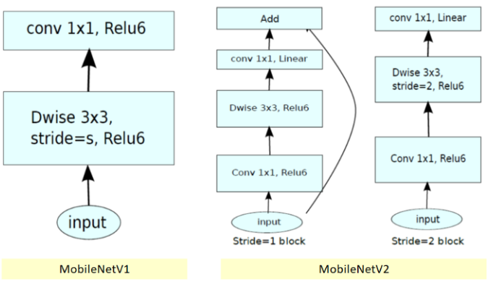
MobileNetV2 Convolutional Layers
Notes:
We have two types of blocks. One is residual block with stride of 1. Another one is block with stride of 2 for downsizing.

Slide 40
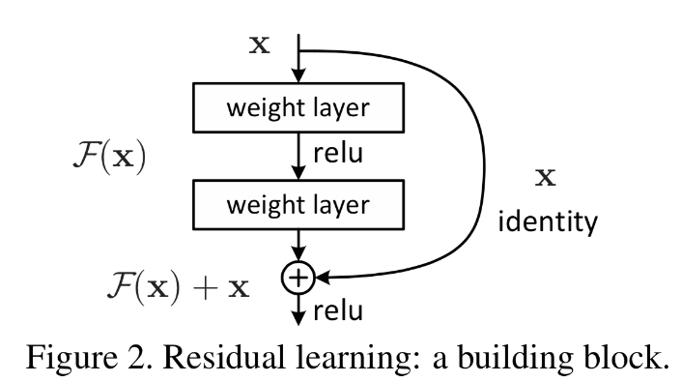
Residual Connection
A residual connection consists of making the output of an earlier layer available as input to a later layer, effectively creating a shortcut in a sequential network. Rather than being concatenated to the later activation, the earlier output is summed with the later activation, which assumes that both activations are the same size.
Residual connections tackle two common problems in deep-learning: vanishing gradients and representational bottlenecks.

Slide 41
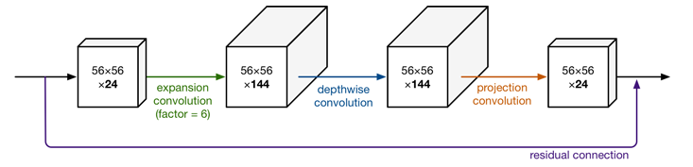
BottleNeck Residual Block
This kind of layer is also called a bottleneck layer because it reduces the amount of data that flows through the network.
Notes:
For example, if there is a tensor with 24 channels going into a block, the expansion layer first converts this into a new tensor with 24 * 6 = 144 channels. Next, the depthwise convolution applies its filters to that 144-channel tensor. And finally, the projection layer projects the 144 filtered channels back to a smaller number, say 24 again.The default expansion factor is 6.
The second new thing in MobileNet V2’s building block is the residual connection.

Slide 42
Inverted Residual Block
This kind of layer is also called a bottleneck layer because it reduces the amount of data that flows through the network.
Notes:
For example, if there is a tensor with 24 channels going into a block, the expansion layer first converts this into a new tensor with 24 * 6 = 144 channels. Next, the depthwise convolution applies its filters to that 144-channel tensor. And finally, the projection layer projects the 144 filtered channels back to a smaller number, say 24 again.The default expansion factor is 6.
The second new thing in MobileNet V2’s building block is the residual connection.

Slide 43
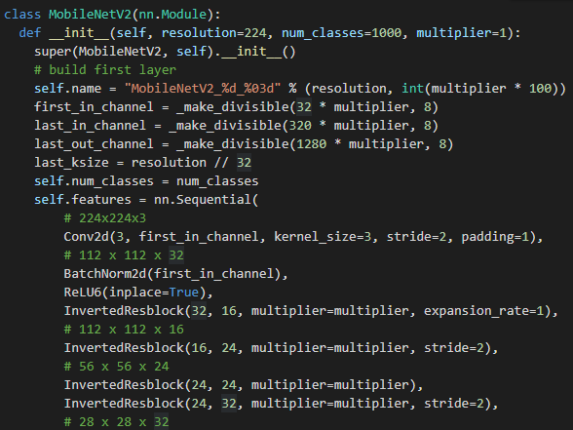
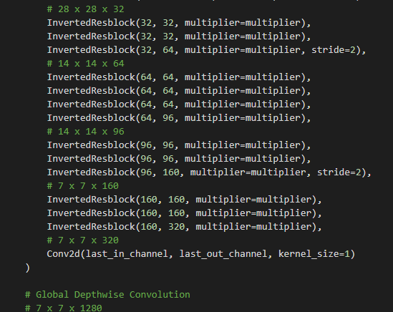

Slide 44
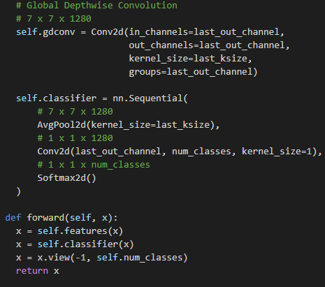

Slide 45
5- MobileNet V3

Slide 46
MobileNet V2 Convolutional Layers
The main contribution of MobileNetV3 is the use of AutoML to find the best possible neural network architecture for a given problem. This contrast with the hand-crafted design of previous versions of the architecture.
we deploy two techniques in sequence — MnasNet and NetAdapt : adds squeeze and excitation layers[2] in the initial building block taken from V2

Slide 47
4- Limitation of MobileNets

Slide 48
Limitation of MobileNets

