Slide 1
CSE381 — INTRODUCTION TO MACHINE LEARNING
Mushroom Edibility Classification
Phase 2 — Model Comparison, Error Analysis, and Final Selection
Summer 2026 | Milestone 2
Prepared by: Nadine Radwan · Ahmed Mohamed Elsayed · Hisham Mohamed
Prepared for: Dr Mahmoud Khalil · ENG Hala Shaheen

Slide 2
INTRODUCTION
The Problem: Classifying Mushrooms as Edible or Poisonous
Mushroom edibility is a binary classification problem — edible (e) vs. poisonous (p) — where the two classes can share very similar physical characteristics, so reliable prediction requires combining multiple attributes rather than one feature.
1
Implement Decision Tree and KNN classifiers
2
Evaluate all models with 5-fold cross-validation
The two error types are not equal: predicting a poisonous mushroom as edible is a safety-critical false negative, while predicting an edible mushroom as poisonous is merely overcautious.
3
Compare performance using consistent test-set metrics
4
Analyze classification errors — especially poisonous → edible
odor & spore-print-color
5
Select the most suitable final classifier
were removed — both are near-perfect predictors on their own, so dropping them forces the models to combine weaker signals instead of relying on one obvious feature.
2

Slide 3
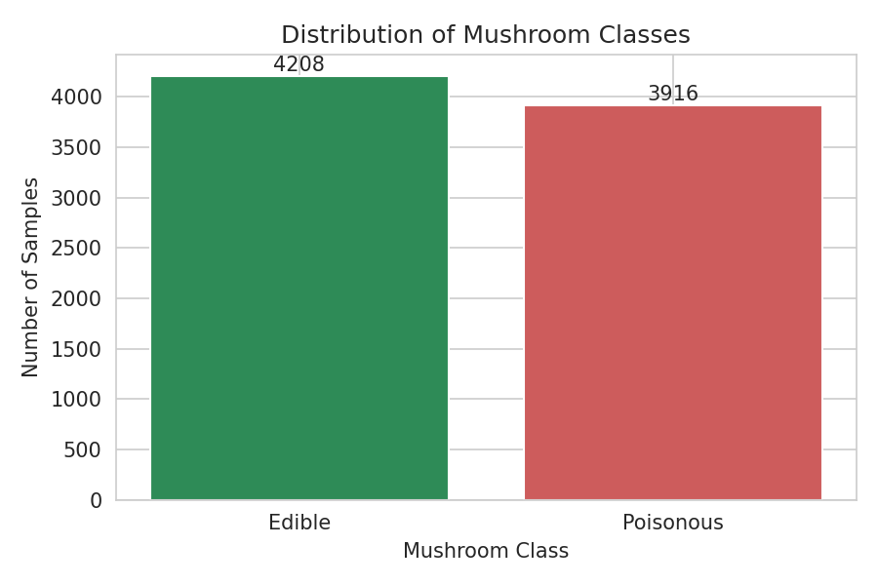
PHASE 1 RECAP
Dataset, Feature Reduction & Preprocessing
8,124
20
2,480
total samples
features used
missing stalk-root
Preprocessing Pipeline
1
2
3
4
Drop odor & spore-print-color
→
80/20 stratified split (seed=42)
→
Impute stalk-root with train mode
→
One-Hot Encode + align columns
Fig. 1 — Balanced class distribution (4,208 edible / 3,916 poisonous)
Result: 6,499 training samples · 1,625 testing samples, both fully numeric with zero missing values.
3

Slide 4
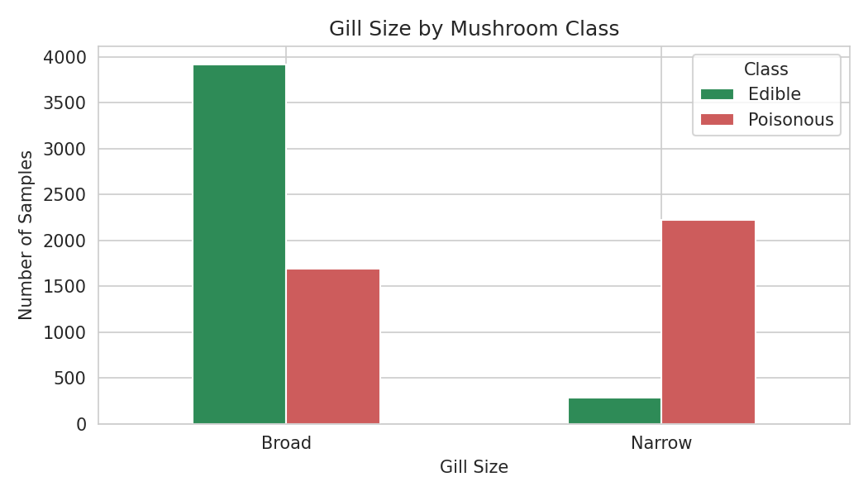
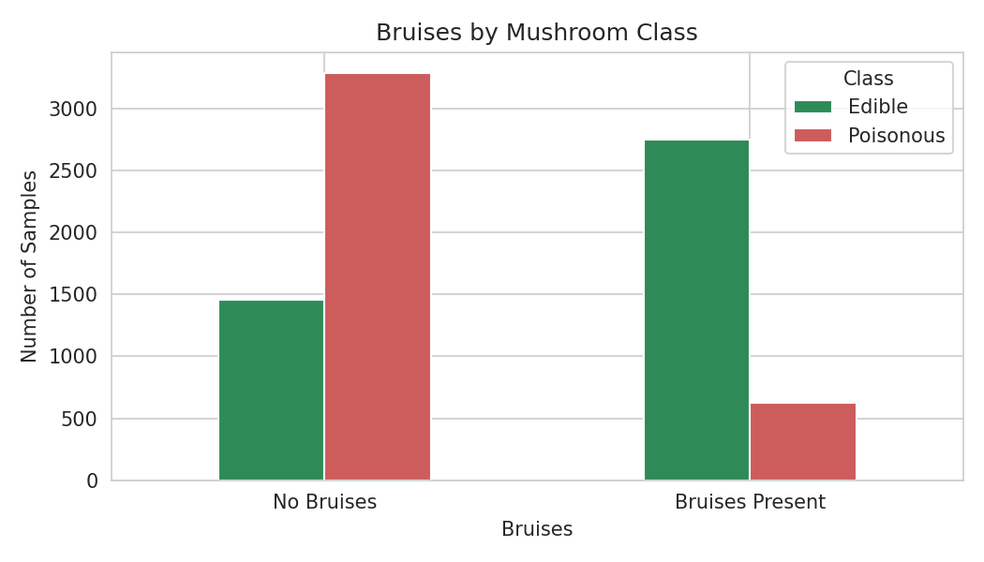
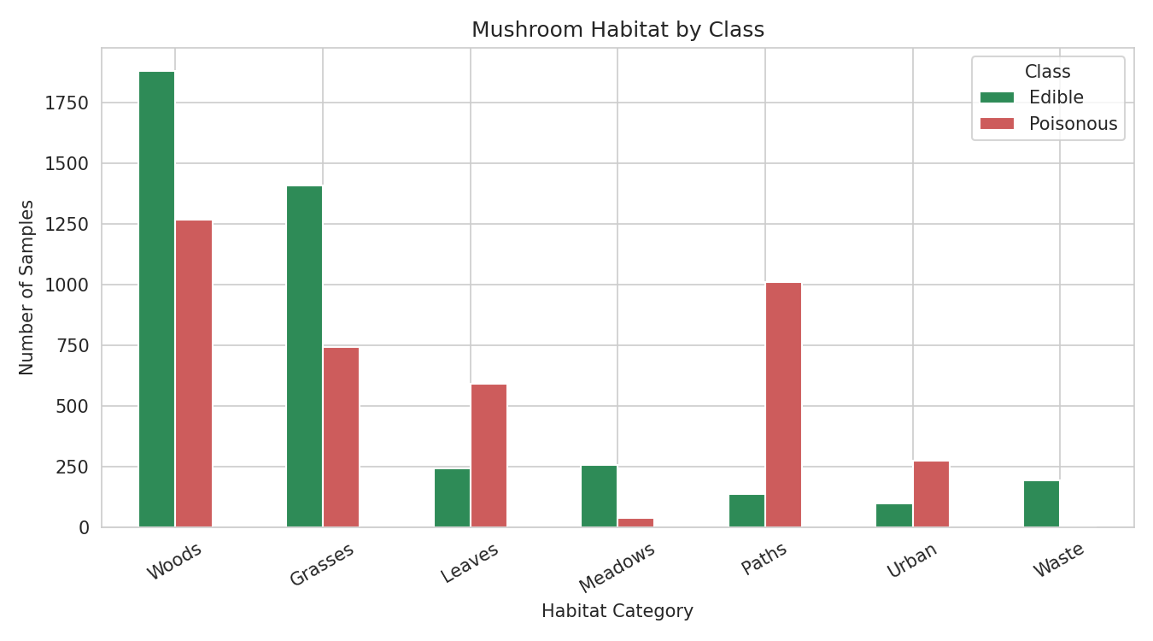
PHASE 1 RECAP
EDA Highlights & Logistic Regression Baseline
Gill size: broad → mostly edible; narrow → mostly poisonous
Bruising: bruised mushrooms are predominantly edible
Habitat: woods/grasses skew edible; paths/urban skew poisonous
Logistic Regression Baseline (Phase 1)
99.49%
99.57%
7
Mean CV Accuracy
Test Accuracy
Misclassified (all false negatives)
4

Slide 5
PHASE 2 SETUP
Comparing Three Classifier Families
Same training/testing split as Phase 1. All models evaluated with 5-fold cross-validation and identical test-set metrics for a fair comparison.
Logistic Regression
Decision Tree
K-Nearest Neighbors
LINEAR · BASELINE
TREE-BASED · NONLINEAR
INSTANCE-BASED
LogisticRegression(max_iter=1000)
DecisionTreeClassifier(random_state=42)
KNeighborsClassifier(n_neighbors=5)
Simple, interpretable baseline
Learns nonlinear decision rules
Classifies via 5 nearest neighbors
Produces class probabilities
Captures feature interactions
Distance over 98 binary features
Learns a linear decision boundary
No feature scaling required
No explicit model is trained
5

Slide 6
PHASE 2 RESULTS
Cross-Validation Results
Five-fold cross-validation was performed on the training data only, before any test-set evaluation.
Logistic Regression — Fold Detail
Fold 1
99.77%
Fold 2
99.85%
Fold 3
99.38%
Fold 4
99.15%
Fold 5
99.31%
Decision Tree and KNN achieved a near-identical mean CV accuracy of 99.9538% — both outperforming the Logistic Regression baseline's 99.4922%.
6

Slide 7
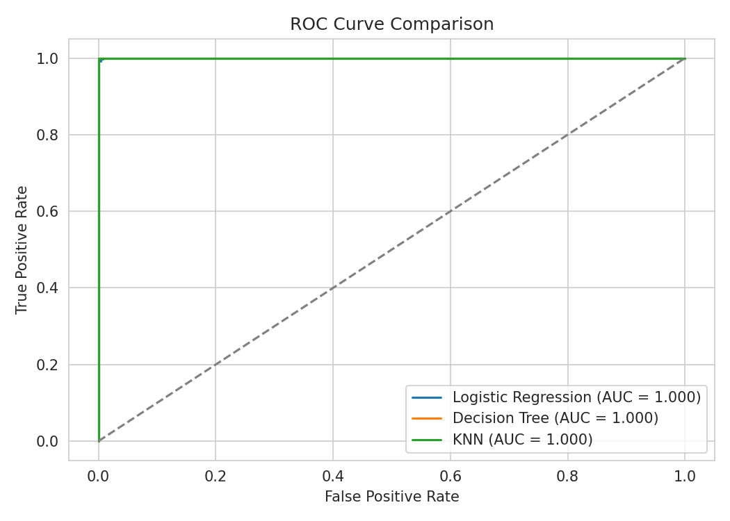
PHASE 2 RESULTS
Test-Set Performance Comparison
All three classifiers evaluated on the same 1,625-sample held-out test set.
Model | Test Accuracy | Poisonous Precision | Poisonous Recall | Poisonous F1 | ROC-AUC
Logistic Regression | 99.5692% | 100.00% | 99.11% | 99.5510% | 99.9964%
Decision Tree ★ | 100.0000% | 100.00% | 100.00% | 100.0000% | 100.0000%
KNN | 100.0000% | 100.00% | 100.00% | 100.0000% | 100.0000%
Decision Tree and KNN achieved perfect ROC-AUC (1.000) and eliminated all seven false negatives produced by the Logistic Regression baseline.
Logistic Regression still reached a near-perfect ROC-AUC of 0.9999 despite its 7 test-set errors — a reminder that ROC-AUC reflects ranking across thresholds, not the confusion matrix at one fixed threshold.
7

Slide 8
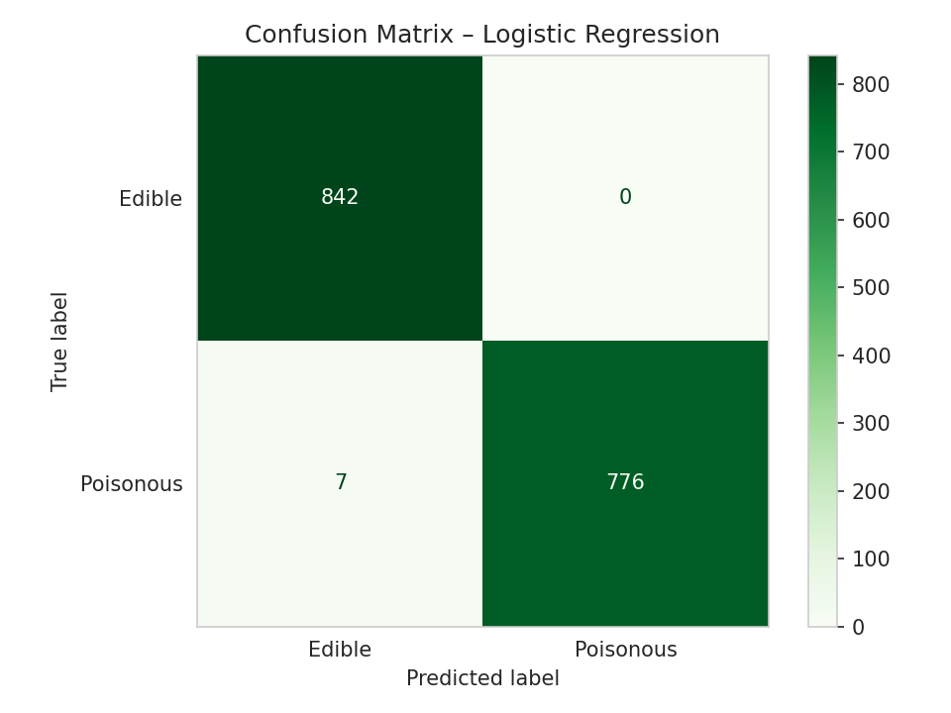
TASK 7: ERROR ANALYSIS
Where the Models Failed — and Why It Matters
Misclassification Counts
Model | Correct | Errors | Poisonous→Edible
Logistic Regression | 1,618 | 7 | 7
Decision Tree | 1,625 | 0 | 0
KNN | 1,625 | 0 | 0
All 7 Logistic Regression errors were poisonous → edible
The most safety-critical error type in this domain: a dangerous mushroom incorrectly labeled safe. False-negative rate = 7 / 783 = 0.89%.
Fig. — Logistic Regression Confusion Matrix
Interpretation: Logistic Regression's linear decision boundary placed these 7 poisonous samples on the edible side. Decision Tree and KNN classified them correctly because both can represent nonlinear relationships between the encoded features.
8

Slide 9
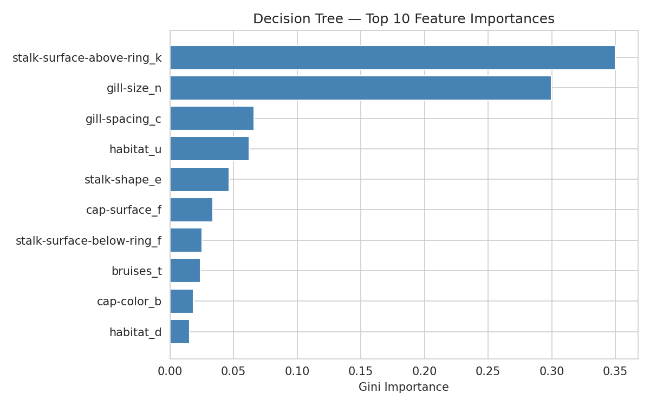
FINAL MODEL SELECTION
Decision Tree Feature Importance & Final Selection
SELECTED FINAL MODEL
Decision Tree Classifier
✓ 100% test accuracy · 100% poisonous F1
✓ Zero false negatives
✓ ROC-AUC = 1.0 · Mean CV = 99.95%
✓ Clearer feature-based decision rules than KNN
Why Decision Tree over KNN?
Both achieved identical perfect test results and nearly identical CV accuracy (99.9538% vs. 99.9538%). Decision Tree was preferred for its interpretable, feature-based decision rules and more efficient prediction — it does not need to compare each new sample against all stored training observations the way KNN does.
Fig. 9 — Top 10 encoded features by Decision Tree importance. stalk-surface-above-ring_k (~0.35) and gill-size_n (~0.30) dominate; the tree combines several weaker signals rather than relying on one feature.
Caveat: perfect test accuracy is dataset-specific, not a guarantee on unseen or real-world mushroom samples.
9

Slide 10
CONCLUSION
From Baseline to Final Model
Decision Tree and KNN both eliminated every safety-critical error the Logistic Regression baseline produced, achieving perfect test-set accuracy, F1, and ROC-AUC on the 1,625-sample held-out set.
100%
Decision Tree test accuracy
The Decision Tree was selected as the final model for its combination of perfect test performance, interpretable feature-based rules, and efficient prediction — while KNN remains an equally strong, if less transparent, alternative.
0
false negatives (DT & KNN)
Limitations & Future Work
1.0
Decision Tree/KNN were not hyperparameter-tuned or pruned; preprocessing was not embedded in a scikit-learn Pipeline across CV folds; no independent external dataset was tested. Results are academic and must not guide real-world foraging decisions.
ROC-AUC (DT & KNN)
AI was used only for research, clarification, and report organization — every figure, table, and metric traces to executed notebook code.

