Slide 1
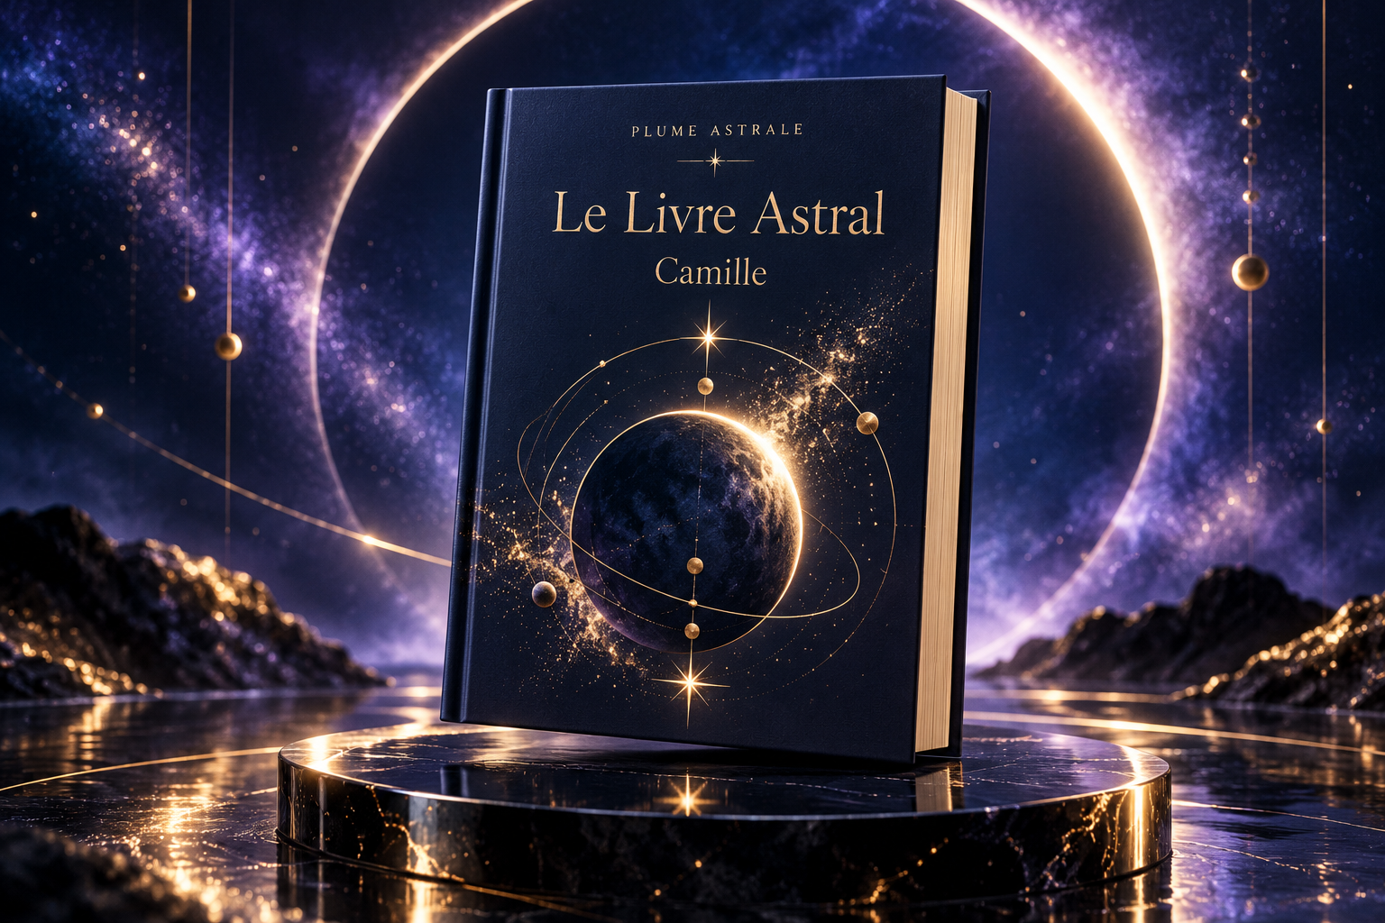
Plume Astrale
Personal birth-chart readings
you can keep
Symbolic self-reflection
Book design concept
1 / 7
Notes:
Timing: 25 seconds. Pitch slide 1 of 6.
ENGLISH SCRIPT
Plume Astrale is a French application that turns birth details into a personal astrology reading. My goal is to make that experience clear, engaging, and worth keeping. The main product is a structured report that people can explore online and save as a PDF.
REPÈRES FRANÇAIS
Plume Astrale transforme des informations de naissance en lecture astrologique personnelle. L’objectif est une expérience claire et agréable, avec un rapport structuré que l’on peut parcourir et conserver en PDF.
SOURCES AND STATUS
User-provided final invitation and project conversation, October 2026. Project repository supplied by the user. Current live flow to verify before recording. No sales or customer counts claimed. Visual: generated design concept from this conversation, not a real app screenshot or a manufactured product.

Slide 2
The user problem
A personal reading needs context
01
Birth-chart symbols can be difficult to interpret
02
A long report needs a clear reading path
03
People need an output they can revisit
2 / 7
Notes:
Timing: 30 seconds. Pitch slide 2 of 6.
ENGLISH SCRIPT
I am designing for people who are curious about astrology but need help understanding what a birth chart means. A chart can look complex, and a long report can be hard to navigate. Plume Astrale brings the information into one guided experience, with explanations and chapters that make the reading easier to follow.
REPÈRES FRANÇAIS
Le projet s’adresse aux personnes curieuses d’astrologie qui ont besoin de repères pour comprendre leur carte du ciel. L’expérience organise cette lecture avec des explications et des chapitres.
SOURCES AND STATUS
User-provided final invitation and project conversation, October 2026. Project repository supplied by the user. Current live flow to verify before recording. No sales or customer counts claimed.

Slide 3
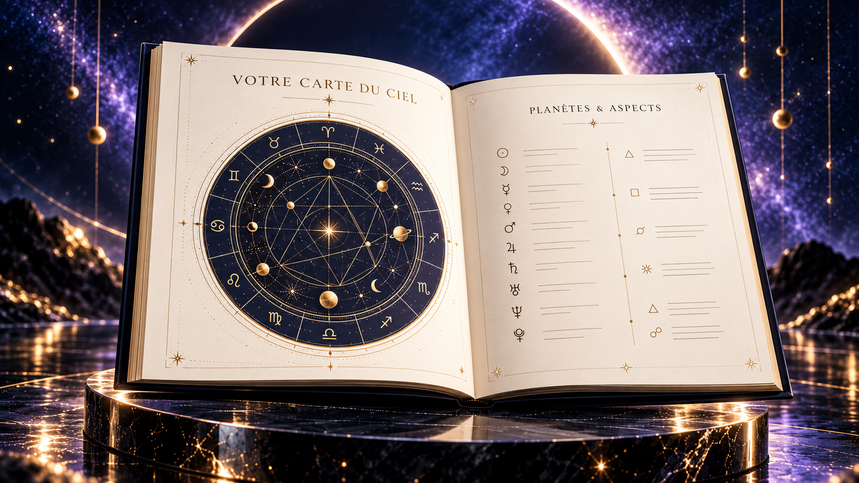
The product journey
A guided reading
01
Enter the birth details
02
Explore the chart and its interpretation
03
Keep the report as a PDF
Illustrative layout
3 / 7
Notes:
Timing: 35 seconds. Pitch slide 3 of 6.
ENGLISH SCRIPT
The journey starts with a simple form. The user provides birth details, including the time when it is known. The application connects astrology data with an AI-assisted explanation. The output combines a chart and a structured reading. In the demonstration, I use a report generated earlier so the jury can see the actual output without waiting for generation.
REPÈRES FRANÇAIS
Le parcours commence par un formulaire. L’heure est utilisée lorsqu’elle est connue. Le projet relie les données astrologiques à une explication assistée par IA. La démonstration ouvre un rapport déjà généré pour montrer le résultat réel sans attendre.
SOURCES AND STATUS
User-provided final invitation and project conversation, October 2026. Project repository supplied by the user. Current live flow to verify before recording. No sales or customer counts claimed. Visual: generated design concept from this conversation, not a real app screenshot or a manufactured product.

Slide 4
Built with Emergent
A connected application
01
Application interface and user journey
02
Astrology data and AI-assisted text
03
Payment and report-delivery workflows
4 / 7
Notes:
Timing: 30 seconds. Pitch slide 4 of 6.
ENGLISH SCRIPT
I used Emergent to build and improve the application across the interface and backend. The project connects astrology data, AI-assisted writing, and payment workflows. My work also includes the editorial structure and the visual identity. My current focus is testing the complete journey and making report delivery more reliable before expanding the product range.
REPÈRES FRANÇAIS
Emergent a servi à construire et améliorer l’interface et le backend. Les intégrations relient données astrologiques, rédaction assistée et paiement. La priorité actuelle est de tester le parcours complet et de fiabiliser la livraison.
SOURCES AND STATUS
User-provided final invitation and project conversation, October 2026. Project repository supplied by the user. Current live flow to verify before recording. No sales or customer counts claimed.

Slide 5
Business model
Paid readings first
01
Personal reports purchased individually
02
A credit system for eligible services
03
Book and gift editions as a next step
5 / 7
Notes:
Timing: 30 seconds. Pitch slide 5 of 6.
ENGLISH SCRIPT
The revenue model is based on paid personal reports and a credit system for eligible services. I want to start with a clear purchase and a useful result. Book and gift editions are a possible next step. I will measure completed purchases, successful delivery, customer feedback, and margin before investing further in acquisition.
REPÈRES FRANÇAIS
Le modèle repose sur les rapports payants et les crédits pour les services concernés. Les éditions cadeau sont une évolution envisagée. Les indicateurs à suivre sont les achats finalisés, les livraisons réussies, les retours clients et la marge.
SOURCES AND STATUS
User-provided final invitation and project conversation, October 2026. Project repository supplied by the user. Current live flow to verify before recording. No sales or customer counts claimed.

Slide 6
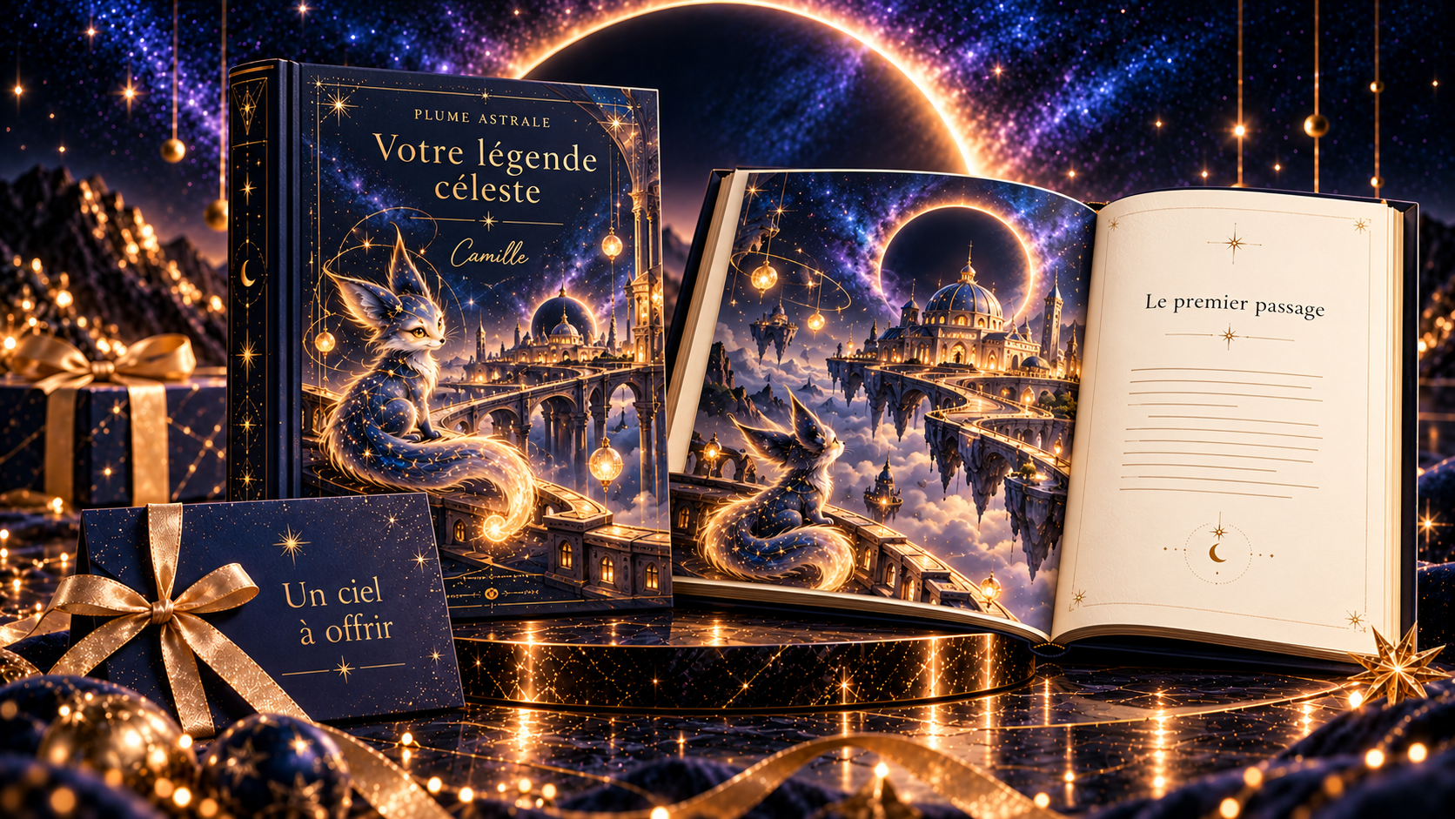
The next milestone
A reliable book experience
Consistent report quality
A validated print sample
A small gift-product pilot
Gift stories: concept stage
6 / 7
Notes:
Timing: 30 seconds. Pitch slide 6 of 6.
ENGLISH SCRIPT
My next milestone is a consistent report that can become a book. I will validate a print sample and test a gift offer with real users. This illustrated story collection is still a concept. Emergent helped me build the application. I now want to prove the complete customer experience.
REPÈRES FRANÇAIS
Le prochain objectif est un rapport de qualité constante, un exemplaire papier validé et un petit test d’offre cadeau. La collection de contes illustrés présentée est encore un concept.
SOURCES AND STATUS
User-provided final invitation and project conversation, October 2026. Project repository supplied by the user. Current live flow to verify before recording. No sales or customer counts claimed. Visual: generated design concept from this conversation, not a real app screenshot or a manufactured product. Gift stories remain a concept.

Slide 7
Nadine Zebdi
Founder of Plume Astrale
Digital product designer
and developer
plume-astrale.fr
7 / 7
Notes:
Timing: 60 seconds. Founder segment.
ENGLISH SCRIPT
My name is Nadine Zebdi. I am a French entrepreneur, and I design and build digital products. With Plume Astrale, I wanted to create a personal experience that people could keep and return to over time. I have worked on the user journey, the visual identity, and the connection between data and written content. Emergent helped me test ideas and improve the application through iteration. This project has also taught me that a strong visual experience needs reliable delivery behind it. My ambition is to build a product that people understand, enjoy, and feel comfortable offering to someone else. Thank you.
REPÈRES FRANÇAIS
Je suis Nadine Zebdi, entrepreneuse française, conceptrice et développeuse de produits numériques. Je souhaite créer une expérience personnelle que l’on garde et que l’on retrouve. Mon travail porte sur le parcours, l’identité visuelle et le lien entre données et contenu. L’ambition est un produit compréhensible, agréable et que l’on a envie d’offrir.
SOURCES AND STATUS
User-provided final invitation and project conversation, October 2026. Project repository supplied by the user. Current live flow to verify before recording. No sales or customer counts claimed.

