Slide 1
AI ACADEMY · NATIONAL AI CENTER · ML FINAL PROJECT 2026
Ensemble Methods
Boosting vs. Bagging
“Under what conditions does boosting outperform bagging, and vice versa — and why?”
Nadir Askarov
From-scratch implementations in NumPy · tag v1.0-final

Slide 2



THE STUDY
Two ways to build a strong classifier from weak ones
We implement three algorithms from scratch, then run a controlled empirical study across three datasets chosen to differ in the ways theory says should matter — dimension, class balance, and class overlap.
Decision Tree
AdaBoost
Random Forest
CART with exhaustive split search. One weighted-sample-aware class serves all three roles.
Discrete SAMME over depth-1 stumps. Re-weights misclassified points each round — attacks bias.
Bagging over full trees with √p feature subsampling and OOB scoring — attacks variance.
Not allowed as implementations: sklearn's tree / ensemble classes, xgboost, lightgbm. Used only as sanity-check baselines.

Slide 3
BACKGROUND
The same error, split two ways
BOOSTING
BAGGING
sequential · corrects mistakes
parallel · averages instability
BASE LEARNER
A stump — too rigid to fit much
BASE LEARNER
A deep, fully-grown tree
ASSUMES
The learner is biased, not noisy
ASSUMES
The learner is unstable, not biased
MECHANISM
Re-weight missed points, add votes αₘ
MECHANISM
Bootstrap + vote; decorrelate with √p
REDUCES
Bias (and variance as a side effect)
REDUCES
Variance (bias is left untouched)
FAILS WHEN
Labels are noisy, or the stump is too weak
FAILS WHEN
The base learner is genuinely biased

Slide 4
EXPERIMENTAL SETUP
Three datasets, deliberately different
Dataset | Samples | Features | Classes | Minority | Role
Breast Cancer | 569 | 30 | 2 | 37.3% | Balanced control
Adult Income | 8,000 | 104 | 2 | 24.9% | High-dim, one-hot
Covertype | 9,999 | 54 | 7 | 0.47% | Multi-class, imbalanced
0.47%
104
≤ 0.6%
minority class on Covertype — 47 of 9,999 rows
features on Adult after one-hot encoding
gap vs sklearn on the two larger datasets
Each cap is class-stratified, so imbalance survives subsampling; the ranking between models is unaffected.

Slide 5
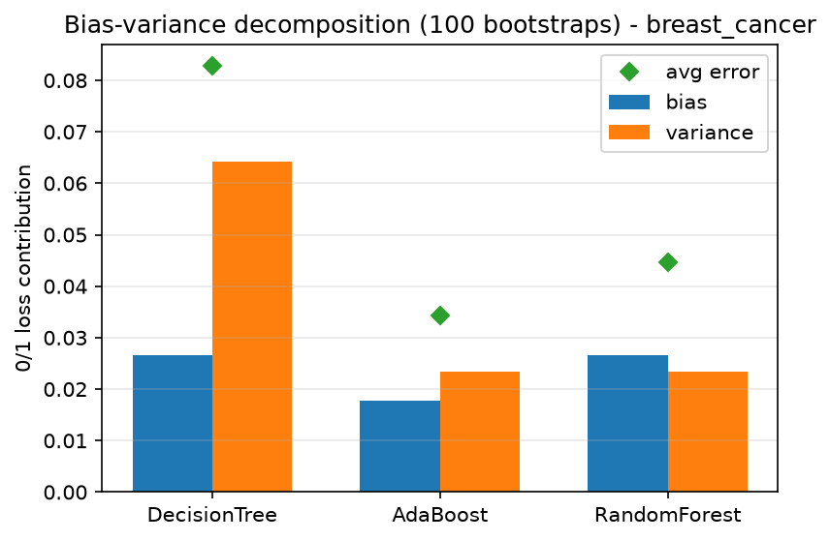
KEY RESULT · EXPERIMENT 6
Bias–variance: the mechanism, isolated
Bagging leaves bias untouched
Bias identical to a single tree — 0.0265, exactly — while variance falls 64% (0.0642 → 0.0234).
Boosting is the only bias-reducer
Bias 0.0265 → 0.0177, a 33% cut, and it damps variance too (0.0235).
This predicts everything else
Wins when bias is the binding constraint; loses when the mechanism chases noise.
100 bootstrap replicates · Breast Cancer

Slide 6
EXPERIMENT 4 · 5-FOLD CV, 100 ESTIMATORS
Head-to-head: often a tie, sometimes not
Dataset | Model | Accuracy | Macro-F1 | AUC
Breast Cancer | Decision Tree | 0.916 | 0.911 | 0.914
 | AdaBoost | 0.975 | 0.974 | 0.995
 | Random Forest | 0.960 | 0.957 | 0.992
Adult Income | Decision Tree | 0.810 | 0.745 | 0.744
 | AdaBoost | 0.858 | 0.789 | 0.912
 | Random Forest | 0.857 | 0.796 | 0.909
Covertype | Decision Tree | 0.656 | 0.495 | 0.722
 | AdaBoost | 0.589 | 0.323 | 0.853
 | Random Forest | 0.733 | 0.463 | 0.929
Boosting wins clean & balanced
Breast Cancer: 0.975 vs 0.960.
Usually indistinguishable
Adult differs by 0.0005 — inside fold-to-fold σ ≈ 0.01.
Bagging wins multi-class
Covertype: AdaBoost (0.589) falls below a single tree; RF wins at 0.733.
Bold = best in group. sklearn's forest (not shown) tracks ours within 0.9 pts.

Slide 7
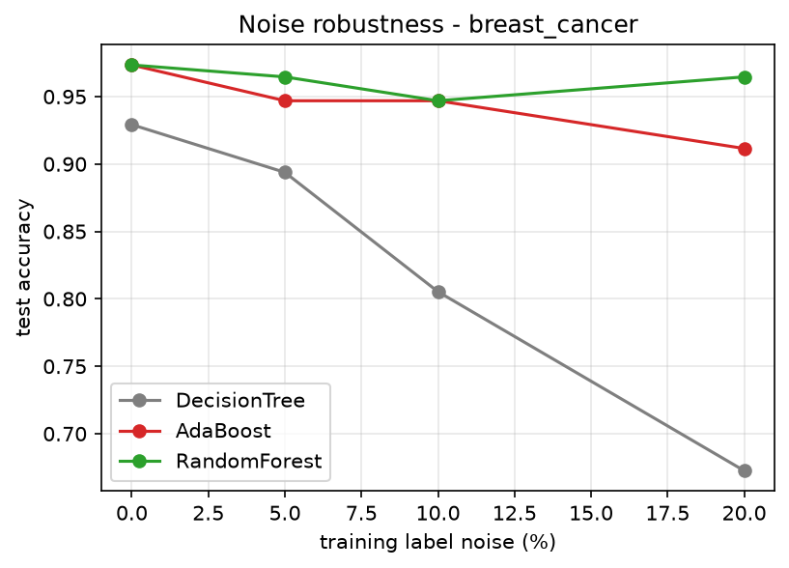
EXPERIMENT 5 · KEY RESULT
Under label noise, the philosophies split
Accuracy lost at 20% noise
0.9 pt
Random Forest — barely moves
6.2 pt
AdaBoost — ~7× more sensitive
Why? The weight update can't tell a hard example from a mislabelled one, so AdaBoost spends late rounds fitting the corrupted points. Bagging just averages them away.
Train labels flipped; evaluated on the clean test set · Breast Cancer

Slide 8
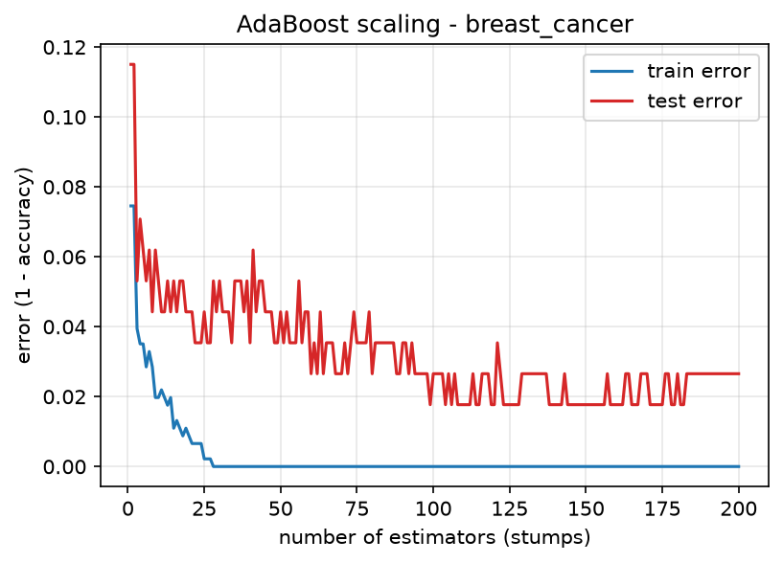
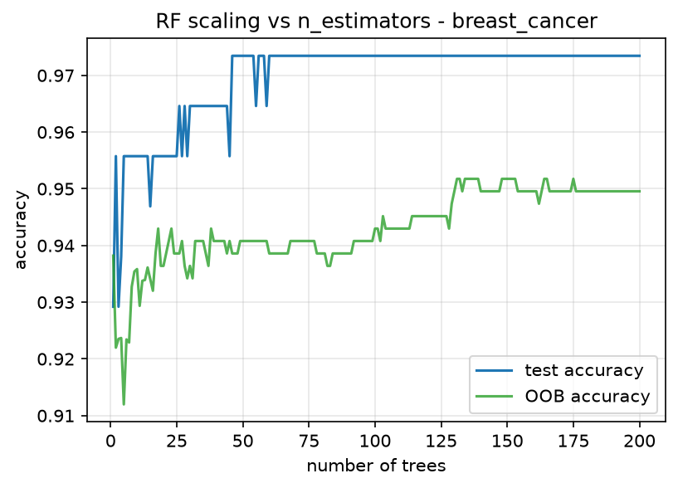
EXPERIMENTS 2 & 3
How each ensemble scales
AdaBoost overfits — mildly, late
Random Forest just converges
Training error → 0; test error flattens early, then drifts up slightly. Rounds aren't a delicate knob on clean data.
Test accuracy plateaus after ~50 trees; more never hurt. OOB tracks test from a pessimistic direction — free validation.

Slide 9
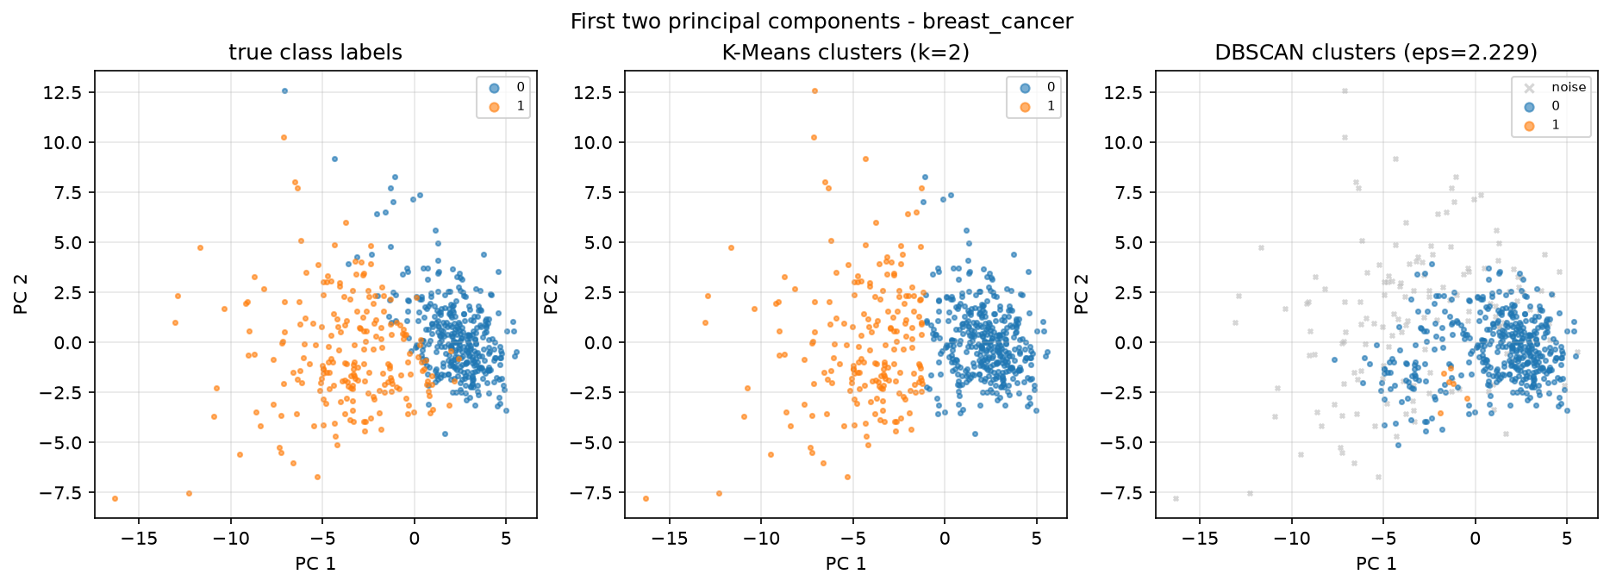
EXPERIMENT 7 · PCA / K-MEANS / DBSCAN
Do clusters predict classifier performance?
K-Means ARI ranks the datasets…
Breast Cancer
0.671
Adult
0.187
Covertype
0.099
…in the same order accuracy does.
The relationship is one-directional: high ARI predicts easy classification, but low ARI does not predict hard.
First two PCs of Breast Cancer — true class, K-Means (k=2), DBSCAN

Slide 10

THE ANSWER
It depends — and predictably so
Boosting wins on clean, balanced, low-dimensional data
Where the stump's bias is the binding constraint and labels are trustworthy — Breast Cancer, 0.975 vs 0.960.
If forced to pick one
Random Forest
Bagging wins under noise or when the learner is too weak
Not because it won more — because its failure mode is graceful: no overfitting as trees grow, and free OOB validation.
0.9 pts lost to AdaBoost's 6.2 under 20% noise; and it beats a stump-based ensemble outright on 7-class Covertype.
Most of the time, it barely matters
NEXT
Quantify class-weight treatment on Covertype · Gradient Boosting · t-SNE vs PCA on Adult.
On Adult the two differ by 0.0005. They don't rank — they fail differently, in the directions bias–variance predicts.
Nadir Askarov · AI Academy 2026 · Every number reproducible via run_all.py

