Slide 1

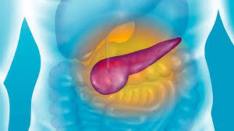

Predicting Pancreatic Cancer: Diagnosis and Stage
Nadira Amadou Mahamane
Engineering Physics, Computer Science
University of Central Arkansas
ASRI-2022- Cancer

Slide 2
Contents
Introduction/ Background
Hypothesis
Results
Methodology
Conclusion/ SWOT Analysis

Slide 3
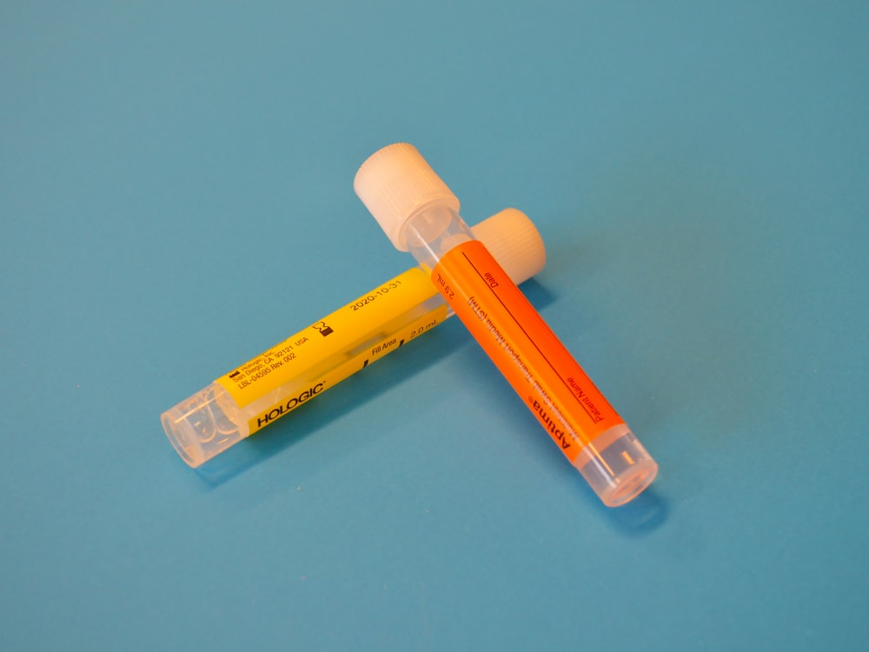
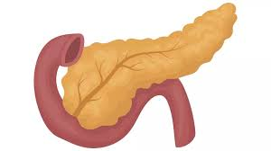
Introduction
Why Urine samples?
Non-invasive
High volume collection
Ease of repeated measurement
Colon cancer, ovarian, lung, and cholangiocarcinoma
Background
Pancreatic Ductal Adenocarcinoma (PDAC)
aggressive and incurable malignancies
9% surviving more than 5%
Major issue: late diagnosis
Early detection 70% chance of +5 years survival
Treatment
Surgery
Chemotherapy
Radiation therapy
Combination of above
Previous Researches
Cancer can be detected with machine learning
Identified 3 protein biomarkers
Improve current diagnosis with a non-invasive method
Widely used approach: Multivariable regression
logistic regression for binary control

Slide 4

Hypotheses
We can use the biomarkers data to determine if a patient has cancer.
02
There is a correlation between the different biomarkers in Cancer .
🤔
01
❓

Slide 5
Methodology
Use Random Forest classification and K-Nearest Neighbors to train and model data
Visualize the information about the data file
Drop columns with too many values and fill in missing values
📊
🧹
🤖
🗂
🧐
📉
Split and prepare data for training and modeling using the scikit-learn package
Make analysis
Determining the statistical relation between the different biomarkers using Anova test

Slide 6
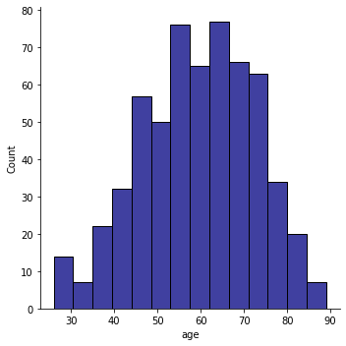
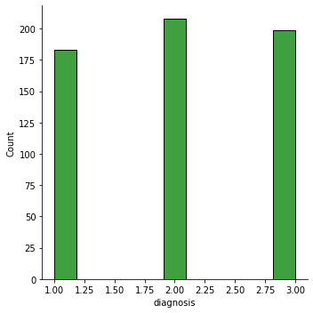
Result --Demographic
👦🏻 👧🏾 Min: 26 years
Mean: 59 years
👵🏾 👴 Max: 89 years
👨
👩

Slide 7
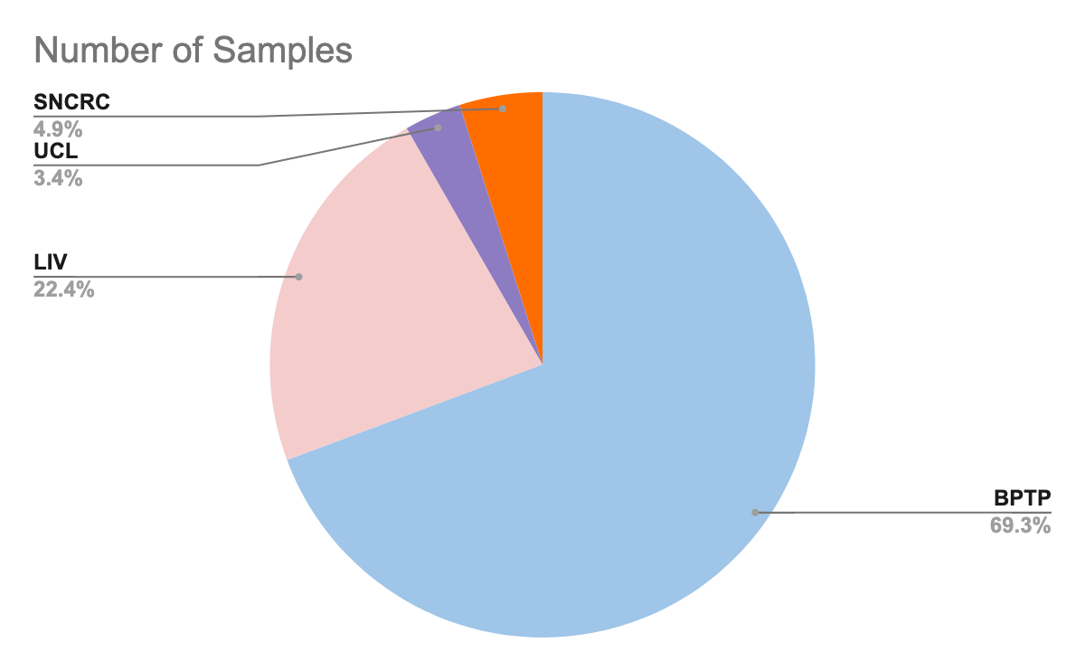
SAMPLES’ ORIGIN
🇬🇧 : 95.1%
🇪🇸 : 4.9%
Spanish National Cancer Research Centre,
Madrid, Spain (SNCRC)
University College London
Liverpool University, London
Barts Pancreas Tissue Bank, London, UK

Slide 8
INDEPENDENT AND DEPENDENT VARIABLES
🧪 Urinary biomarkers :
Creatinine: Urinary biomarker of kidney function
LYVE1: protein that may play a role in tumor metastasis
REG1B: protein that may be associated with pancreas regeneration.
TTF1: regeneration and repair of the urinary tract
🕵🏽‍♀️Diagnosis:
1: Control
2: benign
3: pancreatic cancer

Slide 9
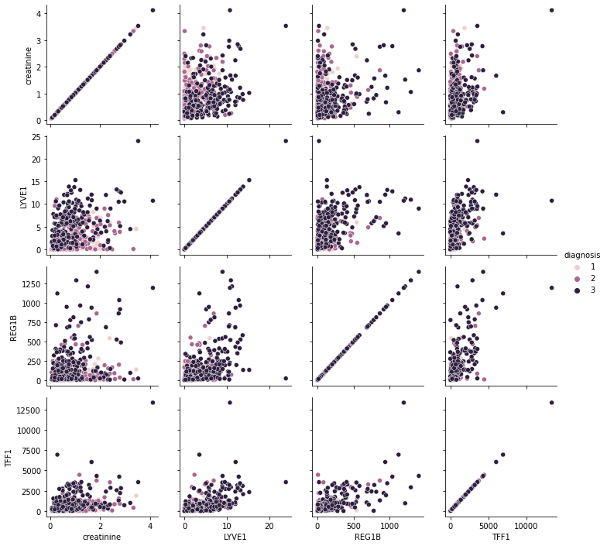
Statistical Analysis between the different biomarkers in Cancer

Slide 10
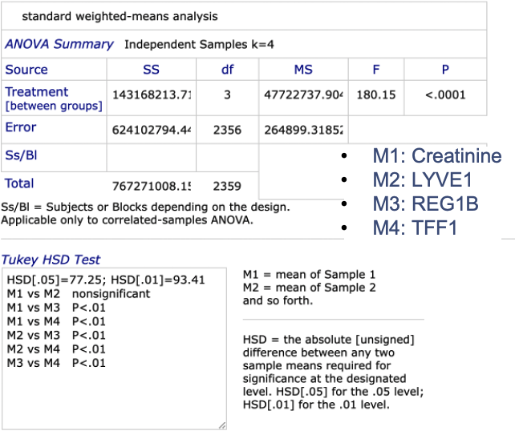
ANOVA TEST
Analysis of variance
Statistical difference between the means of independent group
P value: evidence against a null hypothesis
P<0.01

Slide 11
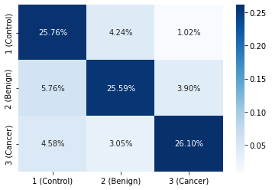
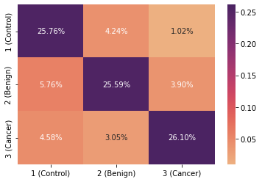
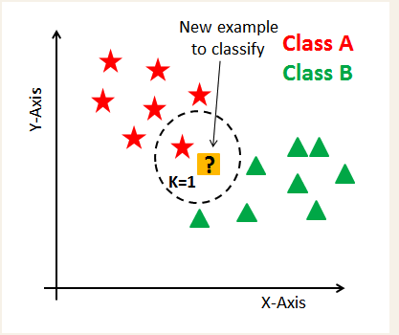
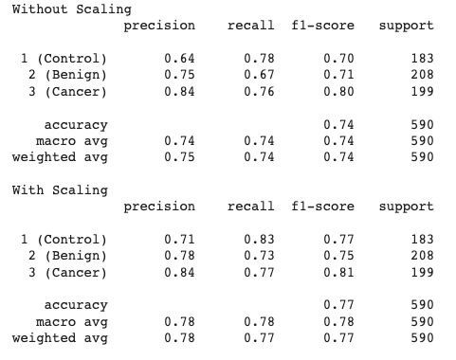
K-nearest Neighbor
Find a predefined number of training samples closest in distance to the new point, and predict the label from these
Non-parametric: no assumption for underlying data distribution
calculate distance
Find closest neighbors
Vote for labels
Small N: low bias, high variance
Big N: computationally expensive
N= 3

Slide 12
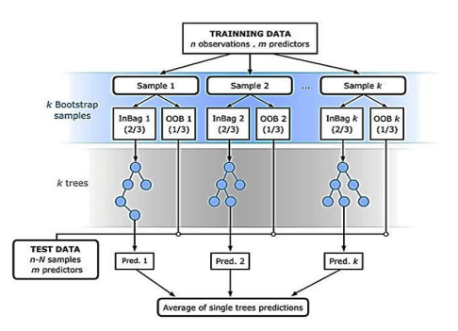
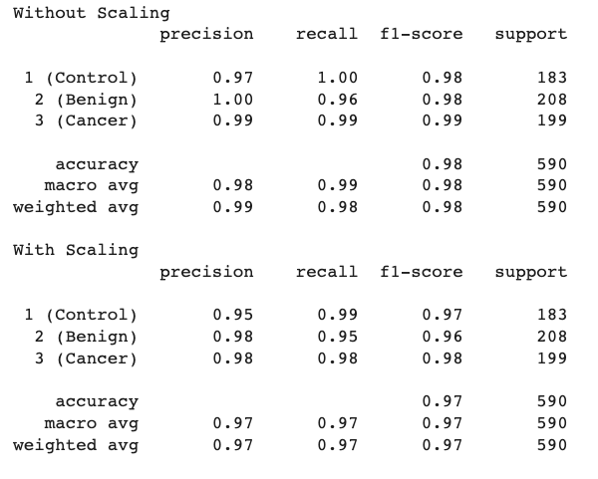
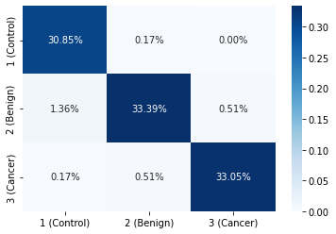
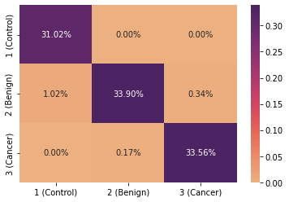
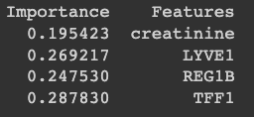
Random Forest classification
Find a predefined number of training samples closest in distance to the new point, and predict the label from these
Overcoming the problem of excessive computability
Less sensitive to outlier data
Parameters can be adjusted

Slide 13
SWOT Analysis
STRENGTHS
WEAKNESSES
Model can be trained to diagnose cancer
There is no correlation between the different biomarkers
Heatmap percentage are low
S
W
OPPORTUNITIES
THREATS
Further analysis and research
Neural Network usage
O
T
Time constraint
Knowledge barrier

Slide 14
References
Blyuss, O., Zaikin, A., Cherepanova, V. et al. Development of PancRISK, a urine biomarker-based risk score for stratified screening of pancreatic cancer patients. Br J Cancer 122, 692–696 (2020). https://doi.org/10.1038/s41416-019-0694-0
Zuherman Rustam; Zhafarina, Fildzah; Glori Stephani Saragih; Sri Hartini. IAES International Journal of Artificial Intelligence; Yogyakarta Vol. 10, Iss. 2, (Jun 2021): 476-481. DOI:10.11591/ijai.v10.i2.pp476-481
scikit-learn.org/stable/
www.datacamp.com/tutorial/random-forests-classifier-python
datacamp.com/tutorial/k-nearest-neighbor-classification-scikit-learn

Slide 15

Thanks
🙏🏾
Any questions?
You can find me at:
LinkedIn: Nadira Mahamane
namadoumahamane1@cub.uca.edu

