Slide 1
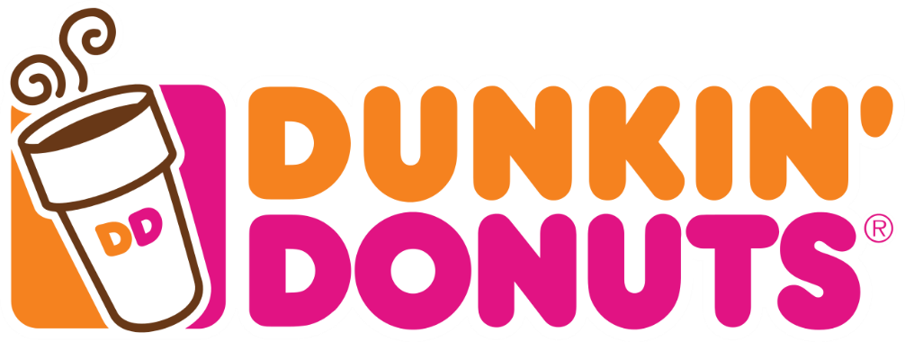
Nadira Zahiruddin, Christine Lee, Anushka Goyal
Dunkin Donuts is an American global donut company that provides and an everyday stop for coffee and baked goods. Dunkin Donuts was found in Canton, Massachusetts in 1950. Dunkin' Donuts is the world’s leading donut chain and has been ranked No.1 for customer loyalty in the coffee category for nine years. Dunkin Donuts operates more than 11,500 stores in 40 countries worldwide.
With Dunkin Donuts fast expansion in the east coast, the company has to track its revenue and operating costs in different locations. In order to answer business related queries, the company can access its dimensions: products, customers, employees, stores, order, and order details to answer business related queries. The company can decide which stores are top performers or not to figure out how to allocate its resources to help the company make improvements and anticipate and fulfill its customers' needs.
https://github.com/nadirazahiruddin/Assignment-2

Slide 2
Assumptions:
One order can only have one product
Product
Product ID (PK)
Product Name
Category
Price
Cost
Inventory
Customer
Customer ID (PK)
First Name
Last Name
Address
Email
Phone Number
Order Details
Order Detail ID (PK)
Customer ID (FK)
Store ID (FK)
Order ID (FK)
Product ID (FK)
Total Price/Revenue
Total Quantity
M
1
1
M
M
Store
Store ID (PK)
City
State
Zip Code
Country
Region
M
1
Employee
Employee ID (PK)
First Name
Last Name
Address
Store ID (FK)
Order
Order ID (PK)
Order Date
Total Price
Employee ID (FK)
1
1
M
M
1

