Slide 1
Freelens.us project
Development team:
Maksim Bondarenko(https://github.com/the12chairs)
Nadir Nigmatullin(https://github.com/nadirq)
Сurator:
Andrey Ermolenko

Slide 2
Summary
Camerist hiring platform
Lack of competition
Monetization opportunities
Good development practice

Slide 3
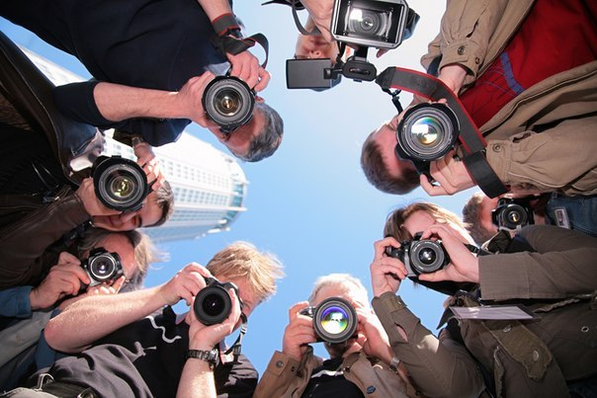

Idea

Slide 4
Solution
Sweet picture of freelens.us

Slide 5



How it works
Look through for camerist
Choose a convenient time
Cheeze!

Slide 6
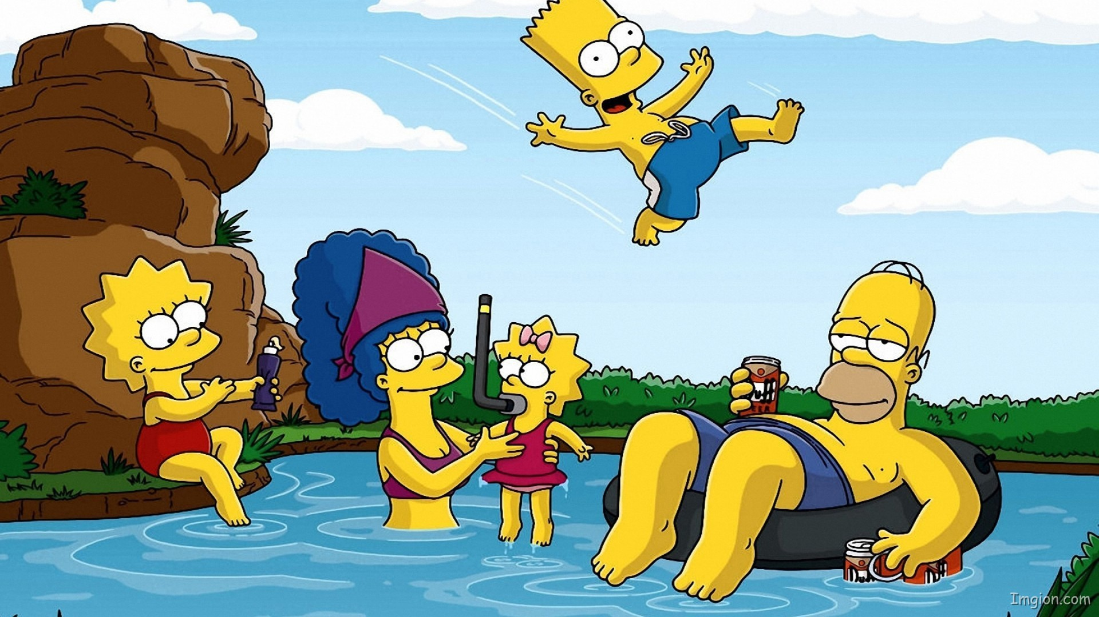
Enjoy your photos!
Photosessions
Photomontage
Retouch
Restoration
Best camerists at one site

