Slide 1
🏥
HEALTHCARE DATA ANALYTICS
100
Healthcare Prescription Safety &
Patient Risk Intelligence Platform
PATIENTS
275
ADMISSIONS
Identifying high-risk patients, understanding readmission drivers, and testing whether readmission risk can be predicted from admission data.
19.3%
READMIT RATE
35%
Nadiya
Ironhack Data Analytics Bootcamp — Final Project
HIGH-RISK
Notes:
Title. Introduce yourself and the project in one breath: a healthcare analytics capstone spanning the full pipeline, from raw data to a live prediction tool.

Slide 2
THE BUSINESS PROBLEM
Readmissions are expensive and often predictable
Hospitals are increasingly evaluated and penalized on how often patients bounce back within 30 days. A readmission usually means the discharge plan, the medication regimen, or the underlying risk wasn't well understood the first time. Three questions drive better decisions before it happens:
🎯
📋
💊
Who is at risk?
Why do they return?
Is it safe?
Which patient groups by age, insurance, diagnosis are most likely to be readmitted.
Which diagnoses are most associated with repeat admissions and longer stays.
Which medications carry the highest reported rate of adverse events.
A fourth question ties it together: once we understand these patterns, can we predict readmission risk directly?
Healthcare Risk Intelligence Platform
2
Notes:
The Problem. Frame it as a business problem before a data problem — readmissions cost hospitals money and signal missed risk. State the three questions.

Slide 3
DATA & APPROACH
Two real-world sources, one end-to-end pipeline
DATA SOURCES
TOOLS & TECHNIQUES APPLIED
MIMIC-IV Demo
Python
Data Cleaning
🐍
🧹
100 anonymous patients • 275 hospital admissions • diagnoses, admission type, length of stay, and 30-day readmission outcome.
pandas / numpy pipeline
typing, nulls, duplicate
🔗
Data Wrangling
🌐
API Integration
OpenFDA Adverse Event API
joins across 3 sources
live OpenFDA pulls
Public FDA feed of reported drug adverse events, pulled live via API an independent medication-safety signal, not linked to these specific patients.
📊
EDA & Visualizations & Statistics
🤖
Machine Learning
distributions, correlation
LogReg vs Random Forest
Every number in this deck is recomputed directly from the current processed data.
🗄️
SQL
📈
Streamlit + Tableau
queries over the merged schema
interactive delivery
Healthcare Risk Intelligence Platform
3
Notes:
Data & Approach. Name both data sources and the full tool stack once, cleanly — this is where you check off Python/SQL/EDA/ML/Streamlit/Tableau without reading a list.

Slide 4
EXECUTIVE OVERVIEW
The population, at a glance
100
275
19.3%
35%
PATIENTS
ADMISSIONS
30-DAY READMISSION RATE
HIGH-RISK PATIENTS
High risk = 3+ admissions OR a 30-day readmission — the same explainable rule used throughout the portal and dashboards.
PATIENT POPULATION SPLIT
Standard risk — 65 patients (65%)
High risk — 35 (35%)
One in five admissions in this population results in a readmission within 30 days, and roughly a third of patients already meet a high-risk profile before we build any model the next three sections unpack why.
Healthcare Risk Intelligence Platform
4
Notes:
Executive Overview. Anchor the room with the four headline numbers before diving into any one slice.

Slide 5
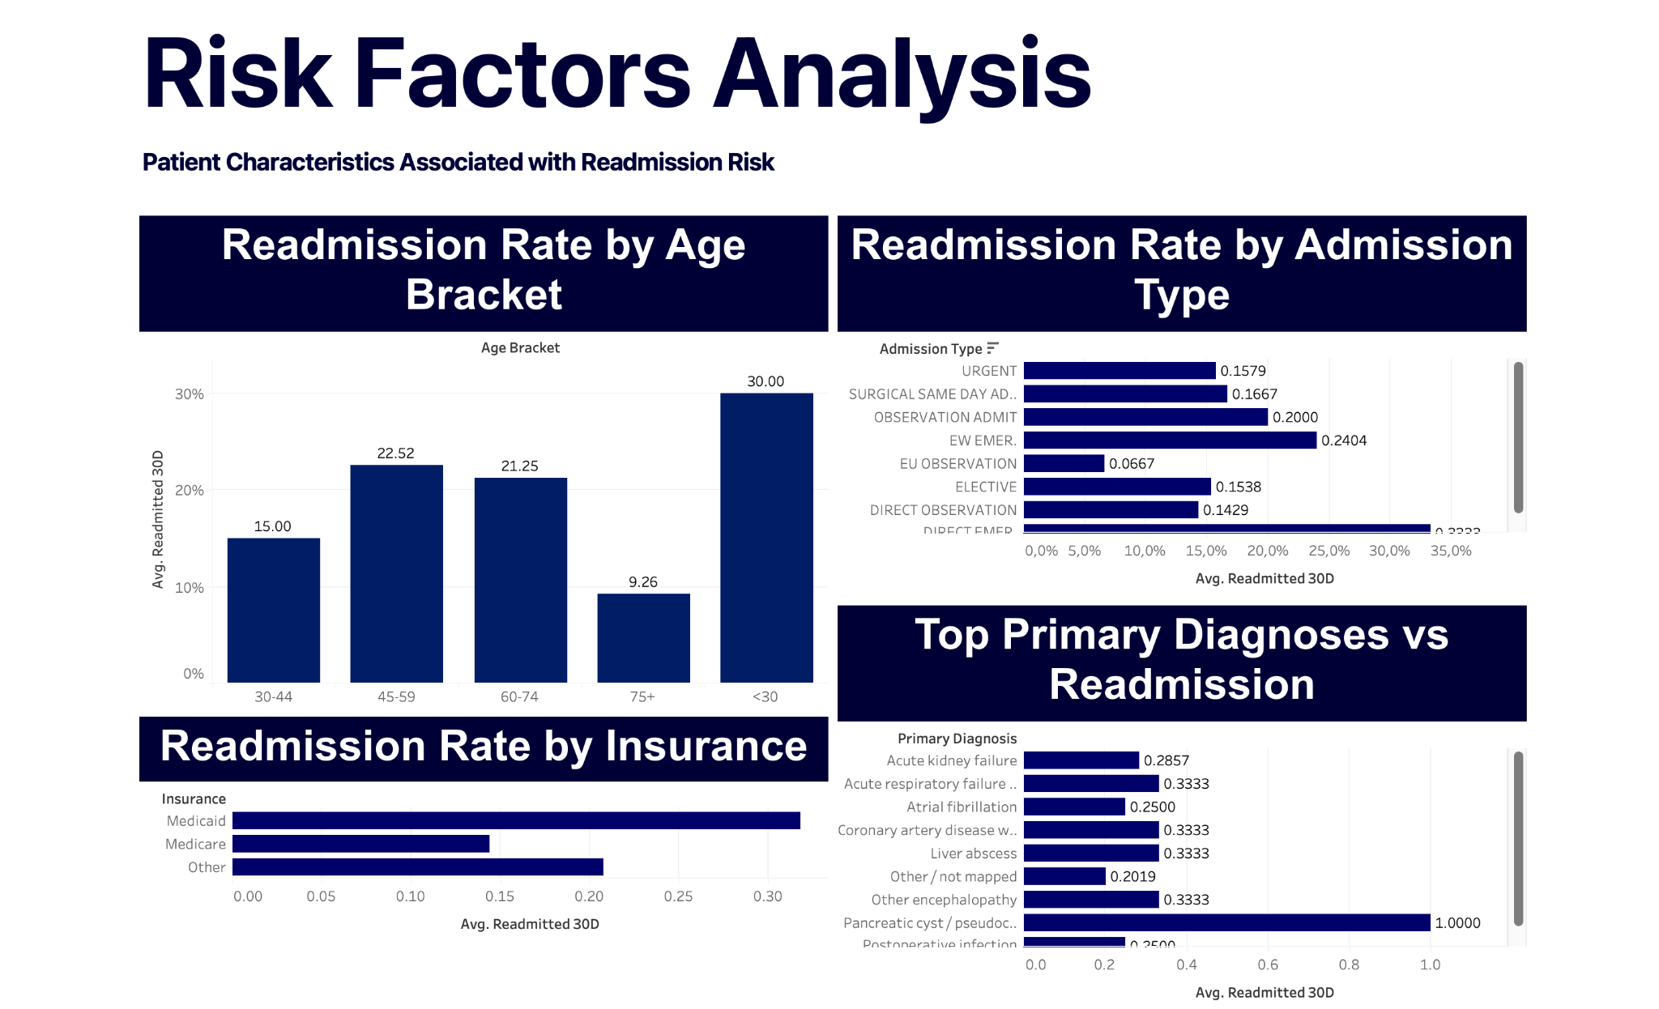

Q1 — PATIENT RISK
Which patient groups are at highest risk?
EXPLORE IT LIVE
Scan for the interactive Tableau dashboard
Cut off in this screenshot:
Direct Emergency admit: 33.3% (highest of any admission type)
Postoperative infection: 25.0%
Age and insurance both matter, but neither alone Q4 shows what drives risk once they're combined.
Healthcare Risk Intelligence Platform
5
Notes:
Q1. Walk the two charts left to right. Flag the small sample size for <30 honestly — this builds credibility.

Slide 6
Q2 — DIAGNOSIS PATTERNS
Which diagnoses are most associated with repeat admissions?
Top 10 diagnoses by volume, with 30-day readmission rate stated for each
Coronary atherosclerosis
Aortic valve disorder
1
No readmits
6
No readmits
n = 7 admissions
n = 4 admissions
Acute kidney failure
Postoperative infection
2
28.6% readmit
7
25.0% readmit
n = 7 admissions
n = 4 admissions
Systolic heart failure
Other encephalopathy
3
No readmits
8
33.3% readmit
n = 6 admissions
n = 3 admissions
NSTEMI
CAD with angina
4
No readmits
9
33.3% readmit
n = 4 admissions
n = 3 admissions
Atrial fibrillation
Acute pancreatitis
5
25.0% readmit
10
No readmits
n = 4 admissions
n = 3 admissions
“Other / not mapped” diagnoses are excluded, so this reflects real, named diagnoses only. Rates on the smallest bases (n=3) are directional, not statistically robust see Acute kidney failure (n=7) for the more reliable signal.
Healthcare Risk Intelligence Platform
6
Notes:
Q2. Point out the top of each list, then the honest exclusion of unmapped diagnoses — shows rigor.

Slide 7

Q3 — MEDICATION SAFETY
Which medications have the highest reported adverse events?
Live dashboard
Top medications by report volume (distinct safety reports)
Most reported adverse reactions (distinct safety reports)
1
LETAIRIS
61 of 100 (61%)
1
Dyspnoea
11 reports
61 of 100 reports
shortness of breath
2
PREDNISONE
7 of 100 (7%)
2
Headache
8 reports
7 of 100 reports
8 of 100 reports
3
CASODEX
3 of 100 (3%)
3
Diarrhoea
6 reports
3 of 100 reports
6 of 100 reports
4
7 medications
2 of 100 (2%)
4
Unevaluable Event
6 reports
incl. XANAX, LIPITOR, ASPIRIN — 2 reports each
reaction not further specified
5
122 other medications
1 of 100 (1%)
5
Malaise
6 reports
single-report only, out of 145 total
6 of 100 reports
⚠
Read this data honestly
OpenFDA is a public adverse-event feed, independent of the MIMIC patients above, it answers Q3 on its own, not linked patient-by-patient. LETAIRIS alone appears in 61% of all 100 safety reports in this feed a concentration from a small number of repeat reporters, not a clinical signal about the drug's safety. 122 of 145 distinct medications show up in just one report, so rankings beyond the top few should be read as directional, not statistically robust.
Healthcare Risk Intelligence Platform
7
Notes:
Q3. Lead with the caveat before the chart, not after — OpenFDA is independent of the patient data.

Slide 8

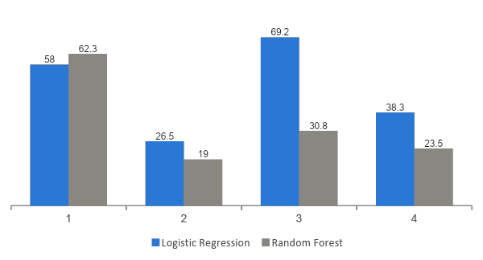
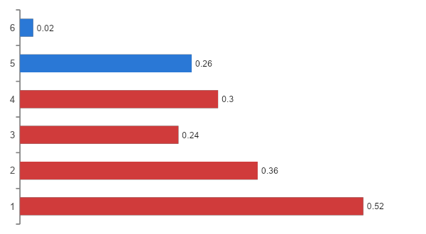
Q4 — PREDICTIVE MODELING
Can we predict whether a patient will be readmitted?
Live dashboard
Model comparison on the held-out test set
What drives predicted risk (Logistic Regression)
We chose Logistic Regression: lower overall accuracy (58% vs. 62%), but more than double the recall (69% vs. 31%) catching real readmissions matters more here than a cleaner-looking accuracy number. Honest caveat: F1 = 0.38, trained on just 275 admissions. This is a leakage-free proof-of-concept, not a clinically validated tool.
Healthcare Risk Intelligence Platform
8
Notes:
Q4. This is the technical center of gravity — spend a bit more time here. Explain the recall-over-accuracy choice in plain business terms.

Slide 9
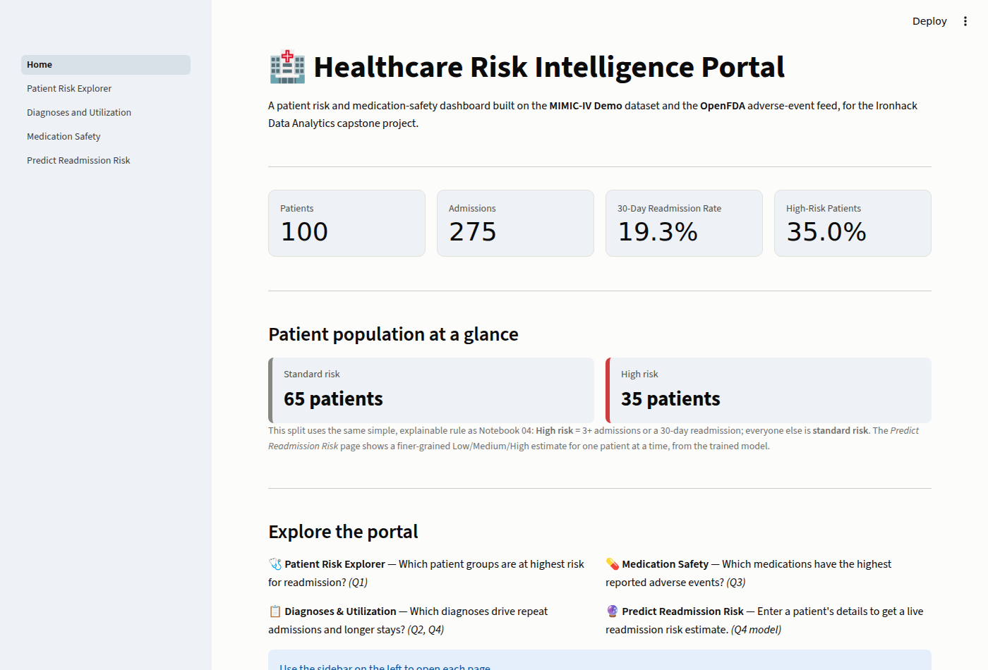
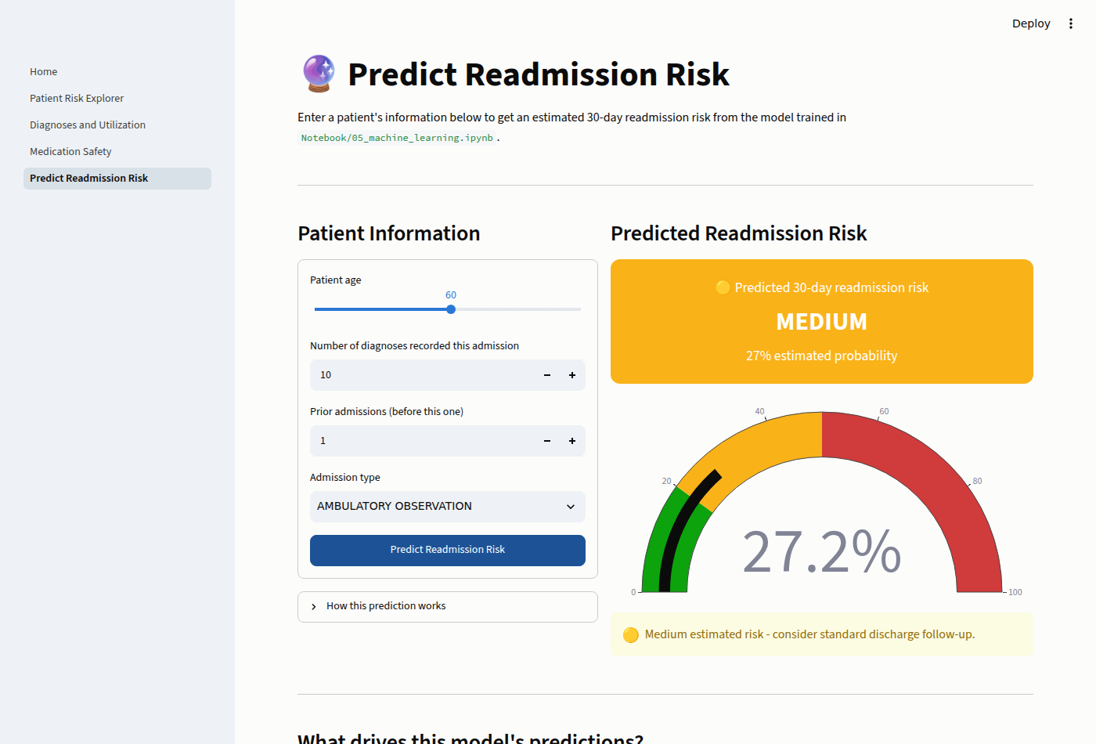
LIVE DEMO
Putting it in front of a user: the Streamlit portal
Every question above is also answerable interactively — a 5-page app where a user filters and explores the data, and can score a new patient live.
Home -> KPIs, risk split, and page-by-page navigation
Predict Readmission Risk —> Input: patient form → Output: live risk gauge
Healthcare Risk Intelligence Platform
9
Notes:
Live Demo. If presenting live, switch to the running app here instead of the screenshots. Otherwise narrate the two screens.

Slide 10

LIMITATIONS & NEXT STEPS
Honest about scope, clear on what's next
–
Small sample: 100 patients, 275 admissions directional, not statistically robust
–
OpenFDA adverse events are not linked to these specific MIMIC patients
🏥
–
Model is a leakage-free proof-of-concept (F1 = 0.38), not a clinical decision tool
Thank you
RECOMMENDED NEXT STEPS
+
Validate on a larger, prospective patient cohort
Questions welcome
+
Link medication history directly to individual patient records
Nadiya
Ironhack Data Analytics Bootcamp
+
Track model performance over time as new admissions come in
Connect on LinkedIn
Healthcare Risk Intelligence Platform
10
Notes:
Close. Deliver limitations with confidence, not apology — then invite questions.

