Slide 1

IRONHACK UNIVERSITY
Predicting Student Dropout
& Academic Success
A machine learning approach to early academic risk detection
Kseniia Iukhlina · Carla Fajula · Nadiya Al-Shahaibi
Student Success Prediction | Data Analytics Bootcamp ML Project

Slide 2



INTRODUCTION
Project Overview
Goal
Business Question
Impact
Predict whether a student will Dropout, remain Enrolled, or Graduate — using only enrollment-time and early-semester data.
Can we predict who's at risk before they disengage?
Gives academic advisors an early signal to target support proactively, before a student is already lost.
Predicting Student Dropout & Academic Success
1

Slide 3

DATA
Data Selection & Preparation
Dataset
4,424
37
UCI Machine Learning Repository — “Predict Students’ Dropout and Academic Success”
4,424 students across 37 features spanning demographics, admission path, socio-economic status, and semester performance.
Categorical codes validated against documented ranges (attendance and tuition flags confirmed strictly 0/1); IQR-based capping applied to outliers in age, admission grade, and semester performance — rows preserved rather than dropped.
Student records
Features
0
0
Missing values
Duplicate rows
Data types: 29 integer · 7 float · 1 categorical (string)
Predicting Student Dropout & Academic Success
2

Slide 4
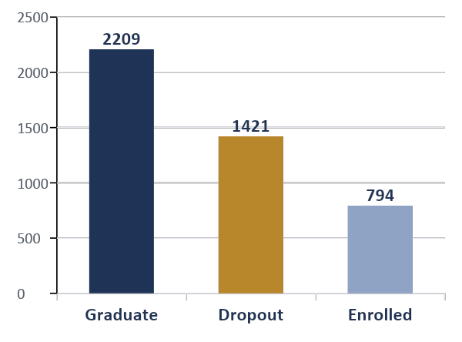
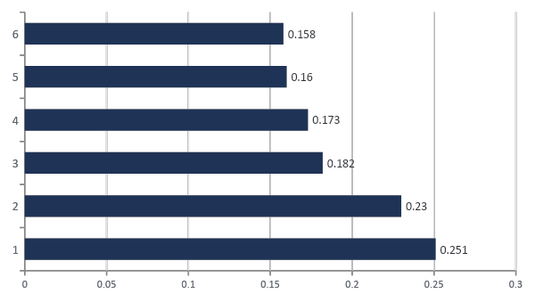
DATA
Feature Selection & Relationships
Strongest Predictors (Cramér's V)
Target Distribution (n = 4,424)
Chi-square test of association · all significant at p < .001 unless noted
Predicting Student Dropout & Academic Success
3

Slide 5


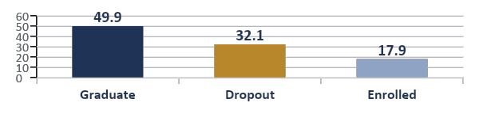



MODELING
Model Building & Evaluation
Target Class Balance
Evaluation Metrics
Because classes are imbalanced (50% / 32% / 18%), plain accuracy is misleading. We report:
Balanced accuracy · Macro F1 · Per-class precision/recall · Confusion matrix
Enrolled is clearly under-represented.
K-Nearest Neighbors
Random Forest
Gradient Boosting
69% accuracy - 0.61 macro F1 - baseline model
73% accuracy - 82% train (9pp gap)
75% accuracy - 0.66 macro F1 - top model
Predicting Student Dropout & Academic Success
4

Slide 6
MODELING · Nadiya
KNN Results
69%
60%
0.61
Accuracy
Balanced Accuracy
Macro F1-score
Per-Class Performance
Confusion Matrix
Interpretation
Class | Precision | Recall | F1 | n
Dropout | 0.73 | 0.65 | 0.69 | 284
Enrolled | 0.39 | 0.30 | 0.34 | 159
Graduate | 0.74 | 0.85 | 0.79 | 442
 | Drop | Enro | Grad
Drop | 184 | 36 | 64
Enro | 42 | 48 | 69
Grad | 26 | 40 | 376
Strong on Dropout and Graduate. Weakest on Enrolled (F1 0.34) — early-semester signals for currently-enrolled students overlap with both eventual outcomes, so the model most often confuses them with Graduate.
rows = actual · columns = predicted
k = 5 (default) · uniform weights · minkowski distance
Baseline configuration before hyperparameter search (next slide).
Predicting Student Dropout & Academic Success
5

Slide 7

MODELING · Nadiya
Hyperparameter Tuning & Class Imbalance
Search Strategy
SMOTE Experiment
GridSearchCV and RandomizedSearchCV — 5-fold stratified CV, optimizing macro F1 — both converged on the same setting.
Oversampled the minority classes in training only, then re-trained KNN and compared to the un-balanced baseline on the same test set.
k = 13
distance
n_neighbors (best)
weighting
Without SMOTE
With SMOTE
52.4%
50.9%
Best CV macro F1: 0.611
Balanced accuracy · Macro F1 0.52
Balanced accuracy · Macro F1 0.50
Slightly above the baseline's cross-validated score — but this gain did not carry over to the held-out test set.
Result: SMOTE decreased performance for this KNN model — likely because synthetic samples distort real distance relationships across mixed categorical/numerical features. Not recommended in its current form for this project.
Predicting Student Dropout & Academic Success
6

Slide 8
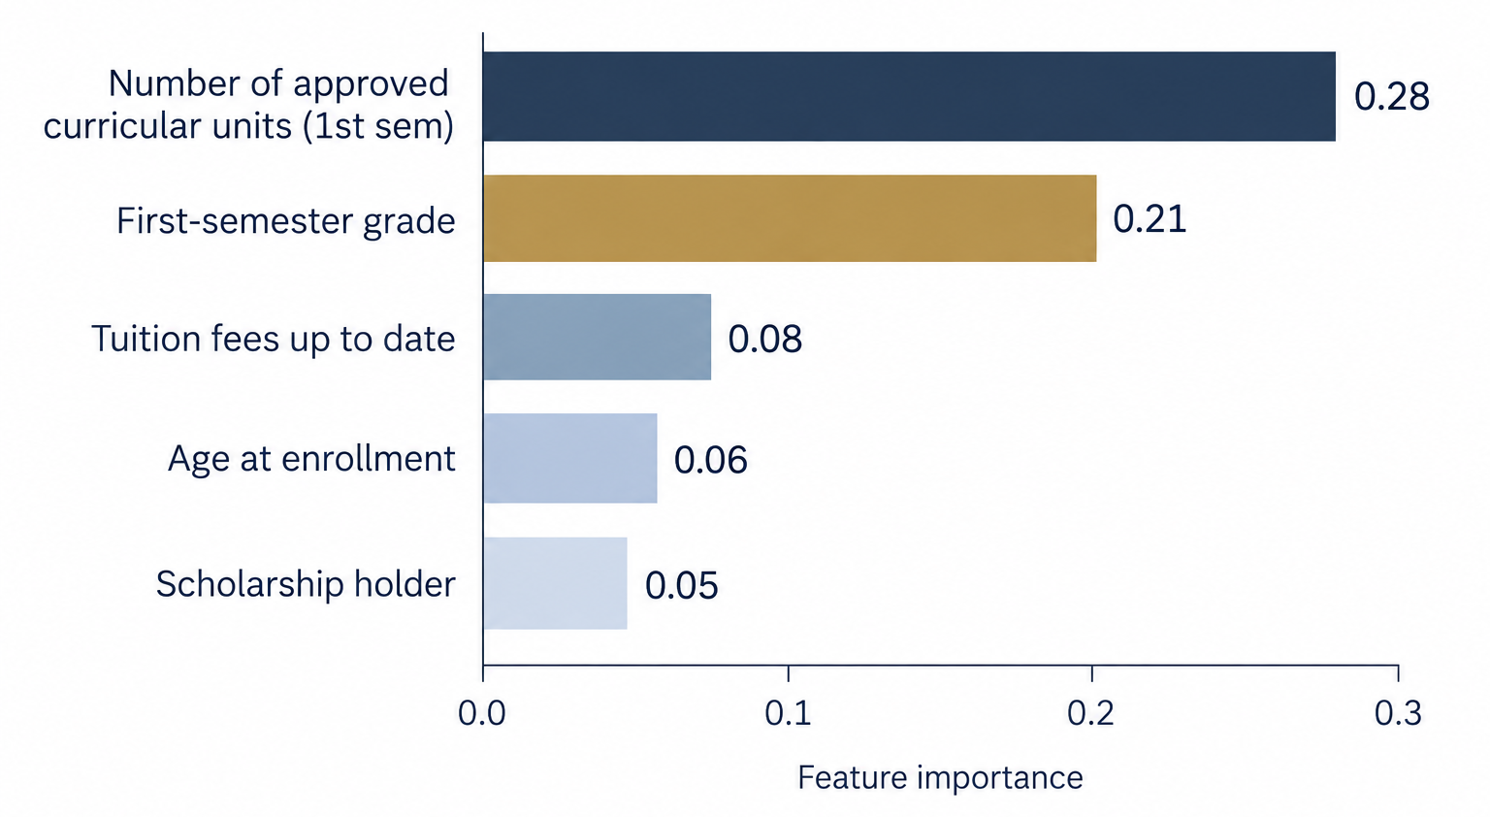
MODELING · Carla
Random Forest Results
73.45%
82.40%
62.05%
Accuracy
Training Accuracy
Balanced accuracy
Confusion Matrix
Top Feature Importance
Interpretation
Good overall performance
First semester academic performance matters most
Struggle switch the enrolled class
 | Drop | Enro | Grad
Drop | 290 | 93 | 71
Enro | 112 | 187 | 96
Grad | 62 | 58 | 487
rows = actual · columns = predicted
Predicting Student Dropout & Academic Success
8

Slide 9
MODELING · Kseniia
Gradient Boosting Results
75%
71%
0.67
Accuracy (imbalance)
Accuracy (balance)
Macro F1-score
Per-Class Performance
Confusion Matrix
Interpretation
Class | Precision | Recall | F1 | n
Dropout | 0.82 | 0.69 | 0.75 | 284
Enrolled | 0.39 | 0.57 | 0.46 | 159
Graduate | 0.83 | 0.78 | 0.81 | 442
 | Drop | Enro | Grad
Drop | 195 | 62 | 27
Enro | 26 | 90 | 43
Grad | 16 | 81 | 345
Strong on Dropout and Graduate. Weakest on Enrolled (F1 0.46) — early-semester signals for currently-enrolled students overlap with both eventual outcomes, so the model most often confuses them with Graduate.
rows = actual · columns = predicted
Winning combination
max_depth = 3 · n_estimators = 100 · learning_rate = 0.10
Predicting Student Dropout & Academic Success
9

Slide 10
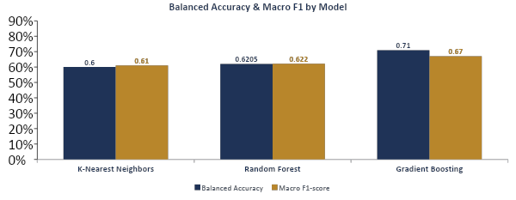
MODELING
Model Comparison
Gradient Boosting wins on both balanced accuracy and macro F1 — the metrics that matter most on this imbalanced target.
Predicting Student Dropout & Academic Success
9

Slide 11


IMPACT
Real-World Application and Impact
Student data
Risk prediction
Early identification
Targeted support
Responsible use
Support human judgement
Consider false positives and false negatives
Ensure fairness across different groups
Possible support
Academic support
Personalised guidance
Follow-ups
Prediction ≠ Causation
Predicting Student Dropout & Academic Success
11

Slide 12



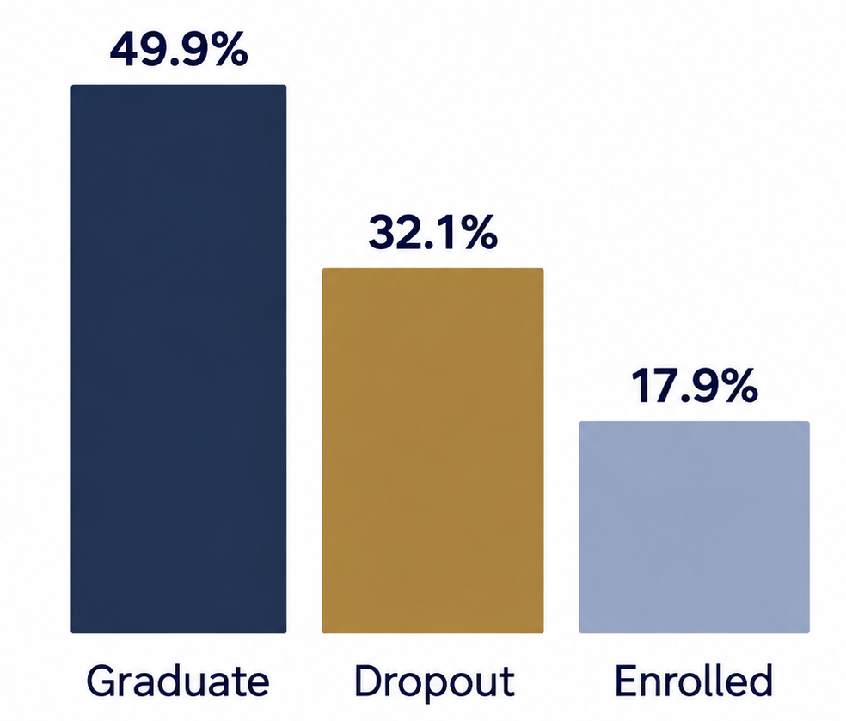
RETROSPECTIVE
Challenges, Learnings & Next Steps
Target class imbalance
Key Learnings
Next Steps
Balancing techniques reduced overall accuracy but improved detection of minority class.
Accuracy alone is not enough.
Feature engineering
More models and optimisation
Addition student information
Advisor dashboard
Our results show the potential of Machine Learning to support earlier intervention.
Predicting Student Dropout & Academic Success
12

Slide 13
Thank You
Predicting Student Dropout & Academic Success
Kseniia Iukhlina · Carla Fajula · Nadiya Al-Shahaibi
IRONHACK UNIVERSITY
Questions & Discussion

