Slide 1

Computational Social Science
Research project - Online Courses
Harvard and MIT online courses
Students:
Nađa Jeličić
Dhurim Sylejmani
Nābīl Afrāz
Mentor:
JProf. Dr. Claudia Wagner

Slide 2
Data
● Dataset: MIT and Harvard online courses
● Shape of starting data set: 641138 rows, 20 columns
● Columns that measure interaction with course : number of events, played videos, forum posts…
● Columns that show data about student: country of origin, year of birth, gender...

Slide 3
Research question
Which factors are related with student’s success?

Slide 4
Research Methodology
Collecting and Reading of Related Work
Data Preparation and Cleaning
Creating Descriptive Statistics Analysis
Correlation Analysis
Handling Multicollinearity
Using Linear Regression Model
Notes:
Data Prep : Removing Nans, converting categorical variables to dummy indicators, deriving columns , dropping null values
Descriptive Statistics ???: we did this analysis to get a better understanding of our data and represent it in meaningful plots
Correlation : strength of a relationship between two, numerically measured, continuous variables. Karl Pearson Method
Multicollinerarity : checking high correlations between two or more predictor variables.

Slide 5
Data preparation and cleaning
Start: 641138 rows , 20 columns
Dropping columns with irrelevant data
Converting categorical variables into dummy/indicator variables: Gender, Country of Origin, Level of Education
Derive columns: Year of Birth to Age, Total Activity
Dropping rows with null values
494790 rows, 53 columns
Notes:
We are satisfied with remaining number of rows based on analysis all dropped rows had numerus null values in columns
Students that didnt enter data

Slide 6
Statistics
Number of people who viewed the courses is 400262. Almost 62 % of people viewed the courses.
Number of people certified is 17687. Only 2.75 % people certified the courses.
Notes:
We are satisfied with remaining number of rows based on analysis all droped rows had numerus null values in columns
Students that didnt enter data
Say that such low precentage for certiffied students makes it even more meaningfull to find what is in corelation with success Dont say what causes the success this is correlation but not causality We say we investigate correlation with success not what causes it

Slide 7
Correlation analysis
Correlation table gives measurements of how close variables X and Y follow a perfect linear relationship
Two independent variables should not be strongly correlated

Slide 8
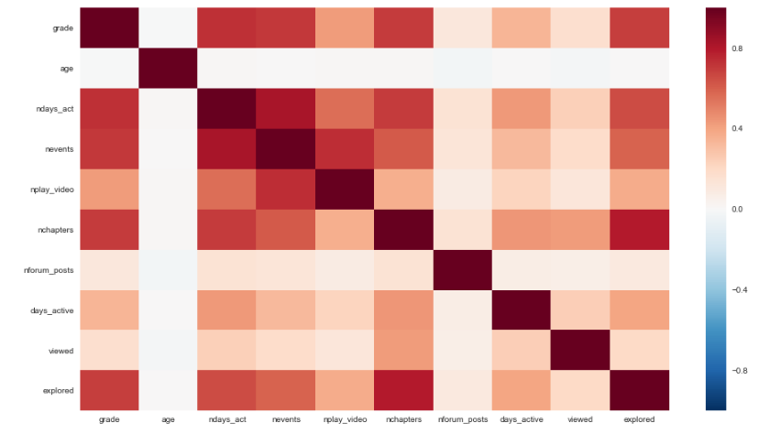
Correlation analysis

Slide 9
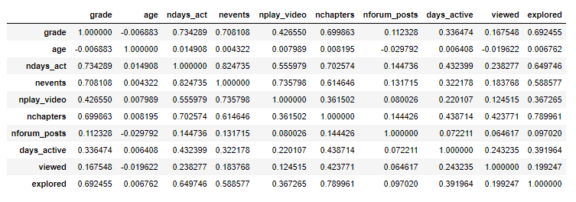
Correlation analysis

Slide 10
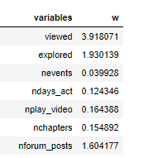
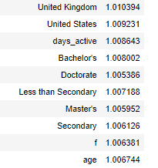
Multicollinearity

Slide 11
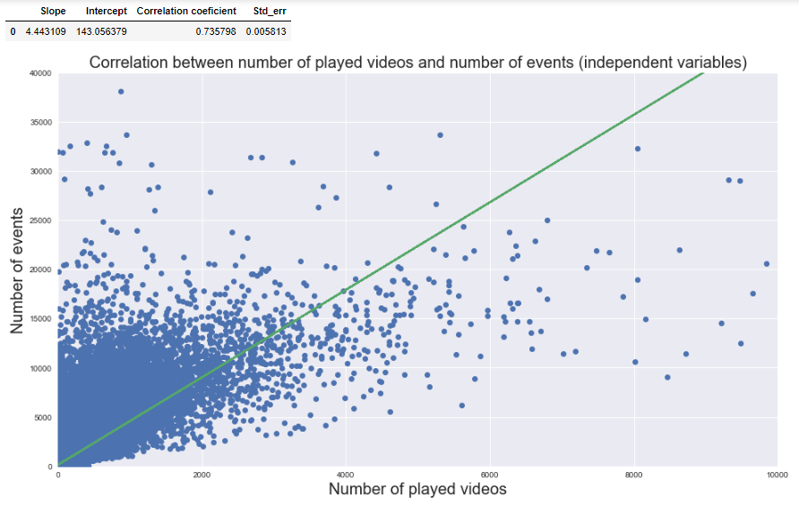

Slide 12
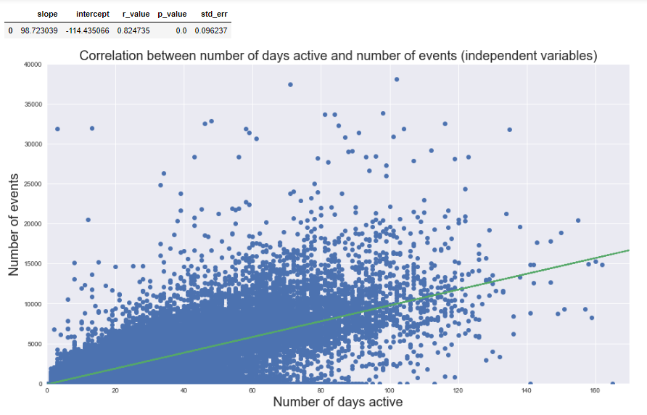

Slide 13
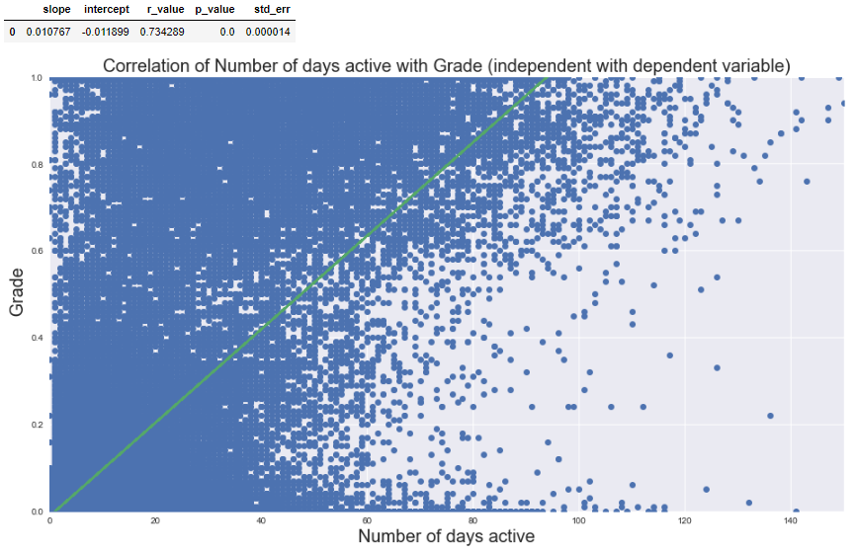

Slide 14
Handling Multicollinearity
Columns excluded: Number of Chapters, Number of Played Videos, Total Activity, Age

Slide 15
Linear Regression Model
Independent variables: Viewed, Explored, Number of Events, Number of days active, Number of Forum Posts, countries, levels of education, gender
R squared value: 0.643208031565
Limitation by data provided
Notes:
Our model describes around 65% of the data distribution.
Based on runing linear regression with multiple combinations of independant variabls we conclude that R2 cant go much over 0.6 which is limitation by data and we conclude that our modeling choices were good since we achieved 0.64

Slide 16
Linear Regression Model
The best coefficient - explored: 0.2107163868212053
Explored shows if students accessed the highest level of course in courseware
Analysis of linear relationship between explored and grade showed lower R squared results
Conclusion: it was a good choice not to exclude all highly correlated independent variables

Slide 17
Linear Regression Model
Based on coefficients interesting fact can be that female students have positive value and male students have negative value of coefficient
P-values analysis shows that the selection of independent variables was good

Slide 18
Thank you!
Questions?

