Slide 1
Parametrically modulated regressors
Jeanette Mumford
University of Wisconsin - Madison

Slide 2
What question does a parametrically modulated regressor answer?
Show emotional stimuli in scanner
Use post-fMRI behavioral task to estimate valence
Q: Does BOLD activation increase with valence?
Gambling task
Can win variable amounts for each gamble
Q: Does BOLD activation increase with amount a person could lose on a gamble?

Slide 3
What do we need from previous lectures?
Do you recall how we generate regressors for our time series models?
Do you recall what collinearity is?
Do you recall what the downside of collinearity is?
Notes:
Colinearity can sometimes be a problem with parametric regressors
Colinearity makes p values huge because there’s lots of noise (the model-based variance will be large)

Slide 4
Getting started
If you fully understand a simple linear regression, you can understand what parametric modulators are doing

Slide 5
My analogy
Notes:
Calculate slope (of interest – tells you the relationship) and intercept (tells you the reaction time the 0 year old)
Mean centering makes 0 the average age, and the intercept makes the intercept the mean reaction
Mean-centering is the easiest orthogonalization, the only one that should do

Slide 6
How do we make regressors?

Slide 7
Our boxcar regressor
Notes:
Parametric modulation – first regressor models the mean, second regressor models the slope

Slide 8
Our boxcar regressor, modulated

Slide 9
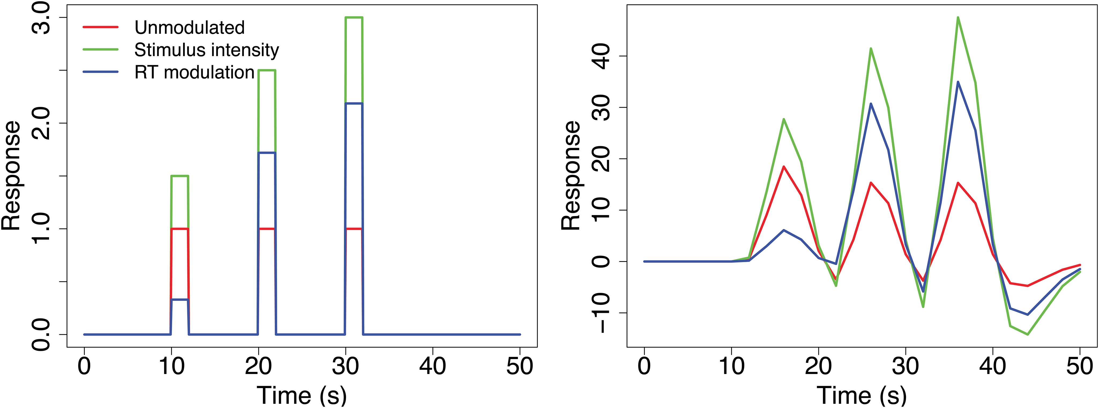
Just add convolution!
Notes:
Two modulations in this model – RT modulator and stimulus intensity modulator

Slide 10
Interpretation
Just like a regular old regression slope!
Hypothesis testing
reg 1 = unmodulated regressor
reg 2 = modulated regressor
c1 = [0, 1] tests positive slope
c = [0, -1] tests negative slope
c3 = [1, 0] Mean activation when the modulator = 0
More on this in a bit!!
Notes:
C1 contrast measures positive slope
Just a slope, NOT a correlation
C3 contrast is the mean activation when modulator is 0 (or, if RT, the mean activation when RT is 0)

Slide 11
Sometimes run into trouble with more than one modulator
Modulators might be correlated
Often orthogonalization is misused here
Notes:
More than modulator – regressors may be correlated

Slide 12
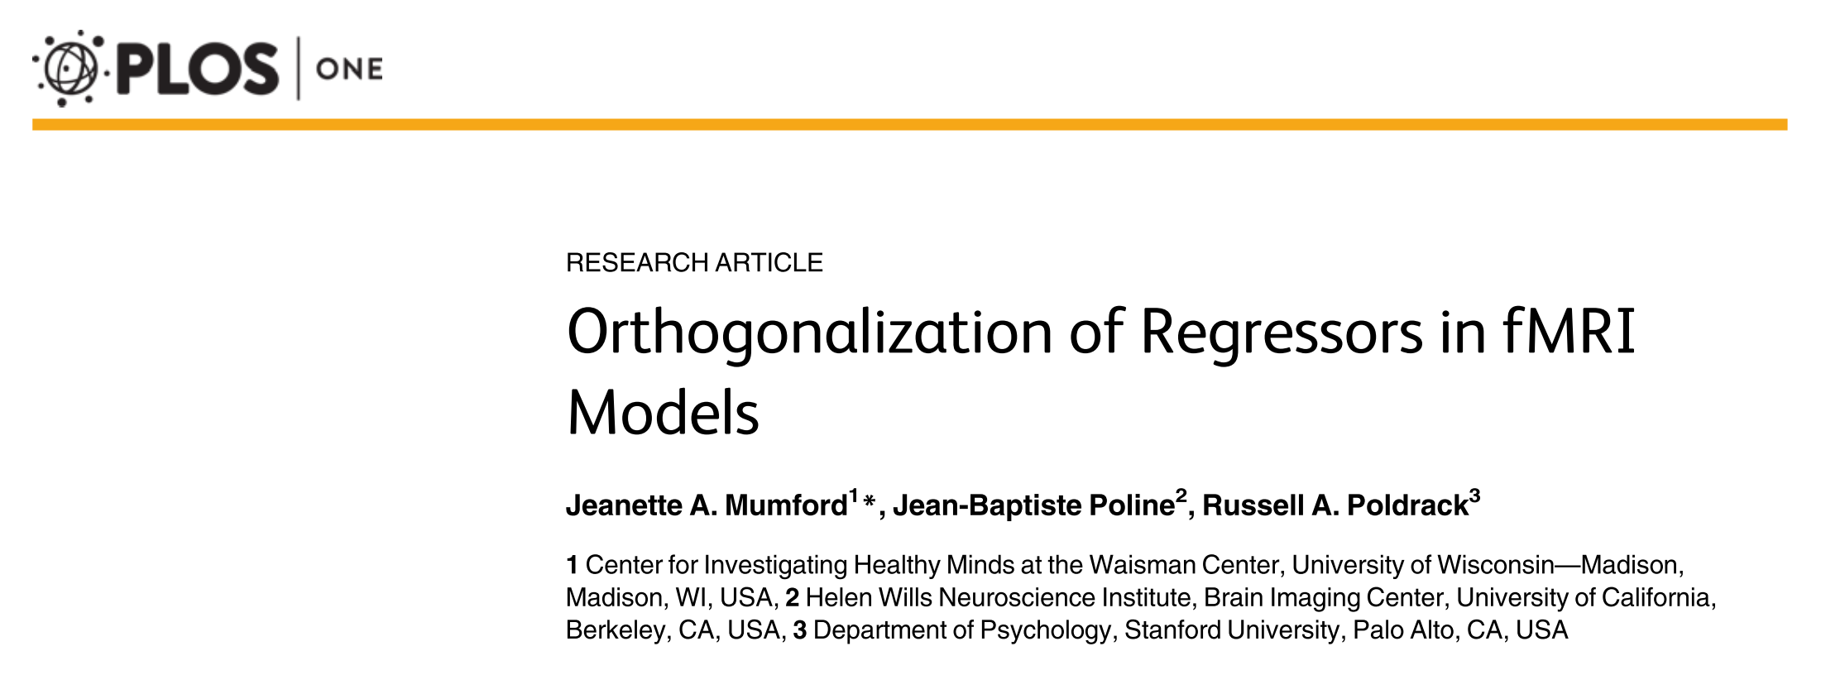
Reference
Notes:
SPM misuses orthogonalization

Slide 13
How regression naturally works
Each regressor’s p-value only reflects its unique variability
Y
X1
Notes:
Gray circle represents variability of data

Slide 14
How regression naturally works
Each regressor’s p-value only reflects its unique variability
Y
X1
X2
Notes:
Shared part gets modeled out,
Unique part of X2 is what the p-value is based on
Unique part of X1 is what the p-value for X1 is based on
With suppression and enhancement, it’s not so simple as X1’s “credit” goes down because X2 is added

Slide 15
What is orthogonalization?
Giving that shared portion to one of the regressors
Say X2 gives it up to X1
We say X2 is orthogonalized with respect to X1
Notes:
If X2 is orthogonalized with respect to X1, means X2 gives up its shared portion to X1
So, X1’s parameter adjustment now goes back to what it would have been without X2 in the model
Once do orthogonalization, you can’t say that you’ve “adjusted for another variable”
It will make X1’s pvalue go down

Slide 16
What is orthogonalization?
Giving that shared portion to one of the regressors
Say X2 gives it up to X1
We say X2 is orthogonalized with respect to X1
Y
X1
X2

Slide 17
What happens to estimates?
Same design as before (stimulus followed by feedback)

Slide 18
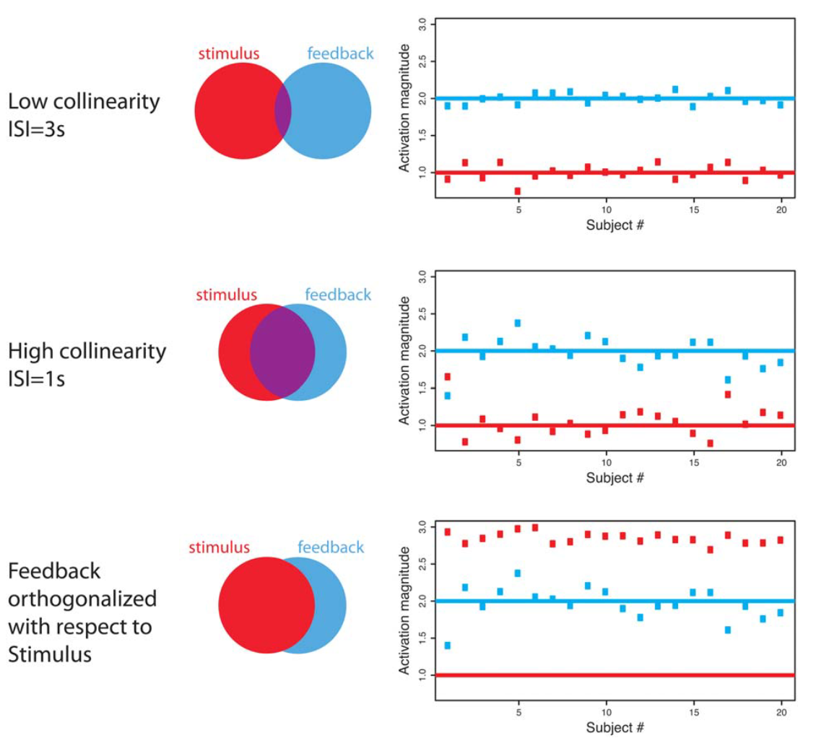
What happens to estimates?
Notes:
Very little overlap, so not colinear
Red dots are parameter estimates for stimulus
Blue dots are parameter estimates for feedback
(one per each subject)

Slide 19
What happens to estimates?
Notes:
With lower ISI, colinearity problem is much worse
If feedback estimate is really high, stimulus estimate will be really low (because it will be pushed down to balance out the high estimate of the other variable)

Slide 20
What happens to estimates?
Notes:
In orthogonalization, stimulus is no longer adjusted for feedback
You’ve changed the shape of the feedback regressor to do this
Feedback is still adjusted for stimulus (because still only getting credit for blue part)
Model fit for feedback stays exactly the same
If you are only interested in stimulus (last image), just take feedback out of the model

Slide 21
Orthogonalization can lead to very misleading results
Basically “un-controls” one covariate for the other
But that’s the entire reason we model multiple regressors!
If you orthogonalize “motion” with respect to task, you are not “fixing” collinearity
At all
Please don’t do it
Your orthogonalized model behaves, basically, as if you omitted motion

Slide 22
Orthogonalization can lead to very misleading results
Basically “un-controls” one covariate for the other
But that’s the entire reason we model multiple regressors!
If you orthogonalize “motion” with respect to task, you are not “fixing” collinearity
At all
Please don’t do it
Your orthogonalized model behaves, basically, as if you omitted motion
Notes:
Mean-centering age is ok because need to change the interpretation of the intercept
Can’t fix task-correlated motion

Slide 23
Orthogonalization can lead to very misleading results
Basically “un-controls” one covariate for the other
But that’s the entire reason we model multiple regressors!
If you orthogonalize “motion” with respect to task, you are not “fixing” collinearity
At all
Please don’t do it
Your orthogonalized model behaves, basically, as if you omitted motion

Slide 24
Orthogonalization can lead to very misleading results
Basically “un-controls” one covariate for the other
But that’s the entire reason we model multiple regressors!
If you orthogonalize “motion” with respect to task, you are not “fixing” collinearity
At all
Please don’t do it
Your orthogonalized model behaves, basically, as if you omitted motion

Slide 25

Recap
Orthogonalization is NOT a band-aid for collinearity
Collinearity
Orthogonalization

Slide 26
Is orthogonalization ever okay?
Yes!
Mean centering covariates! – (parameter estimate will be the same)
Parametric modulation!
Same idea as mean centering
Unmodulated regressor should represent mean activation for that task
Modulation regressors should reflect unique variability of that modulation value

Slide 27
Beware of what your software does!
Setup: Modeling stimulus intensity and RT as parametric modulators
Orthogonalization is *okay* if done properly
Goal: Orthogonalize each of RT and intensity with respect to unmodulated regressor
Notes:
To just make the interpretation of the unmodulated regressor the mean activation
If don’t do anything, the current interpretation of the unmodulated regressor is activation when stimulus intensity and RT are 0

Slide 28
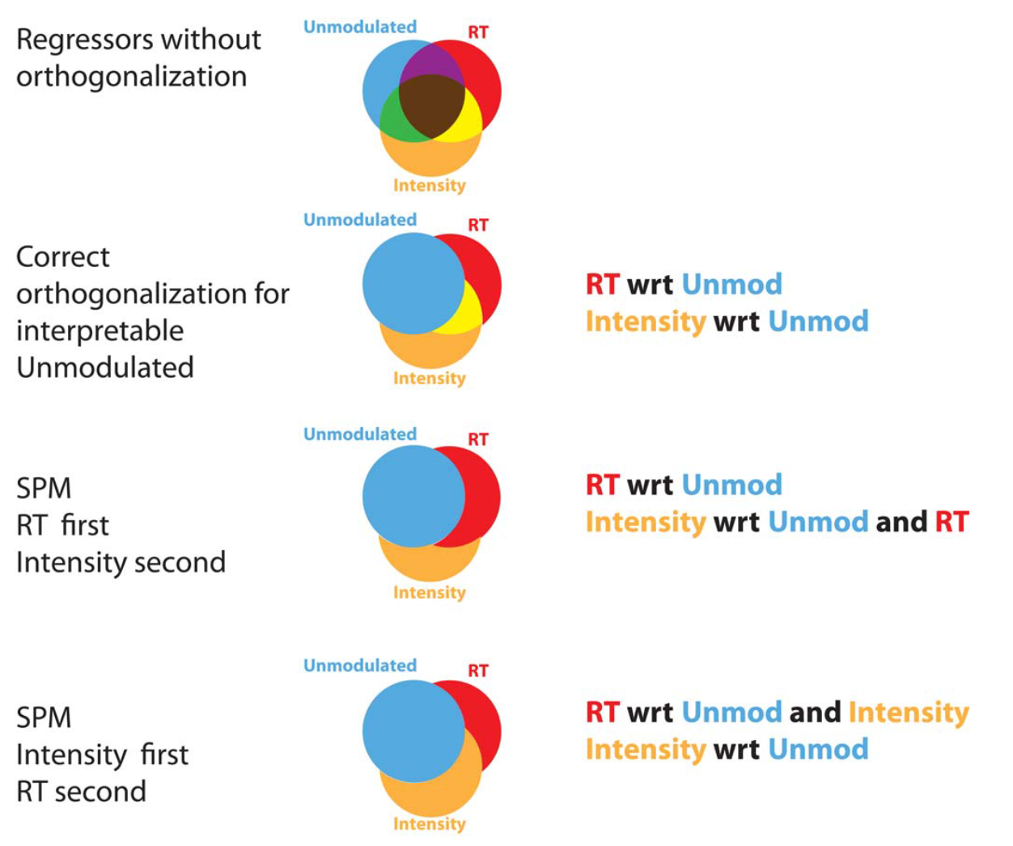
Notes:
As it is each regressor only gets the variance that’s in the same color as the text

Slide 29
Notes:
As soon as unmodulated regressor is blue, the interpretation is mean bold activation
Need to orthogonalize RT wrt unmodulated regressor and intensity wrt unmodulated regressor

Slide 30
Notes:
Earlier than SPM12, bottom image set is what SPM is doing by default

Slide 32
Aw no, SPM ☹

Slide 33
Aw no, SPM ☹
There’s a fix
mean center modulators
What seems like a fix, but isn’t
SPM’s “No orthogonalization” option alone
We still need the modulated regressors to be orthogonalized with respect to the unmodulated regressor and to keep the unmodulated regressor’s parameters interpretable
Notes:
Mean centering the two modulators in the bold model fixes the interpretation of the unmodulated regressor

Slide 34
Aw no, SPM ☹
Let me write out the different combos on the board! You help me determine the interpretations of the parameter estimates in each case.

Slide 35
Today in lab
What will happen if you let SPM do the default thing with 2 sets of modulators?
i.e. what’s the interpretation of the parameter estimates for the unmodulated regressor, first added modulation and second added modulation?
What would the correlation between the regressors look like?

Slide 36
Today in lab
How do we make SPM do what we’d like it to do?

Slide 37
Summary
If you do orthogonalize
Your p-value for the regressor you orthogonalized with respect TO will change
It will almost always decrease….this is not good
The regressor that was actually changed will have the same p-value!
Notes:
NEVER MEAN-CENTER WITHIN GROUP!!
ALWAYS ACROSS ALL GROUPS!!!

Slide 38
RT explanation
Setup: You have two tasks (A&B) and you know there are RT differences (A has longer RT), but the hypothesis of interest is A>B…duration and amplitude are almost perfectly confounded, so you want to be sure the A>B comparison is not reflecting RT differences, but is reflecting amplitude differences
Solution: Model RT as a nuisance regressor to adjust your A-B comparison
Notes:
Task A:
Onset Duration Regressor
10 2 1
20 2 1
30 2 1
Task B:
15 2 1
25 2 1
35 2 1
MEAN CENTER RT ACROSS ALL TRIALS!!
Throw them in as mean centered regressor
This is only a problem if I’m interested in task versus baseline
If interested in task A versus task B only, this is not an issue

Slide 39
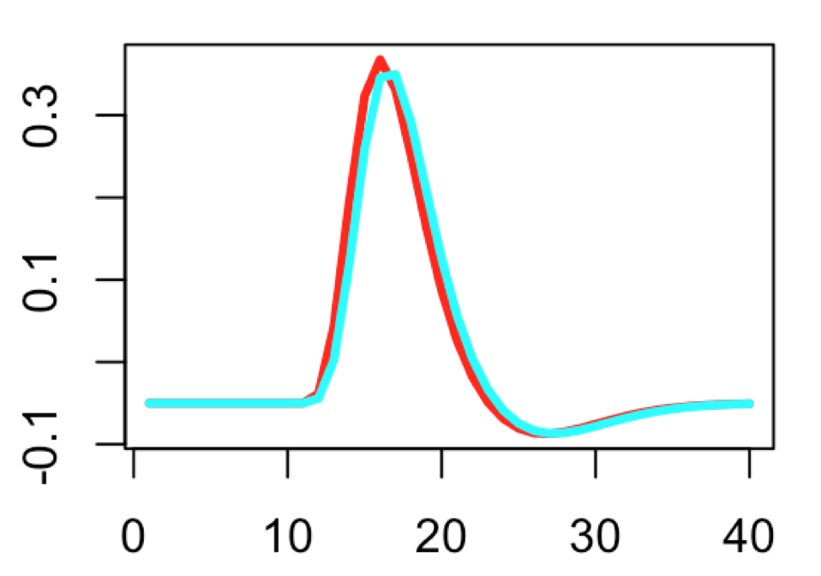
Both the problem and the solution to our problem
Duration and amplitude of response are almost perfectly confounded.
Duration = 1, amp = 2
Duration = 2, amp = 1

Slide 40
What if we did use duration?
Regressor 1 : Unmodulated task A
Regressor 2: Unmodulated task B
Regressor 3: RT modeled via duration
What is the interpretation of regressor 1’s Parameter estimate?

Slide 41
Orthogonlization could work
We’d need to simultaneously orthogonalize RT with respect to all other trials (A and B, combined).
Then the interpretation of A, alone, would be mean activation during trial A
Interpretation of A-B would be RT-adjusted difference between A and B

Slide 42
Problem: software doesn’t allow us to do that orthogonalization!
Only allows orthogonalizing with respect to one and then the other, but not both at the same time
True for SPM and FSL
Solution: Use the parametric modulation and mean center RT!
Equivalent to the proper orthogonalization!!

Slide 43
Questions?

