Slide 1
Statistical Modeling and Inference
Week 6

Slide 2
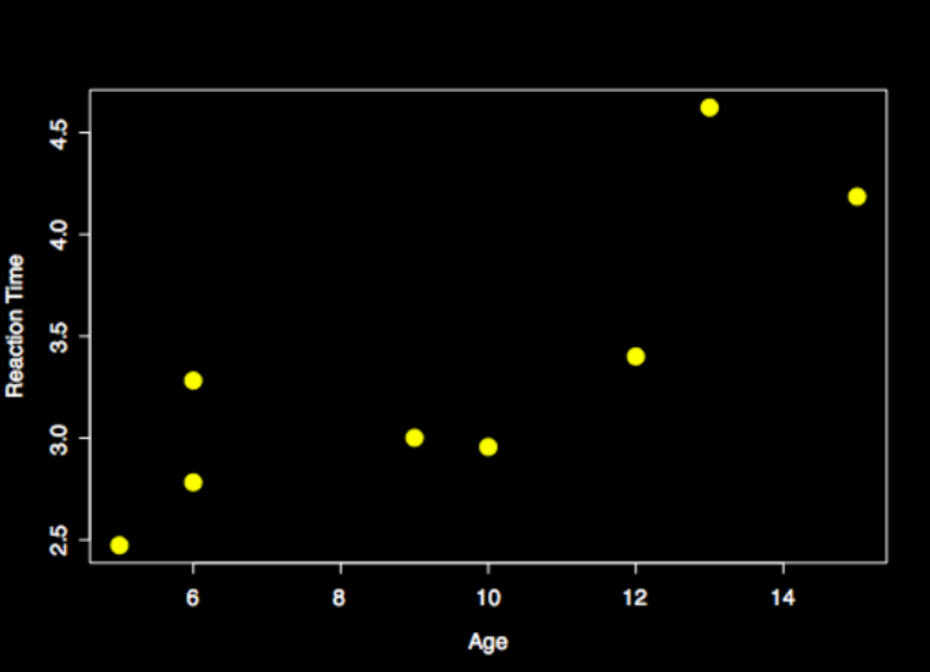
Models help tell stories
Notes:
Show same points with a fitted linear regression line, Maybe 2: One linear and one quadratic.
Fix x axis

Slide 3
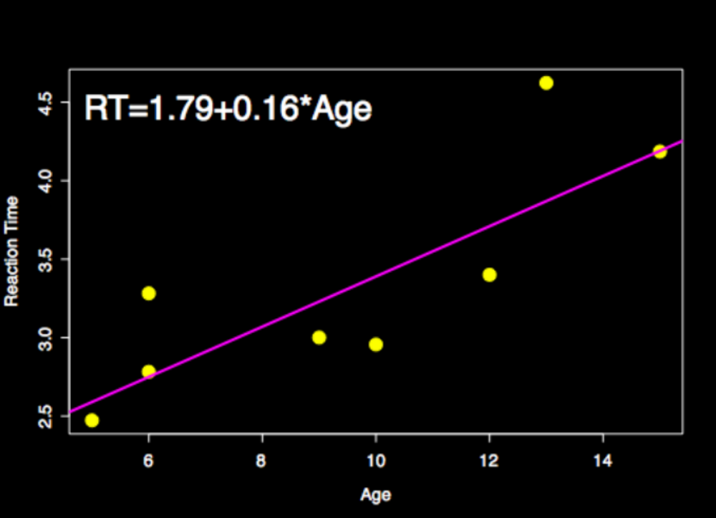
Models help tell stories
P<0.01
Notes:
Show same points with a fitted linear regression line, Maybe 2: One linear and one quadratic.

Slide 4
Goal of next 2 hours
Hour 1
  Brush up on some stats lingo
  Review the general linear model (GLM)
Hour 2
  Hypothesis testing
  Building Models
Notes:
Change to just a bullet called GLM

Slide 5
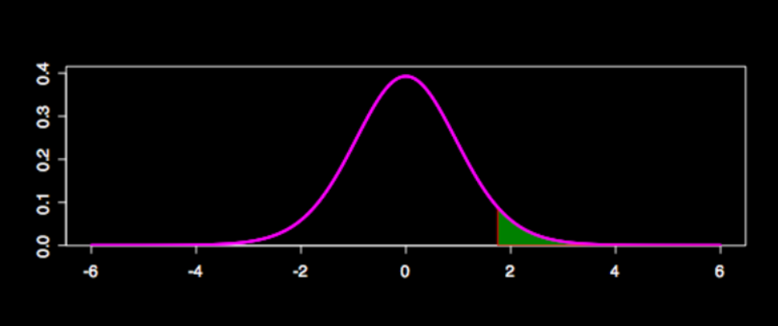
Statistical Terms
Probability: The expected relative frequency of a particular outcome.
  P(heads)=0.5
  P(height>69)=0.3
69

Slide 6
Statistical Terms
Probability: The expected relative frequency of a particular outcome.
  P(heads)=0.5
  P(height>69)=0.3
69

Slide 7
Statistical Terms
Random variable
  Variable determined by random experiment
  P(H>h)=Probability that height is larger than some observed height h

Slide 8
Statistical Terms
Probability distribution, f(h)
  Describes the distribution of a random variable
  Area under pdf gives probability
Notes:
Change change density to distribution

Slide 9
Statistical Terms
What distribution do we use?
  Typically assume normal (Gaussian)
  Functions of normals give other popular distributions
    Chisquare is the square of a normal
    T involves a normal and a chisquare
    F is the ratio of two chisquares

Slide 10
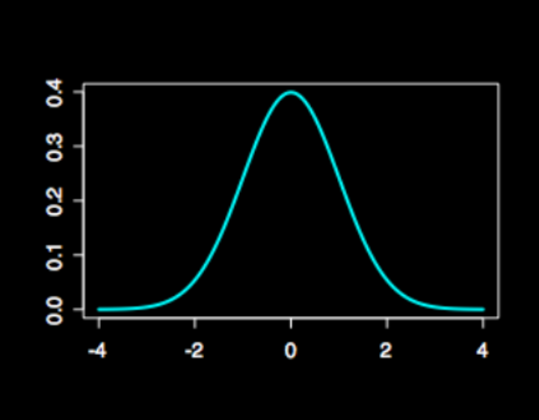
Statistical Terms
Statistical Independence
  X and Y are independent if the occurrence of X tells us nothing about Y
Expected Value
  The mean of a random variable ( )
Notes:
Use latex on the distribution thing
Actually I might junk this slide if I don’t use independence later
OR
I should add unbiased and minimum variance

Slide 11
Statistical Terms
Variance
  How the values of the RV are dispersed about the mean
Covariance
  How much 2 RV’s vary together
  If 2 RV’s are independent, BUT the opposite is not true
Notes:
Remove 2nd bullet of cov

Slide 12
Statistical Terms
Bias and Variance can be used to assess an estimator
  Bias: On average, the estimate is correct
  Variance: The reliability of the estimate
  Efficient: The most efficient estimate has the lowest variance among all unbiased estimators

Slide 13
Bias and Variance
high bias / low variance
low bias / high variance
high bias / high variance
low bias / low variance

Slide 14





The Model
For the ith observational unit
: The dependent (random) variable
: Predictor variable (not random)
, : Model parameters
: Random error, how the observation deviates from the population mean

Slide 15

Fixed:
  Mean of , ( )
Random:
  Variability of
    It follows that the variance of is

Slide 16
Fitting the Model
Reaction Time (s)
Q: Which line fits the data best?
Age

Slide 17

Fitting the Model
Minimize the distance between the data and the line (error).
Absolute distance? squared distance?
Error term
Reaction Time (s)
Age

Slide 18

Least Squares
Minimize squared differences
Minimize

Slide 19

Least Squares
Minimize squared differences
Minimize
  Works out nicely distribution-wise
  You can use calculus to get the estimates

Slide 20
Property of Least Squares
Gauss-Markov theorem
  Under the assumptions we’ve made so far (error has mean 0, with constant variance and uncorrelated) the least squares estimators are unbiased and have minimum variance among all unbiased linear estimates
i.e. The logical way to estimate the model gives really great estimates!

Slide 21
Property of least squares
Gauss Markov
  Assumptions
    error has mean 0
    things aren’t correlated
    variance is the same for all observations
  Unbiased and have lowest variance among all unbiased estimators

Slide 22
Property of least squares
Gauss Markov
  Assumptions
    error has mean 0
    things aren’t correlated
    variance is the same for all observations
  Unbiased and have lowest variance among all unbiased estimators

Slide 23
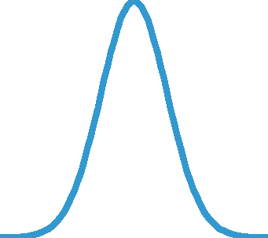
What’s maximum likelihood?
Maximize the likelihood:
Mean =110 small likelihood
Mean =120 large likelihood
100
110
120
110
120
130

Slide 24


What about the variance?
We also need an estimate for
  Start with the sums of squared error
  Divide by the appropriate degrees of freedom
    # of independent pieces of information - # parameters in model

Slide 25
Multiple Linear Regression
Add more parameters to the model
Time for linear algebra!

Slide 26

Matrices
is a 2x3 matrix
Row index
Column index

Slide 27
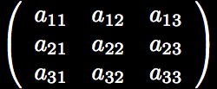
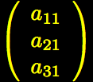

Matrices
Square matrix- Same # of rows and columns
Vector- column(row) vector has 1 column(row)

Slide 28
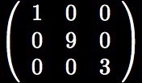
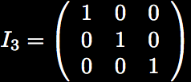
Matrices
Special matrices
  Diagonal Matrix
  Identity -

Slide 29
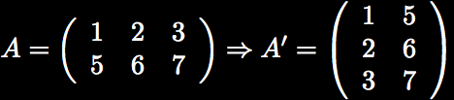

Matrices
Transpose: or . Swap columns and rows.
Element-wise addition and subtraction
Notes:
Remove dimensions must match

Slide 30
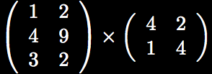

Matrices
Multiplication: Trickier
  Number of columns of first matrix must match number of rows of second matrix

Slide 31

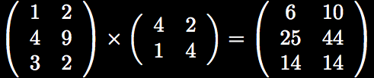
Matrices
Multiplication
_x0003__x0016_
_x0003__x0016_
_x0003__x0016_

Slide 32
Matrices
Multiplication
_x0003__x0016_
_x0003__x0016_
_x0003__x0016_
1x4+

Slide 33
Matrices
Multiplication
_x0003__x0016_
_x0003__x0016_
_x0003__x0016_
1x4+2x1=6

Slide 34
Matrices
Multiplication
_x0003__x0016_
_x0003__x0016_
_x0003__x0016_
1x2+2x4=10

Slide 35
Matrices
Multiplication

Slide 36

Matrix Inverse
Denoted
Only for square matrices
Only exists if matrix is full rank
  All columns (rows) are linearly independent
, but I’ll spare the details

Slide 37
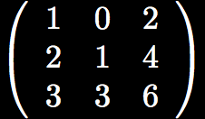
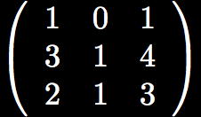
Rank Deficient Matrices
2*column1=column3
column1+column2=column3

Slide 38


Inverting rectangular matrix
If the columns *only* are linearly independent, then is invertible
Pseudoinverse:

Slide 39


Expectation and Variance

Slide 40
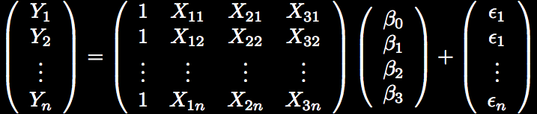
Back to linear regression
. . .
. . .
. . .
. . .
. . .
. . .
(nx1)
(nx4)
(4x1)
(nx1)

Slide 41
Back to linear regression
. . .
. . .
. . .
. . .
. . .
. . .
(nx1)
(nx4)
(4x1)
(nx1)

Slide 42
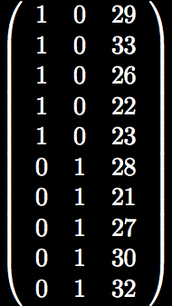
Viewing the Design Matrix
M F age
Look at the actual numbers

Slide 43
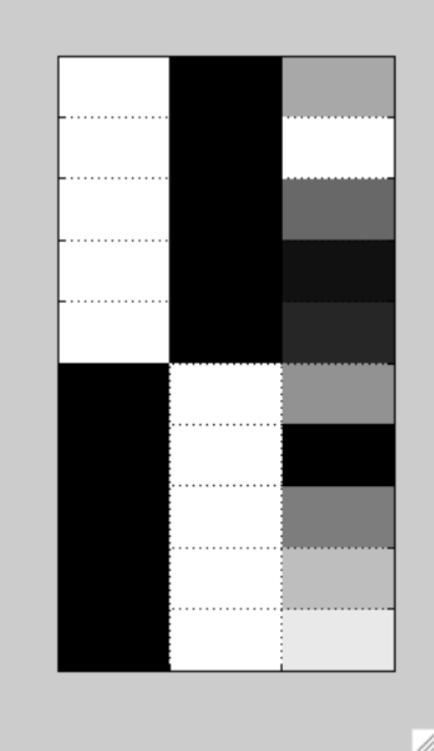
Viewing the Design Matrix
M F age
Look at in image representation
  Darker=smaller #

Slide 44
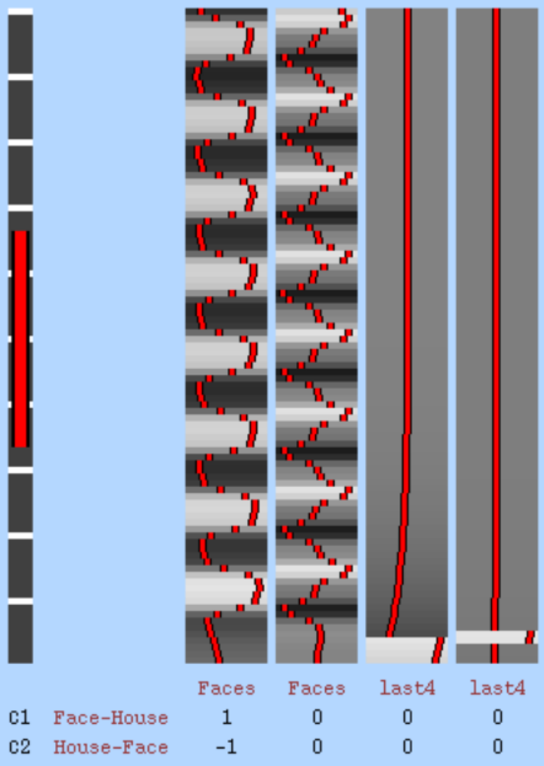
Viewing the Design Matrix
fMRI example (FSL)
Look at in image representation
  Darker=smaller #
  Useful for large fMRI designs

Slide 45

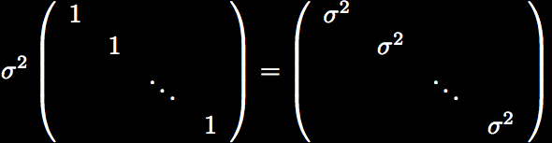
Multiple Linear Regression
The distribution of Y is a multivariate Normal
0
0
0
0

Slide 46



Multiple Linear Regression
is really easy to derive

Slide 47
Multiple Linear Regression
is really easy to derive
Same as least squares, but much easier to understand and write code for…thanks linear algebra!

Slide 48


Multiple Linear Regression
where
N=length(Y)
p=length( )

Slide 49




Statistical Properties
So the estimate is unbiased
But we don’t know

Slide 50
Linear regression is flexible!
One sample t-test
Two sample t-test
Paired t-test
ANOVA
ANCOVA
Correlation analysis (careful with interpretation!)
So, we call it the general linear model (GLM)
Notes:
Add some images of what the designs look like for these tests

Slide 51
Hypothesis Testing
How we evaluate the estimates
Fitted model B matches the data better than fitted model A
A
B

Slide 52
5 Parts of Hypothesis Tests
The null hypothesis, H₀
The alternative hypothesis, H_{A}
The test statistic and p-value
The rejection region
The conclusion about the hypothesis

Slide 53
H₀ and H_{A}
Null Hypothesis, H₀
  Typically what you want to disprove
  H₀: My boyfriend is cheating on me
Alternative Hypothesis, H_{A}
  Typically what you want to be true
  H_{A}: My boyfriend isn’t cheating on me

Slide 54
How to use H₀ and H_{A}
Assuming the null is true (my boyfriend is cheating on me), how likely are my data?
  Case 1: He buys me gifts, emails me throughout the day, cooks me dinner, tells everybody how awesome it is that he’s dating a biostatistician
    If he were cheating on me, these things wouldn’t be very likely…so reject H₀ in favor of H_{A}
  Case 2: He stays out late, never says anything nice to me, keeps talking about his fun female coworker, has lipstick on his collar
    If he were cheating on me, these things would be very likely…so accept H₀.

Slide 55
How to use H₀ and H_{A}
Assuming the null is true (my boyfriend is cheating on me), how likely are my data?
  Case 1: He buys me gifts, emails me throughout the day, cooks me dinner, tells everybody how awesome it is that he’s dating a biostatistician
    If he were cheating on me, these things wouldn’t be very likely…so reject H₀ in favor of H_{A}
  Case 2: He stays out late, never says anything nice to me, keeps talking about his fun female coworker, has lipstick on his collar
    If he were cheating on me, these things would be very likely…so do not reject H₀.

Slide 56
H₀ and H_{A} in GLM
Your study
  How is reaction time associated with age?
Two-sided hypothesis
  As age increases, reaction time changes
  Rejection of null means slope is positive or negative

Slide 57
H₀ and H_{A} in GLM
One-sided hypothesis test
  As age increases reaction time increases
  Rejecting null only concludes a positive slope
  Typically the type of hypothesis test for fMRI

Slide 58


Test Statistic
Decision about H₀ is based on our data
We need a statistic with a known distribution!
  Ugh! We don’t know

Slide 59

Test Statistic
We do know

Slide 60
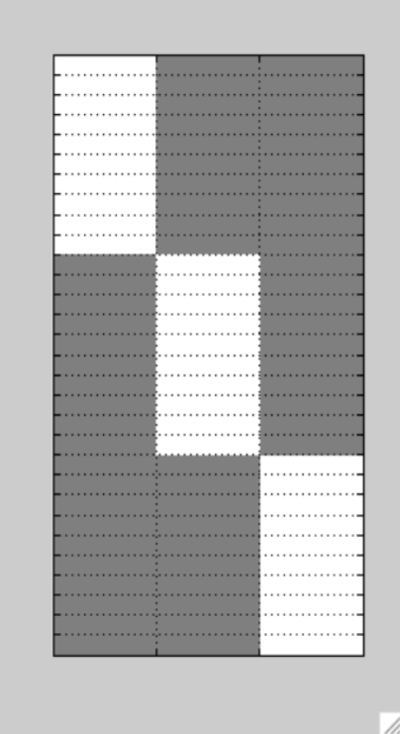


Contrasts
Sometimes we’re interested in the sums or differences of 2 parameters
  Compare G1 to G2
    c is a contrast
G1 G2 G3

Slide 61
Contrasts
Sometimes we’re interested in the sums or differences of 2 parameters
  Compare G1 to G2
    c is a contrast
G1 G2 G3

Slide 62
Contrasts
Sometimes we’re interested in the sums or differences of 2 parameters
  Compare G1 to G2
    c is a contrast
G1 G2 G3

Slide 63

Test Statistic
Of course we can test contrasts of parameters as well

Slide 64
P Values 1-Sided Hypothesis
Given the null is true, how likely is it to obtain a value more extreme than our statistic?

Slide 65
Start with the distribution under the null
  There were 22 observations (N=22)
  Simple linear regression (p=2)
  Null is a central T distribution with 20 df

Slide 66
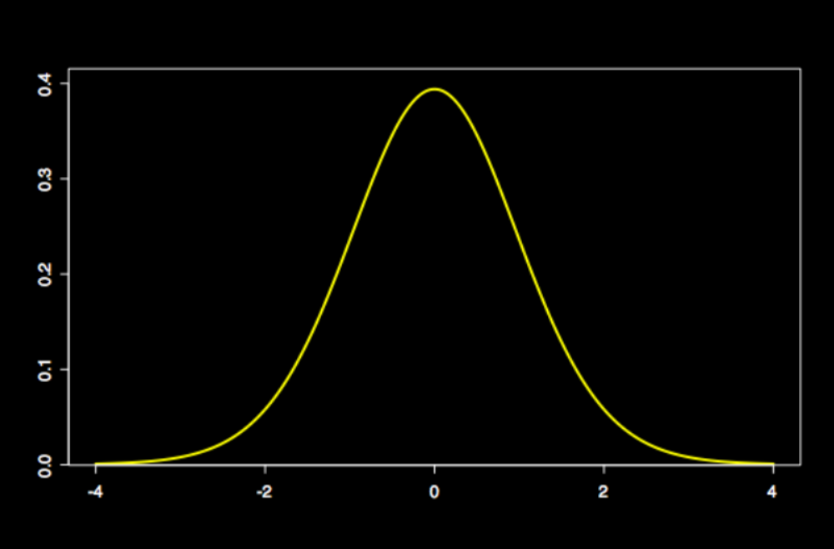
T₂₀

Slide 67
Observed test statistic=2

Slide 68
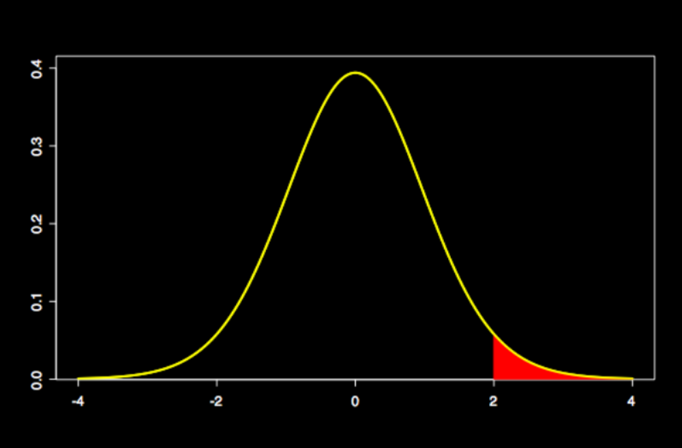
P value
more extreme

Slide 70
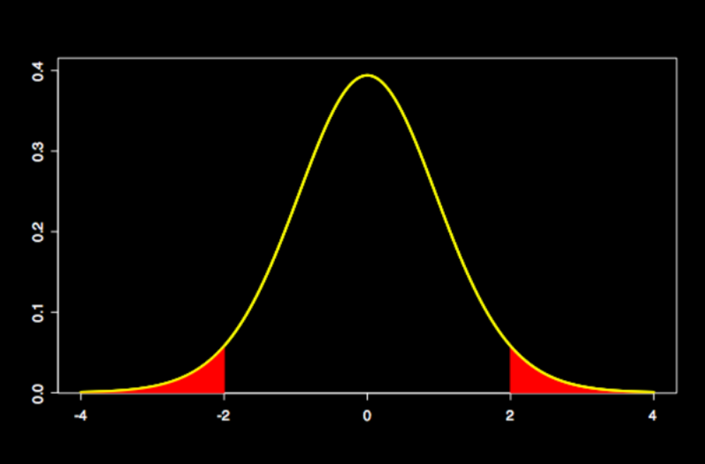
Sum=P value

Slide 71
Assessing a P Value
0.1<p
  Data support the null
0.05<p<0.1
  Weak evidence against the null
0.01<p<0.05
  Some evidence against the null
0.001<p<0.01
  Good evidence against the null
p<0.001
  Really good evidence against the null
Notes:
Remove slide

Slide 72


Notes About P Values
The P value is not the probability that the null is true
  (one sided)
1-p is not the probability that the alternative is true

Slide 73
Rejection Region
We need to choose a threshold
A p value is significant if it falls below the threshold,

Slide 74
Types of Error
Null Hypothesis
TRUE
FALSE
Decision
Reject null
Accept null

Slide 75
Types of Error
Null Hypothesis
TRUE
FALSE
Decision
Reject null
Correct!
Accept null
Correct!

Slide 76
Types of Error
Null Hypothesis
TRUE
FALSE
Decision
Type I Error
Reject null
Correct!
Type II Error
Accept null
Correct!

Slide 77
Power
Probability of rejecting the null, when the alternative is true
Ideal situation has low and high power
  Power is a function of
  Increasing increases power

Slide 78
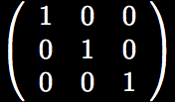
Testing Multiple Contrasts
You can test multiple contrasts simultaneously
  Are any of my beta’s 0?
  Use a contrast matrix
  F test

Slide 79
F tests are great!
If the F test isn’t significant, then none of the individual t tests will be significant
I’ve heard of reviewers getting angry when two insignificant t tests were reported as opposed to 1 F test
Why does it matter how many tests we run?

Slide 80

Multiple Testing Problems
What if we perform many hypothesis tests?
‘Confidence coefficient’
Joint confidence coefficient for 5 independent tests
  Much smaller than we’d like

Slide 81

Multiple Testing Problems
Bonferroni method
  Use
  With fMRI data multiple testing is a big problem and Bonferroni is too conservative…stay tuned

Slide 82

Let’s talk about models!
Focus on residuals and degrees of freedom
Goal…make our t stat as big as we can without using too many DF

Slide 83
Let’s talk about models!
Focus on residuals and degrees of freedom
Goal…make our t stat as big as we can without using too many DF
Can’t do much about these pieces

Slide 84
Let’s talk about models!
Focus on residuals and degrees of freedom
Goal…make our t stat as big as we can without using too many DF
Try to decrease this estimate

Slide 85

Variance Estimate
Recall

Slide 86
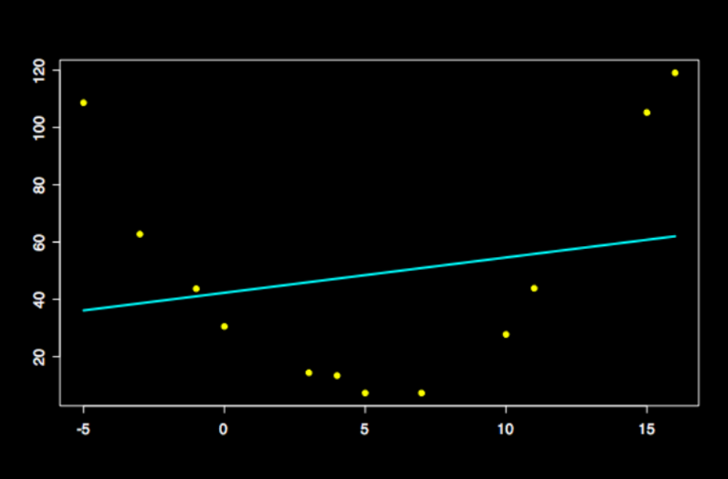
Linear regressor is not significant (p=0.5)

Slide 87
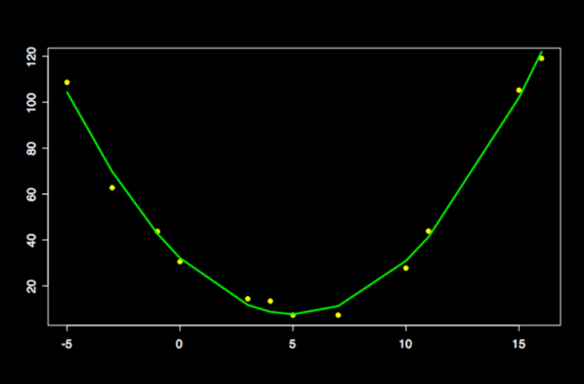
Quadratic regressor is significant (p<0.0001)

Slide 88
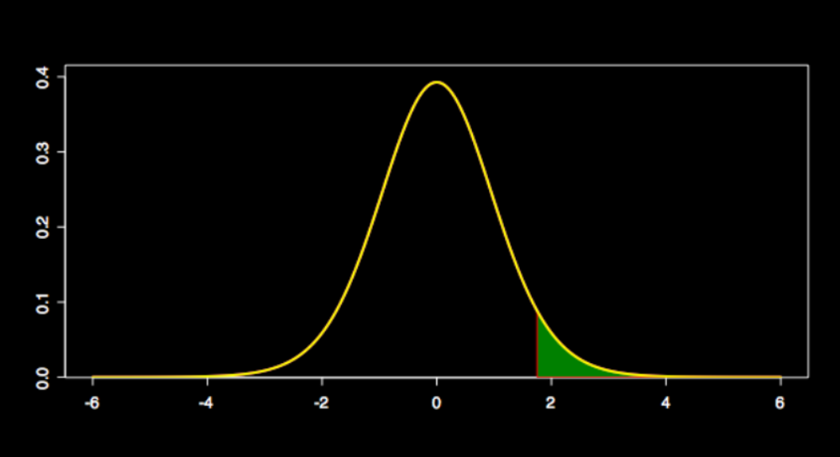
Watch degrees of freedom!
T₁₆
P=0.05

Slide 89
Watch degrees of freedom!
T₁₆
P=0.05
Add 13 regressors, increasing statistic

Slide 90
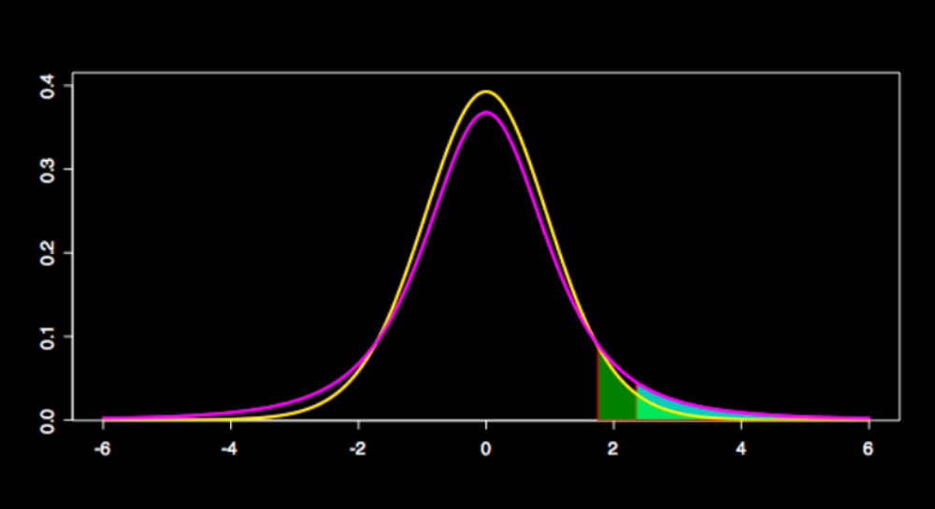
Watch degrees of freedom!
T₁₆
T₃
Both have p=0.05

Slide 91
Recall
GLM is flexible
  One Sample T Test
  ANOVA
  Two sample T Test
  Paired T test
What do the models look like?

Slide 92
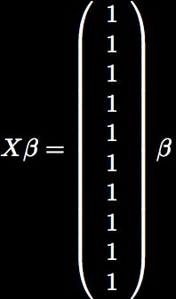
1-Sample T Test
Overall mean

Slide 93
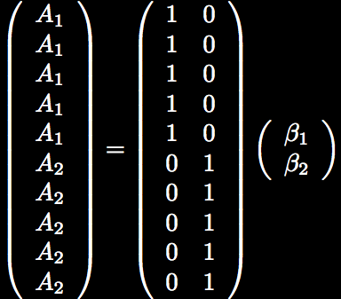
2-Sample T Test
Mean group 1
Mean group 2

Slide 94
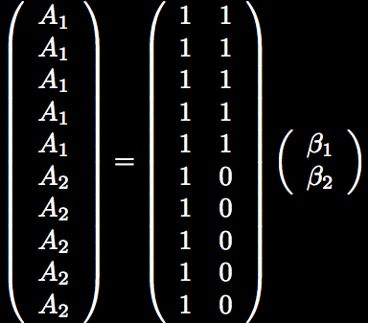
2-Sample T Test
OR
Notes:
Interpretation of the parameters is different
If can’t figure it out, multiply it out

Slide 95
Understanding a model
If you’re unsure about a model or the contrasts
  Plug in numbers
  Look at graphs (fMRI data)
Always ask yourself if your model is doing what you want it to

Slide 96
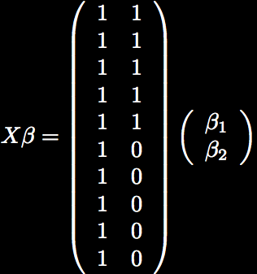
For example…
For the 2 sample T test
  Set
  Then G1=8 and G2=3
  So is the mean of group 2 and is the difference between the groups
  What are the contrasts to test
    Mean of G2
    Mean of G1
    G1-G2

Slide 97
For example…
For the 2 sample T test
  Set
  Then G1=8 and G2=3
  So is the mean of group 2 and is the difference between the groups
  What are the contrasts to test
    Mean of G2
    Mean of G1
    G1-G2
Notes:
Within a group, if I read across the design matrix, do all the subjects have exactly the same row
If so, the contrast for the group average is just that contrast
e.g., mean for group one is [1 1]
Mean for group two is [1 0]

Slide 98
For example…
For the 2 sample T test
  Set
  Then G1=8 and G2=3
  So is the mean of group 2 and is the difference between the groups
  What are the contrasts to test
    Mean of G2
    Mean of G1
    G1-G2

Slide 99
Paired T Test
A common mistake is to use a 2-sample t test instead of a paired test
Tire example
2-sample T test p=0.58
Paired T test p<0.001
Automobile | Tire A | Tire B
1 | 10.6 | 10.2
2 | 9.8 | 9.4
3 | 12.3 | 11.8
4 | 9.7 | 9.1
5 | 8.8 | 8.3

Slide 100
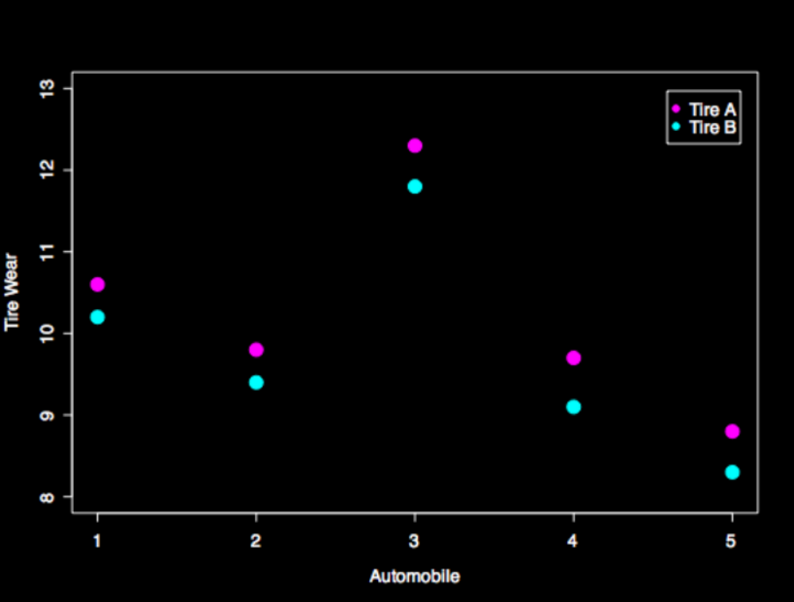
Why so different?
Notes:
It’s all in the residuals of the model

Slide 101
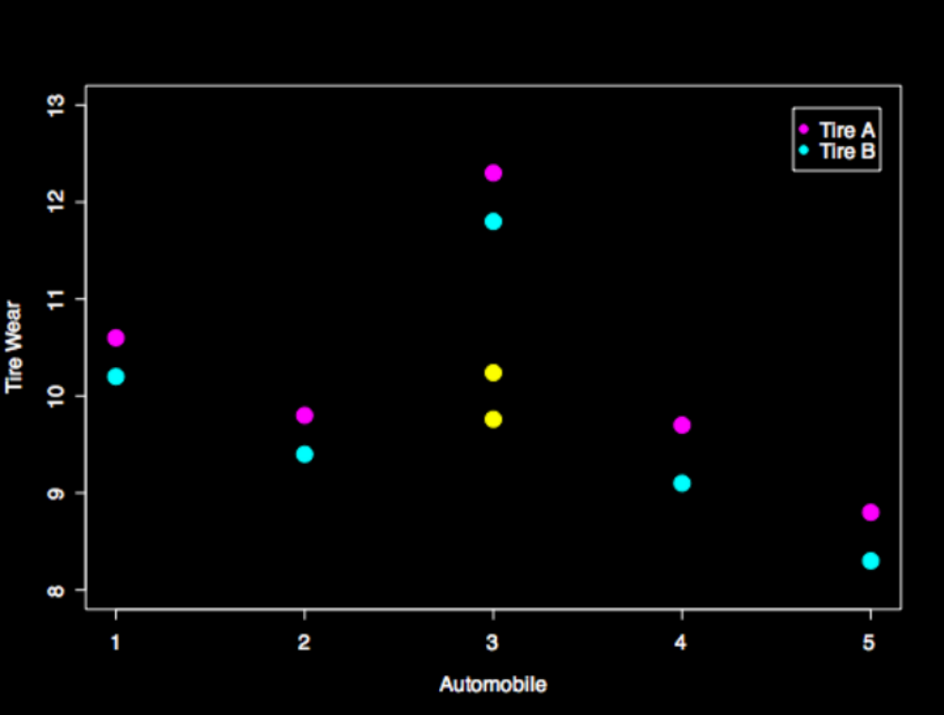
Why so different?
Mean A
Mean B

Slide 102
Why so different?
Difference is OK

Slide 103
Why so different?
Residuals are HUGE!

Slide 104
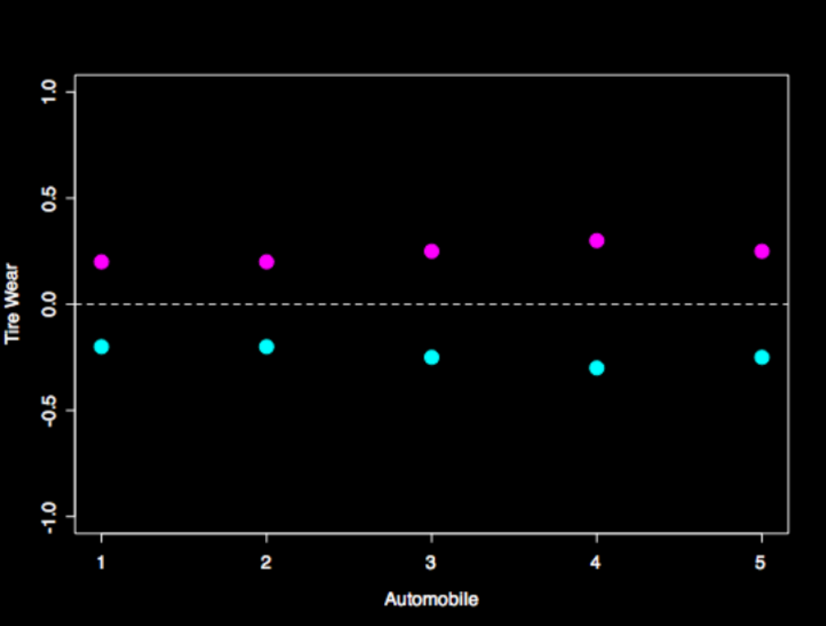
Paired T Test
Adjust for the mean of each pair

Slide 105
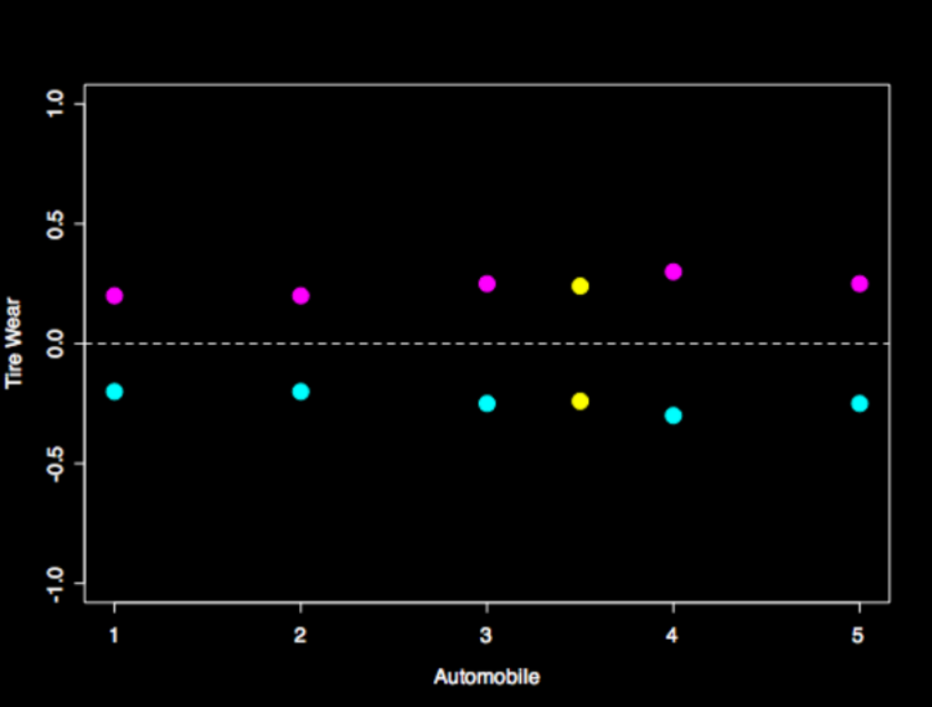
Paired T Test
Mean A
Mean B

Slide 106
Paired T Test
Difference is same
Residual variance much smaller

Slide 107
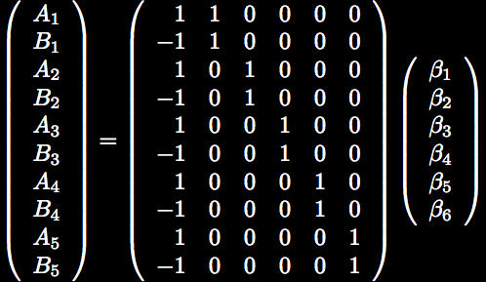

Paired T Test GLM
Difference
Mean of each pair
Notes:
Replaced the column of ones with one column for each subject’s mean
You cannot run any inferences on B2-B6
You can ONLY look at B1
Contrast tests A-B

Slide 108

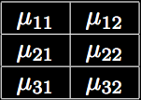
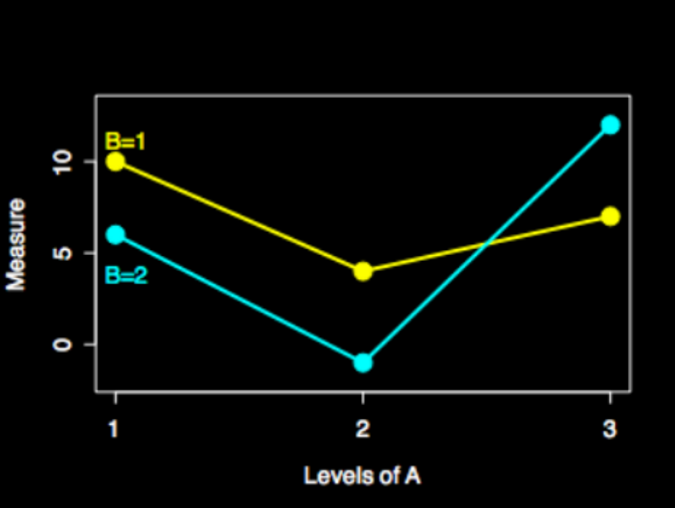
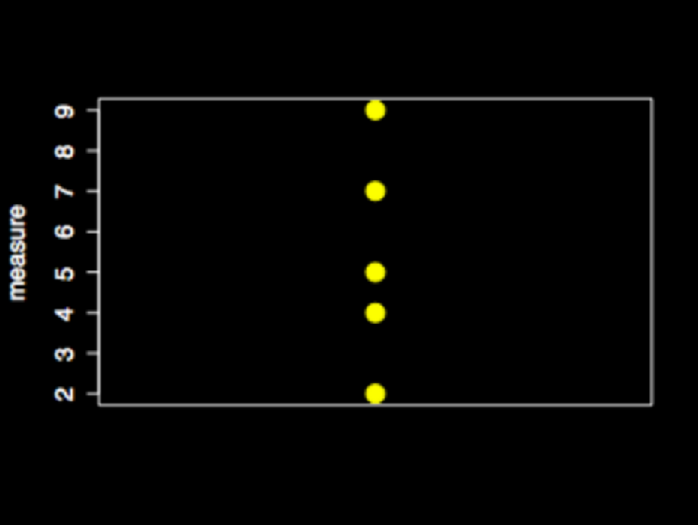
ANOVA
1-way ANOVA
2-way ANOVA
B
A

Slide 109
Modeling ANOVA with GLM
Cell means model
  1-way ANOVA
  2-way ANOVA
  EVs are easy, but contrasts are trickier
Factor effects
  1-way
  2-way
  EVs take more thought, but contrasts are easier
ANOVA uses F tests

Slide 110
Modeling ANOVA with GLM
Cell means model
  1-way ANOVA
  2-way ANOVA
  EVs are easy, but contrasts are trickier
Factor effects
  1-way
  2-way
  EVs take more thought, but contrasts are easier
ANOVA = F tests!

Slide 111
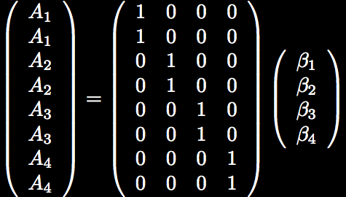
1 Way ANOVA - Cell Means

Slide 112
1 Way ANOVA - Cell Means

Slide 113
1 Way ANOVA - Cell Means

Slide 114

1 Way ANOVA - Cell Means

Slide 115

1 Way ANOVA - Factor Effects
In general
  # of regressors for a factor = # levels-1
  Factor with 4 levels

Slide 116
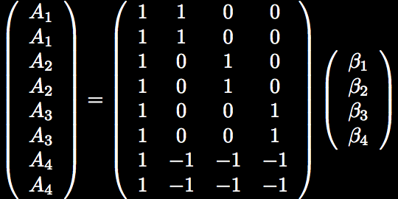
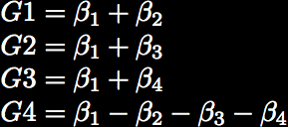
1 Way ANOVA - Factor Effects
mean
Notes:
B1 is the overall mean

Slide 117
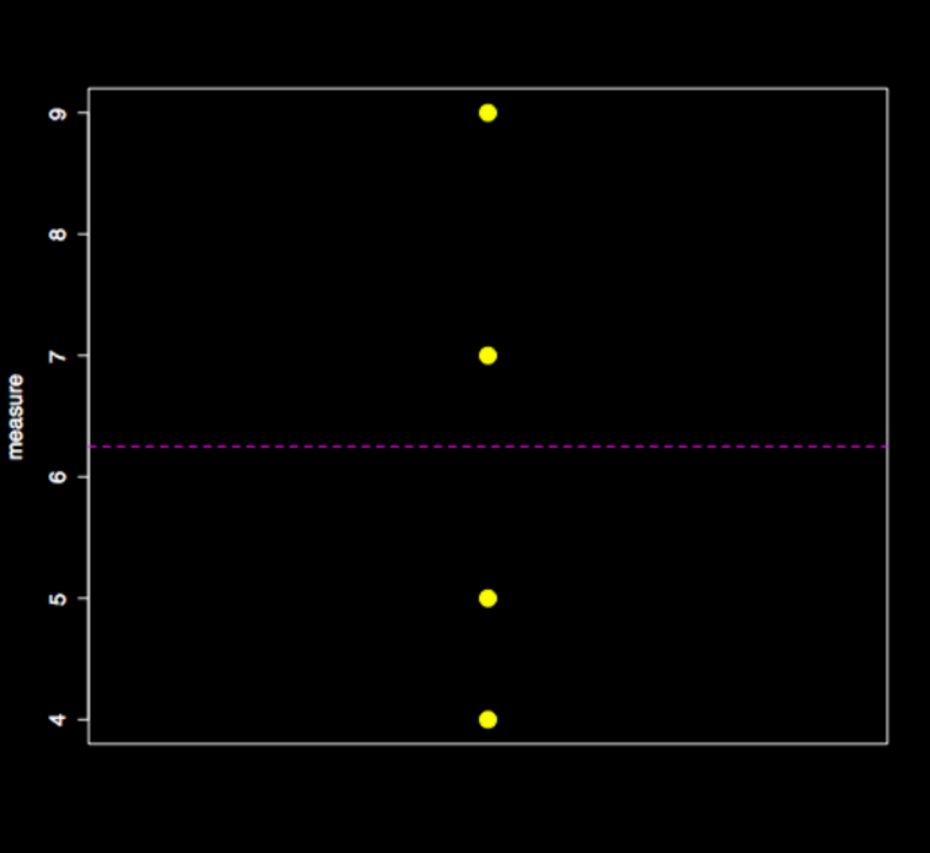
1 Way ANOVA - Factor Effects
2
3

Slide 118
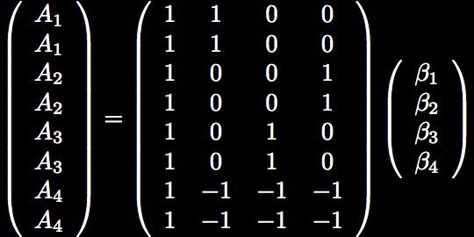
1 Way ANOVA - Factor Effects

Slide 119
1 Way ANOVA - Factor Effects
Notes:
Fix contrast!

Slide 120
1 Way ANOVA - Factor Effects

Slide 121
1 Way ANOVA - Factor Effects

Slide 122
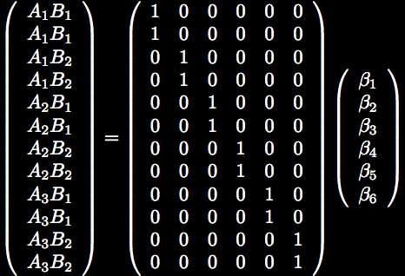
2 Way ANOVA (3x2)
Notes:
Cell Means approach

Slide 123
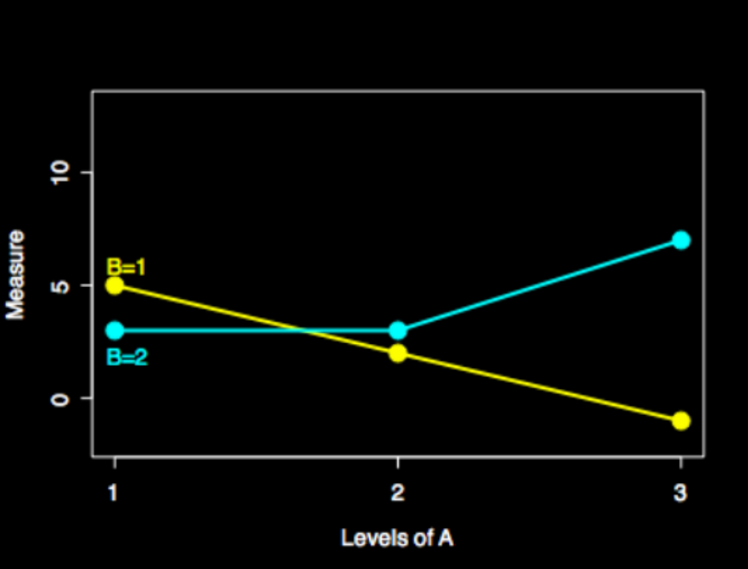
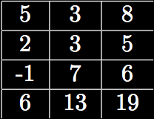
2 Way ANOVA (3x2)
B1
B2
A1
A2
A3
No effect means the marginals would be the same
Null: A1=A2=A3 equivalently A1-A3=0 and A2-A3=0

Slide 124
2 Way ANOVA (3x2)

Slide 125

2 Way ANOVA (3x2)

Slide 126
2 Way ANOVA (3x2)

Slide 127
2 Way ANOVA (3x2)
B1
B2
A1
A2
A3
No effect means the lines would be parallel

Slide 128
2 Way ANOVA (3x2)
B1
B2
A1
A2
A3
No effect means the lines would be parallel
A1B1-A1B2=A2B1-A2B2=A3B1-A3B2

Slide 129

2 Way ANOVA (3x2)

Slide 130

2 Way ANOVA - Factor Effects
Recall for factor effects, a factor with n levels has regressors set up like
A has 3 levels, so 2 regressors
B has 2 levels, so 1 regressor
Notes:
To make interactions, just multiple regressors together

Slide 131
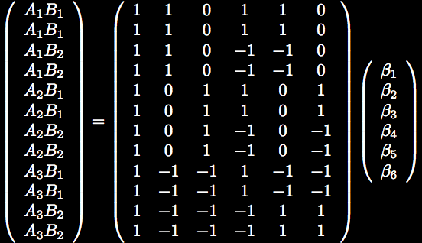
2 Way ANOVA - Factor Effects
A
B
AB
Notes:
Two columns for AB
First column is A1*B
Second column is A2*B

Slide 132
2 Way ANOVA - Factor Effects

Slide 133

2 Way ANOVA - Factor Effects
Notes:
The bottom contrast is an f-test (with two t-tests together)

Slide 134
2 Way ANOVA - Factor Effects

Slide 135

2 Way ANOVA - Factor Effects

Slide 136
2 Way ANOVA - Factor Effects

Slide 137
2 Way ANOVA - Factor Effects

Slide 138
For more examples
The FSL folks have a bunch of great examples
  http://www.fmrib.ox.ac.uk/fsl/feat5/detail.html
Check the FSL help list regularly
  Subscribe at jiscmail
  Often others have already asked your questions!

Slide 139
Why did I just tell you all of this?
The GLM is a flexible model that allows for a variety of analyses
Focusing on residuals and degrees of freedom will help you build good models
Use an F test when appropriate
A lot of the stats lingo and linear algebra stuff comes up in methods papers

Slide 140
Why did I just tell you all of this?
The Gauss-Markov theorem tells us our least squares estimates are best if
  Errors are mean zero, uncorrelated, constant variance
  fMRI data tend to violate these assumptions
Multiple comparisons is a huge problem with fMRI data and Bonferroni doesn’t work well

