Slide 1
Group analysis
Wednesday, Lecture 1
Jeanette Mumford
University of Wisconsin - Madison

Slide 2

Paper

Slide 3
Motivation
How do you typically model repeated measures data?
Eg, behavioral study with 30 presentations of each of 6 stimuli?

Slide 4
Where we’re going
Fixed vs Mixed modeling
2 stage summary statistics approach to mixed model (using non-fmri example)
2 stage summary statistics approach with fMRI data
Software differences (FSL and SPM)

Slide 5
Where we’re going
Fixed vs Mixed modeling
2 stage summary statistics approach to mixed model (using non-fmri example)
2 stage summary statistics approach with fMRI data
Software differences (FSL and SPM)

Slide 6
Mixed Model Motivation
Start with a simple ANOVA example
Study: Is hair length different between males and females?

Slide 7
Mixed Model Motivation
Start with a simple ANOVA example
Study: Is hair length different between males and females?
BTW, this example originally came from Friston and Holmes

Slide 8
Start: 1 hair per person
Two sources of variability
Variance of hair length within person
Variance of hair length between people
Assume within-subject variance is 1

Slide 9
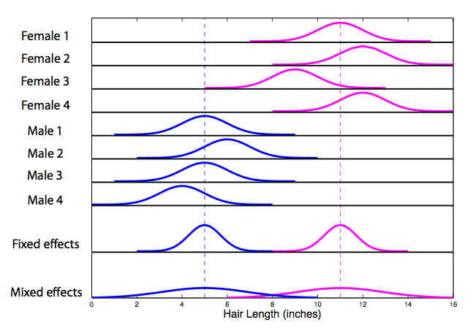
Each distribution has a variance of 1

Slide 10

Fixed effects analysis
We’re only interested in these exact 4 men and 4 women

Slide 12


Mixed effects
Include both within and between subject variances
Adding a between subject means subject is random

Slide 13
Mixed effects
Include both within and between subject variances
Adding a between subject means subject is random
Anything with a variance is random!

Slide 15


Multiple hairs per subject
Fixed effects variance
Mixed effects variance

Slide 16
Multiple hairs per subject
Fixed effects variance
Mixed effects variance
Between subject variance typically dominates

Slide 17
Wrong model leads to wrong conclusion
Scenario 1: Fixed effects model
Significant difference in hair length
Result only applies to these 8 subjects

Slide 18
Wrong model leads to wrong conclusion
Scenario 2: Mixed effects model
Cannot conclude there is a difference in hair length

Slide 19
Mixed Model Comments
If you fail to include a random effect when there is one
Results only apply to that data sample
P-values are smaller than mixed model p-values

Slide 20
Fixed
Mixed
Sample 1
Sample 2
Sample 3
Group Distribution

Slide 21
Fixed
Mixed
Sample 1
Sample 2
Sample 3
Group Distribution

Slide 22
Fixed
Mixed
Sample 1
Sample 2
Sample 3
Group Distribution

Slide 23
Fixed
Mixed
Sample 1
Sample 2
Sample 3
Group Distribution

Slide 24
Take away
What happens if you ignore the random subject effect ?
What happens to the overall variance when you include a between-subject variance?

Slide 25
Take away
What has a bigger impact in reducing variance?
Adding more hairs per subject?
Adding more subjects?

Slide 26
Where we’re going
Fixed vs Mixed modeling
2 stage summary statistics approach to mixed model (using non-fmri example)
2 stage summary statistics approach with fMRI data
Software differences (FSL and SPM)

Slide 27
Moving forward with hair example
Let’s focus on the hair distribution for 3 females with 20 hairs per person

Slide 28
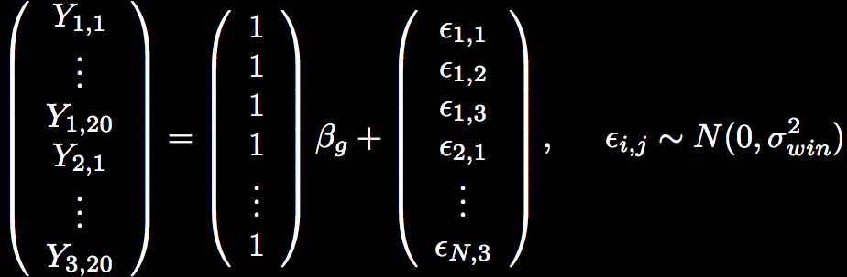
Fixed effects model: modeling the mean of 3 females, 20 hairs
Fixed effect
Residual error

Slide 29
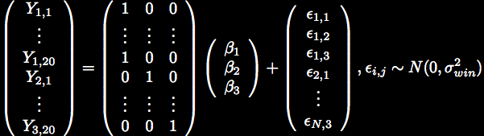
Mixed Effects Model
Stage 1

Slide 30


Mixed Effects Model
Stage 1
Stage 2

Slide 31
Mixed Effects Model
Stage 1
Stage 2
Random effect

Slide 32
Mixed Effects Model
Stage 1
Stage 2
Random effect

Slide 33
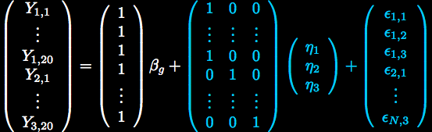
Mixed Effects Model: All-In-One
Variance Terms

Slide 34
How does this relate to fMRI?
Subject 1
Subject 2
. . .
. . .
Subject N
Each time series is a collection of data grouped by subject
A random subject effect is necessary to apply inference to total population

Slide 35
Mixed Model for fMRI Data
fMRI data are more complicated than the hair length example
Not typically estimating an intercept
Time series are temporally autocorrelated
Time series can be quite long
Let’s take a look at the model!
A study with 2 stimuli of interest

Slide 36



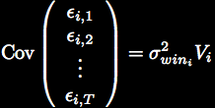

Subject 1
Subject 2
=
+
+
. . .
. . .
. . .
Subject N

Slide 37
Yuck!
Computationally intensive
Large matrices that need to be inverted
What if we add another subject?
Must estimate whole model for all subjects

Slide 38
Recall the two stages
Stage 1
Stage 2

Slide 39



Two-Stage Summary Statistics
Stage 1

Slide 40


Two-Stage Summary Statistics
Stage 1
Stage 2
Use first stage estimates

Slide 41
Two-Stage Summary Statistics
Stage 1
Stage 2
within
between

Slide 42
Two-Stage Model
Stage 1
Means

Slide 43

Two-Stage Model
Stage 1
Means
(same across subjects here)

Slide 44

Two-Stage Model
Stage 1
Means
(same across subjects here)
Stage 2

Slide 45


Two-Stage Model
Stage 1
Means
(same across subjects here)
Stage 2
20 hairs/subject

Slide 46
Two-Stage Model
Stage 1
Means
(same across subjects here)
Stage 2
20 hairs/subject
Pop mean

Slide 47
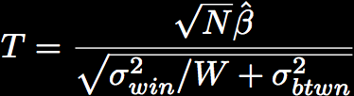
Two-Stage Model
N = # subjects
W = # measures within subject
If new data are added, only run first stage for new data

Slide 48
Take away
Do you understand the “cheat” we use for mixed models?
Is the 2 stage summary statistics approach identical to a full mixed model?

Slide 49
Where we’re going
Fixed vs Mixed modeling
2 stage summary statistics approach to mixed model (using non-fmri example)
2 stage summary statistics approach with fMRI data
Software differences (FSL and SPM)

Slide 50
Two-Stage Summary Statistics
Stage 1
Stage 2

Slide 51



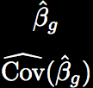
Two Stage Model fMRI
Stage 1
. . .
Estimate N
subject models
. . .
Stage 2
Estimate between subject variance, combine with Stage 1 results

Slide 52


Stage 1: Subject Model
+
=

Slide 53
Stage 1: Estimation
such that

Slide 54

Stage 1: Estimation
such that
Whitened model

Slide 55
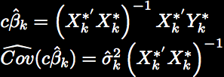
Stage 1: Estimation
such that
Whitened model
Use OLS on whitened model

Slide 56




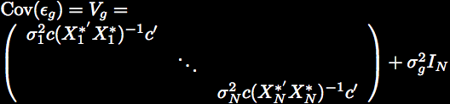
Stage 2: Group Model
=
+

Slide 57
Stage 2: Estimation

Slide 58

Stage 2: Estimation

Slide 59
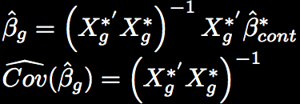
Stage 2: Estimation

Slide 60

Stage 2: Estimation

Slide 61
Take away
What are the benefits of breaking the full mixed effects model into 2 stages for fmri?
You should be able to think of at least 2 reasons

Slide 62
Take away
When the model is estimated how is a subject with a high mfx variance treated differently than a subject with a low mfx variance?

Slide 63
Where we’re going
Fixed vs Mixed modeling
2 stage summary statistics approach to mixed model (using non-fmri example)
2 stage summary statistics approach with fMRI data
Software differences (FSL and SPM)

Slide 64
Stage 1: Subject Model
+
=

Slide 65
Stage 2: Group Model
=
+

Slide 66

How is the model estimated?
Depends on software
SPM: Does not estimate
Due to a set of assumptions, estimation of is unnecessary
FSL: Bayesian approach to estimating

Slide 67

SPM2
Does not estimate
Assumes homogeneous variance across subjects
Assumes first level design is same across subjects
OLS can be used

Slide 68

SPM2 : Single contrast per subject
=
+
A one-sample T-test!

Slide 69




SPM2 : Multiple contrasts per subject
=
+
Global correlation estimate

Slide 70
SPM2 : Summary
Multiple contrasts per subject can enter second level
Contrasts can be correlated
T and F-tests are possible
Special case
One contrast per subject…Reduces to T-test!

Slide 71
SPM2
Pros
Model is easy to estimate
Model is easy to understand
Multiple contrasts can enter the group model and are not considered independent
Cons
Global covariance estimate (same across voxels)
Assumes variance is homogeneous across subjects

Slide 72

FSL: FMRIB Software Library
Bayesian approach to estimating model
Inference is based on posterior distribution of the data
Parameters of interest are treated as random

Slide 73

FSL : Second Level Estimation
Flame 1: Maximum a posteriori (MAP) estimate of found iteratively
Assumes degrees of freedom,
Flame 2: Slower MCMC method of estimation
Applied to voxels close to threshold in step 1
Fine tunes estimates of
Details
Woolrich et al. NI (2004) 1732-47

Slide 74
FSL
Pros
When single contrast is taken to the second level, ~equivalent to all-in-one model
Within-subject variances are carried to the second level
Heterogeneity across subjects is modeled
Cons
Multiple contrasts in the group model are assumed to be independent

Slide 75
Which software?
FSL best for heteroscedastic variances
Different number of trials per subject
SPM best for multiple correlated contrasts at group level
Other differences in first level modeling may sway users one way or another

Slide 76
Take away
What’s the primary difference between FSL and SPM?

Slide 77
Questions?

