Slide 1
Controlling for multiple comparisons using a nonparametric permutation test
Jeanette Mumford

Slide 2
Where we’re going
Type I error overview
Whole brain thresholding options
What type of error rate control should we have?
What statistic should we use?
Family-wise error control
Bonferroni
Maximum T
Random field theory (parametric)
Permutation tests (nonparametric)
Cluster failure!!

Slide 3
Where we’re going
Type I error overview
Whole brain thresholding options
What type of error rate control should we have?
What statistic should we use?
Family-wise error control
Bonferroni
Maximum T
Random field theory (parametric)
Permutation tests (nonparametric)
Cluster failure!!

Slide 4
“Prerequisites”
Linear regression
Basic ideas of
Type I Error
Power

Slide 5
P-value definition
Assuming the null is true . . .
What is the probability of obtaining my statistic or something more extreme?
Notes:
Add illustration

Slide 6
What does the 5% cutoff imply?
If the null is true, we’ll have a false positive 5% of the time

Slide 7
Interpretation
1100 total voxels
100 voxels have β=Δ
80% power -> 80 voxels detected
1000 voxels have β=0
5% type I error -> 50 false positives
 | Declared active | Declared inactive | Total
Non-active
Active
Total

Slide 8
Interpretation
1100 total voxels
100 voxels have β=Δ
80% power -> 80 voxels detected
1000 voxels have β=0
5% type I error -> 50 false positives
What we know (test results)
 | Declared active | Declared inactive | Total
Non-active
Active
Total

Slide 9
Interpretation
1100 total voxels
100 voxels have β=Δ
80% power -> 80 voxels detected
1000 voxels have β=0
5% type I error -> 50 false positives
What we don’t know
(truth)
 | Declared active | Declared inactive | Total
Non-active
Active
Total

Slide 10
Interpretation
1100 total voxels
100 voxels have signal (null is false)
80% power -> 80 voxels detected
1000 voxels have no signal (null)
5% type I error -> 50 false positives
 | Declared active | Declared inactive | Total
Non-active |  |  | 1000
Active |  |  | 100
Total |  |  | 1100

Slide 11
Interpretation
1100 total voxels
100 voxels have signal (null is false)
80% power -> 80 voxels detected
1000 voxels have no signal (null)
5% type I error -> 50 false positives
 | Declared active | Declared inactive | Total
Non-active |  |  | 1000
Active | 80 | 20 | 100
Total |  |  | 1100

Slide 12
Interpretation
1100 total voxels
100 voxels have signal (null is false)
80% power -> 80 voxels detected
1000 voxels have no signal (null)
5% type I error -> 50 false positives
 | Declared active | Declared inactive | Total
Non-active |  |  | 1000
Active | 80 | 20 | 100
Total |  |  | 1100
(Power)
(Type II err.)

Slide 13
Interpretation
1100 total voxels
100 voxels have signal (null is false)
80% power -> 80 voxels detected
1000 voxels have no signal (null)
5% type I error -> 50 false positives
 | Declared active | Declared inactive | Total
Non-active | 50 | 950 | 1000
Active | 80 | 20 | 100
Total |  |  | 1100
(Power)
(Type II err.)

Slide 14
Interpretation
1100 total voxels
100 voxels have signal (null is false)
80% power -> 80 voxels detected
1000 voxels have no signal (null)
5% type I error -> 50 false positives
 | Declared active | Declared inactive | Total
Non-active | 50 | 950 | 1000
Active | 80 | 20 | 100
Total |  |  | 1100
(Type I err.)
(Correct)
(Power)
(Type II err.)

Slide 15
Interpretation
1100 total voxels
100 voxels have signal (null is false)
80% power -> 80 voxels detected
1000 voxels have no signal (null)
5% type I error -> 50 false positives
 | Declared active | Declared inactive | Total
Non-active | 50 | 950 | 1000
Active | 80 | 20 | 100
Total | 130 | 970 | 1100

Slide 16
Interpretation
1100 total voxels
100 voxels have signal (null is false)
80% power -> 80 voxels detected
1000 voxels have no signal (null)
5% type I error -> 50 false positives
focus is on controlling this number
 | Declared active | Declared inactive | Total
Non-active | 50 | 950 | 1000
Active | 80 | 20 | 100
Total | 130 | 970 | 1100

Slide 17
How would you deal with this situation?
Population of 100 students
20 different depression measurements
Are any associated with class performance?
You get the following results

Slide 18
What about this set of p-values?
0.042 | 0.006 | 0.002 | 0.006 | 0.019 | 0.006 | 0.030 | 0.017 | 0.155 | 0.024
Multiple comparison problem:
# of FPs increases as you run more tests

Slide 19

Don’t forget power
Type I error
Power

Slide 20
Where we’re going
Type I error overview
Whole brain thresholding options
What type of error rate control should we have?
What statistic should we use?
Family-wise error control
Bonferroni
Maximum T
Random field theory (parametric)
Permutation tests (nonparametric)
Cluster failure!!

Slide 21
Whole brain: Thresholding the map
What type of error rate does the researcher want to control?
Per comparison error
Use p < 0.05 at each voxel
Family wise error
Probability of any false positives
False discovery rate
Proportion of voxels found to be active that are false activations
What statistic does the researcher want to use?
Voxelwise
Clusterwise
Peakwise

Slide 22
Whole brain: Thresholding the map
What type of error rate does the researcher want to control?
Per comparison error
Use p < 0.05 for each statistic
Family wise error
Probability of any false positives
False discovery rate
Proportion of voxels found to be active that are false activations
What statistic does the researcher want to use?
Voxelwise
Clusterwise
Peakwise

Slide 23
Whole brain: Thresholding the map
What type of error rate does the researcher want to control?
Per comparison error
Use p < 0.05 for each statistic
Family wise error
Probability of any false positives
False discovery rate
Proportion of voxels found to be active that are false activations
What statistic does the researcher want to use?
Voxelwise
Clusterwise
Peakwise

Slide 24
Whole brain: Thresholding the map
What type of error rate does the researcher want to control?
Per comparison error
Use p < 0.05 for each statistic
Family wise error
Probability of any false positives
False discovery rate
Proportion of voxels found to be active that are false activations
What statistic does the researcher want to use?
Voxelwise
Clusterwise
Peakwise

Slide 25
Whole brain: Thresholding the map
What type of error rate does the researcher want to control?
Per comparison error
Use p < 0.05 for each statistic
Family wise error
Probability of any false positives
False discovery rate
Proportion of voxels found to be active that are false activations
What statistic does the researcher want to use?
Voxelwise
Clusterwise
Peakwise

Slide 26
Whole brain: Thresholding the map
What type of error rate does the researcher want to control?
Per comparison error
Use p < 0.05 for each statistic
Family wise error
Probability of any false positives
False discovery rate
Proportion of voxels found to be active that are false activations
What statistic does the researcher want to use?
Voxelwise
Clusterwise
Peakwise

Slide 27
Whole brain: Thresholding the map
What type of error rate does the researcher want to control?
Per comparison error
Use p < 0.05 for each statistic
Family wise error
Probability of any false positives
False discovery rate
Proportion of voxels found to be active that are false activations
What statistic does the researcher want to use?
Voxelwise
Clusterwise
Peakwise

Slide 28
Whole brain: Thresholding the map
What type of error rate does the researcher want to control?
Per comparison error
Use p < 0.05 for each statistic
Family wise error
Probability of any false positives
False discovery rate
Proportion of voxels found to be active that are false activations
What statistic does the researcher want to use?
Voxelwise
Clusterwise
Peakwise

Slide 29






















Error Rate Illustration:
Noise
Signal
Signal+Noise

Slide 30






























Control of Per Comparison Rate at 10%
11.3%
11.3%
12.5%
10.8%
11.5%
10.0%
10.7%
11.2%
10.2%
9.5%
Percentage of Null Pixels that are False Positives
Control of Familywise Error Rate at 10%
FWE
Occurrence of Familywise Error
Control of False Discovery Rate at 10%
6.7%
10.4%
14.9%
9.3%
16.2%
13.8%
14.0%
10.5%
12.2%
8.7%
Percentage of Activated Pixels that are False Positives

Slide 31
Control of Per Comparison Rate at 10%
11.3%
11.3%
12.5%
10.8%
11.5%
10.0%
10.7%
11.2%
10.2%
9.5%
Percentage of Null Pixels that are False Positives
Control of Familywise Error Rate at 10%
FWE
Occurrence of Familywise Error
Control of False Discovery Rate at 10%
6.7%
10.4%
14.9%
9.3%
16.2%
13.8%
14.0%
10.5%
12.2%
8.7%
Percentage of Activated Pixels that are False Positives
Notes:
FWE – is percentage of STUDIES out of all studies that have any false positives

Slide 32
Control of Per Comparison Rate at 10%
11.3%
11.3%
12.5%
10.8%
11.5%
10.0%
10.7%
11.2%
10.2%
9.5%
Percentage of Null Pixels that are False Positives
Control of Familywise Error Rate at 10%
FWE
Occurrence of Familywise Error
Control of False Discovery Rate at 10%
6.7%
10.4%
14.9%
9.3%
16.2%
13.8%
14.0%
10.5%
12.2%
8.7%
Percentage of Activated Pixels that are False Positives
Notes:
% of active pixels that are false positives – white pixels outside circle/All pixels that are positive

Slide 33
Per comparison error control
Single (Null) study
20 tests

Slide 34
Per comparison error control
Single (Null) study
20 tests

Slide 35
Per comparison error control

Slide 36
Family-wise error control

Slide 37
Can look like this too

Slide 38
or this

Slide 39
Levels of inference
Voxel level
Cluster level
Peak level

Slide 40
Voxel-level Inference
Retain voxels above α-level threshold u_{α}
Gives best spatial specificity
The null hyp. at a single voxel can be rejected
Statistic values
space

Slide 41
Voxel-level Inference
Retain voxels above α-level threshold u_{α}
Gives best spatial specificity
The null hyp. at a single voxel can be rejected
u_{α}
space

Slide 42
Voxel-level Inference
Retain voxels above α-level threshold u_{α}
Gives best spatial specificity
The null hyp. at a single voxel can be rejected
u_{α}
space
Significant Voxels
No significant Voxels

Slide 43
Cluster-level Inference
Two step-process
Define clusters by arbitrary threshold u_{clus}
u_{clus}
space
Notes:
In FSL – cluster threshold (default 3.1) – threshold using to define cluster threshold (u-cluster on this chart)
Sets voxels that have to be above the threshold in order to be in a cluster (k alpha = minimum size of cluster for it to be significant) – only 5% of studies will have any false positives

Slide 44
Cluster-level Inference
Two step-process
Define clusters by arbitrary threshold u_{clus}
Retain clusters larger than α-level threshold k_{α}
u_{clus}
space
Cluster not significant
Cluster significant
k_{α}
k_{α}

Slide 45
Peak level inference
Again start with a cluster forming threshold
Instead of cluster size, focus on peak height
Similarly to cluster level inference, significance applies to a set of voxels
The peak and its neighbors
u_{clus}
space

Slide 46
Peak level inference
Again start with a cluster forming threshold
Instead of cluster size, focus on peak height
Similarly to cluster level inference, significance applies to a set of voxels
The peak and its neighbors
Z₄
Z₂
Z₃
u_{clus}
Z₁
Z₅
space

Slide 47
Peak level inference
Again start with a cluster forming threshold
Instead of cluster size, focus on peak height
Similarly to cluster level inference, significance applies to a set of voxels
The peak and its neighbors
Z₄
u_{peak}
Z₂
Z₃
u_{clus}
Z₁
Z₅
space

Slide 48
Peak level inference
Again start with a cluster forming threshold
Instead of cluster size, focus on peak height
Similarly to cluster level inference, significance applies to a set of voxels
The peak and its neighbors
Z₄
u_{peak}
Z₂
Z₃
u_{clus}
Z₁
Z₅
space

Slide 49
Where we’re going
Type I error overview
Whole brain thresholding options
What type of error rate control should we have?
What statistic should we use?
Family-wise error control
Bonferroni
Maximum T
Random field theory (parametric)
Permutation tests (nonparametric)
Cluster failure!!

Slide 50
Bonferroni inequality and FWER
FWER
= P(T₁=FP or T₂=FP or … or T_{N}=FP)
≤ P(T₁=FP) + P(T₂=FP) + … + P(T_{N}=FP)
= α/N + α/N + … + α/N
= α
Notes:
FWE is the probability of ANY study having a false positive
N= number of tests
Doing this means that our error rate will be <= alpha

Slide 51
True FWER when using Bonferroni for 2 tests
FWER
= P(T₁=FP or T₂=FP)
= P(T₁=FP) + P(T₂=FP) – P(T₁=FP and T₂=FP)
= 0.05/2 + 0.05/2 - (?)
If T₁ and T₂ are disjoint, ?=0
FWER = 0.05
If T₁ and T₂ are the same, ?=0.05/2
FWER = 0.05/2 = 0.025

Slide 52
Revisiting those p-values
PCER = 0.05
0.042 | 0.006 | 0.002 | 0.006 | 0.019 | 0.006 | 0.030 | 0.017 | 0.155 | 0.024
FWER < 0.05 via Bonferroni
PCER = 0.05/10 = 0.005
0.042 | 0.006 | 0.002 | 0.006 | 0.019 | 0.006 | 0.030 | 0.017 | 0.155 | 0.024

Slide 53
Where we’re going
Type I error overview
Whole brain thresholding options
What type of error rate control should we have?
What statistic should we use?
Family-wise error control
Bonferroni
Maximum T
Random field theory (parametric)
Permutation tests (nonparametric)
Cluster failure!!

Slide 54
What is a “Maximum” distribution?
Start with P(X₁,X₂)
What does P(Max{X₁,X₂}) look like?

Slide 55
What is a “Maximum” distribution?
Start with P(X₁,X₂)
What does P(Max{X₁,X₂}) look like?

Slide 56
What is a “Maximum” distribution?
Start with P(X₁,X₂)
What does P(Max{X₁,X₂}) look like?
Notes:
You plot the larger value, whether it be X1 OR X2

Slide 57
What is a “Maximum” distribution?
Start with P(X₁,X₂)
What does P(Max{X₁,X₂}) look like?

Slide 58
What is a “Maximum” distribution?
Start with P(X₁,X₂)
What does P(Max{X₁,X₂}) look like?

Slide 59
What is a “Maximum” distribution?
Start with P(X₁,X₂)
What does P(Max{X₁,X₂}) look like?

Slide 60
What is a “Maximum” distribution?
Start with P(X₁,X₂)
What does P(Max{X₁,X₂}) look like?

Slide 61
What is a “Maximum” distribution?
Start with P(X₁,X₂)
What does P(Max{X₁,X₂}) look like?

Slide 62
Remind me what FWER is
Notes:
Proportion of studies that have ANY false positives

Slide 63
Another way to control all tests

Slide 64
Another way to control all tests

Slide 65
Another way to control all tests

Slide 66
Another way to control all tests
Notes:
Only need to focus on the max statistic magnitude – so only need to worry about controlling for that

Slide 67
Parametric vs Nonparametric Inference
Parametric
You have an equation for the distribution function
Nonparametric
Fewer assumptions
Use your data to generate the null (permutations)
To control FWER, we’ll use a Max T distribution
Notes:
22 minutes up to here

Slide 68
FWER – Random Field theory
Parametric approach to controlling false positives
Parametric = there’s an equation that will spit out the p-value
Beyond the scope of this course
Tends to be as conservative as Bonferroni

Slide 69
FWER – Random Field theory
Parametric approach to controlling false positives
Parametric = there’s an equation that will spit out the p-value
Beyond the scope of this course
Tends to be as conservative as Bonferroni

Slide 70
FWER – Random Field theory
Parametric approach to controlling false positives
Parametric = there’s an equation that will spit out the p-value
Voxelwise version tends to be as conservative as Bonferroni

Slide 71
FWER with max statistic
FWER & distribution of maximum
FWER = P(FWE) = P(One or more voxels ≥ u | H_{o}) = P(Max voxel ≥ u | H_{o})
100(1-α)%ile of max dist^{n} controls FWER
FWER = P(Max voxel ≥ u_{α} | H_{o}) ≤ α
α
u_{α}

Slide 72
FWER with max statistic
FWER & distribution of maximum
FWER = P(FWE) = P(One or more voxels ≥ u | H_{o}) = P(Max voxel ≥ u | H_{o})
100(1-α)%ile of max dist^{n} controls FWER
FWER = P(Max voxel ≥ u_{α} | H_{o}) ≤ α
α
u_{α}

Slide 73
FWER with max statistic
FWER & distribution of maximum
FWER = P(FWE) = P(One or more voxels ≥ u | H_{o}) = P(Max voxel ≥ u | H_{o})
100(1-α)%ile of max dist^{n} controls FWER
FWER = P(Max voxel ≥ u_{α} | H_{o}) ≤ α
α
u_{α}

Slide 74
FWER with max statistic
FWER & distribution of maximum
FWER = P(FWE) = P(One or more voxels ≥ u | H_{o}) = P(Max voxel ≥ u | H_{o})
100(1-α)%ile of max dist^{n} controls FWER
FWER = P(Max voxel ≥ u_{α} | H_{o}) ≤ α
α
u_{α}

Slide 75
FWER with max statistic
FWER & distribution of maximum
FWER = P(FWE) = P(One or more voxels ≥ u | H_{o}) = P(Max voxel ≥ u | H_{o})
100(1-α)%ile of max dist^{n} controls FWER
FWER = P(Max voxel ≥ u_{α} | H_{o}) ≤ α
α
u_{α}

Slide 76
FWER with max statistic
FWER & distribution of maximum
FWER = P(FWE) = P(One or more voxels ≥ u | H_{o}) = P(Max voxel ≥ u | H_{o})
100(1-α)%ile of max dist^{n} controls FWER
FWER = P(Max voxel ≥ u_{α} | H_{o}) ≤ α

Slide 77
FWER with max statistic
FWER & distribution of maximum
FWER = P(FWE) = P(One or more voxels ≥ u | H_{o}) = P(Max voxel ≥ u | H_{o})
100(1-α)%ile of max dist^{n} controls FWER
FWER = P(Max voxel ≥ u_{α} | H_{o}) ≤ α
u_{α}

Slide 78
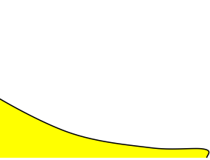
FWER with max statistic
FWER & distribution of maximum
FWER = P(FWE) = P(One or more voxels ≥ u | H_{o}) = P(Max voxel ≥ u | H_{o})
100(1-α)%ile of max dist^{n} controls FWER
FWER = P(Max voxel ≥ u_{α} | H_{o}) ≤ α
u_{α}
α

Slide 79
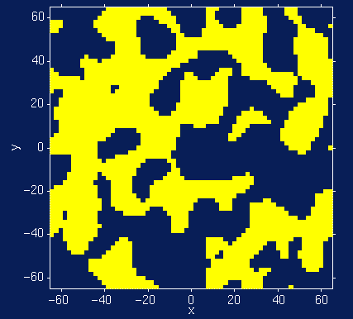
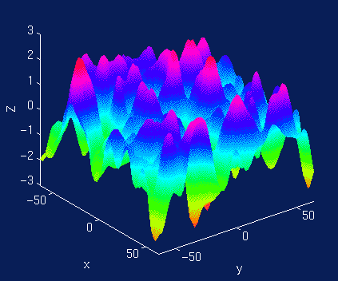
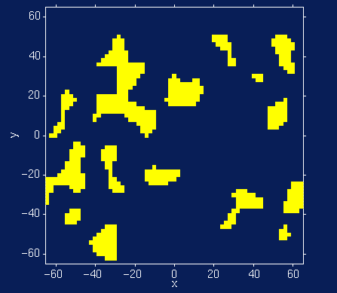
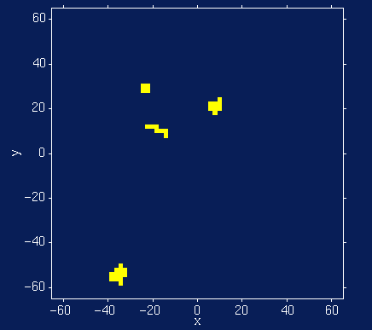
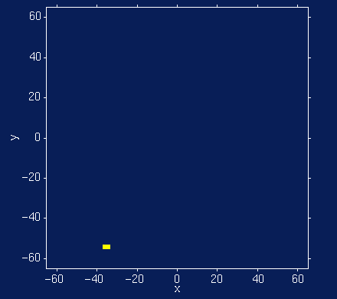
FWER MTP Solutions: Random Field Theory
Euler Characteristic χ_{u}
Topological Measure
#blobs - #holes
At high thresholds, just counts blobs
FWER = P(Max voxel ≥ u | H_{o}) = P(One or more blobs | H_{o}) ≈ P(χ_{u} ≥ 1 | H_{o}) ≈ E(χ_{u} | H_{o})
Threshold
Random Field
No holes
Never more than 1 blob
Suprathreshold Sets

Slide 80
Distribution details
Math is hairy!
Nichols and Hayasaka 2003
Cao and Worsley 2001
What you need to know
Depends on “smoothness” of your image
Must quantify smoothness and it is important to report when using RFT

Slide 81
General idea
E(χ_{u}) ≈ Mathy stuff *Volume/Smoothness
We know what the volume is
What is smoothness?
Notes:
As volume increases, the p-values will increase
The more you smooth your data, the fewer unique tests there are, so fewer tests – decreases your p-value

Slide 82
Smoothness
How smooth are the data?
Measured by FWHM=[FWHM_{x}, FWHM_{y}, FWHM_{z}]
Starting with white noise smooth with a gaussian
How large does the variance of that gaussian need to be such that the smoothness matches your data?

Slide 83
RESEL
RESolution Element
RESEL=FWHM_{x} x FWHM_{y} x FWHM_{z}
RESEL count
If your voxels were the size of a RESEL, how many are required to fill your volume?
10 voxels, 2.5 voxel FWHM smoothness ⇒ 4 RESELS

Slide 84
voxels
FWHM= 2.5 voxels
RESEL count=4

Slide 85
Note about RESEL count
Not the number of independent tests
Not the magic bullet for a better Bonferroni
Re-expression of volume in terms of smoothness
We need it, since it is necessary to calculate our p-values

Slide 86
Revisit distribution
E(χ_{u}) ≈ Mathy stuff *Volume/Smoothness
Smoothness is defined in RESELs
E(χ_{u}) is our p-value
How does a p-value change as volume increases?
How does a p-value change as smoothness increases?

Slide 87
RFT adapts
For larger volumes it is more strict
Multiple comparison problem is worse
For smoother data it is less strict
Multiple comparison problem is less severe

Slide 88
Shortcomings of RFT
Requires estimating a lot of parameters
Random field must be sufficiently smooth
If you don’t spatially smooth the data enough, RFT doesn’t work well
I’ll cover the Eklund paper later on today!

Slide 89
RFT
Voxelwise RFT is rarely used in practice
Too conservative
Cluster wise RFT is very common
We’ll learn about cluster stats with permutation testing

Slide 90
FYI
If you’re using RFT, you probably shouldn’t lower the cluster forming threshold
Assumptions could break down
Topic of Cluster Failure
If you really want to lower it, switch to nonparameteric approaches
SnPM
Randomise
Notes:
If you need to lower your voxelwise threshold, you need to use nonparametric approaches

Slide 91
Permutation test assumptions
Exchangeability holds
When we permute our data, underlying distributional properties remain unchanged
Notes:
Exchangability does not hold for temporally autocorrelated data

Slide 92
What is exchanged?
Under the null, what can be swapped?

Slide 93
What is exchanged?
Under the null, what can be swapped?

Slide 94
What is exchanged?
Under the null, what can be swapped?

Slide 95
Original data
y₁
y₂
y₃
y₄
y₅
y₆
y₇
y₈
x₁
x₂
x₃
x₄
x₅
x₆
x₇
x₈

Slide 96
Permuted data
y₈
y₃
y₂
y₇
y₆
y₁
y₄
y₅
x₁
x₂
x₃
x₄
x₅
x₆
x₇
x₈

Slide 97
When exchangeability doesn’t hold
Correlated data
Temporal correlation

Slide 98
When exchangeability doesn’t hold
Correlated data
Family data

Slide 99
When exchangeability doesn’t hold
Influential outliers with a continuous covariate
Notes:
Influetial outlier is an outlier for both x and y
After permutation, it’s not an influential outlier – it’s only an outlier in y (which means data are not exchangable)
Randomise will not fix outliers
Only fix is to take it out and put it in
Only influential if it’s an outlier in both

Slide 100
When exchangeability does hold
Independent subjects
Homoscedasticity
Heteroscedasticity is fine if you’re running a 1-sample t-test
(I’m sure there are exceptions)

Slide 101
Steps for 2-sided hypothesis test
Compute the statistic (unpermuted)
Permute data
Compute t-statistic for permuted data and store
Repeat steps 2-3, 5,000-10,000 times
Compute the proportion of permutation statistics that are larger to or equal to (in magnitude) the magnitude of your statistic

Slide 102
Notes:
Orange line is the original t-statistic

Slide 110
p=0.021

Slide 111
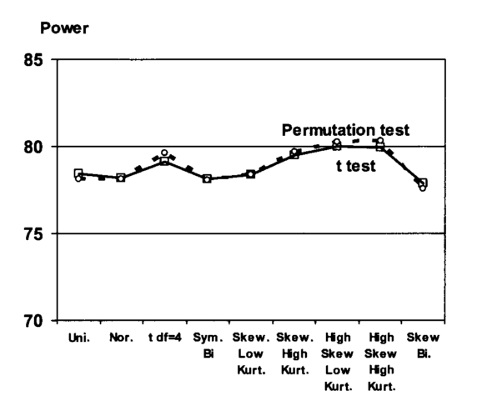
How much does null distribution flexibility help?
O’Gorman, 2012. Adaptive tests of significance with R and SAS

Slide 112
Questions
You can have at most n! permutations
How many permutations can you have when 5 subjects?
What is the smallest p-value possible?
Notes:
120 permutations with 5 subjects
So smallest p-value you can get is 1/120
Need a sample size over 12 to run permutations
More permutations increases the resolution of the p-value estimate, more specific estimate you can make of the p-value

Slide 113
Summary of permutation tests

Slide 114
Permutation test with Max T
What is the Maximum T distribution?
Why does the Max T get the job done?

Slide 115
Steps for max T null
Compute the statistics for all N tests
Permute the data (same across all N models)
Compute the N statistics for the permuted data, and save the largest one
Repeat 2 and 3 5,000-10,000 times
Compute the proportion of permutation statistics that are larger to or equal (in magnitude) to the magnitude for each of your N statistics
Notes:
For a voxelwise maximum T based statistic
When permuting data Swapping the values of 2 subjects in every voxel (always need to swap the same 2 subjects for every voxel in the brain in one permutation test)

Slide 116
Notes:
Each colored line is the non-permuted statistic for 3 different voxels

Slide 117
Notes:
Choose largest statistic, ignoring sign when it’s a 2-sided test
If it’s a 1-sided test, choose the largest stat (NOT ignoring sign – i.e., -1.55 here)

Slide 120
p=0.39
p=0.21
p=0.003
Notes:
p = 0.23, .13, 0.001
P-value for each is the proportion of the distribution that is greater than that t-statistic (using FWE control)
Linear regression between bold and regressor (x value) across a number of independent subjects
Y is voxel intensity of ROI average bold activity
X is regressor (e.g., depression score, age)
In permutation tests, swapping the subjects’ bold intensity values

Slide 121
How does it compare to Bonferroni?
How should we compare them?

Slide 122
Simulation: True FWER control
2 correlated dependent variables (corr = 0.8)
Single continuous regressor
10,000 null data sets (result not in code)
5000 permutations
 | FWER
Bonferroni | 0.0398
Permutation | 0.0483
Notes:
Number is how many false positives there were for those tests – Bonferroni only has 3.9% false positive, so it’s eating into your power (1.1% of your power is lost)
As you have more correlated tests, the Bonferroni familywise error rate gets smaller

Slide 123
Simulation: Power
Single data set
Data correlated at 0.8
20 regressions, all with signal
 | Number of detections
Bonferroni | 0/20
Permutation | 2/20

Slide 124
Revisiting those p-values
PCER = 0.05
0.042 | 0.006 | 0.002 | 0.006 | 0.019 | 0.006 | 0.030 | 0.017 | 0.155 | 0.024
FWER < 0.05 via Bonferroni
PCER = 0.05/10 = 0.005
0.042 | 0.006 | 0.002 | 0.006 | 0.019 | 0.006 | 0.030 | 0.017 | 0.155 | 0.024
FWER = 0.05 via Permutation Test
0.17 | 0.03 | 0.012 | 0.033 | 0.085 | 0.032 | 0.128 | 0.079 | 0.455 | 0.103
Notes:
FWER via permutation test strikes a balance between being conservative and keeping power

Slide 125
Topics
What type of error rate does Bonferroni control?
What are the assumptions of the Bonferroni correction?
Does a standard permutation test control for multiple comparisons? If not, what do we need to change to adjust for multiple comparisons?
When is the permuation-based approach for multiple comparisons better than Bonferroni?
Notes:
Family wise error
All tests have to be independent
No – have to combine it with a max statistic
Only needed when tests are correlated

Slide 126
Where we’re going
Type I error overview
Whole brain thresholding options
What type of error rate control should we have?
What statistic should we use?
Family-wise error control
Bonferroni
Maximum T
Random field theory (parametric)
Permutation tests (nonparametric)
Cluster failure!!

Slide 127

Hopefully you’ve heard about this

Slide 128
Basic idea
Is the Type I error control what we’d like?
Analyzed data through typical pipelines
SPM
FSL
AFNI

Slide 129
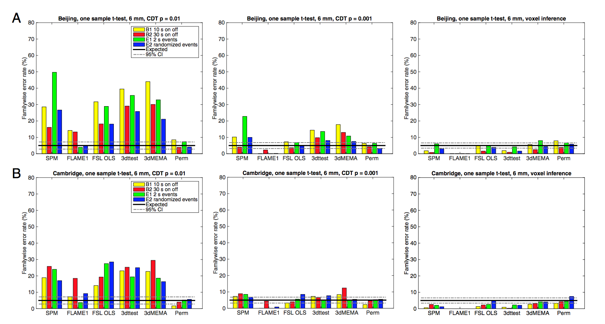
Uh oh

Slide 130
Uh oh

Slide 131
Uh oh
Notes:
R panels – voxel-wise RFT ends up being a conservative as Bonferroni

Slide 132
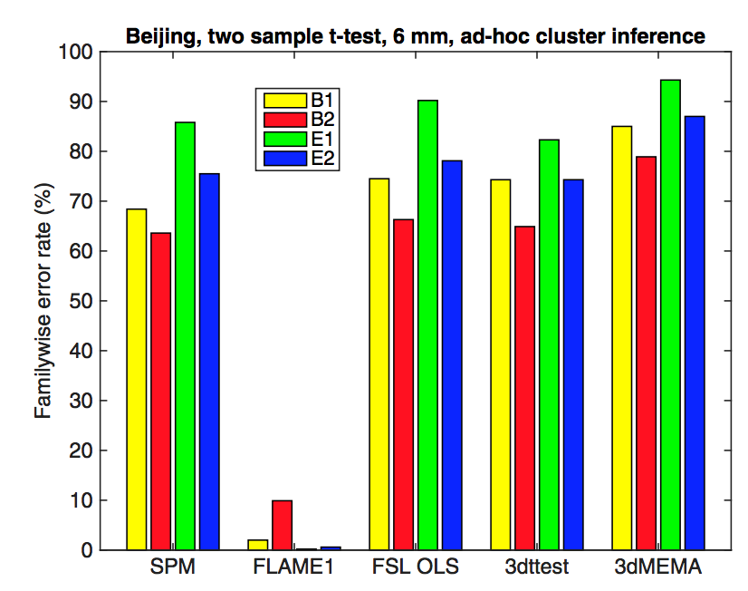
Ad hoc thresholding
Cluster forming threshold of p=0.001
Cluster size threshold of 10 voxels

Slide 133
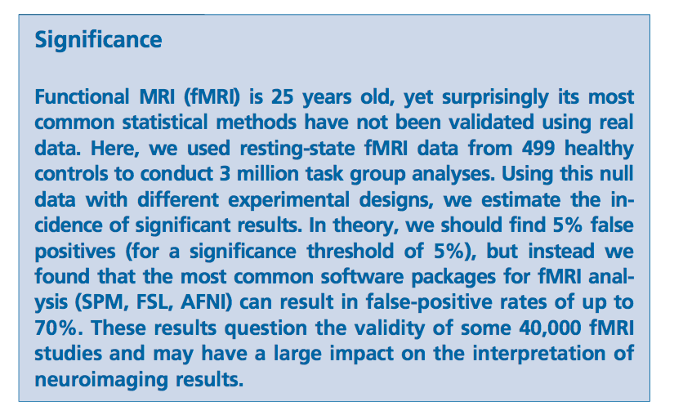

Unfortunate wording
This
Became this

Slide 134
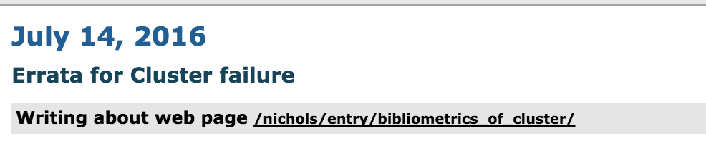
How worried should we be?
Not that worried
Tom Nichols posted an errata
Based on some estimates maybe 3500 studies are impacted
Notes:
RFT theory assumptions:
Spatial smoothness of signal is constant over the brain
Spatial autocorrelation follows a specific distribution (squared exponential)
Cluster forming threshold needs to be high
The first 2 assumptions are violated, but if the cluster forming threshold helps them to hold better

Slide 135
What to do?
You can use nonparametric thresholding
SnPM
randomise
FSL-based, but you can dump in any old NIFTI file
If you’re using parametric thresholding, make sure you cluster forming threshold is p=0.001 or lower
Note z-stat threshold would be higher (3.1 or higher)

Slide 136
Questions?

