Slide 1
Quick explanation of pros/cons slice timing of correction

Slide 2
Slice Timing Correction
All slices aren’t imaged simultaneously
Can collect from top to bottom
Interleaved (even and then odd slices)

Slide 3
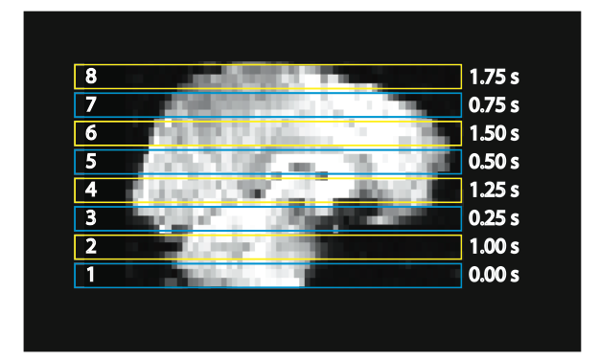

Slide 4
Slice Timing
Data are not acquired at the same time
Our model assumes the data are collected at the same time

Slide 5
Think about it
If something happens in the brain at 3s, when will we see it in
slice 1?
Notes:
slice 1 = at 3s

Slide 6
Think about it
If something happens in the brain at 3s, when will we see it in
slice 1?
slice 2?
Notes:
slice 2 = at 1s
This is because the beginning of the time series for slice 2 starts 1s in.

Slide 7
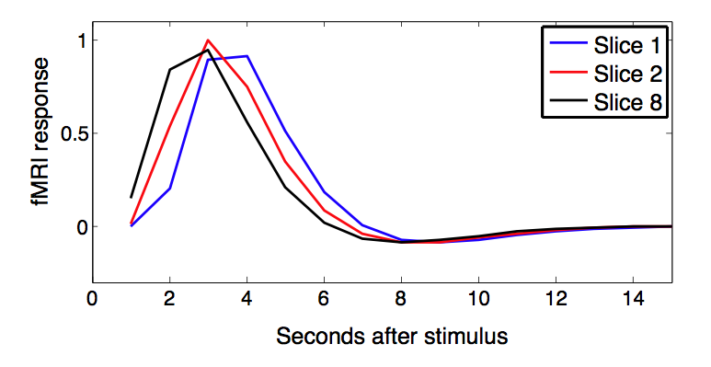
Notes:
Slice 2 is collected 1s after slice 1

Slide 8
Slice timing problems
Worse with ER design or blocked design?

Slide 9
Slice timing problems
Worse with ER design or blocked design?
ER design (isolated trials)
Notes:
Remove isolated trials part

Slide 10
Slice Timing Correction
Tries to fix timing issue so the assumption that data were collected at the same time is more closely met
Uses interpolation
Must know exact timing of acquisition

Slide 11
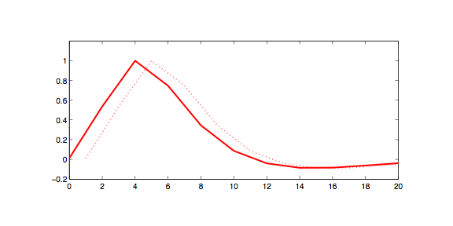
Example: slice 2
Step 1: Shift response
1s

Slide 12
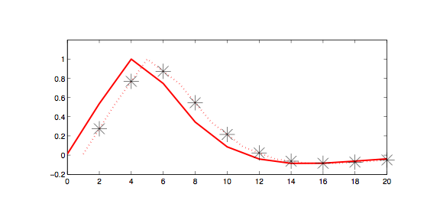
Example: slice 2
Step 2: Interpolate @ TR

Slide 13
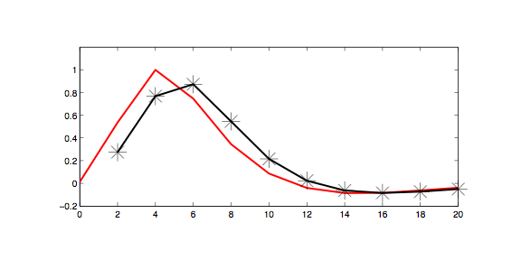
Example: slice 2
Step 2: Interpolate @ TR

Slide 14
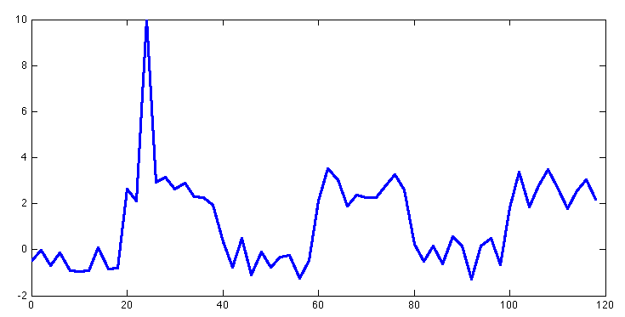
Slice timing issues
One bad scan gets spread to other time points
one outlier

Slide 15
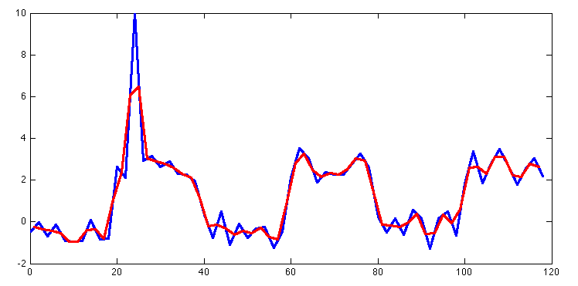
Slice timing issues
One bad scan gets spread to other time points
two outliers

Slide 16
Slice Timing Correction
Not used much
TR<2 + interleaved acquisition+spatial smoothing
Reduces slice timing effects
Adding temporal derivatives to model helps

