Slide 1
Very high-level overview of my research program
Nagesh Adluru
06/11/2024

Slide 2
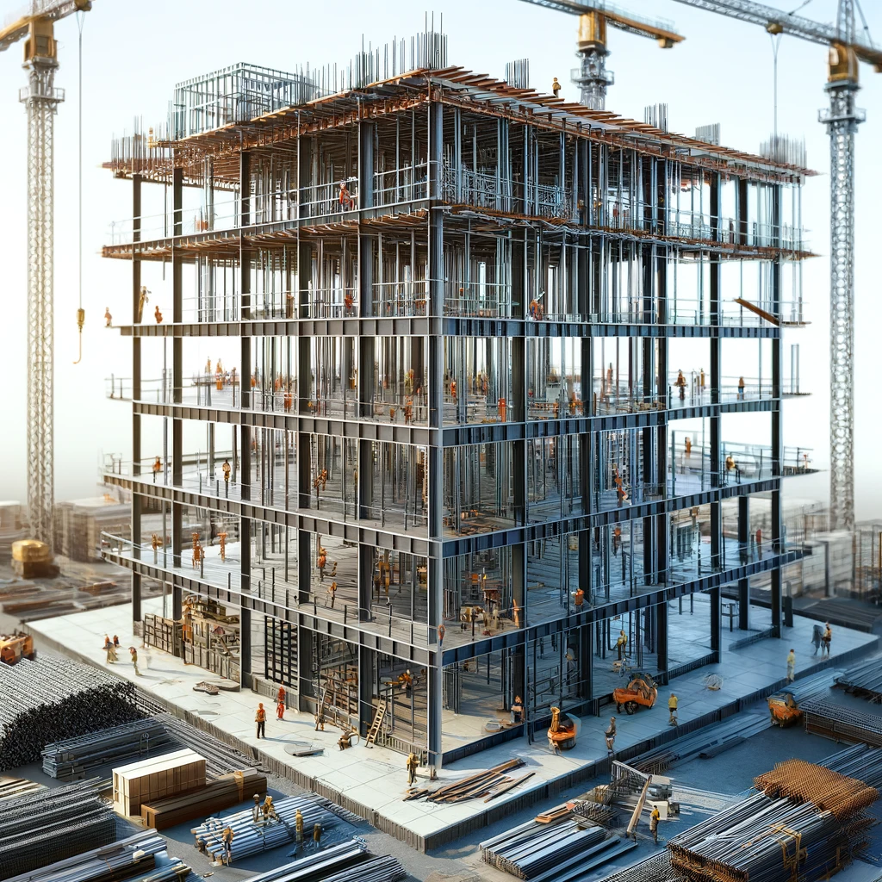
Notes:
From ChatGPT

Slide 3
Academic trajectory
Undergraduate student: Sree Nidhi College, JNTU, India 1999-2003
Computer science
Graduate student: Temple University, Philadelphia 2003-2009
Computer vision and robotics
Morgridge fellow: Waisman & Biostatistics, UW-Madison 2009-2011
Neuroimaging – Tractography representations, classification, segmentation
Scientist: Waisman, UW-Madison 2011-Present
Neuroimaging – Integrated matrix of technologies for neuroscientific discovery
From studying machine’s computational abilities to studying brain’s computational abilities
Notes:
From studying machine computational abilities to studying brain computational abilities

Slide 4
Motto
Knowledge Integration for Neuroscientific Discovery
(KIND)

Slide 5
Mission
Integrate the best forms of knowledge to answer fundamental and emergent questions in neuroscientific discovery to help improve human health span.

Slide 6
Talk outline
5 key questions
4 knowledge areas
3 vignettes
2 planned studies
1 currently enrolling study

Slide 7
Talk outline
5 key questions
4 knowledge areas
3 vignettes
2 planned studies
1 currently enrolling study
Notes:
Fun

Slide 8
5 key neuroscience questions that have been shaping my research experience for over 15 years
How does brain develop and change with age in autism spectrum? (since 2009)
Does brain health indicate atypical changes prior to clinical symptoms and cognitive impairments in individuals with risk for Alzheimer’s disease? (since 2009)
Does brain age differently than the rest of the body, and what types of behavior help improve the cognitive health span? (since 2010)
Can we predict functional outcomes for individuals who experienced stroke using brain biomarkers? (since 2013)
Does epileptiform electrical activity in the brain relate to underlying connectivity structure? (since 2020)

Slide 9
4 key knowledge areas integrated
Diffusion weighted MRI
Connectivity networks
Statistical analysis of complex data
Machine learning and AI

Slide 10
Diffusion weighted MRI
DTI and beyond
NODDI estimates and assumptions
Black holes in DKI
Novel diffusion encoding
Notes:
NODDI
DKI
MDD

Slide 11
Connectivity networks
Study of shapes and signals of networks over many scales
Tractography (warping, dissections, networks)
Topological data analysis
Wavelets on graphs
Notes:
Tractography
TDA
Wavelets on graphs

Slide 12
Statistical analysis of complex data
Discovering biologically interpretable correlations between complex data types
Statistics on manifolds
Harmonization of clinical data
Normative modeling
Notes:
Harmonization
Normative modeling
Data on manifolds

Slide 13
Machine learning and AI
Efficient processing and analysis workflows
Segmentation (amygdalar sub-nuclei, stroke lesion)
Chat interface (before ChatGPT)
Large (relatively) BioAge models
Epigenetic age
Brain age
Notes:
Segmentation
Distortion corrections
BioAge estimation

Slide 14
3 vignettes
Brain health in autism spectrum
Brain health in AD
Brain health in epilepsy

Slide 15
Brain health in autism
Role of corpus callosum
Shapes
Classification
Longitudinal trajectories
Characterizing heterogeneity
Normative modeling
Role of brain stem
Weighted medians
Geometric consistency
Precision matrices
Notes:
ISMRM 2021
Final progress report
Normative modeling

Slide 16
Brain health in AD
NODDI
Manifold statistics
Network analysis
Wavelets
TDA
Geographical neighborhood effects

Slide 17
Brain health in epilepsy
Network analysis
Harmonizing clinical MRI data
Geographical neighborhood effects

Slide 18
2 planned studies (under consideration/review at NIH)
Are brain connectivity biomarkers for fronto-temporal and Alzheimer’s dementia specific and different?
Can we slow aging of brain and cognition using meditation practice?
Notes:
This project will investigate the usefulness of network biomarkers for differential diagnosis of FTLD and AD; to
identify asymptomatic, at-risk individuals; and to improve prognostication of cognitive decline relative to clinical
dementia risk models.

Slide 19
1 currently enrolling study (NIH funded)
Aging of Brain and Cognition – Post Stroke (ABC-PS)

Slide 20
Sincere thanks to everyone
Faculty, students, staff, in Madison, Philadelphia, New York City, India.
And many international friends and collaborators, and non-work friends.
Waisman, Radiology, ADRC, CHM, Neurology, HERI, IoA, Biotechnology, Biostatisitcs, Morgridge
Family

