Slide 1
Brainstem-nuclei wide association study (BWAS) of sensory measures in autism
Nagesh Adluru, BSIRG team, Brittany Travers
12/11/2024

Slide 2
Introduction
Identify brainstem-nuclei wide linear (differential) associations of sensory measures above and beyond age, sex, and movement during imaging effects.
These associations can inform discover mechanistic hypotheses underlying motor functional differences that maybe present in individuals with autism.
Notes:
BS should be aligned sensory and motor
Do have hypotheseis. These nuclei do so many things and have a lot of overlap. Autonomic sensory wholistic. Integrated picture.
BOT2 only. Wanted to get a ssense of whether or not.
Measure at floor for non-ASD for SEQ3.0 and EASI. BOT2 pretty good range for both.

Slide 3
Methods
Brainstem-nuclei were identified using BSNA and LONI atlases and characterized using microstructural imaging and morphometric (volumetric changes).
Sensory measures were characterized using SEQ3.0, EASI, BOT2 instruments.
Trend level (uncorrected p≤0.05) and significant level (FDR corrected* p≤0.05) associations were identified.
Individual level data were visualized for the identified associations.
* Correction was performed per microstructural and morphometric and sensory measure across the different nuclei.

Slide 4
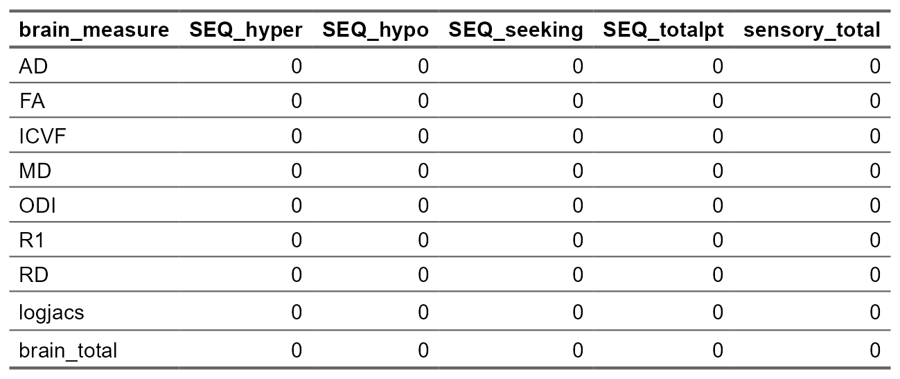
Results
BWAS (SEQ 3.0) summary view significant level

Slide 5
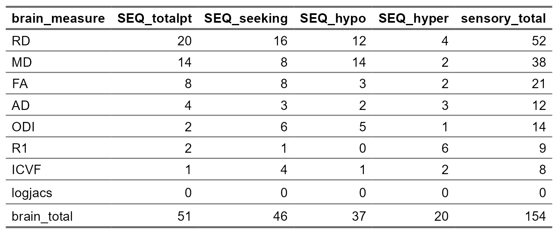
Results
BWAS (SEQ 3.0) summary view trend level

Slide 6
Results
BWAS (EASI) summary view
significant level
trend level

Slide 7
Results
BWAS (BOT2) summary view
significant level
trend level

Slide 8
Results
Individual level (nuclei)
BWAS (SEQ3.0)
BWAS (EASI)
BWAS (BOT2)

Slide 9
Results
Individual level (participants x nuclei)
BWAS (SEQ3.0)
trend level
BWAS (EASI)
significant level
trend level
BWAS (BOT2)
significant level
trend level

Slide 10
Next steps
Main effects of BOT2 across the two groups.
Think about LONI for EASI.
Include LONI for BOT2.
Correlations (differential) with additional phenotypic measures within ASD (contrasting non-ASD).
Drawing mechanistic hypotheses.
Writeup.

Slide 11
Thank you!
BSIRG team
Participants
UW-Madison and NIH
Families and friends

Slide 12
Brainstem-nuclei wide association study (BWAS) of sensory measures in autism Take 2
Nagesh Adluru, BSIRG team, Brittany Travers
12/11/2024

Slide 13
Introduction
Identify brainstem-nuclei wide linear (differential) associations of sensory measures above and beyond age, sex, and movement during imaging effects.
These associations can inform discover mechanistic hypotheses underlying motor functional differences that maybe present in individuals with autism.
Also helps estimate the effect sizes.
Notes:
BS should be aligned sensory and motor
Do have hypotheseis. These nuclei do so many things and have a lot of overlap. Autonomic sensory wholistic. Integrated picture.
BOT2 only. Wanted to get a ssense of whether or not.
Measure at floor for non-ASD for SEQ3.0 and EASI. BOT2 pretty good range for both.

Slide 14
Methods
Brainstem-nuclei were identified using BSNA and LONI atlases and characterized using microstructural imaging and morphometric (volumetric changes).
Sensory measures were characterized using SEQ3.0, EASI, BOT2 instruments.
Trend level (uncorrected p≤0.05) and significant level (FDR corrected* p≤0.05) associations were identified.
Individual level data were visualized for the identified associations.
* Correction was performed per microstructural, morphometric, atlas, and sensory measure across the different nuclei.

Slide 15
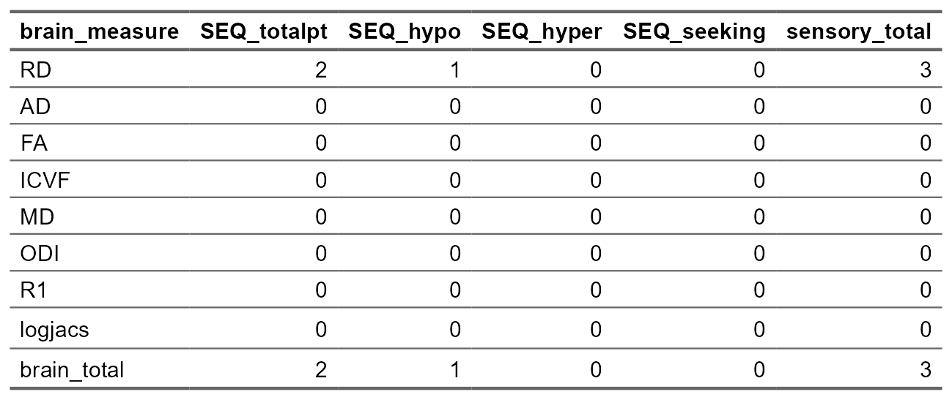
Results
BWAS (SEQ 3.0) summary view significant level

Slide 16

Results
BWAS (SEQ 3.0) summary view trend level

