Slide 1





ENGINEERING PRESENTATION • MATLAB ANALYSIS
PRESSURE PERFORMANCE
Statistical and Stochastic Analysis of Athletic Performance Under Stress
A MATLAB-based engineering project that investigates whether NBA players perform significantly worse under clutch pressure using Bernoulli modeling, hypothesis testing, bootstrap resampling, and player-level analysis.
NBA Free-Throw Data | 2006–07 to 2015–16

Slide 2
02 · OUR PROJECT
Our Project
A data-driven engineering study of clutch free throws using MATLAB.
KEY CONCEPT
?
Research Question
X
Random Variable
Do players shoot worse under clutch pressure?
Made FT = 1, Missed FT = 0
λ
Stochastic Model
Σ
MATLAB Output
Xᵢ ~ Bernoulli(p)
CI, z-test, bootstrap
Application context: free throws under pressure
Free throws → binary data → statistical evidence.
Core message: pressure effect is tested as a stochastic signal, not an opinion.
Pressure Performance | NBA Free Throws | MATLAB-based analysis
02

Slide 3
03 · RESEARCH QUESTION
Do Athletes Perform Worse Under Pressure?
We analyze whether “clutch pressure” changes NBA free-throw success, and whether any apparent effect is stable or mainly caused by limited sample size.
◉
?
≈
Observed Phenomenon
Engineering Question
Interpretation
Clutch vs. non-clutch free throws
Signal or statistical noise?
Small drop, not dramatic collapse
HYPOTHESES
H₀ : mean(Clutch FT% − Non-Clutch FT%) = 0
H₁ : mean(Clutch FT% − Non-Clutch FT%) < 0
Engineering implication: quantify whether the pressure effect is a real signal or just variability.
Pressure Performance | NBA Free Throws, 2006–07 to 2015–16 | MATLAB-based analysis
03

Slide 4
04 · DATA PIPELINE
Dataset Must Be Corrected Before Testing
▦
RAW DATA STRUCTURE
!
KEY DATA ISSUE
461 player-season records covering 200 unique players.
Columns include total attempts, total FT%, clutch attempts, and clutch FT%.
Regular season and playoff statistics are reported separately.
Season-total FT% already includes clutch attempts.
Zero playoff clutch attempts are treated as missing observations, not true 0% shooting.
A direct comparison of total FT% vs clutch FT% would partially compare the same attempts against themselves.
CORRECTED BASELINE / MATLAB CORRECTION
RegTotMakes = round(T.RegFTpct .* T.RegTotAtt);
RegClMakes = round(T.RegClFTpct .* T.RegClAtt);
T.RegNonClAtt = T.RegTotAtt - T.RegClAtt;
T.RegNonClMakes = RegTotMakes - RegClMakes;
T.RegNonClFTpct = T.RegNonClMakes ./ T.RegNonClAtt;
Pressure Performance | NBA Free Throws, 2006–07 to 2015–16 | MATLAB-based analysis
04

Slide 5
05 · STOCHASTIC MODEL
Each Attempt is a Bernoulli Random Variable
The stochastic component is valid at the aggregated level supported by the dataset.
Xᵢ ~ Bernoulli(p)
X₁, X₂, …, Xₙ
Xᵢ = 1 if the free throw is made
Xᵢ = 0 if the free throw is missed
E[Xᵢ] = p Var[Xᵢ] = p(1−p)
✓
MODEL ASSUMPTION
△
ENGINEERING INTEGRITY
Attempts are treated as Bernoulli observations under each condition. The spreadsheet gives aggregated makes/attempts, so chronological lag correlation cannot be measured.
We state the data limitation instead of inventing a stochastic pattern the data cannot support.
Pressure Performance | NBA Free Throws, 2006–07 to 2015–16 | MATLAB-based analysis
05

Slide 6
06 · IMPLEMENTATION
MATLAB Workflow: From Data to Inference
Read
Excel
›
Clean
Data
›
Compute
Non-Clutch
›
Estimate
p, Var, CI
›
Run
Tests
›
Bootstrap
Players
›
Generate
Figures
DATA LOADING AND CLEANING
BERNOULLI SUMMARY AND Z-TEST
PLAYER-LEVEL BOOTSTRAP
T = readtable(dataFile, ...
'VariableNamingRule', 'preserve', ...
'TextType', 'string');
T.RegClFTpct(T.RegClAtt == 0) = NaN;
T.PoClFTpct(T.PoClAtt == 0) = NaN;
[pRegCl, vRegCl, ciRegCl] = ...
bernoulliSummary(regClM, regClN, ...
alphaLevel);
[zReg, pRegTwo, pRegChoke, ...
pooledRegDiff] = twoPropTests( ...
regClM, regClN, regNonM, regNonN);
for b = 1:bootstrapReps
idx = randi(nPlayers, ...
nPlayers, 1);
bootMeanDiff(b) = ...
mean(Pf.Diff(idx), ...
'omitnan');
end
bootCI = prctile( ...
bootMeanDiff, [2.5 97.5]);
Pressure Performance | NBA Free Throws, 2006–07 to 2015–16 | MATLAB-based analysis
06

Slide 7
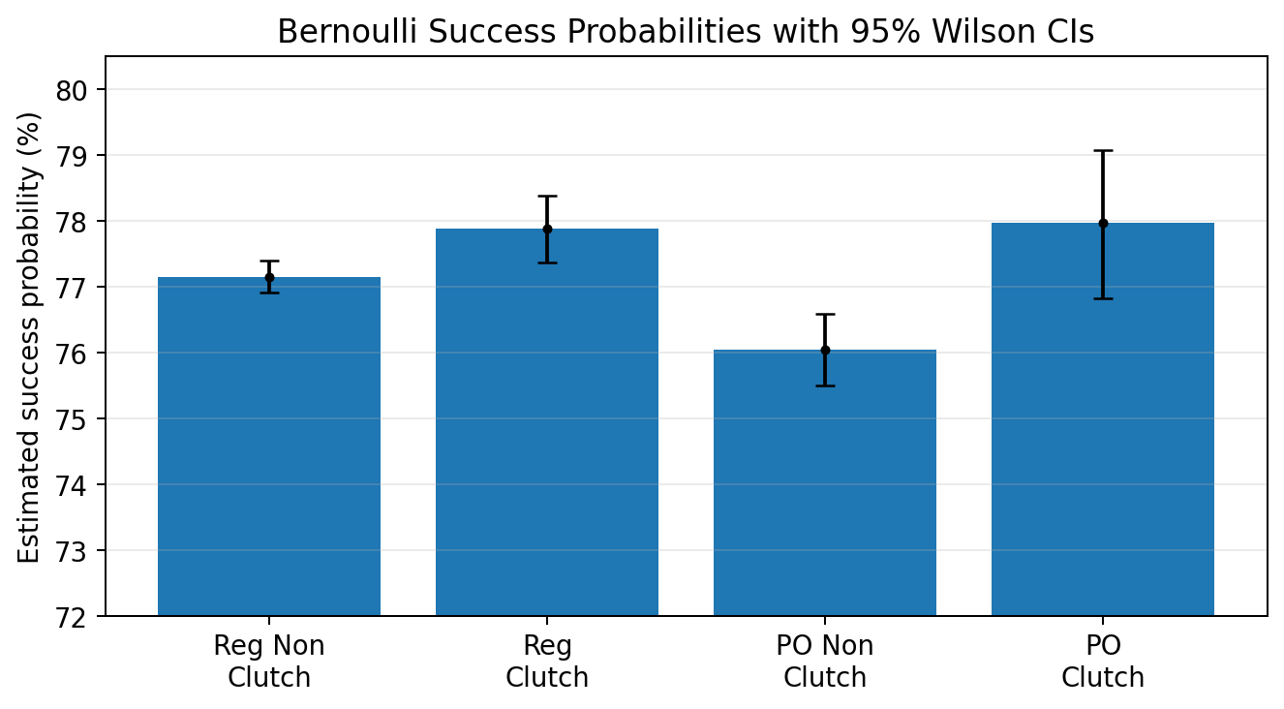
07 · RESULTS
Pooled Bernoulli Result: Attempt-Weighted View
Bernoulli success probability with 95% Wilson CI
77.16%
77.88%
REGULAR NON-CLUTCH
REGULAR CLUTCH
92,862 / 120,353
20,105 / 25,815
76.05%
77.97%
PLAYOFF NON-CLUTCH
PLAYOFF CLUTCH
18,147 / 23,862
4,089 / 5,244
Key point: when every attempt is pooled, clutch success is slightly higher. This does not contradict the player-level drop because weighting is different.
Pressure Performance | NBA Free Throws, 2006–07 to 2015–16 | MATLAB-based analysis
07

Slide 8
08 · HYPOTHESIS TESTING
Statistical Tests Show Weighting Matters
ANALYSIS
WEIGHTING
DIFFERENCE
P-VALUE
CONCLUSION
Pooled regular Bernoulli
Attempts
+0.72%
0.0119
Clutch slightly higher
Regular player-season
Equal player-season
−1.00%
0.0090
Small significant drop
Regular ≥10 clutch att.
Equal player-season
−1.10%
0.0034
Small significant drop
Career player-level
Equal players
−1.27%
0.0203
Small significant drop
Playoffs
Equal player-season
+1.17%
0.1918
Not significant / noisy
Playoff warning: p value is very high, so playoffs should be reported as unstable rather than confirmed.
Interpretation: pooled tests describe an attempt drawn from the full shot pool; player-level tests describe the average athlete. Main answer depends on estimand: shot-weighted view ≠ average-player view.
Pressure Performance | NBA Free Throws, 2006–07 to 2015–16 | MATLAB-based analysis
08

Slide 9
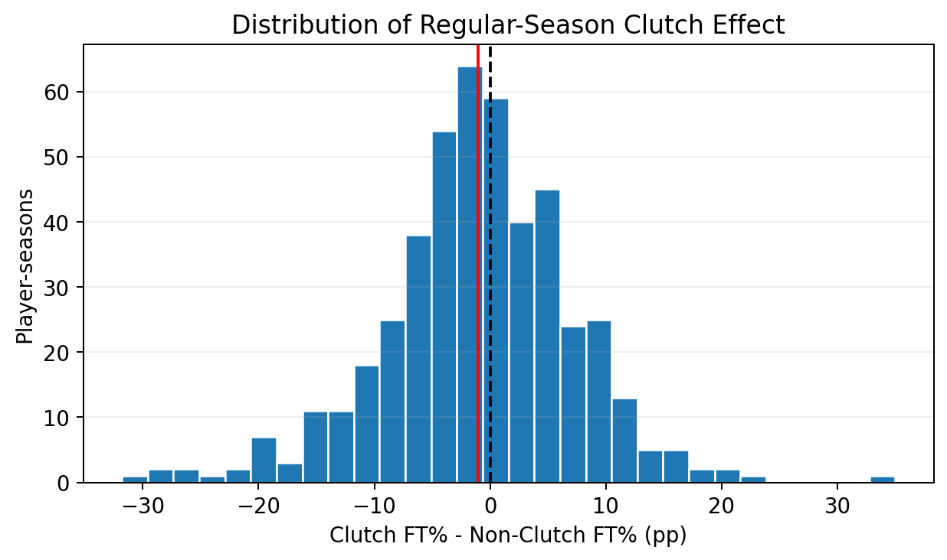
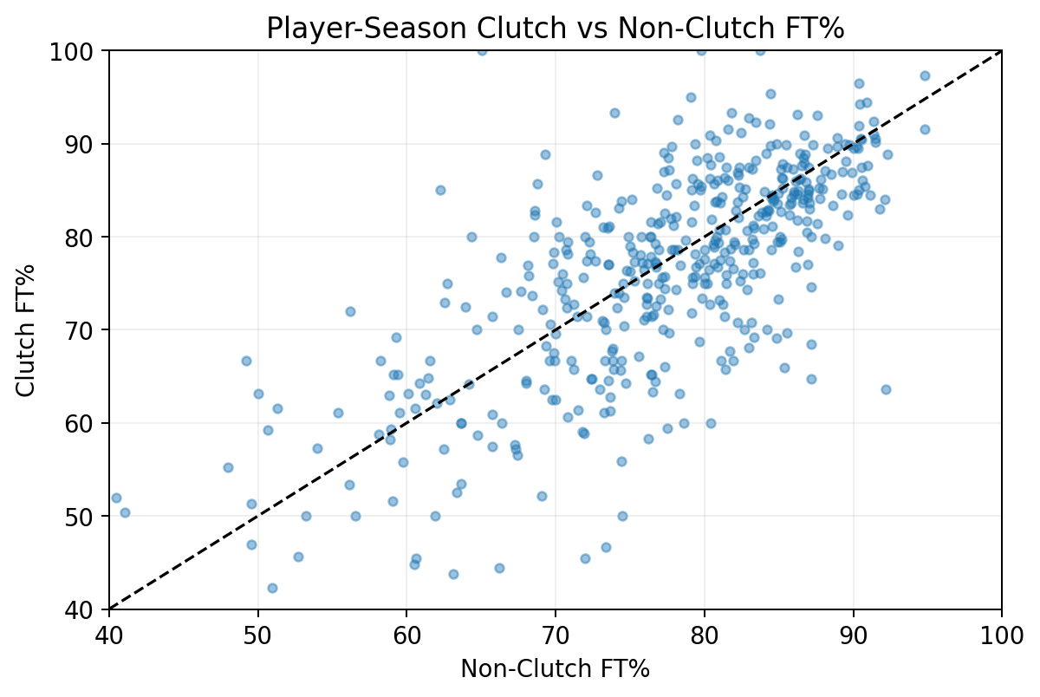
09 · GRAPHS
Visual Evidence: Distribution and Head-to-Head Comparison
Distribution of regular-season player-season clutch effects
Player-season clutch vs non-clutch FT%
Graphs show a small average regular-season drop, but not a dramatic universal collapse.
Pressure Performance | NBA Free Throws, 2006–07 to 2015–16 | MATLAB-based analysis
09

Slide 10
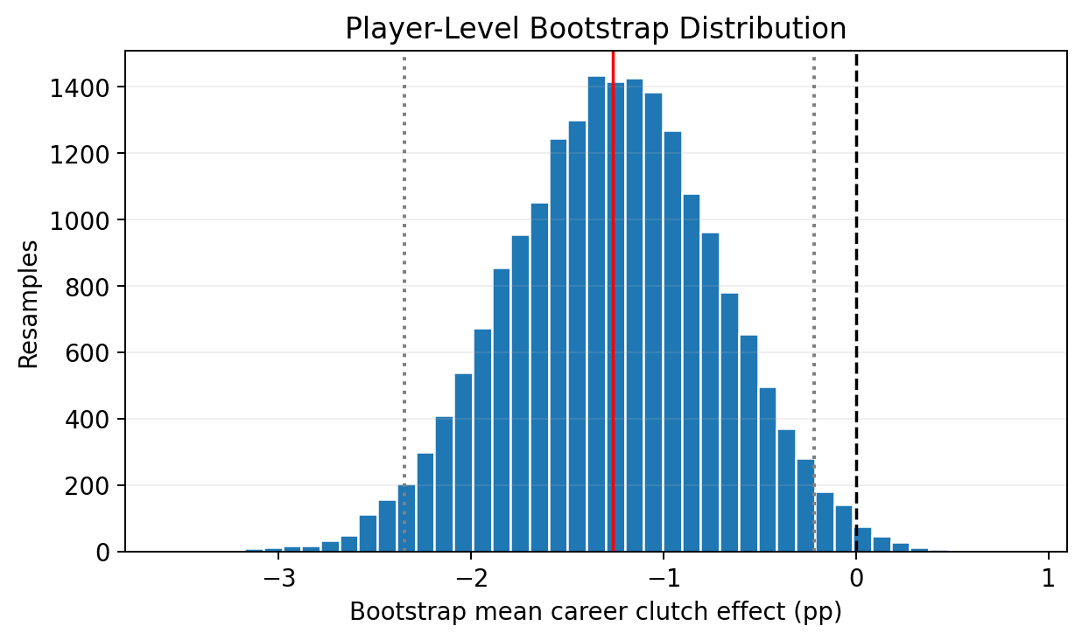
10 · RESAMPLING
Bootstrap Validation Strengthens the Player-Level Result
20,000-resample bootstrap distribution
−1.27 pp
−1.26 pp
OBSERVED CAREER MEAN
BOOTSTRAP MEAN
for b = 1:bootstrapReps
idx = randi(nPlayers, nPlayers, 1);
bootMeanDiff(b) = mean(Pf.Diff(idx), 'omitnan');
end
Pressure Performance | NBA Free Throws, 2006–07 to 2015–16 | MATLAB-based analysis
10

Slide 11
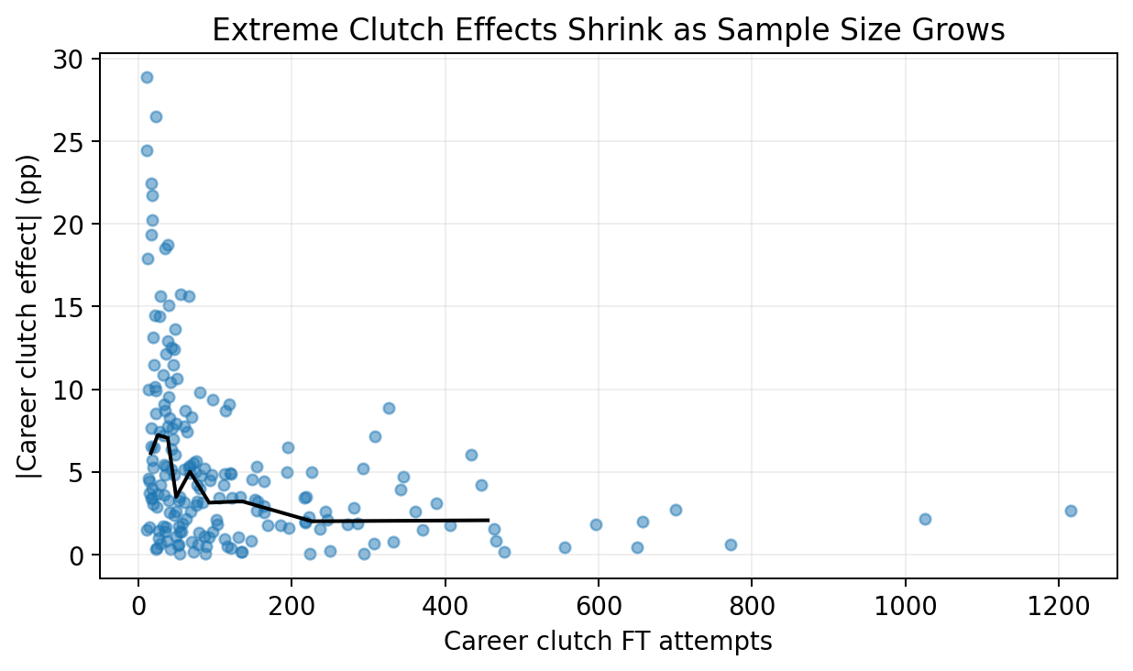
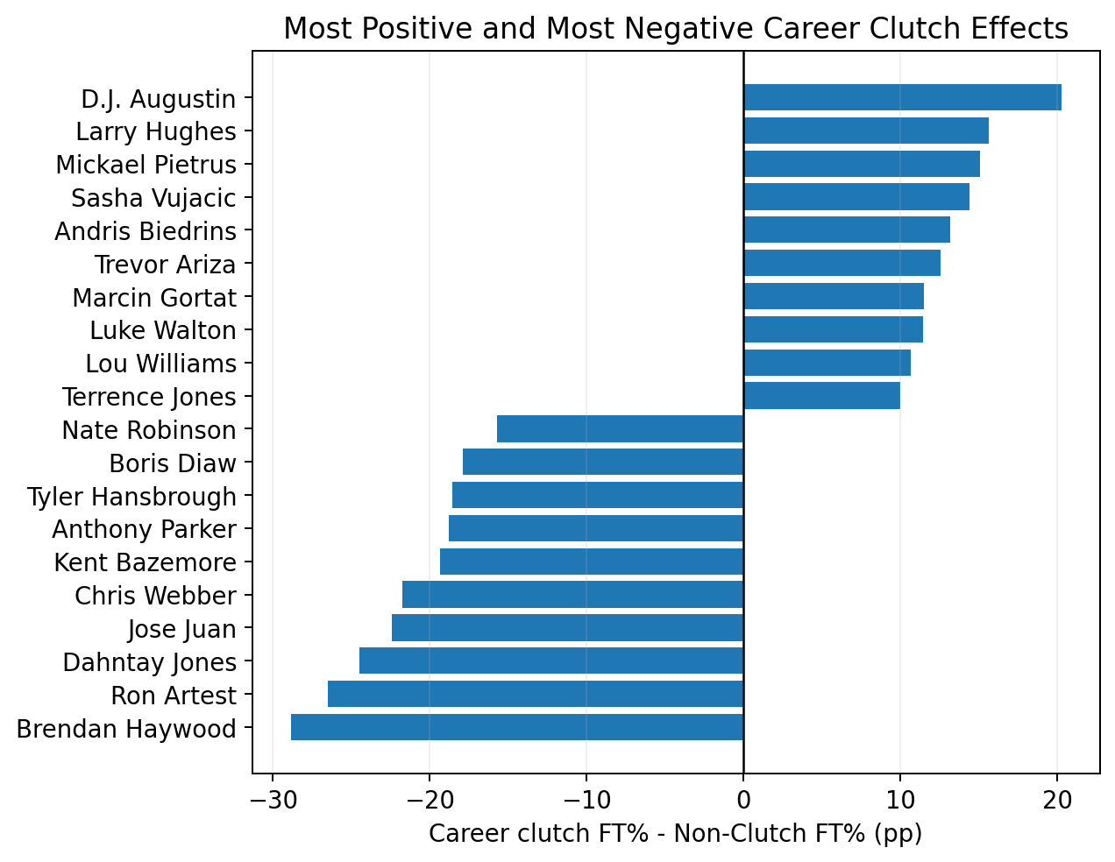
11 · SMALL-SAMPLE NOISE
Extreme Clutch Labels Are Strongly Affected by Sample Size
Absolute career clutch effect vs. career clutch attempts
Most positive and negative career clutch effects
As clutch attempts increase, extreme apparent effects shrink. This is strong evidence of small-sample noise in player rankings.
Statistical implication: do not label individual players as reliable “chokers” from small samples.
Pressure Performance | NBA Free Throws, 2006–07 to 2015–16 | MATLAB-based analysis
11

Slide 12
12 · CONCLUSION
Final Conclusion and Defensible Scope
✓
WHAT WE CAN CLAIM
✕
WHAT WE CANNOT CLAIM
Clutch situations are associated with a small decrease in the average player’s free-throw percentage.
The player-level drop is statistically significant but practically small.
Extreme individual clutch/choke labels are highly sensitive to sample size.
This is observational, so it does not prove psychological pressure caused the change.
The dataset is aggregated, so consecutive-shot correlation cannot be estimated.
A shot-level dataset is required for streak/hot-hand analysis.
ONE-SENTENCE SUMMARY
The data support a small negative average-player association with clutch pressure, while most dramatic individual “clutch/choke” labels are largely sample-size driven.
Engineering lesson: separate true effect from random variation before making performance claims.
Pressure Performance | NBA Free Throws, 2006–07 to 2015–16 | MATLAB-based analysis
12

Slide 13
13
Thank You
Questions & Discussion

